Slide 1
Climate Change and Environmental Concerns in Indus Delta
Naseer Memon
Chief Executive, SPO

Slide 2
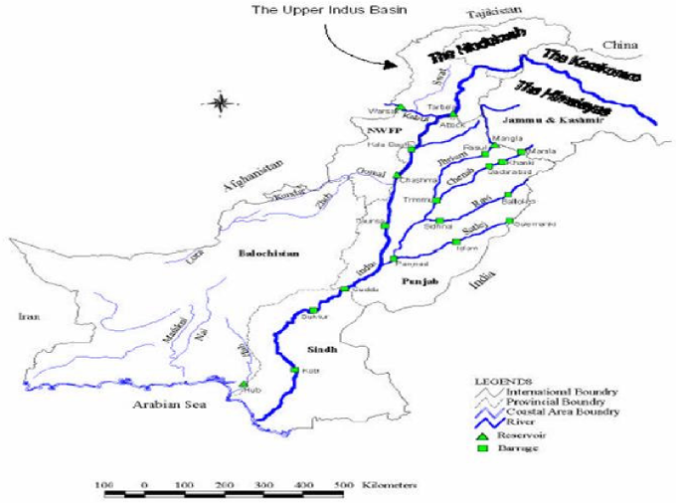
River Network in Pakistan

Slide 3
Climate Change and Pakistan
Various studies place Pakistan among the highly vulnerable countries due to climate change
During last three years country has witnessed rapid weather shift in various provinces.
Monsoon has become highly unpredictable
Country witnessing floods in one province and drought in other
Indus River—lifeline of Pakistani economy-is becoming highly erratic

Slide 4
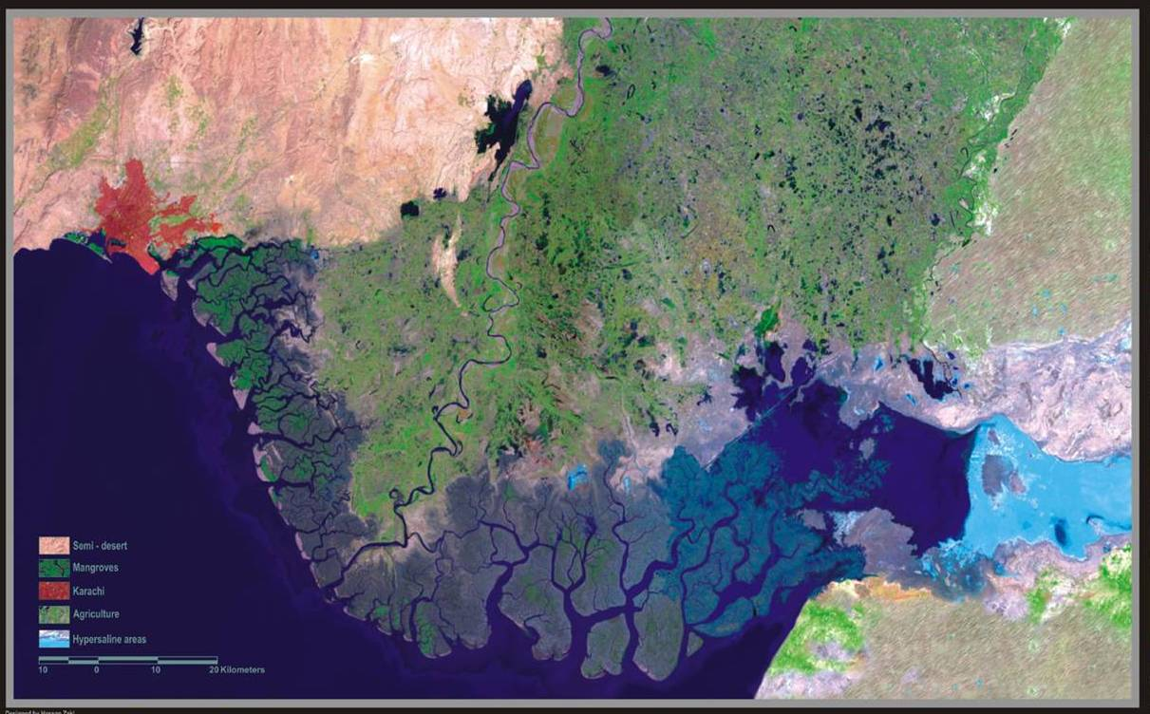
Indus Delta at a glance
ranked as the 7th largest Delta in the world
^{spreads over 600, 000 ha}
Comprises 17 major and numerous small Creeks
^{Length 240 Km}
It holds 97% of the total mangrove forests of Pakistan
Indus Delta is home to over one million people of which135,000 depend on mangroves for their livelihood (IUCN 2003)

Slide 5
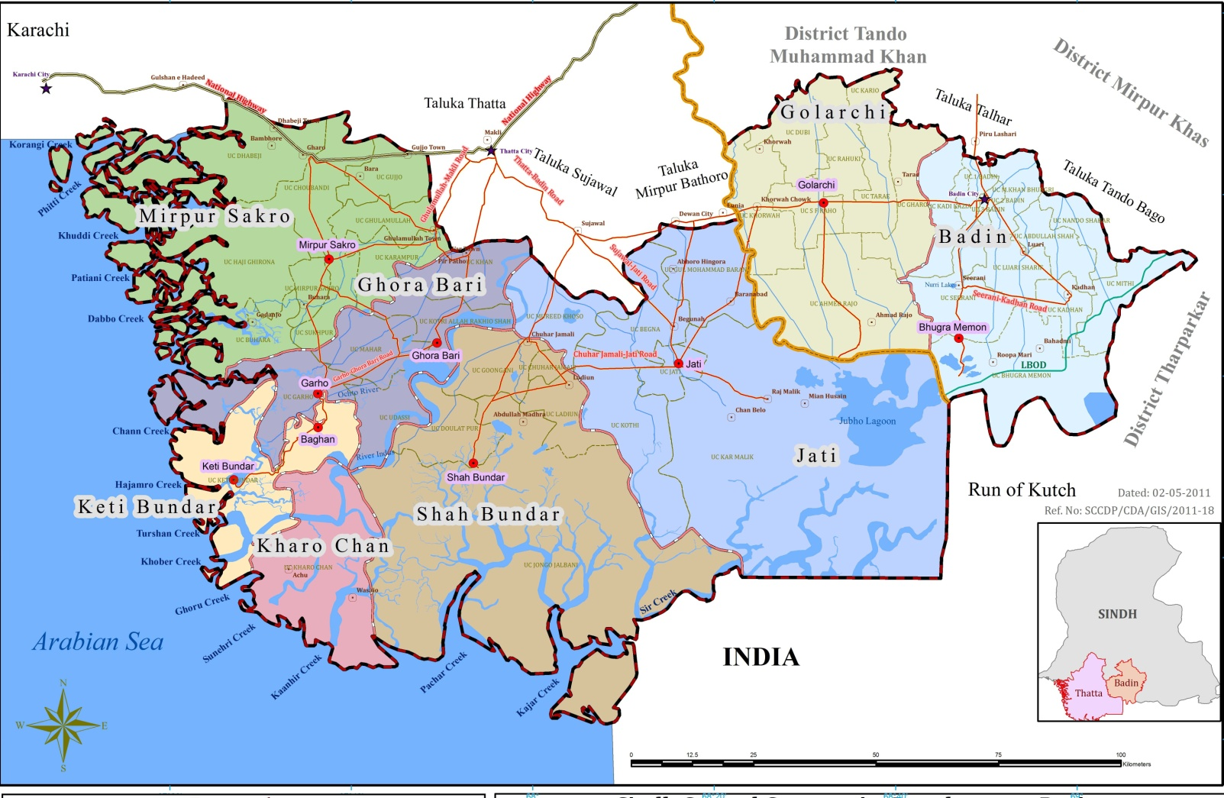

Area Map

Slide 6
Community Profile
Population in 1998 = 2.2 million
Population in 2010 = 3.0 million
More than 80% male and more than 90% female are illiterate
Approx. 75% people live in mud-houses
Fishing and Agriculture are sources of income for 30% and 26% people respectively
More than 75% people live below poverty line i.e. 1 US$/capita
Source: Baseline survey of coastal areas, Sindh Coastal Area Development Project

Slide 7
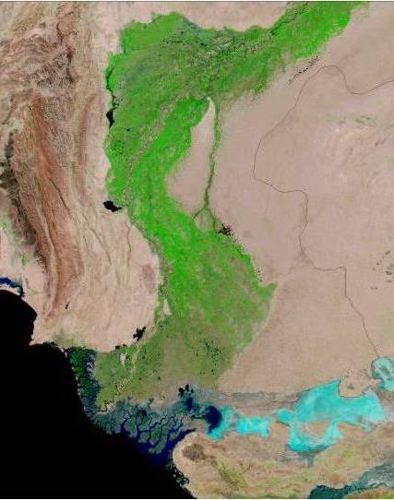
Indus is lifeline for the economy of Pakistan
The Indus river basin stretches from the Himalayan Mountains in the north to the dry alluvial plains of Sindh in the south. The area of Indus basin is 944, 574 Km²
Pakistan depends on irrigation and water resources for 90 percent of its food and crop
Indus Basin Irrigation System (IBIS) is the largest contiguous irrigation system in the world developed over the last 140 years.
The system is comprised of three major storage reservoirs, 19 barrages or head works, and 43 main canals with a conveyance length of 57,000 km, and 89,000 water courses with a running length of more than 1.65 million Km.
Indus River Basin
Source: Minister of Water & Power, GoP, 2003, Nasa Earth Observatory

Slide 8
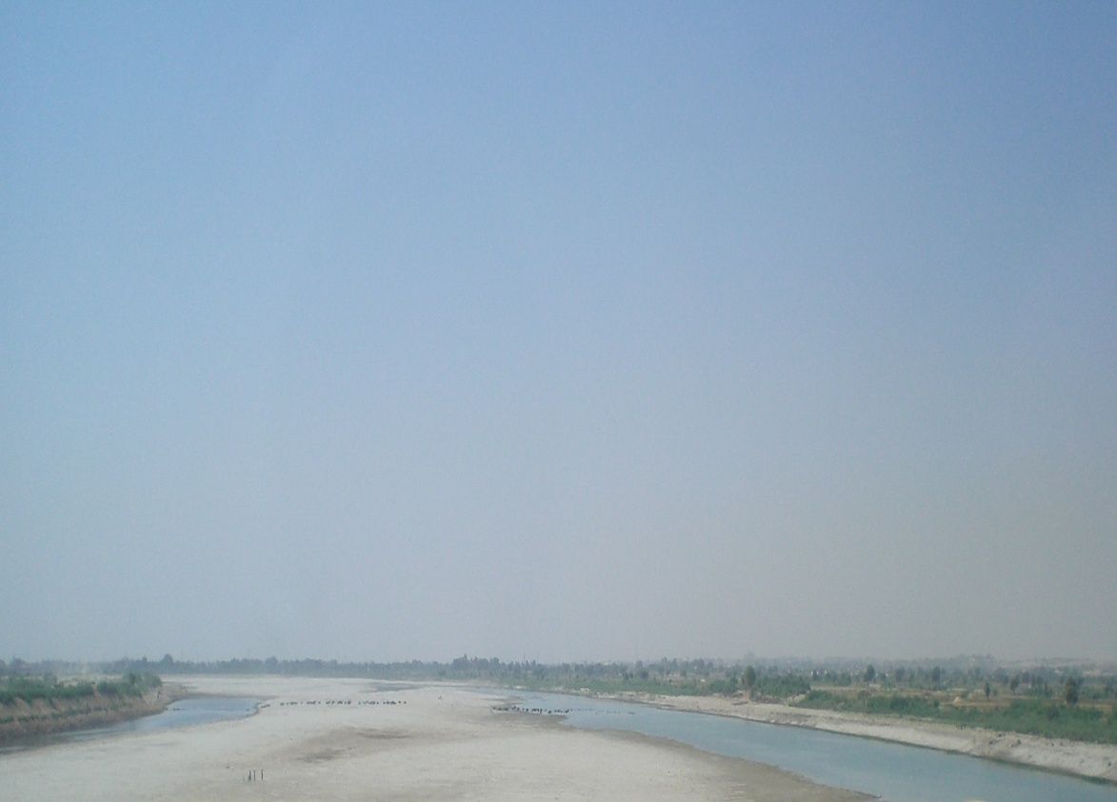
Impacts of Pakistan’s Irrigation System on Indus Delta
Dams and barrages have resulted in the siphoning off 74 percent of Indus waters before it reaches Kotri Barrage, the last barrage point on the Indus in the southern Sindh province.
Available data from 1960 shows a steady drop in fresh water inflow to Indus Delta.
Notes:
A. Inam1, S. Amjad, A. Ali and S. H. Khan, NIO, Karachi. The Anthropogenic Affects and Natural Hazards on the Stability of the

Slide 9
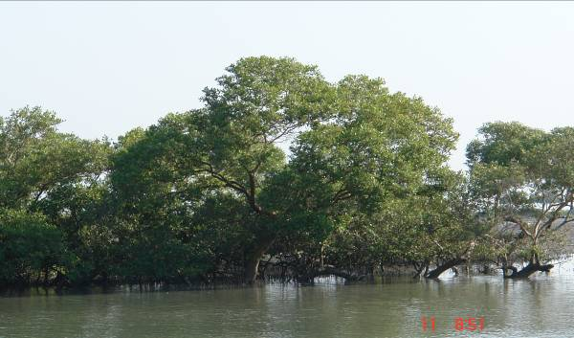
Impact on Mangrove Ecosystem
Inflow from Indus has been reduced from 150 MAF in 1890s to merely 10 MAF in 1990s.
According to IUCN studies 27-35 MAF fresh water is required to maintain deltaic ecology.
Silt deposition reduced from 400 to 100 million tons during past century
The deltaic area has been estimated to have reduced from 3,000 km2 to 250 Km2 (Hassan, 1992).

Slide 10
Flow data below Kotri Barrage

Slide 11
Climate Change and Indus Delta
According to Intergovernmental Panel on Climate Change (IPCC) reports, by 2050 the annual run-off is projected to decline by 27 per cent.
Government of Pakistan is considering to construct several new large dams on Indus.
Reduced flows due to climate change and further upstream diversion would be devastating for Indus Delta

Slide 12
Impacts
Notes:
NATURAL AND MAN MADE STRESSES ON THE STABILITY
OF INDUS DELTAIC ECO REGION. A. Inam, T. M. Ali Khan, A. R. Tabrez, S. Amjad, M. Danish,
S. M. Tabrez. National Institute of Oceanography, ST. 47 Clifton Block 1, Karachi

Slide 13
Sea level rise
Pakistan is facing sea level rise problem and its associated impacts. The tide gauge record of Karachi harbor for the past 100 years shows that sea level at Karachi has raised at about 1.1 mm/year (Quraishee, 1988; ESCAP, 1996).

Slide 14
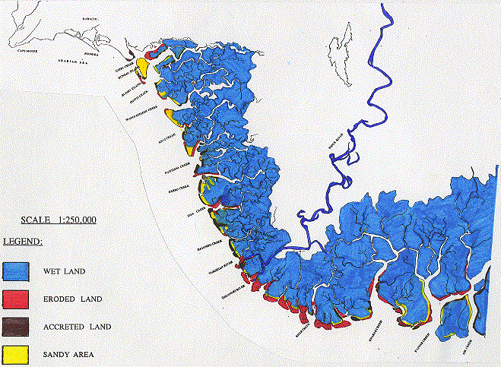
Monitoring & Mapping Land Accretion & Erosion on Indus Delta Region using SRS Data of 1978 & 1998
HUB RIVER
KARACHI
CAP MONZE
MANORA
MAKLI HILLS
GIZRI CREEK
BUDAL ISLAND
BUDDU ISLAND
PHITTI CREEK
THATTA DISTRICT
WADDI KHUDDI CREEK
KHAI CREEK
RIVER INDUS
PAITTIANI CREEK
Arabian Sea
DARBO CREEK
SISA CREEK
Legend:
HAJAMRO CREEK
Wet Land
TURSHIAN RIVER
Eroded Land
ARABIAN SEA
QALANDRI RIVER
Accreted Land
Sandy Area
KHARAK CREEK
Channel/Canal
KHAR CREEK
KAJHAR CREEK
SIR CREEK
Notes:
Ms. Meherunissa, 2006 (SUPARCO)

Slide 15
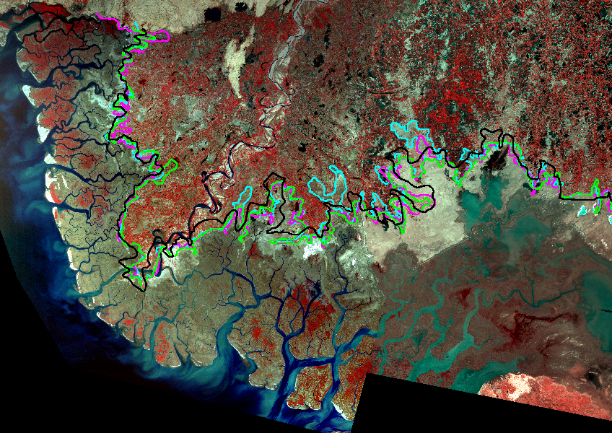
Integration of Tidal Boundaries based on Multi-Temporal SRS Data
KARACHI
Haleji Lake
Badin District
Phitti Cr.
Thatta
Mangrove Swamps
Makli Hills
Waddi Khuddi Cr.
Badin
Sujawal
Khai Cr.
Thatta District
Paitiani Cr.
Dabbo Cr.
Indus River
Dhands
Chhan Cr.
Keti Bandar
Tidal Link
Hajamro Cr.
Shah Bandar
Turshian River
Indus Delta
Jangh River
Mangroves
Rann of Kutch
Qalandri River
Gahbar Cr.
Legend:
Tidal Boundary 1976 by Black
Tidal Boundary 1989 by Green
Tidal Boundary 1998 by Magenta
Tidal Boundary 2003 by Cyan
Arabian Sea
Kharak Creek
Khar Creek
Pakhar Cr
Kajhar Cr.
Sir Cr.
Notes:
Mehrunnisa, SUPARC 2006

Slide 16
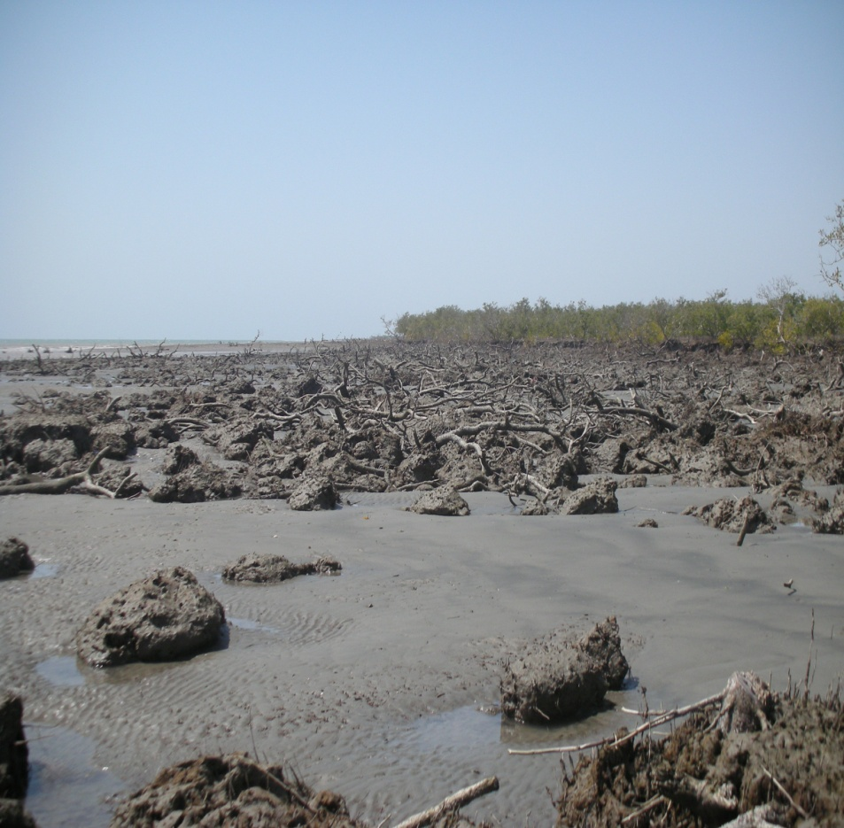
Sea Intrusion - Impacts
0.5 million hectares of fertile land in Thatta district alone (or 12% of the entire cultivated area of the province) is affected by sea intrusion.
Salinity on Sindh coast increased from 35 ppt to 45ppt in two decades.

Slide 17
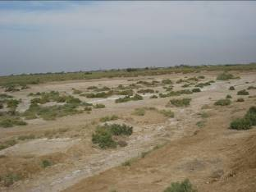
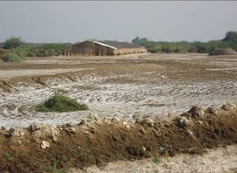
Impacts of Sea Intrusion
Lives of about 400,000 fishermen families are affected.
Range land depletion, shortage of fodder and food crops, reduction in potable water, losses to livestock is causing out-migration of communities

Slide 18
Status of Mangrove Forests
Source : Coastal Environmental Management Plan for Pakistan, UNESCAP, GOP

Slide 19
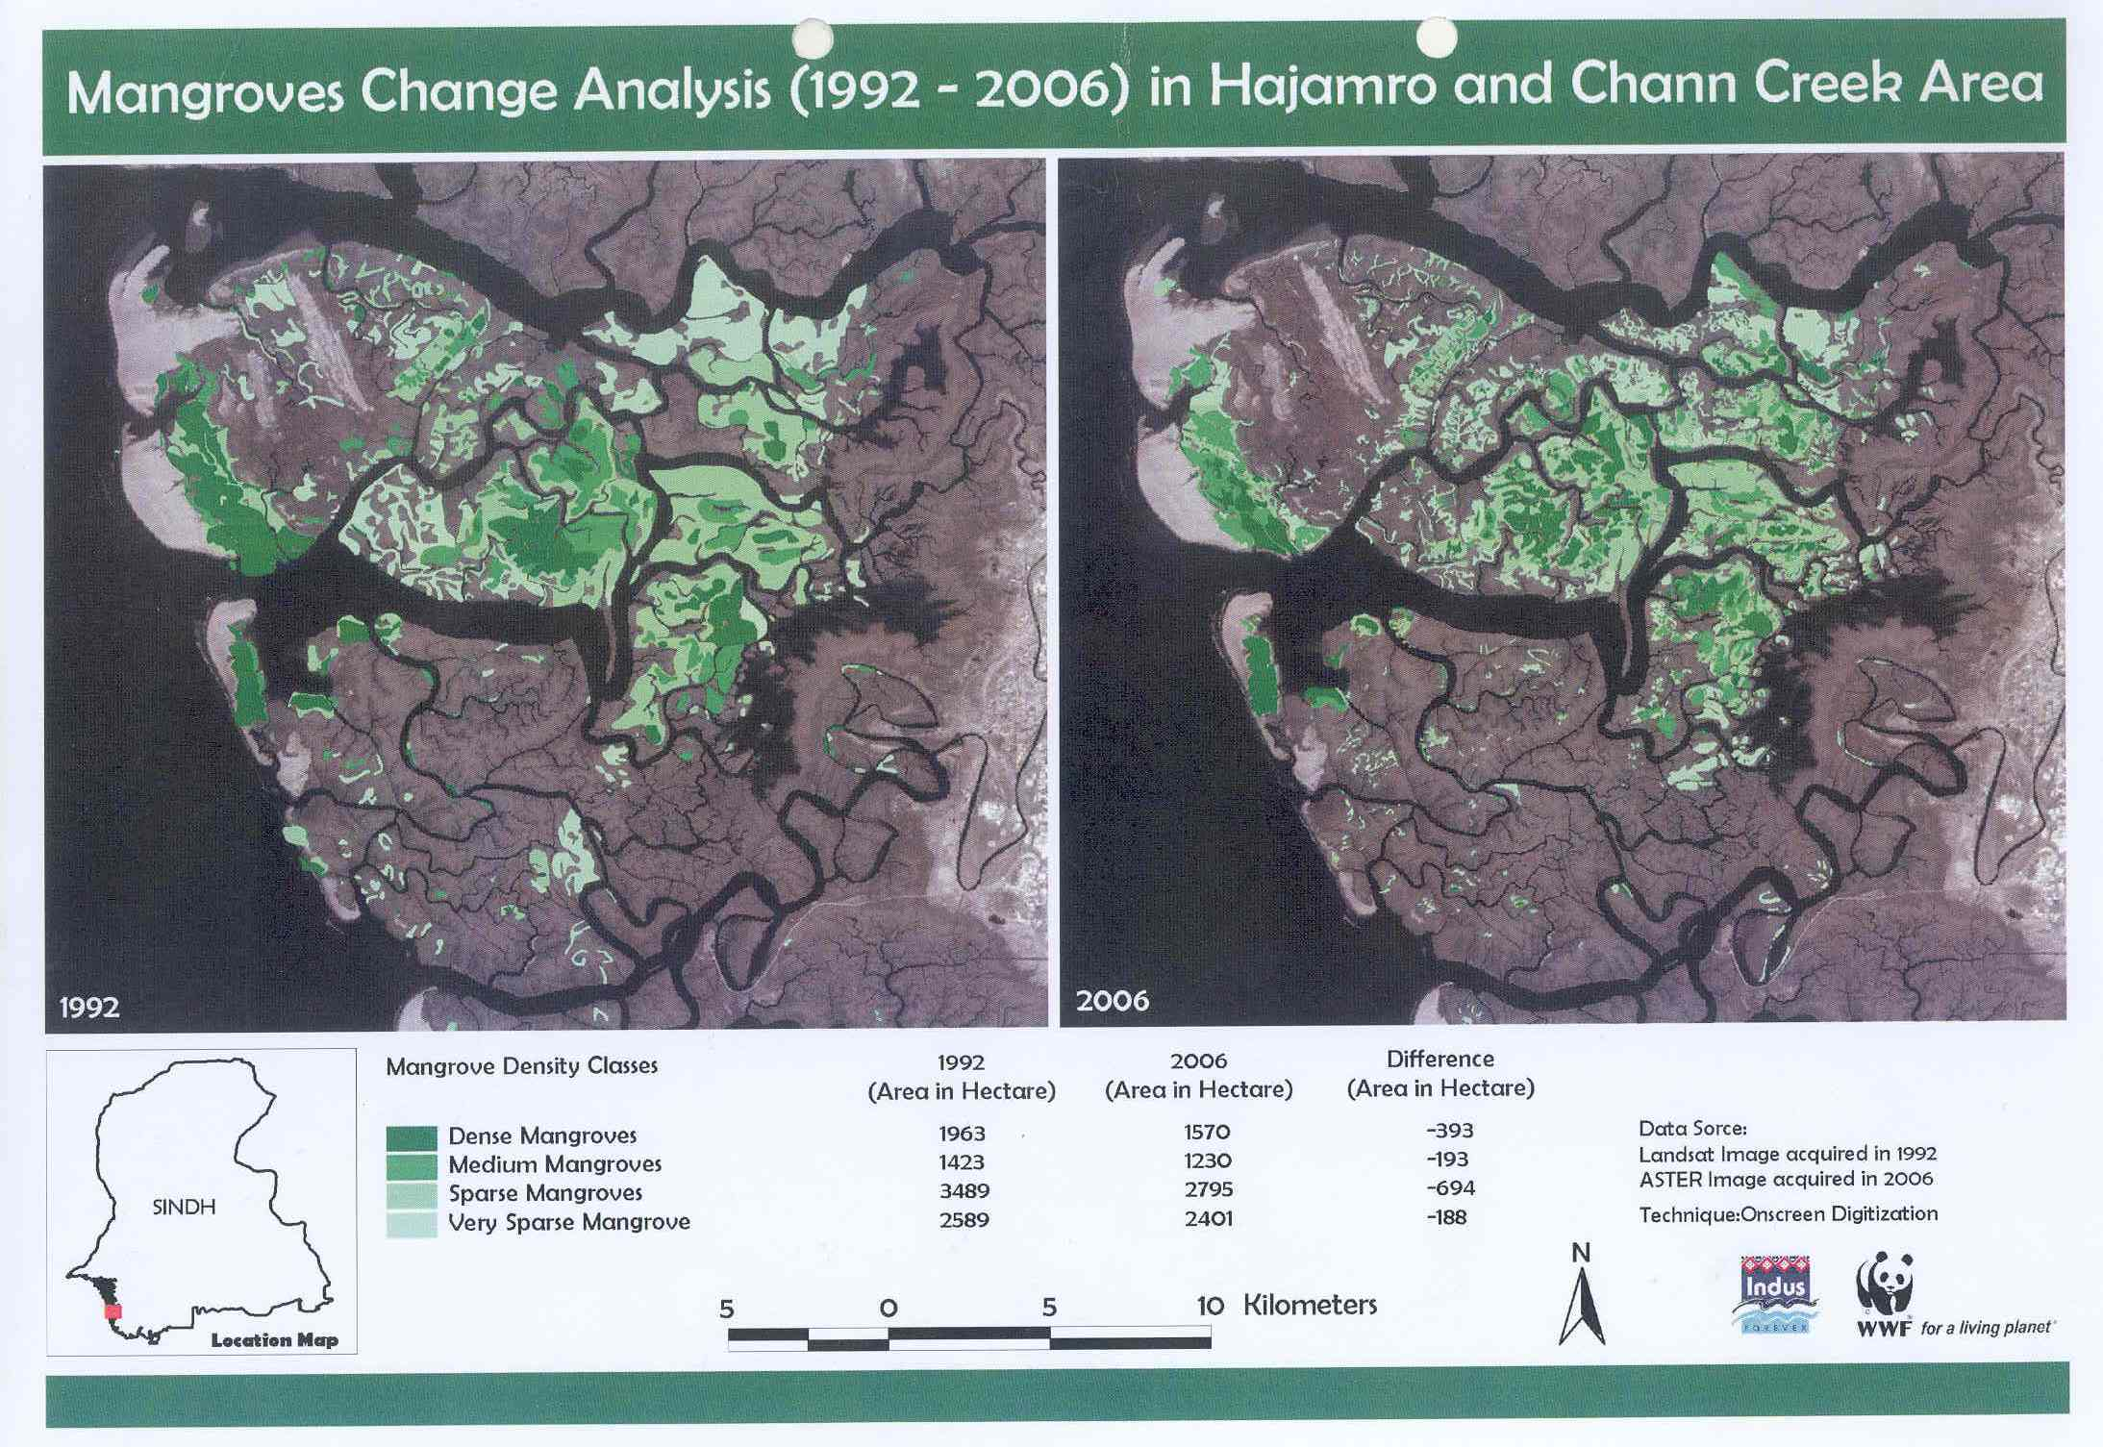

Slide 20
Impact of loss of mangroves
Only 15% of the existing forest is in healthy state.
Till 1950s there were 8 mangrove species in Indus delta, 4 of them are vanished now.

Slide 21
Impact of loss of mangroves
According to some estimates about 70% of Pakistan’s shrimp fishery is dependent on mangroves.
It nurtures some 23 species of shrimp and about 155 species of fish.
It provides fodder for 6,000 camels and 3,200 buffaloes.

Slide 22
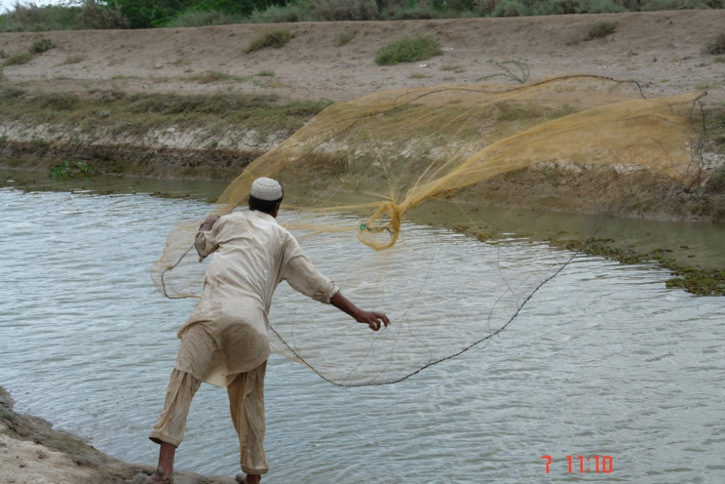
Declining Marine Fish Catch
Year | Marine Fish Production (000 tonnes
1999 | 333
2000 | 218
2001 | 278
2002 | 286
2003 | 270
2004 | 275
2005 | 276
2006 | 285
2007 | 250
2008 | 339
2009 | 340
2010 | 342
Sindh Economic Survey 2009-10

Slide 23
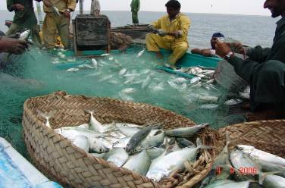
Declining Palla Fish Catch

Slide 24
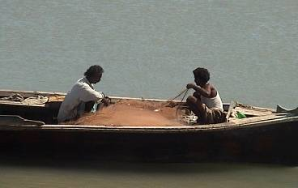
Declining number of fishing crafts
Year | No of fishing crafts
1999 | 14,982
2000 | 6,360
2001 | 6,704
2002 | 6,813
2003 | 6,813
2004 | 6,813
2005 | 10,640
2006 | 10,680
2007 | 10,792
2008 | 10,918
2009 | 10,933
2010 | 10,964
Sindh Economic Survey 2009-10

Slide 25
Impact on Fisheries
Some shrimp and fish species require low salinity water (maxm. 15 ppt) at early stage of life. But salinity in creeks has increased to 50 ppt.
The Palla fish (Tenualosa ilisha), has significantly declined from 10,000 MT/annum in 1970s to 400-600 MT/annum in late 90s.
An alarming decline in Jaira shrimp has been recorded. This specie registered a fall from 10,000 MT in 1971 to 5,311 MT in 1998.

Slide 26
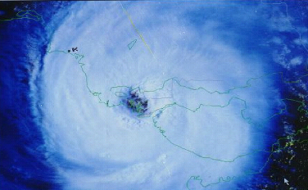
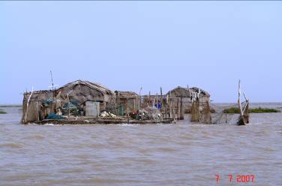
Intensity, Frequency & Devastation of Cyclones
Sindh coast is vulnerable to cyclones.
On an average four cyclones hit Sindh coast in a century.
The period of 1971-2010 records 17 cyclones on the Sindh coast.
Changing climate can make cyclones more frequent and violent
Satellite image of the powerful Cyclone TC 02A, hitting the Thatta District at 3:30 pm (PST) on May 20th, 1999

Slide 27
Future Challenges
Indus Delta faces variety of challenges in the wake of climate change.
Some of the consequences may be
  alarming sea level rise
  Sea intrusion and submergence of islands
  more frequent and violent cyclones
  loss of mangroves and associated biodiversity
  loss of livelihood means and drinking water
  marginalization and outmigration of coastal communities

Slide 28
Thank you

