Slide 1
Extreme Event, Livelihood Loss and Adaptation Strategies: Evidence from Indian Sundarban delta
Santadas Ghosh
Associate Professor, Visva-Bharati University, India
[Partial outcome of a research project sponsored by SANDEE]

Slide 2
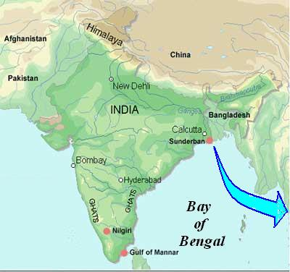
Sundarban in India: Location

Slide 3
54 islands with population settlements
48 islands constitute the Reserve Forest

Slide 4
Background
Densely populated remote islands in a corner of India
Predominance of agricultural – single annual crop
Cyclone Aila in May 2009 – salt deposits on agricultural field
Near complete loss of annual crop
How the households coped with it?

Slide 5
Livelihoods based on surrounding natural resources

Slide 13
Honey/Bee-wax Collection

Slide 14
Main Livelihood: Agriculture

Slide 18
Islands in times of Low Tide

Slide 19
Islands in times of High Tide

Slide 21
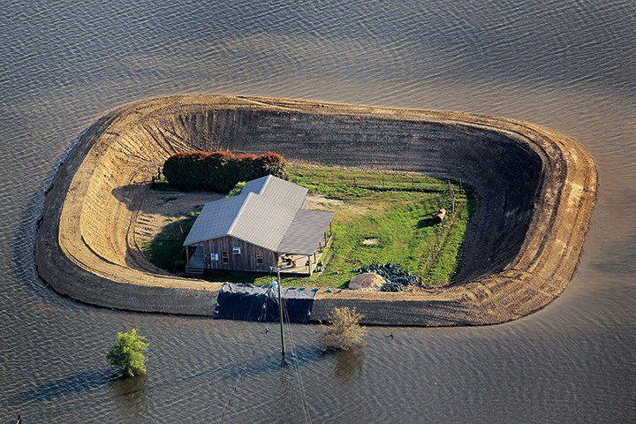
Courtesy: Unusual facts < https://www.facebook.com/#!/unufacts>

Slide 22
Cyclone Aila: 100-120 Kmph: 25th May, 2009 (photograph courtesy: NASA)

Slide 40
Effect of Aila: Agricultural Loss and Nature’s Resilience
Damage Category | Duration of water stay | No. of land-holding HH | First Round (Mar-Jun, 2010) |  | Second Round (Jan-Mar, 2011) |  | Third Round (Jan-Mar, 2012)
 |  |  | % of HH taking up cultivation | Avg Produ ctivity (Qtl/ Bigha) | % of HH taking up cultivation | Avg Produ ctivity (Qtl/ Bigha) | % of HH taking up cultivation | Avg Produ ctivity (Qtl/ Bigha)
0 | 0 | 153 | 73 | 3.3 | 88 | 3.6 | 90 | 4.3
1 | 1-2 | 41 | 73 | 2.9 | 78 | 3.5 | 85 | 4.1
2 | 3-6 | 34 | 62 | 2.6 | 85 | 3.5 | 91 | 3.7
3 | 7-13 | 98 | 49 | 1.7 | 89 | 2.5 | 95 | 3.7
4 | 14-30 | 132 | 25 | 1.7 | 93 | 2.4 | 93 | 4.1
5 | > 30 days | 68 | 12 | 1.5 | 87 | 2.2 | 97 | 3.8
Total |  | 526

Slide 41
Coping with Natural Resources: River & Forest
Damage Category | No. of survey HHs | Percentage of survey households that depended on river/forest for their livelihood (fully or partially)
 |  | Before Aila (May, 2009) | 1st round survey (Mar-Jun, 2010) | 2nd round survey (Jan-Mar, 2011) | 3rd round survey (Jan-Mar, 2012)
0 | 153 | 8.5 | 11.8 | 12.4 | 10.5
1 | 41 | 7.3 | 4.9 | 7.3 | 9.8
2 | 34 | 14.7 | 26.5 | 5.9 | 8.8
3 | 98 | 15.3 | 23.5 | 32.7 | 23.5
4 | 132 | 21.2 | 24.2 | 26.5 | 25.0
5 | 68 | 16.2 | 19.1 | 29.4 | 25.0
Aggregate | 526 | 14.3 | 18.4 | 21.1 | 18.3

Slide 42
Coping with Outside Jobs: Labour migration
Damage Category | No. of survey HHs | Percentage of survey households that depended on earning from outside Sundarban as migrant workers (fully or partially)
 |  | Before Aila (May, 2009) | 1st round survey (Mar-Jun, 2010) | 2nd round survey (Jan-Mar, 2011) | 3rd round survey (Jan-Mar, 2012)
0 | 153 | 27.5 | 30.7 | 58.2 | 55.6
1 | 41 | 26.8 | 29.3 | 58.5 | 61.0
2 | 34 | 14.7 | 14.7 | 61.8 | 52.9
3 | 98 | 18.4 | 24.5 | 55.1 | 51.0
4 | 132 | 13.6 | 16.7 | 68.9 | 59.1
5 | 68 | 20.6 | 25.0 | 63.2 | 58.8
Aggregate | 526 | 20.5 | 24.1 | 61.2 | 56.3

Slide 43
Findings from Statistical Analysis
Productivity loss is reversible, land regains fertility in two years
Adapting for new livelihood needs some gestation period, but are often irreversible
Asset poor and lowly educated depended on river and forest
Lowly educated and bigger families opted for outside jobs
Coping with migration is more than that with river and forest

Slide 44
Post Aila: Government Initiative for livelihood protection
Aim: In-situ protection of local livelihood
Building of concrete shelters for disaster victims
Wider and taller embankments
Buffer zone between embankment and river
Mangrove belt in the buffer zone
Need for land acquisition
Huge investment: first phase estimate Rs. 10 billion
[ Little progress for more than three years after Aila]

Slide 45
Some other Observations
Mangroves withstood the cyclone without any visible damage
No loss in wildlife recorded
Out migration of labourer from Sundarban showed an increasing trend even before Aila
Fish/crab catching and other livelihood activity based on natural resources put significant anthropogenic stress on the ecosystem
Sundarban is a World Heritage Site and the most important Tiger Reserve
The delta is very much active and inhabited islands didn’t gain matured heights

Slide 46
Policy Implications
Evidence from Literature : investment on protective infrastructure might provide pervert incentive for migration decision
Climate Change threats: more extreme events in Bay of Bengal coast
Out migration trend provide evidence of unsustainable population
Long term policy should be directed towards helping people to relocate themselves, rather than protecting them locally

Slide 47
Thank you!

