Slide 1
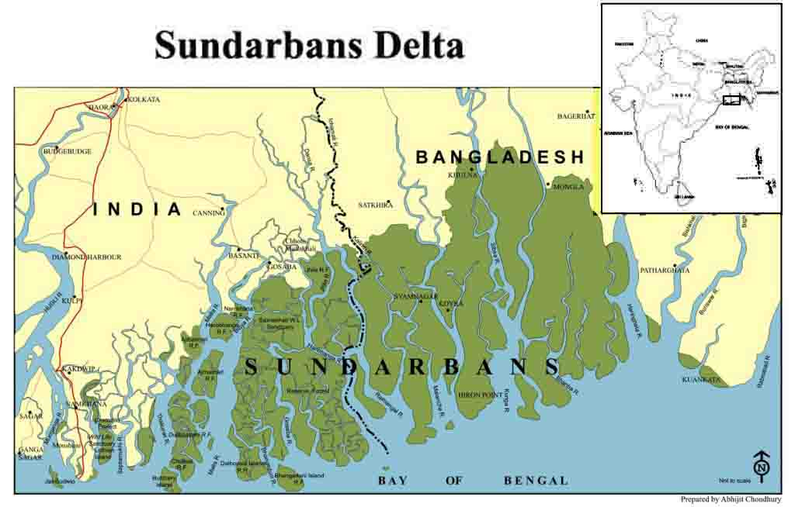
Regional Conference on Climate Change Adaptation in Coastal Areas:
Perspectives in the Dasht, Indus, and Sunderbans Deltas
Savar, 16-17 October 2012
Mr. Mowdudur Rahman, CCEC, Khulna

Slide 2
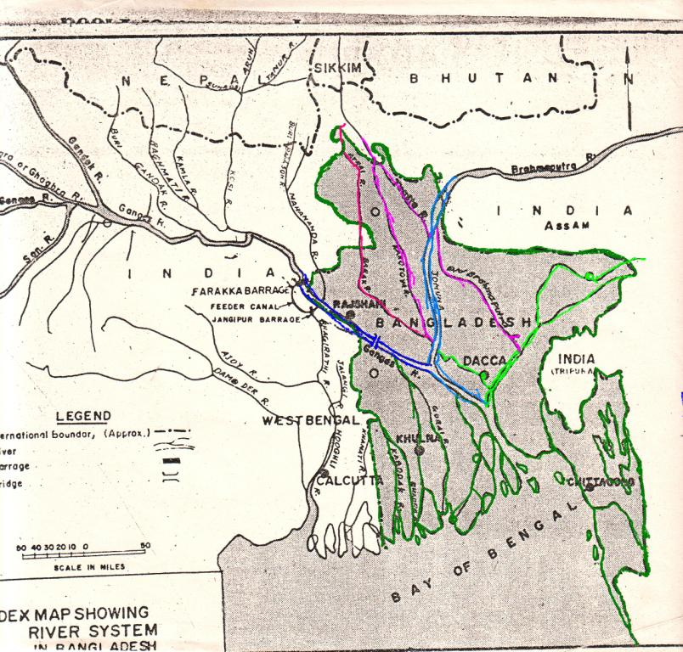
Bangladesh connected with Indian Rivers

Slide 3
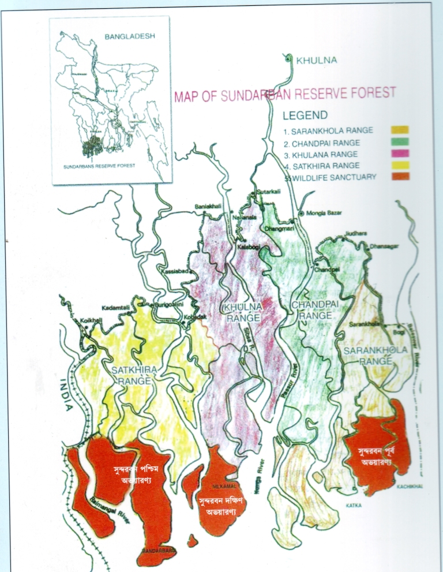
Sundarbans Reserve Forest (SRF) (601,700 hactares / 414,300 hac forests)
187,400 ha water (rives, estuaries, ponds and canals),
139,700 ha WH/Sanctuaries.
4% of Bangladesh (40% of total forest lands earns 50% of forest revenue)
gradually decline in revenue due to climate change impacts (Banik, 2004 )

Slide 4
Sundarbans: Ecosystem Services and Conservation
Biodiversity: The Sundarbans provides ideal habitats for a variety of mammals (32 sp. are recorded), waders and seabirds and also suitable nesting sites for both marine turtles and the endangered estuarine terrapin Batagur baska (Blower, 1985). But above all the Sundarbans are well known as the home of the royal Bengal tiger (Panthera tigris tigris, whose population is estimated 440 in Bangladesh and 274 in India (FD and UNDP, 2004)
Natural Gene pool: Sundarbans is the most important, rare, natural gene pool in the world
Moratorium: Now, there is no commercial timber felling due to a moratorium imposed by the GOB (UNEP, 2001); Logging is ban since 1989 including top dying Sundri followed by cyclone Sidr in 2007 (GOB).

Slide 5
IMPACTS IN THE SUNDARBANS DELTA
Sea level rise, climate change and global warming
Natural disaster/cyclone/tidal surge/storm/flood
Fresh water reduction from the north (FARAKKA BARRAGE)/
Increased salinity
Top dying in Sundri trees
Disruption of natural regeneration
Illegal shrimp fry collection, hunting and tree felling
Development of activities with in Ecologically Critical Area (ECA)
Embankment (polder) erosion/water logging

Slide 6
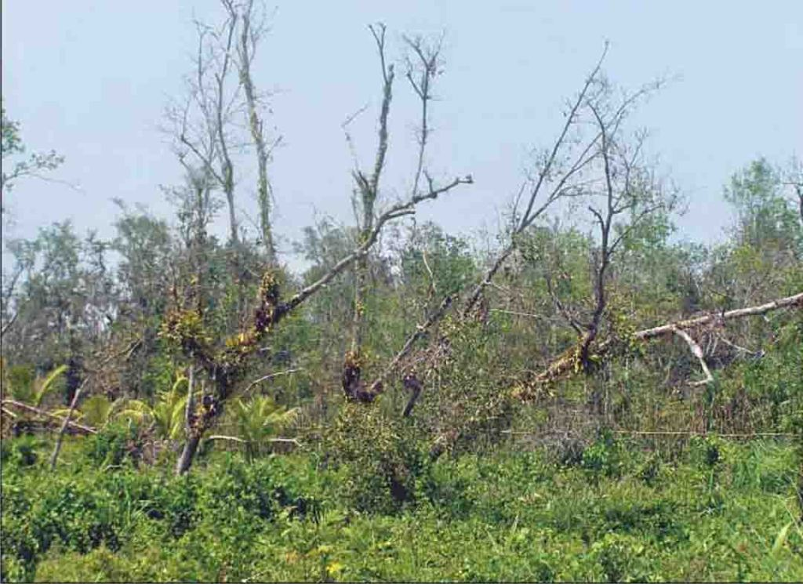
Top dying in Sundri (Heritiera fomes) trees:
In 1985, Overseas Development Administration (ODA) published a report on top dying in
Sundri trees which in turn FD, BFRI, KU and FAO " Integrated Forest Resource Management
Project" (FRMP) start investigation and conduct research:
Increased salinity
Reduction of fresh water from the Ganges/Padma
Silt deposits/creation of alluvial lands
Fungal attack
Storm surge and cyclone
Changes in soil properties
BUT specific causes responsible for top dying was not identified

Slide 7
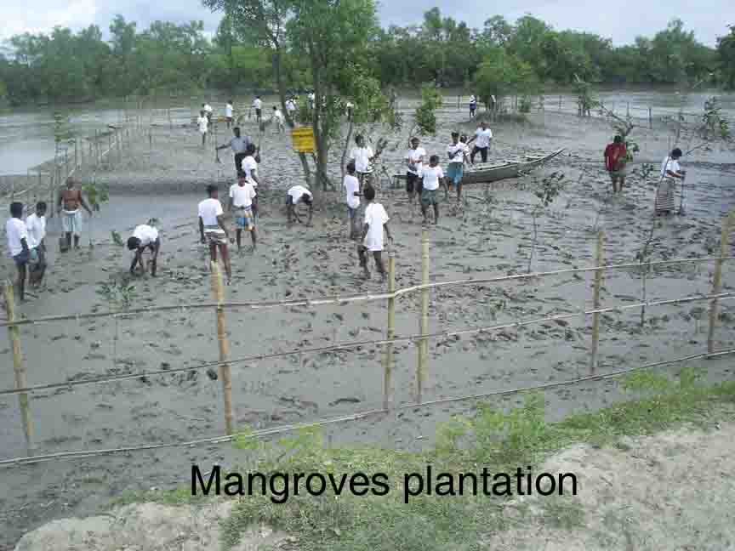
CCEC experiences of resilience institutions and initiatives
Sundarbans stakeholders (bouali, mouali, jellay and crab collector) cooperative society (community based local institute) already dealing with resilience issues of climate change.
Crab fattening project
Mangrove Protection Society
Disaster Management Committee

Slide 8
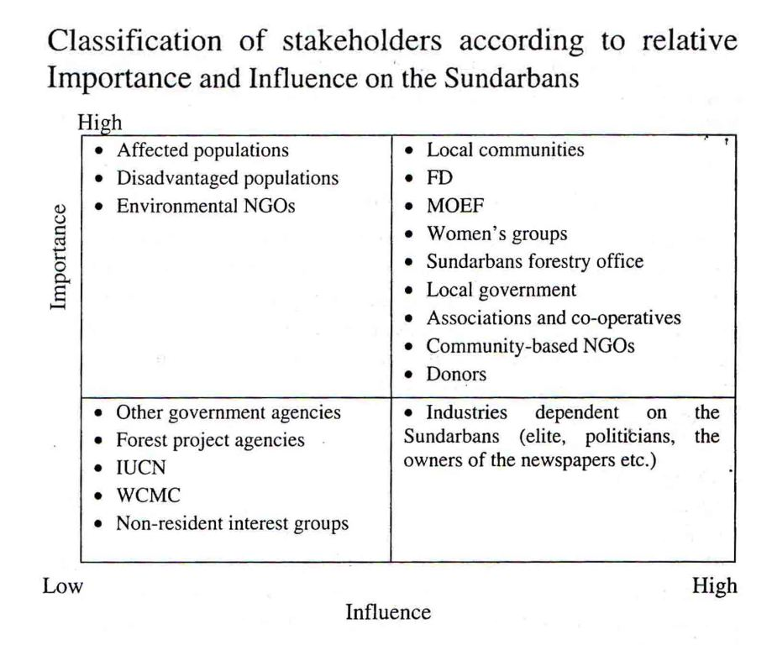

Slide 9
Climate interventions Initiated by The Government of Bangladesh
GOB has formulated the BCCSAP 2009
Established Climate Change Trust Fund (CCTF)
Form Climate Change Unit (CCU) for the operation of CCTF
Constitution of Climate Change Trust Fund Policy (17 Member CC Trustee Board headed by Hon'ble Minister and Technical Committee headed by the Secretary, MoEF
Enactment of Climate Change Trust Act
Climate Change Action Plan is built on Six pillars
Food security,
Social protection and health,
Comprehensive disaster management,
4. Infrastructure research and knowledge management,
5. Mitigation and low carbon development and
6. Capacity building and institutional development
Recommendation:
* A permanent set up for CCU is required

Slide 10
Proposed Directions and Priorities for Donor Engagement
Current Donors Engaged in the Coastal Areas of Bangladesh
EU: SEALS
GIZ: SDBC
UNDP
USAID/IPAC
World Bank
Future Directions for Donors
Co-management Organization/CMC ( 50% FD revenue will go to
the communities through CMC)
Emphasis should be placed on education and environment
NGO’s
Prioritize local community engagement in project development
and implementation.

