Slide 1

Implications for Resilience Management and Livelihoods
Soma Saha
WWF-India

Slide 2
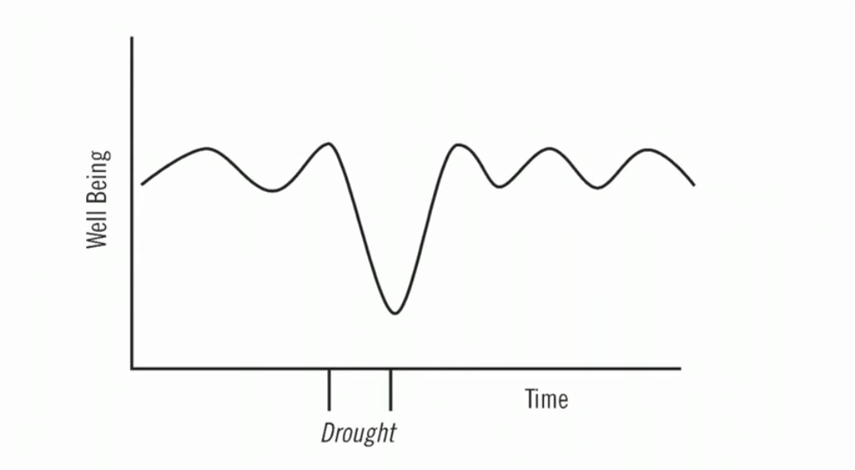
What is resilience?
The ability of a social or ecological system to absorb disturbances while retaining the same basic structure and ways of functioning, the capacity of self-organization, and the capacity to adapt to stress and change (IPCC-WG2)
World Resources Institute, Enabling Adaptation
Notes:
Building resilience is a bit better than coping. It is often referred to as “buying time.” We are building resilience through business-as-usual conservation measures. When a community or an ecosystem is resilient, well-being may decline during an extreme event, like a drought, but after sometime it is able to recover to its previous state.
2

Slide 3
How to manage resilience?
Resilience = 1/ Vulnerability i.e. Increase in resilience= Decrease in vulnerability
Vulnerability = (Exposure X Sensitivity)/ Capacity
Vulnerability = (Exposure X Sensitivity)/ Capacity = Resilience

Slide 4
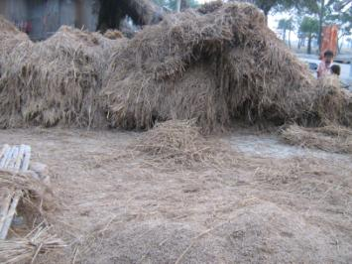
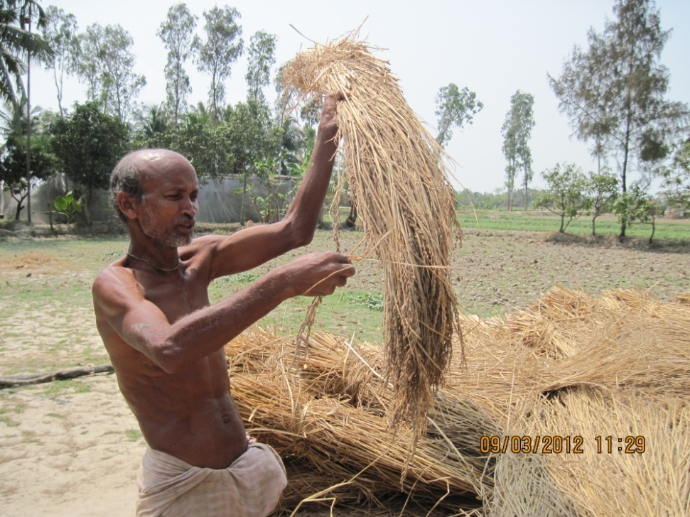
Paddy harvested at Tipligheri, Gosaba
Paddy harvested at Mousuni, Namkhana

Slide 5
Steps of resilience management
Step-1: Climate data analysis and Vulnerability assessment
Step-2: Interventions to increase capacity of the community

Slide 6
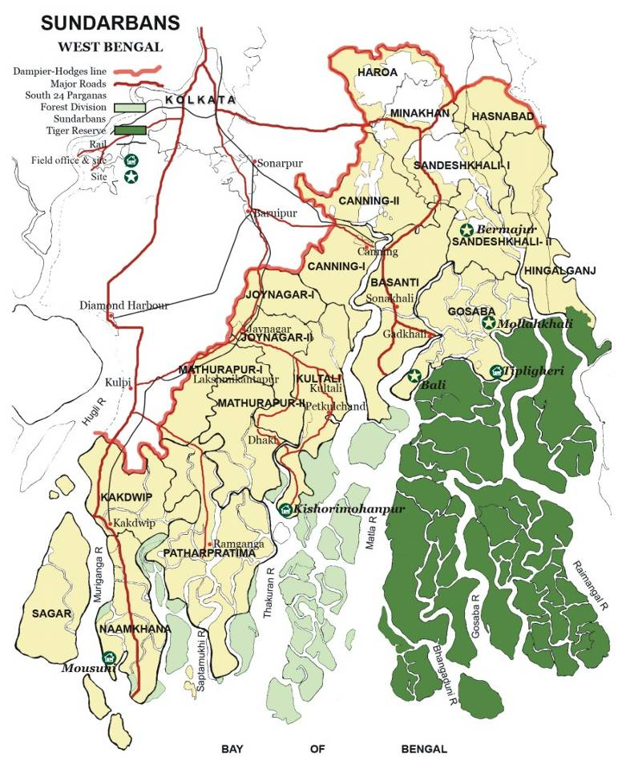
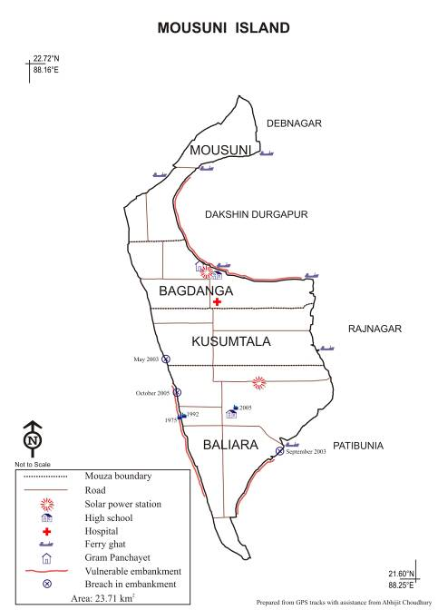
The Mousuni Island

Slide 7
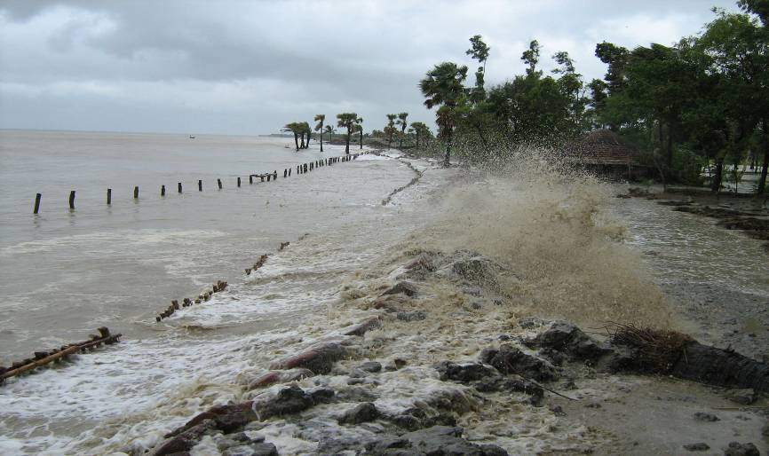
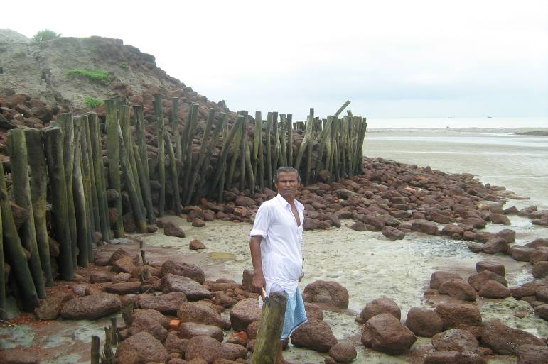
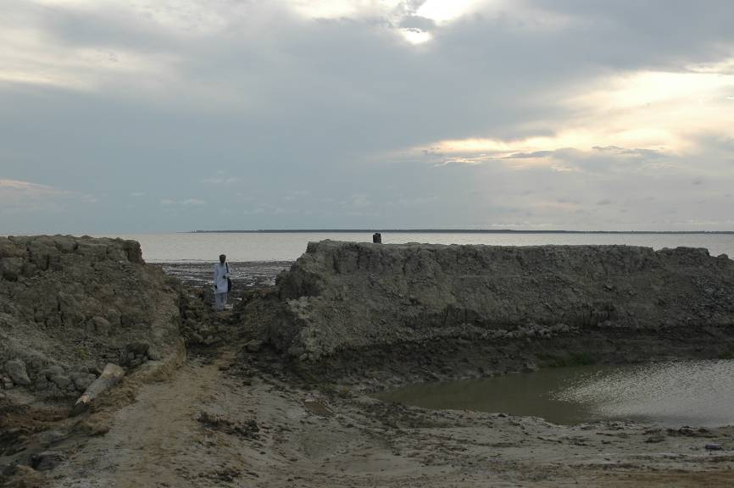
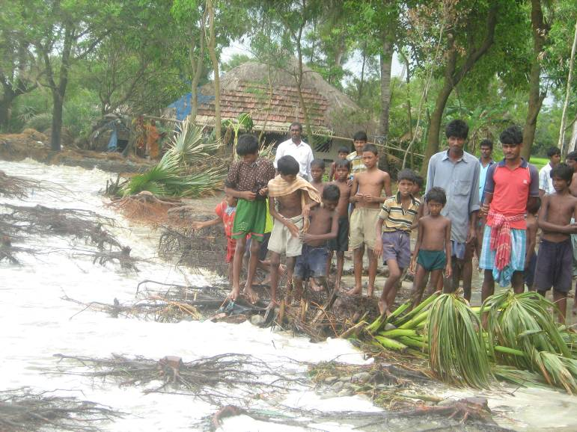
Mousuni Island, Sundarbans, India

Slide 8
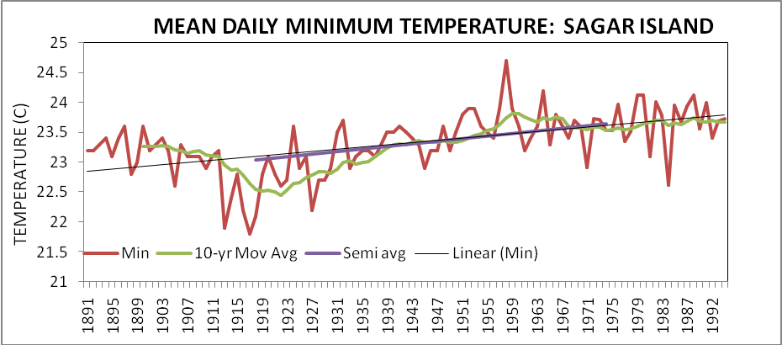
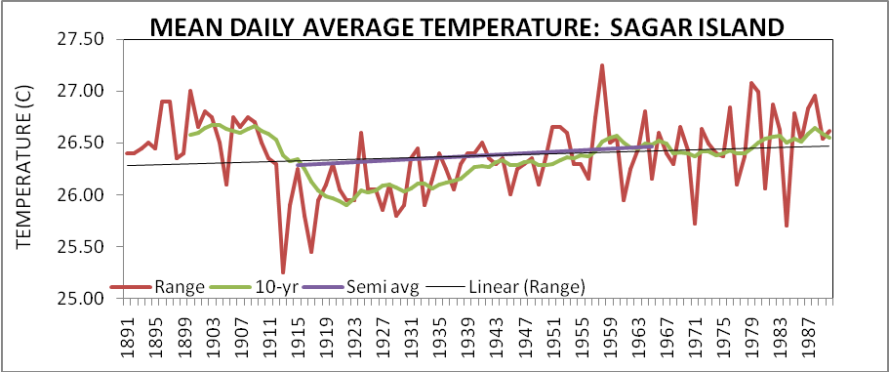
Step-1: Climate Data Analysis
0.6⁰C increase in average daily min. temperature over a period of 80 years (1891-1970)
0.1⁰C increase in average daily temperature over a period of 80 years (1891-1970)

Slide 9
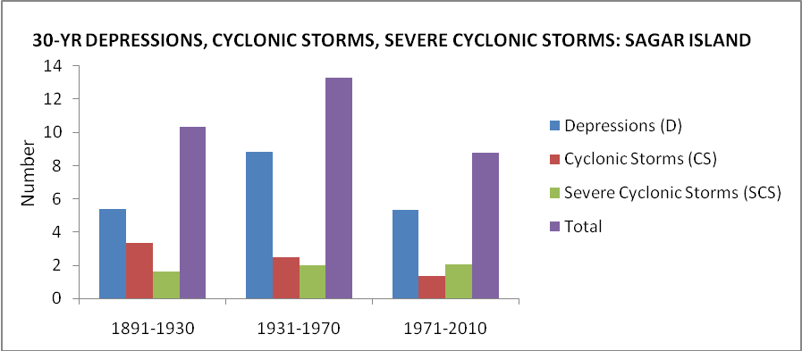
Increase in frequency and severity of cyclonic storms and
depressions in Bay of Bengal over a period of 120 years (1891-
2010)
Period | Depression (D) | Cyclonic Storms (CS) | Severe Cyclonic Storms (SCS) | All disturbances
1891-1930 | 5.40 | 3.33 | 1.6 | 10.33
1931-1970 | 8.83 | 2.5 | 1.98 | 13.31
1971-2010 | 5.35 | 1.35 | 2.05 | 8.75

Slide 10
Step-1 contd.: Vulnerability Assessment
Embankment vulnerability and Coastal Erosion maps of Baliara mouza, Mousuni

Slide 11
Erosion and Land use maps of Baliara mouza, Mousuni

Slide 12
Elevation map and Composite vulnerability map of Baliara, Mousuni

Slide 13
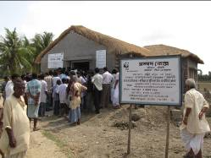
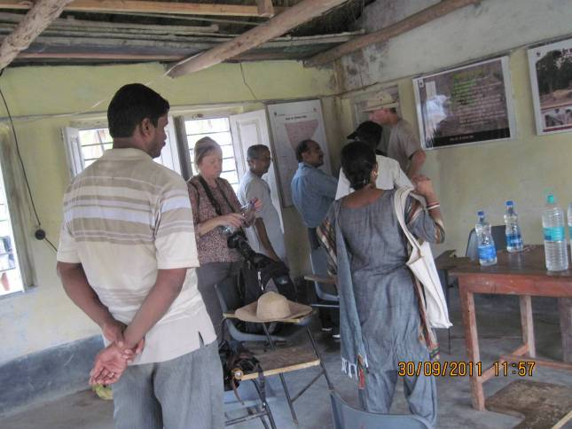
Step-2: Interventions
Establishment of Climate Adaptation Centre for a vulnerable island.
Institutional mechanism for Community based disaster preparedness
Demonstration and promotion of climate resilient agriculture and pisciculture practices.
Climate Adaptation Centre

Slide 14
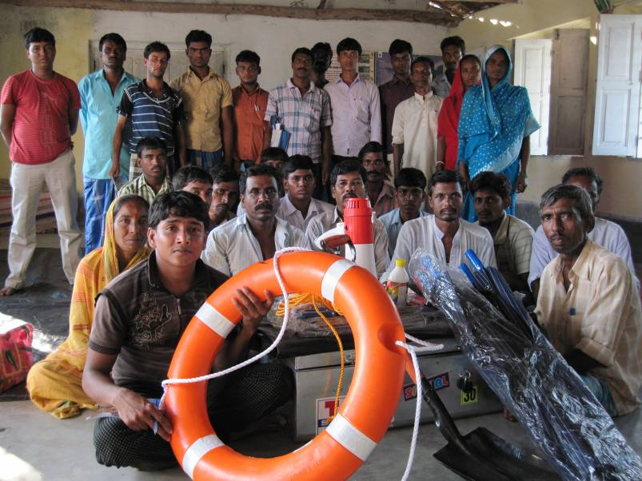
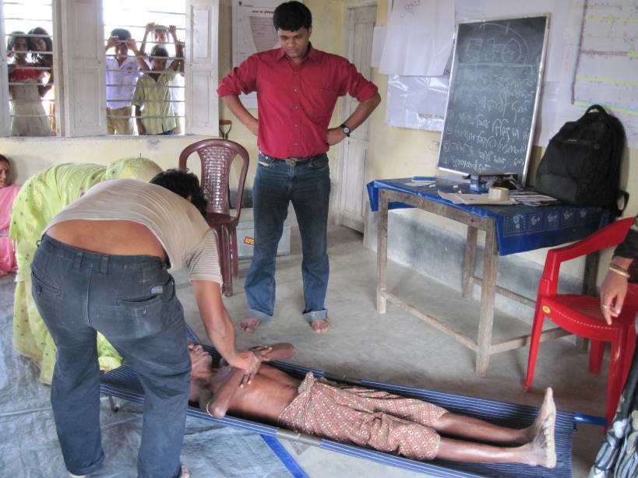
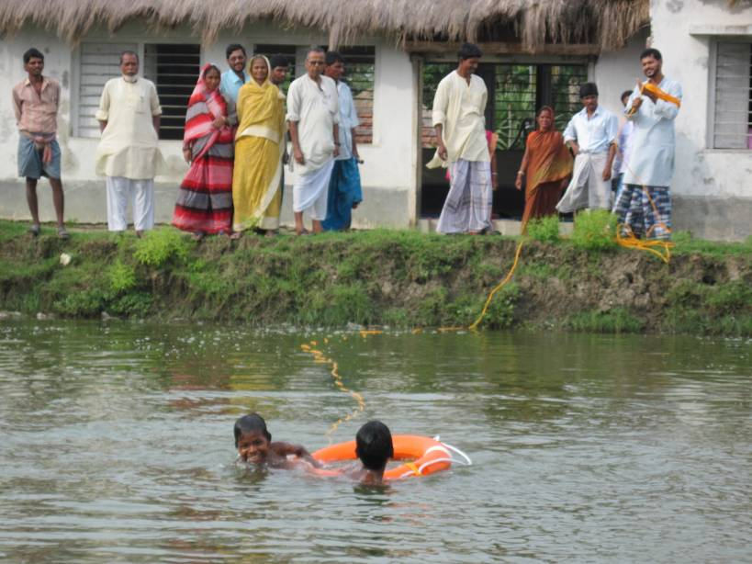
Training on Disaster preparedness

Slide 15
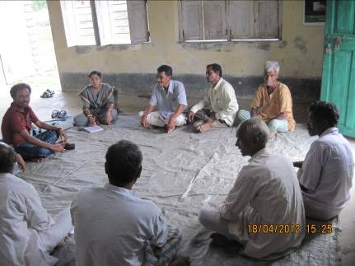
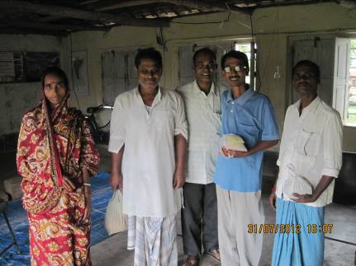
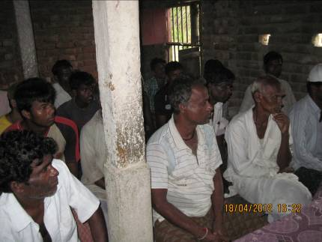
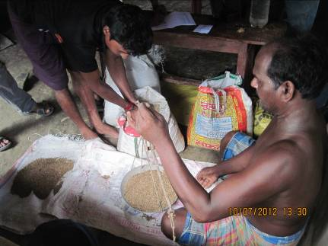
Climate resilient agriculture: farmers’ participation
Farmers’ meeting
Paddy seed distribution

Slide 16
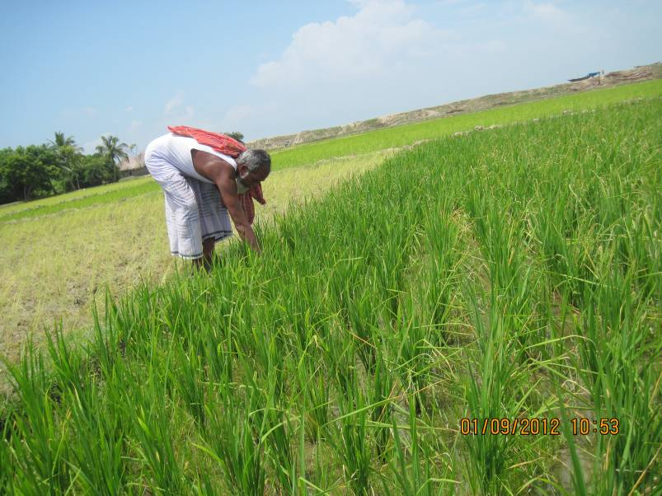
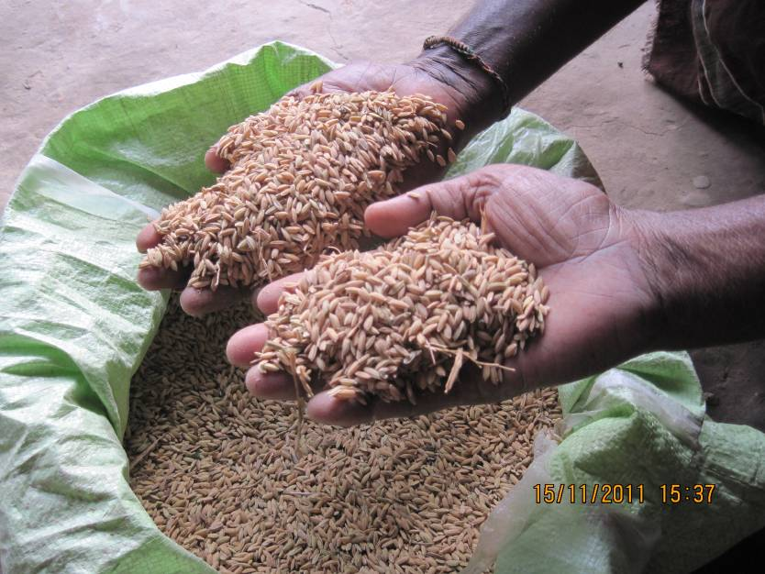
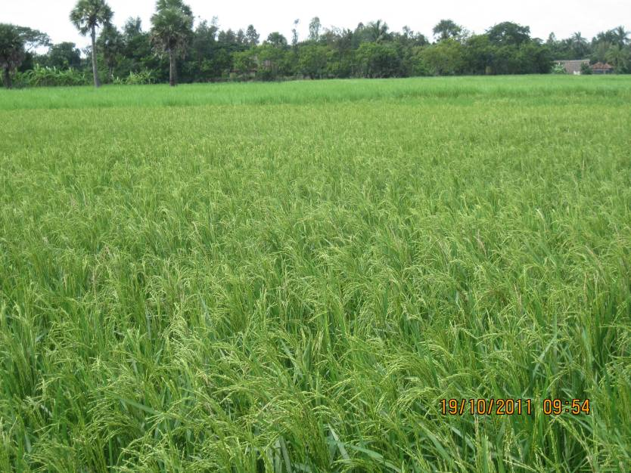
Salt tolerant paddy cultivation

Slide 17
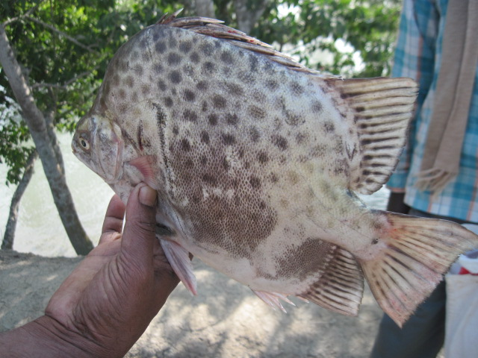
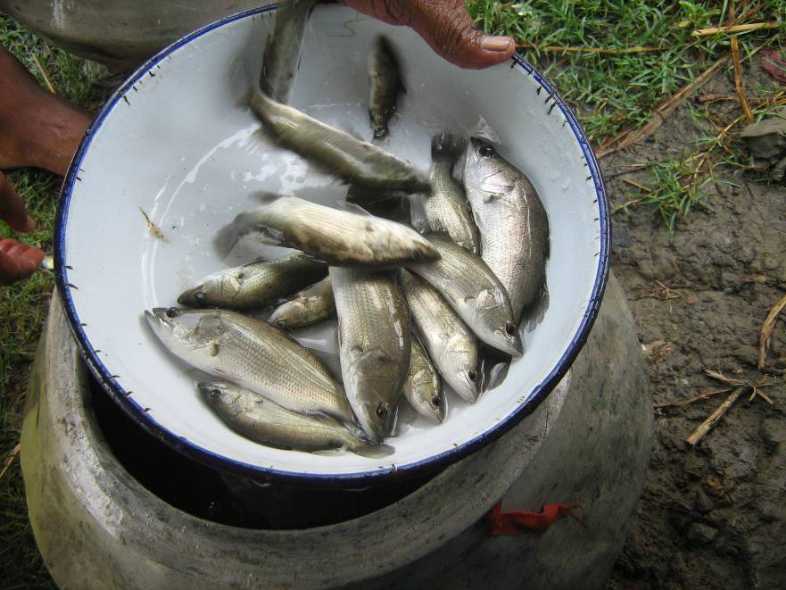
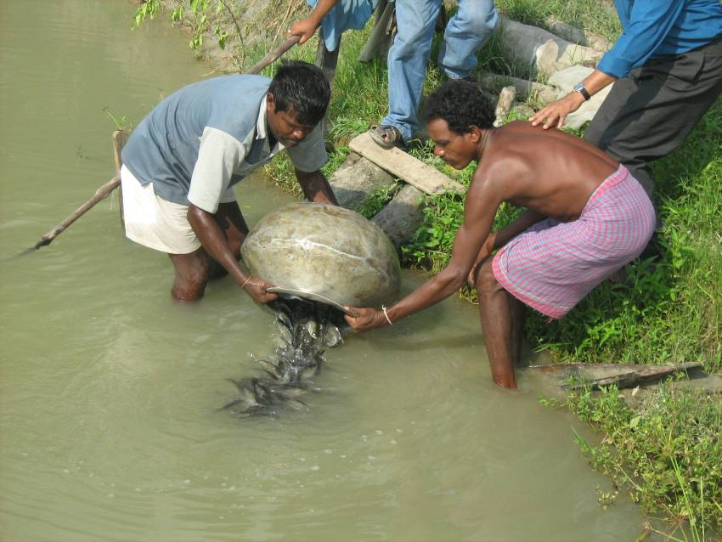
Climate resilient pisciculture

Slide 18
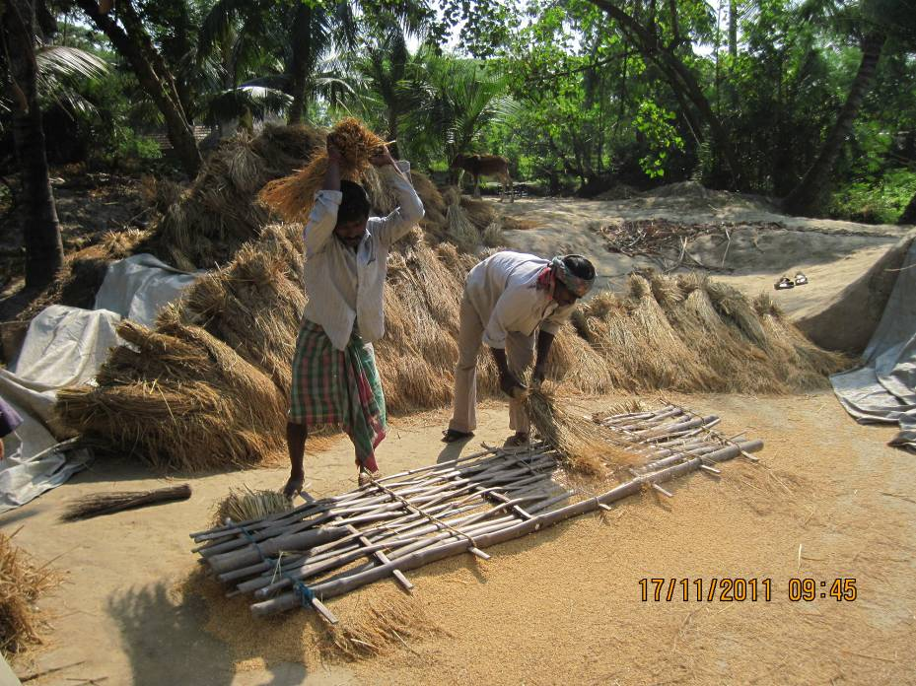
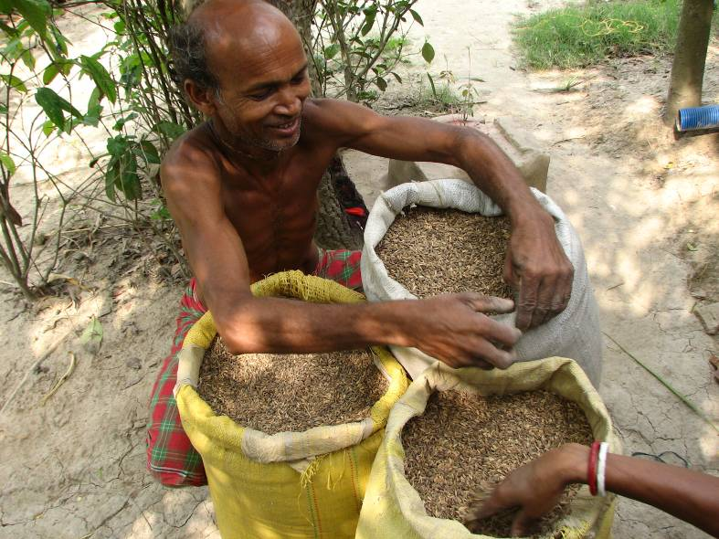
Implications of resilience management and livelihood
Sensitivity reduction
Importance of capacity building
Importance of livelihood diversification

Slide 19
Thank you
www.wwfindia.org

