Slide 1
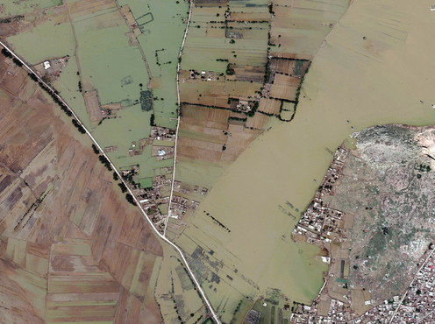
Use of Satellite Images for Disaster Assessments

Slide 2
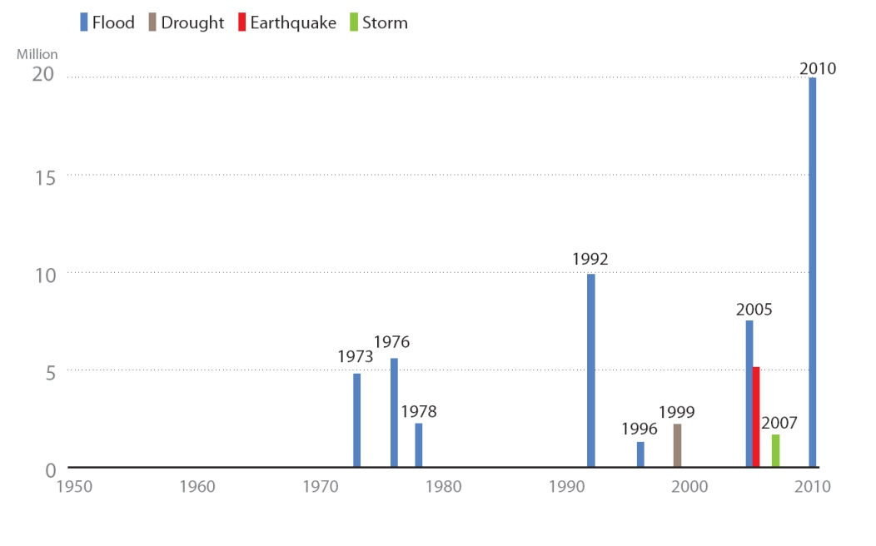
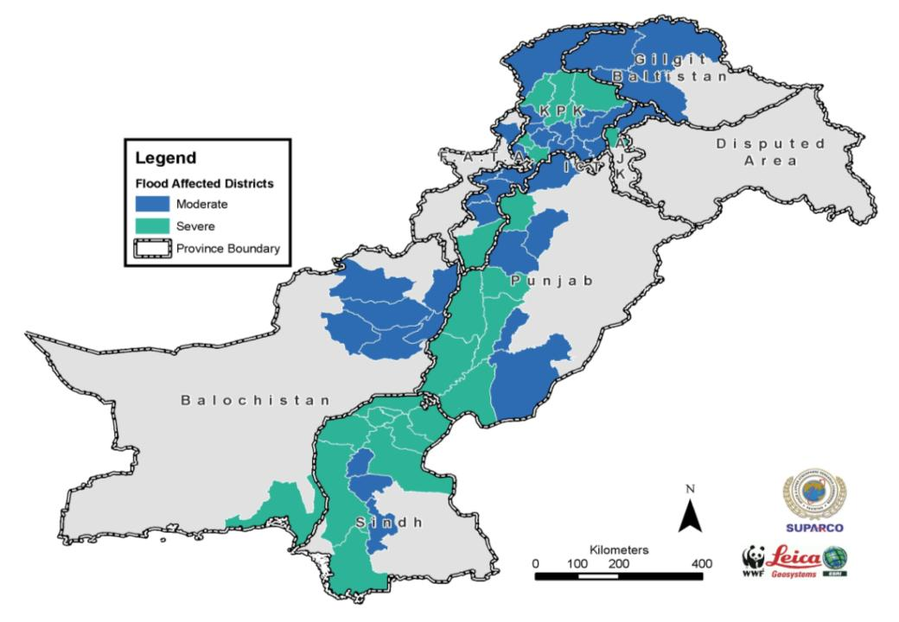
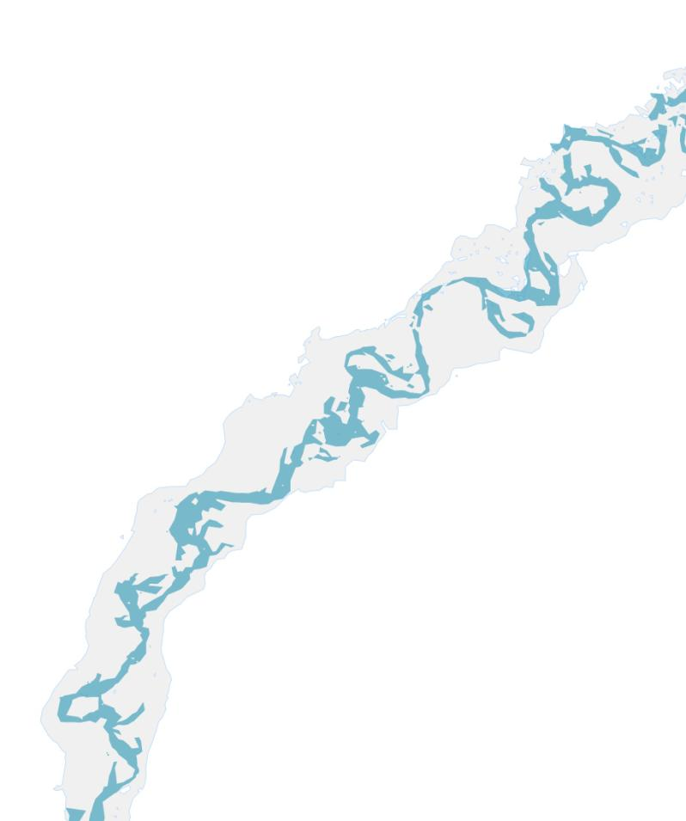
Notes:
Summary of previous natural disastrous

Slide 3
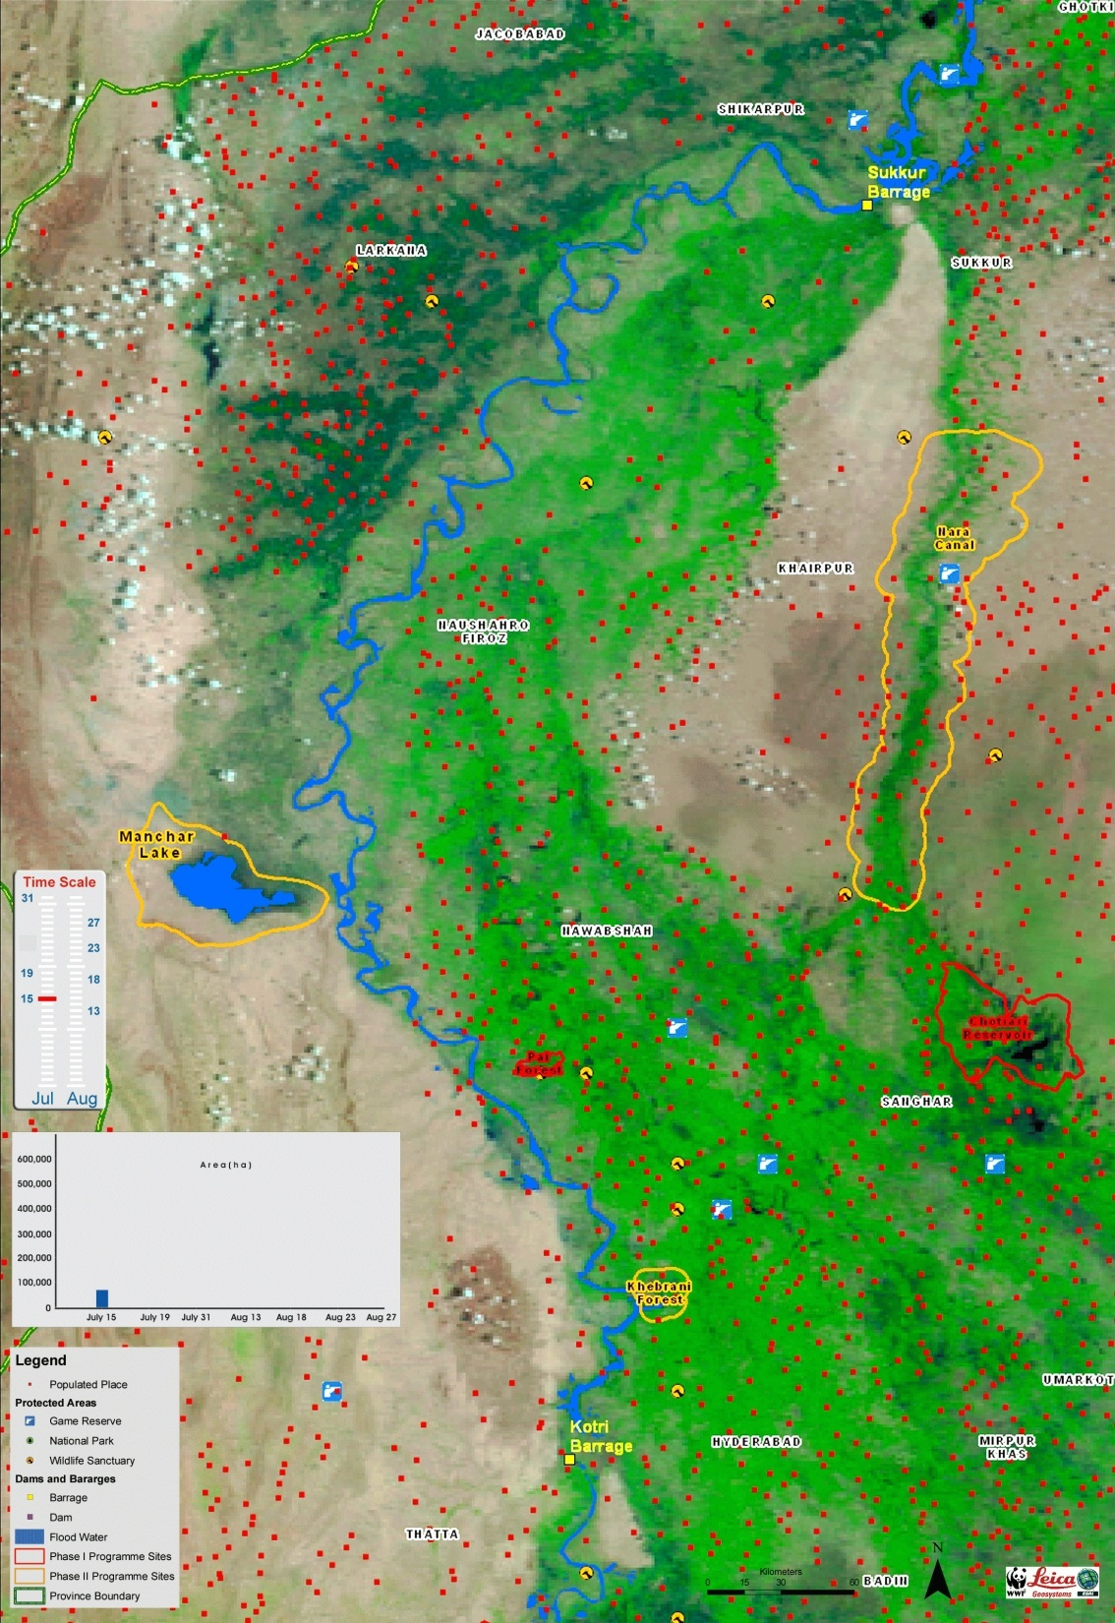
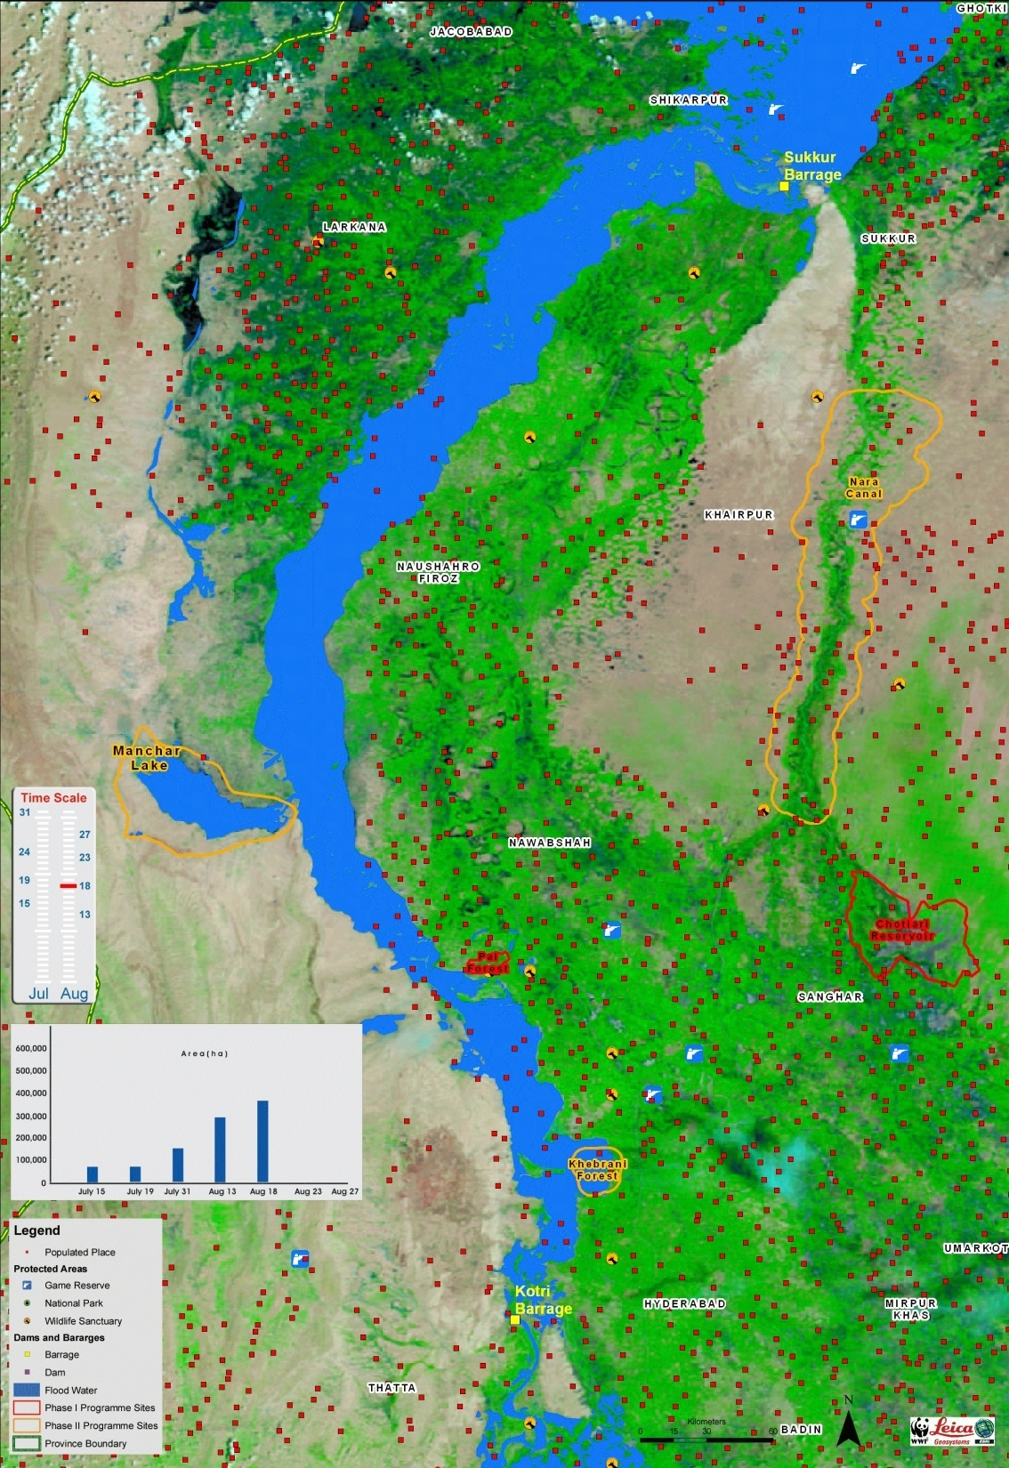
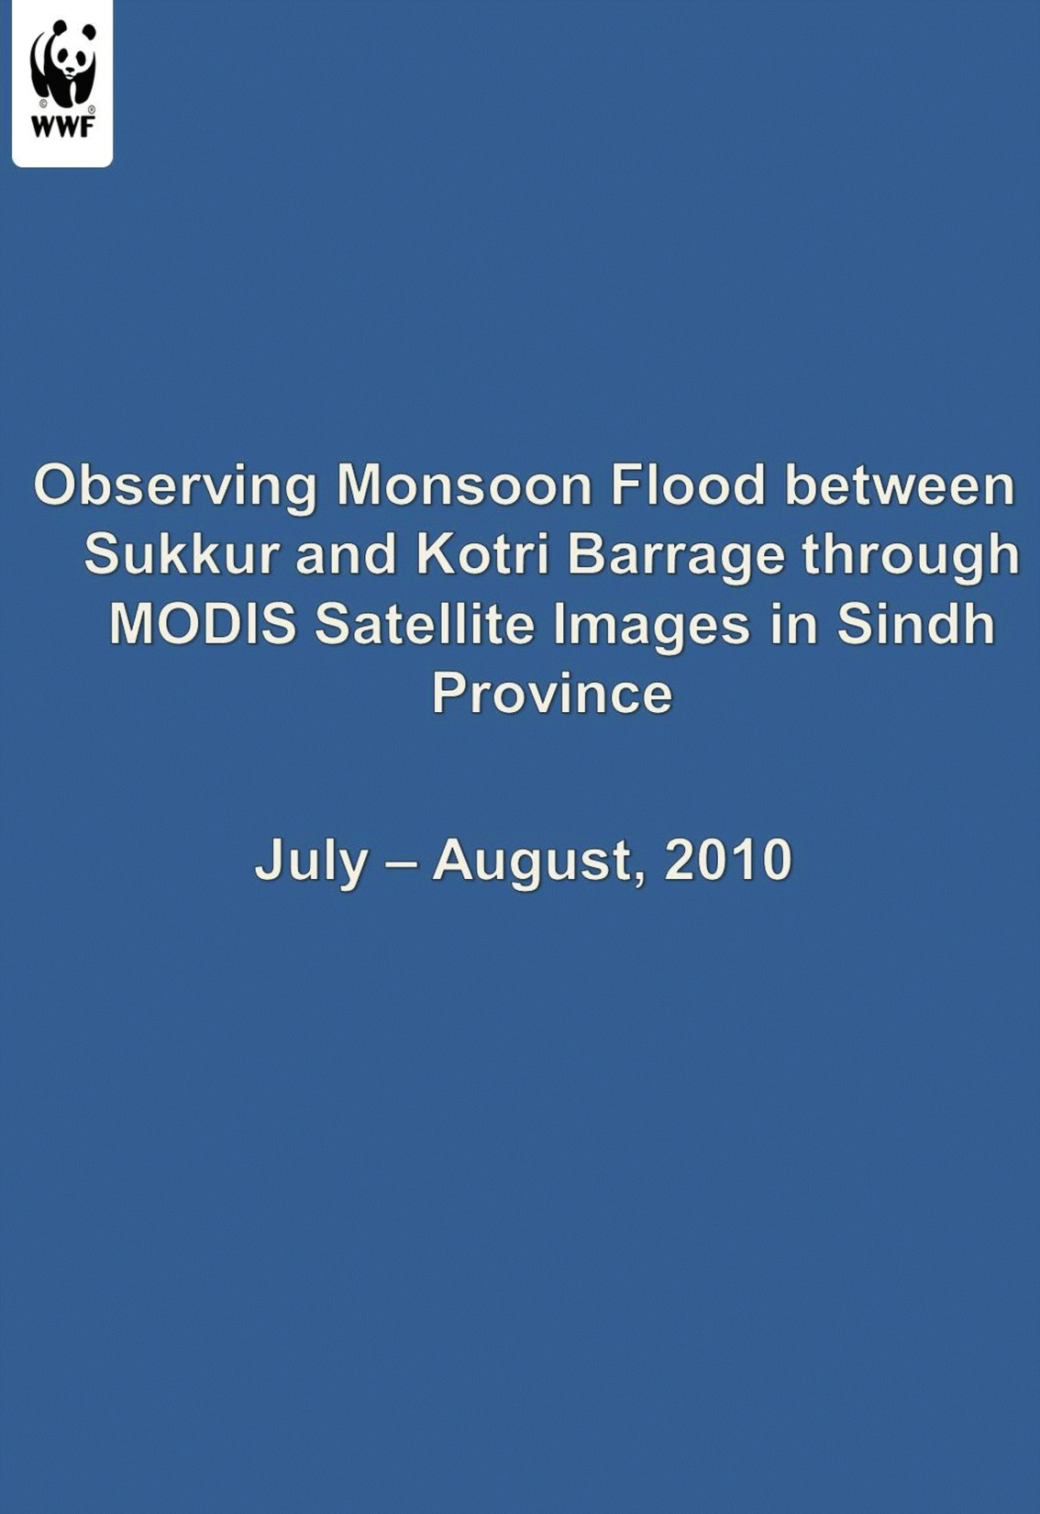
Notes:
Animation of the expand of flood water - 2010

Slide 4
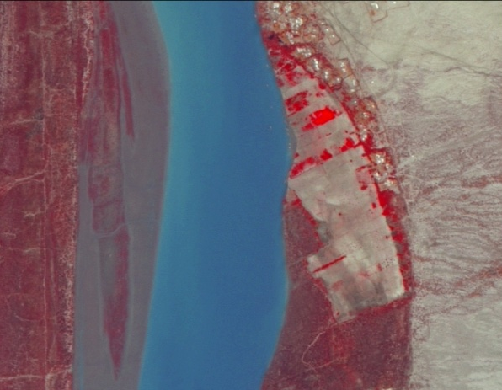
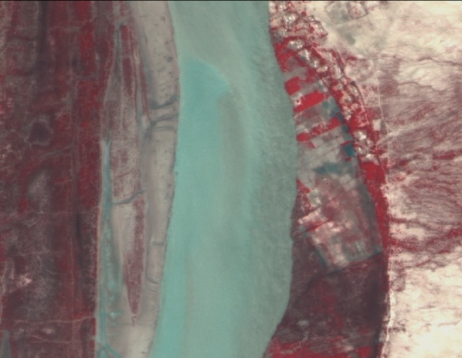
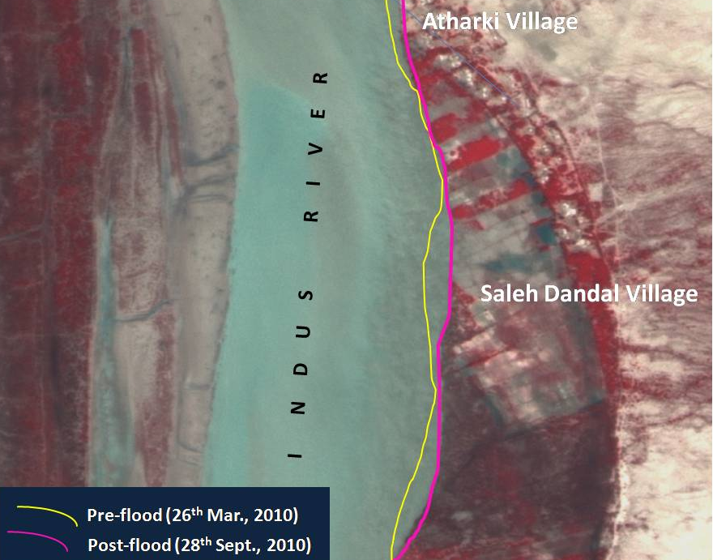
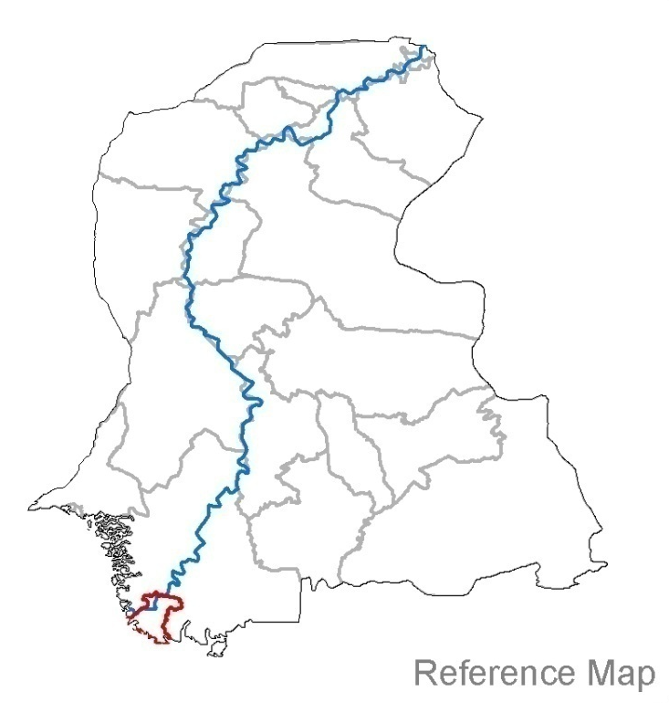
Pre and Post Flood Ecological Assessment, Kharo Chann, Pakistan
(a)
(b)
Notes:
The large print screen shot describes the change in land extent i.e. land erosion due to flood water that washed away the agriculture fields. The upper two images highlight the mechanism of freshwater availability of floods which destroyed invasive (mesquite) vegetation hence leading the natural vegetation of the area to flourish.

Slide 5
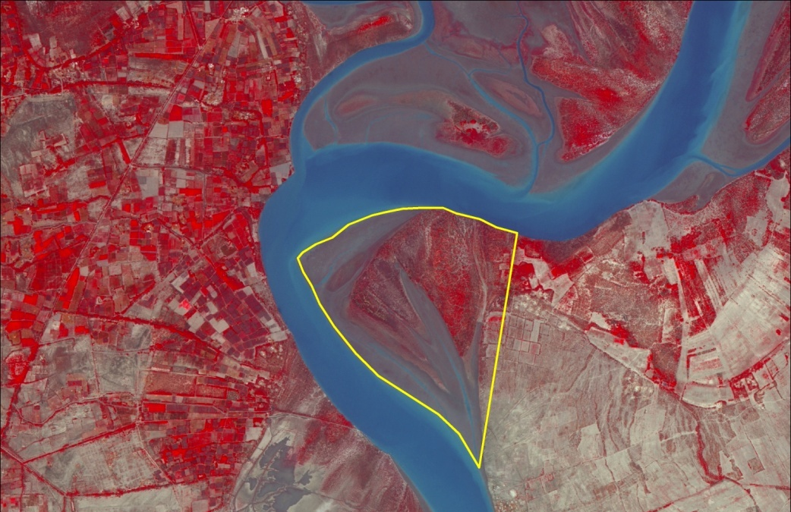
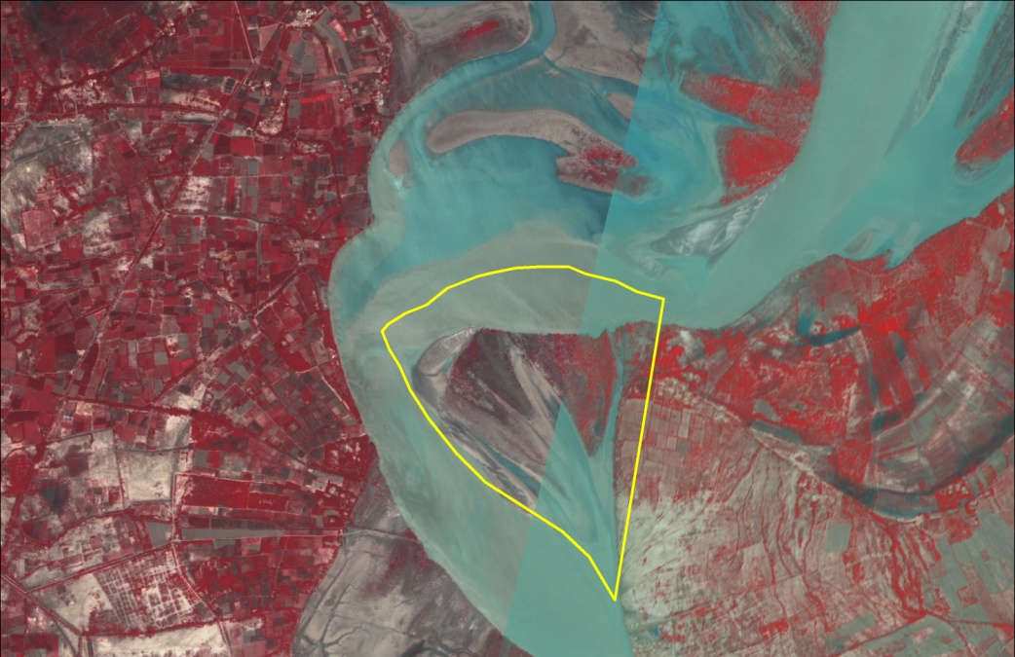
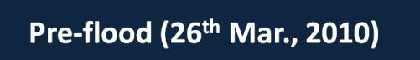

Land erosion and clearing of vegetation

Slide 6
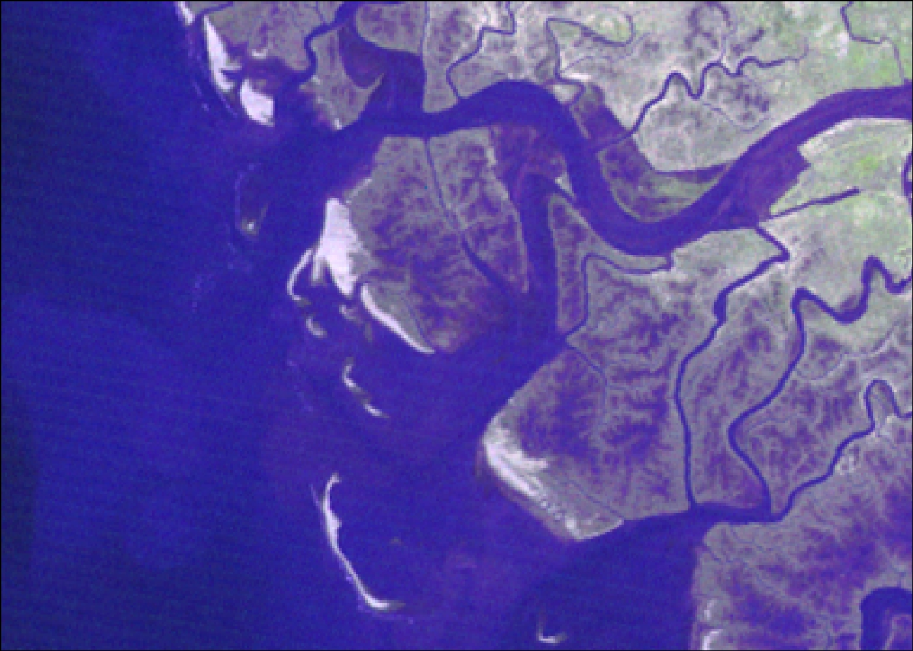
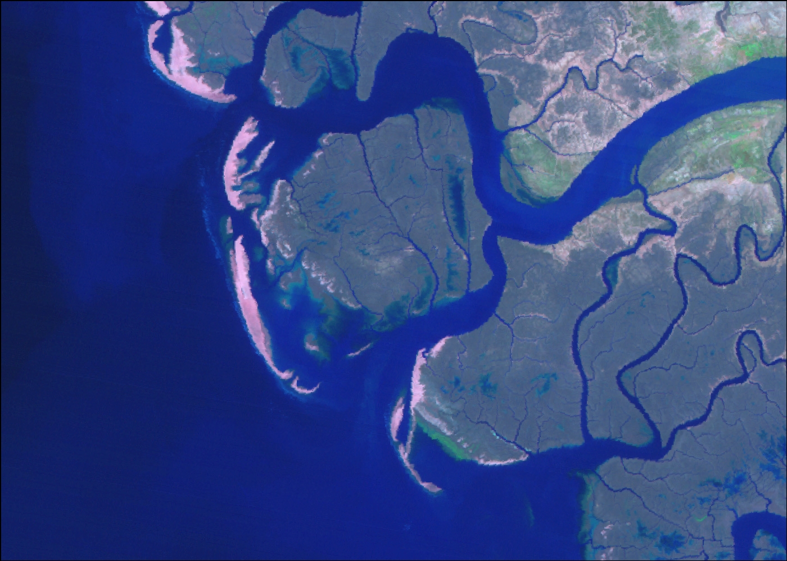
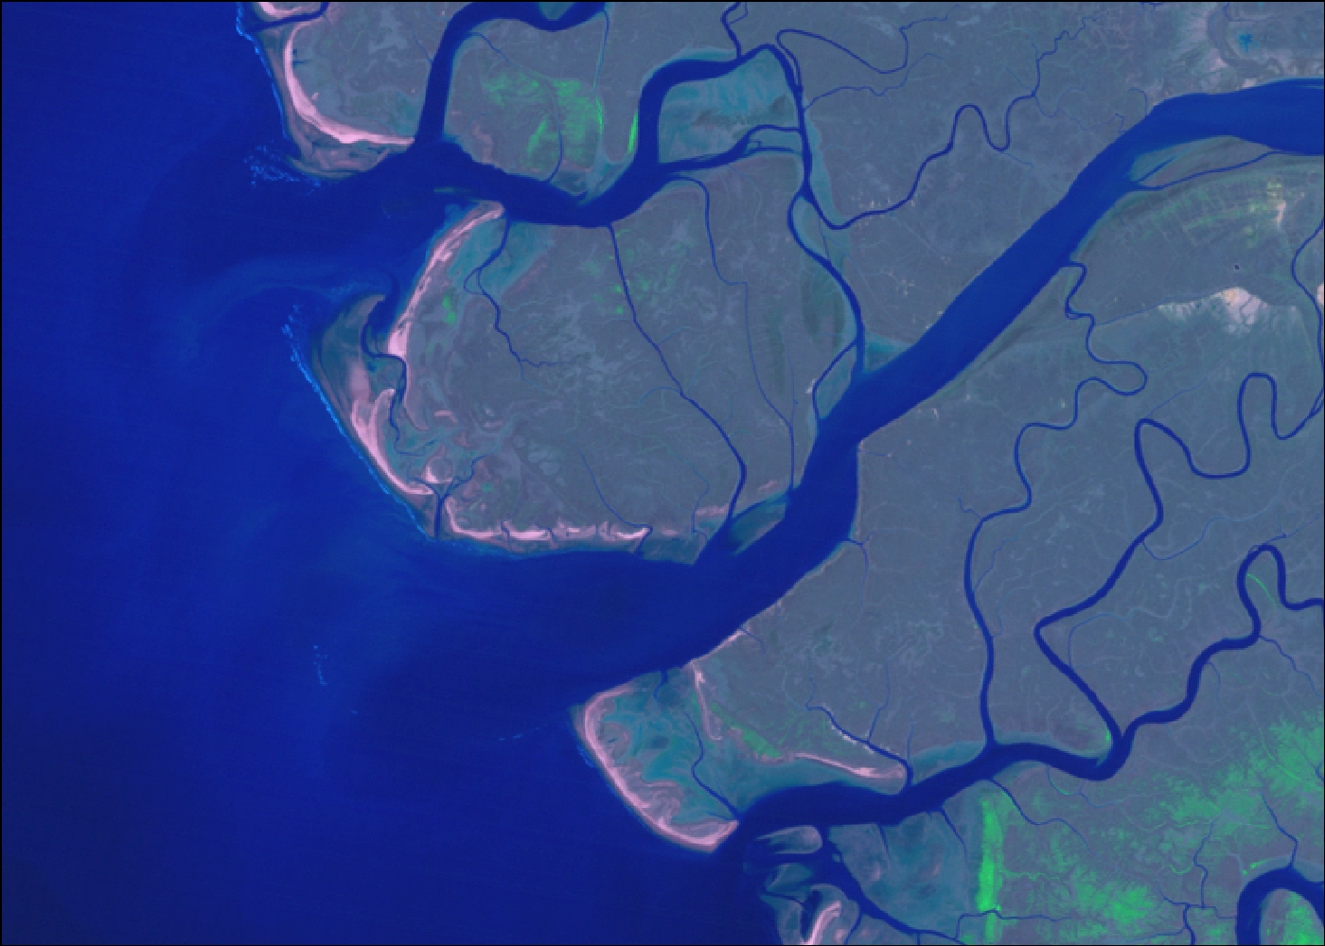
Change in Indus River Course
1989
2011
1972

Slide 7
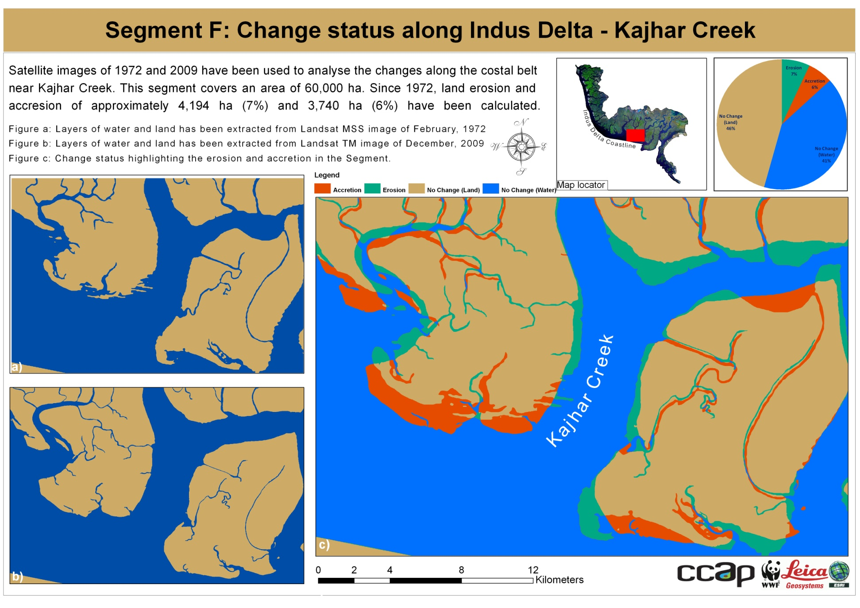
Change Status Along Indus Delta – Kajhar Creek

Slide 8
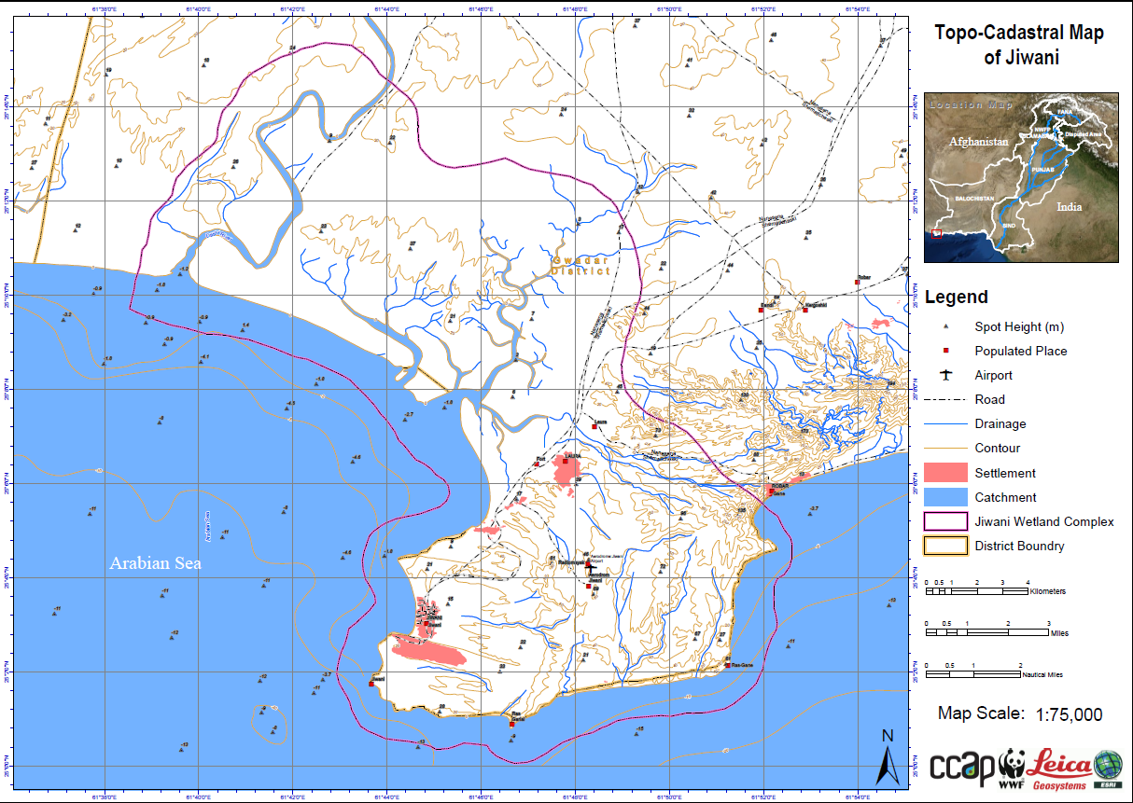
Topo-Cadastral Map of Jiwani

Slide 9
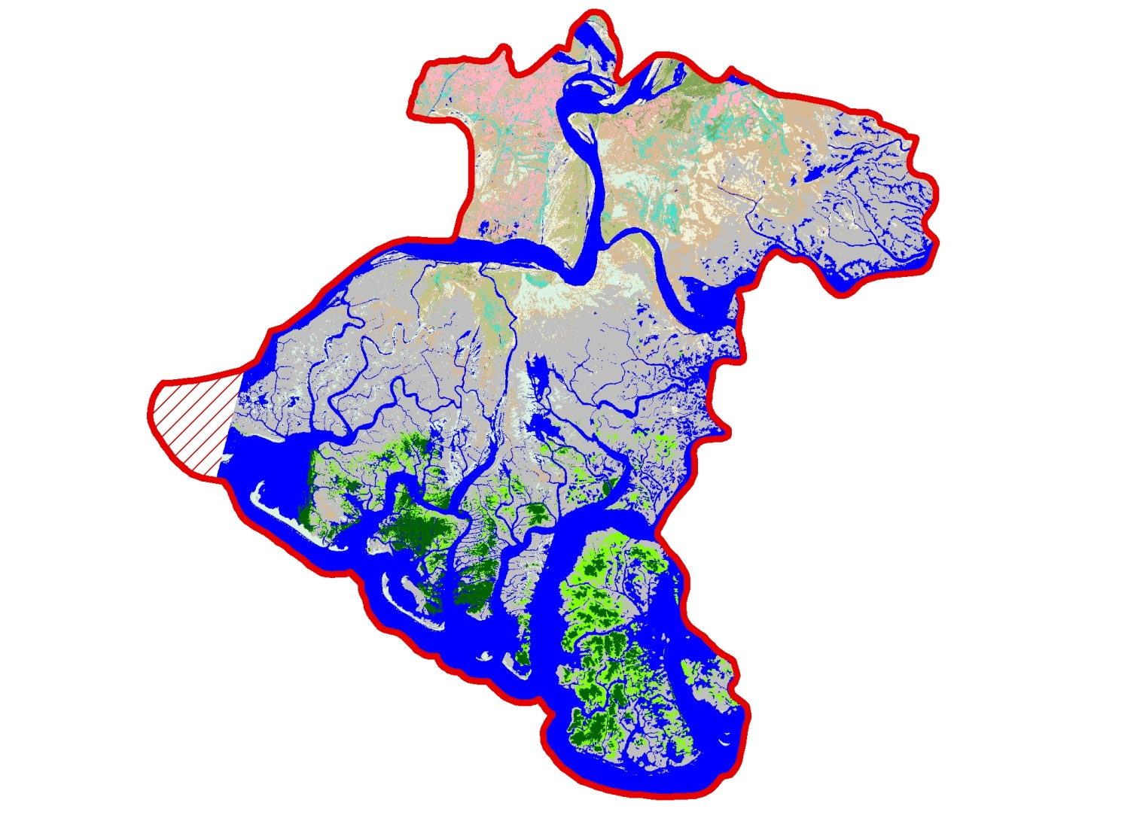
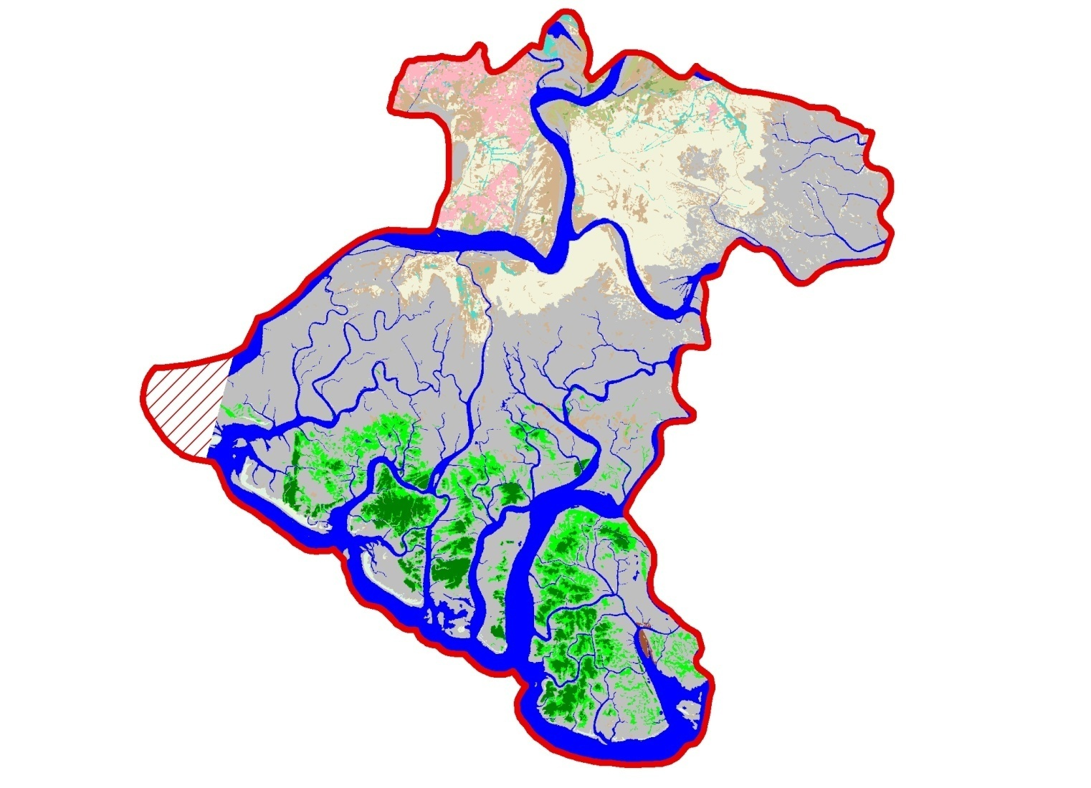
Pre and Post flood Land Cover map of Kharo Chann

