Slide 1
Effective climate finance governance: Lessons learned from Bangladesh
M. Zakir Hossain Khan
Coordinator
Climate Finance Governance Project, TIB
October 17, 2012

Slide 2
Climate Finance: Global Initiatives
UNFCCC established in 1992, came into force on 1994 – key milestone in CF
“the state parties should protect the climate system on the basis of equity and in accordance with their common but differentiated responsibilities” - Article 3, UNFCCC; Clause 1, Copenhagen Accord, UNFCCC
Kyoto protocol (1997, effective from 2005) – Market based source of fund for adaptation through Clean Development Mechanism (CDM)
Special Climate Change Fund and the Least Developed Countries Fund under Marrakesh Accords in 2001

Slide 3
Climate Finance: Global Initiatives
Establishment of the Adaptation Fund under the Kyoto Protocol Bali Action Plan in 2007
Joint commit. of Developed countries US$ 30 billion for near-term finance (2010-2012USD 100 biln/year by 2020 – Sec.8, COP15 Accord;
Under Cancun Agreement, established Green Climate Fund at CoP16 in 2010; will be operated as well as accountable to UNFCCC
Major principles
Adequate and Predictable Public funding (new and additional) from polluter countries equitably - under polluters’ pay principle; and
New or innovative source of fund must ensure principle of “Do no harm” to others – avoiding any discrimination or destruction

Slide 4
Climate Finance: How it works…
OECD Countries: Japan, US, UK, Germany, Norway, France, Netherlands, Spain, Canada, Australia, NZ…
Bilateral
Funding
Adaptation Fund
Special Climate Change Fund
Least Developed Countries Fund
REDD + (UNDP/UNEP) +FCPF
Climate Investment Funds (MDBs)
Green Climate Fund
Clean Development Mechanism
MIE: UNDP,
UNEP, MDB
Climate Justice
Or
Polluter Pays Principle
NIE: GIZ
National
Budgets
MIE: UNDP,
UNEP, MDB
Developing Countries (All)
BRICS
NIE

Slide 5
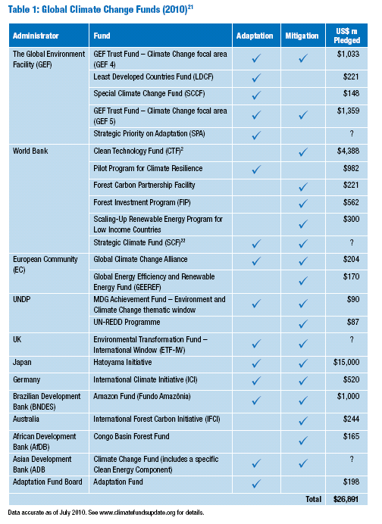

Slide 6
Climate Change Impacts- Bangladesh Context
Bangladesh emits only less than 1/5th of 1 % of world total
Rainfall is predicted to become higher and more unpredictable
During 1984 to 2007, the physical damage from 6 floods worth around US$ 15.178 billion including thousands of deaths
By 2050, rice production could decline by 8% and wheat by 32% (1990)
Coastal people are more vulnerable
Frequency and intensity of disasters are likely to increase
45 cm rise of sea level may inundate 10-15% land by 2050 resulting 35 million climate refugees in coastal districts
Climate change could affect more than 70 million people of Bangladesh

Slide 7
Emerging research findings on CC: relevance for Bangladesh
2-4⁰ Celsius
IRREVERSIBLE
2015
2nd Commitment period ??? 2013-2020
SLR will be more than the forecast
In BD, Increase salinity and loss of lands will be more than the expected level

Slide 8
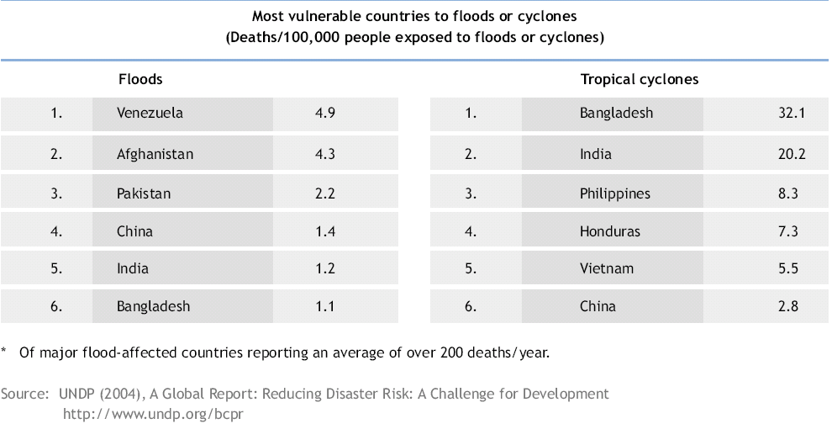
Vulnerbality: Context during BCCSAP Formulation
Climate Vulnerability Index 2011
Bangladesh, the highest vulnerable country in the world over next 30 years
It lies in ‘extreme risk’ category among 170 countries

Slide 9
Climate Finance Governance in Bangladesh: Best Practices
Bangladesh Climate Change Strategy & Action Plan 2009 – Six Thematic Areas
Bangladesh Climate Change Trust Fund (BCCTF) Act, 2010 – Block budgetary allocation of govt. –first to create such fund by climate victim country
BCCTF Gazette for NGO funding, 2009 – special initiative to provide fund to NGOs, CSOs and think tanks
Formation of Bangladesh Climate Change Resilience Fund (BCCRF), 2010 – Multi-donor trust fund (Grant) by developed countries
Pilot Program for Climate Resilience (PPCR) – Multi-Development Banks Fund (Grant +Loan)

Slide 10
BCCSAAP – Bible of National Climate Finance
Bangladesh Climate Change Strategy & Action Plan 2009 is a part of the overall development strategy of the country
Focus of the BCCSAP
To formulate a strategy to for pro-poor,
climate resilient and low carbon development, based on four building blocks of Bali Action plan (adaptation, mitigation, tech transfer and adequate as well as timely flow of new and additional funds) within a framework of food, energy, water, livelihoods and health security
Estimate Cost of programs could be of $5 billion (2009-2018 )

Slide 11
Thematic Pillars and Programs – BCCSAAP 2009
Key pillars or themes
Food security, social protection & health
Comprehensive disaster management
Infrastructure, especially in vulnerable regions
Research & knowledge management
Mitigation & low carbon development
Adaptation capacity building and institutional strengthening
44 programs and 145 Actions/Projects (Mid and Long term)
34 programs focused on adaptation and 10 programs are focused on low carbon development or mitigation

Slide 12
Climate Finance Governance in Bangladesh

Slide 13
Bangladesh Climate Change Trust Fund
Bangladesh climate change trust fund (GOB funded/Act no.57-2010)
Allocated fund of FY2012-13 $340 Million (August’12)
June 2012 approved projects of $163.5 Million (August’12)
66% to be spent for projects in 6 thematic areas defined in BCCSAP
Interest from remaining 34% deposited in the Bank for emergency relief
Fund recipients - Government organizations, NGOs, think- tanks & other non-profit organizations
95 Projects approved to Gov agencies
55 NGO proposal have been selected for funding

Slide 14
Bangladesh Climate Change Resilience Fund ($170 million - allocated)
Contribution of donors
UK $101.0 million
Denmark $1.8 million
EU $20.8 million
Sweden $23.0 million
Switzerland $3.4 million
USAID $13.0 million
AusAID $7.0 million
A total amount of $ 113.5 million contributed
Public sector projects (90% of funding)
CSO/Private Sector (10%, managed by PKSF)

Slide 15
National Climate Finance in Bangladesh

Slide 16
Key questions – Effective CFG
Whether emerging risks are captured in the BCCSAP, key guideline of allocation of funds?
Whether is this climate funded projects are different from traditional development project??
Right utilization of fund – marginalized and regional aspects???
How far the climate victims are really resilient????

Slide 17
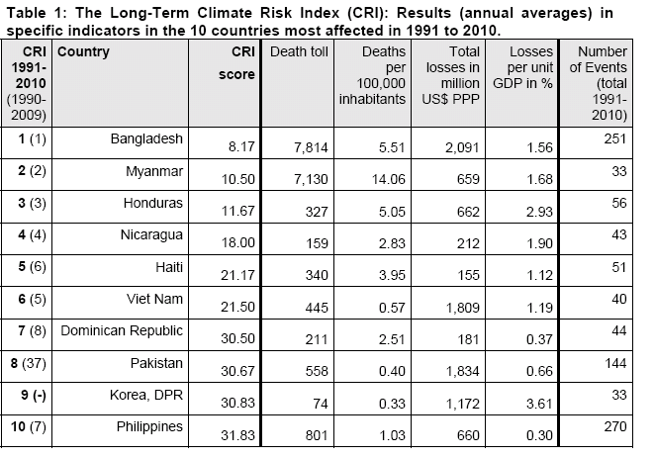
Recent Vulnerability: Unaddressed in BCCSAP
Bangladesh, Myanmar and Honduras have been identified to be the most affected in 20-year period - Global Climate Risk Index 2012, Germanwatch

Slide 18
Challenges to effective CFG in Bangladesh:
Vulnerability and Prioritization of funding of BCCTF
almost 1/3 of funds allocated by BCCTF for low carbon development

Slide 19
Challenges to effective CFG
Deficit of disclosure (BCCTF & BCCRF)
ToR/modalities between BCCTF and PKSF and World Bank and PKSF
Project selection - approval or rejection process
Project progress/evaluation report
EIA Report, where applicable
Role of World Bank in project selection/rejection
Minutes of Trustee Board/Governing Council meetings
MRV related reports; and
Financial statement/audit report
Notes:
Extracted from MoEF website on 26 March 2012

Slide 20
Challenges to Effective CFG: Transparency & disclosure
Availability of Information | BCCRF (Not subjected to RTI Act) | BCCTF (Subjected to RTI Act)
Documents available | A general overview of the Fund, Concept note on NGO funding, project summaries (2 projects, nothing on the largest ongoing project) | Approved project list; Decision to review the project proposals submitted earlier by NGOs; Project proposal format, BCCTF Act, Gazette on NGO funding, BCCSAP, NAPA docs
Unavailability of specific information. | Reason for delay Non-disclosure of ToR & project documents Additional 4-5% to be charged by World Bank No manual/guidelines for procedural integrity. | Management or operating cost of BCCTF and CCU Information on activities and operations of CCU No separate webportal
Notes:
Extracted from MoEF website on 26 March 2012

Slide 21
Challenges to effective CFG
Partisan political influence & Conflict of interest in project selection
Strong inter-ministirial Coordination is yet to be established
Absence of specific safeguards to prevent political influence in project approval process as well as misuse of funds – visa-a-vis funding of NGOs
Not having coordination between BCCTF & BCCRF
Delay in setting up the BCCRF Secretariat
Low skills and capacity of officials in the new territory of climate funding
No practical oversight initiative by Parliamentary Standing Committee

Slide 22
Challenges to effective CFG
No policy/ToR exist on the following:
Participation of affected community, CSO and local people in project design & implementation
Grievance management system at all stages of fund management & project implementation
Overlap and/or duplication when same organization is funded by more than one funds
Selection process, monitoring and verification of project activities

Slide 23
Challenges to Effective CFG
Inadequacy on-
Needs assessment – funds and actions (both sectors and geographical location)
Participatory project development
Absence of consultation/communication among agencies
Absence of legal obligation of consultation with affected communities in BCCSAAP

Slide 24
Weak enforcement and governance of Govt. Departments: Progress in works of BCCTF funded projects of Water Development Board
Source: http://www.bwdb.gov.bd/images/stories/docs/december2011.pdf

Slide 25
Sector Specific Challenges to CFG
Theme-1: Food Security, Social Protection and Health
Faster than predicted displacement of coastal people
Selection bias for safety net programs–both targeted people and areas
Low health expenses for vulnerable people
Theme-2: Comprehensive Disaster Management
Low allocation to promote indigenous knowledge on adaptation
Less attention in funding to address the salinity and crises of drinking water
Theme-4: Research and Knowledge Management
Inadequate funding to build national climate change study center
Lack of funding for alternative energy uses, fuel efficient technologies
Theme-6: Capacity Building & Institutional Strengthening
No fund allocated yet to build quality scientists
Absence of plan main-streaming climate change in the media

Slide 26
55.27% of BCCTF allocated to Costal Areas

Slide 27
Empirical Findings: Challenges to CFG
Project Name | Construction of Cyclone Resistant Houses at Char Area in Aila Affected District of Khulna | Land Reclamation by Constructing Char Mynka-Char Islam-Char Montaz Cross-Dam | Plantation of BWDB,s Embankment in the Coastal Belt and its adjacent Char Areas
Implementing Organization | Department of Relief & Rehabilitation | Bangladesh Water Development Board | Forest Department
Total Cost (In Tk.) | $2.98 million | $ 2.9 million | $1.43 million
Implementing Time | Apr’10 to Mar’12 | Jan’11 to Jun’12 | Jan’10 to Jun’11
Thematic area | Comprehensive Disaster Management | Infrastructure | Mitigation and Low Carbon Development

Slide 28
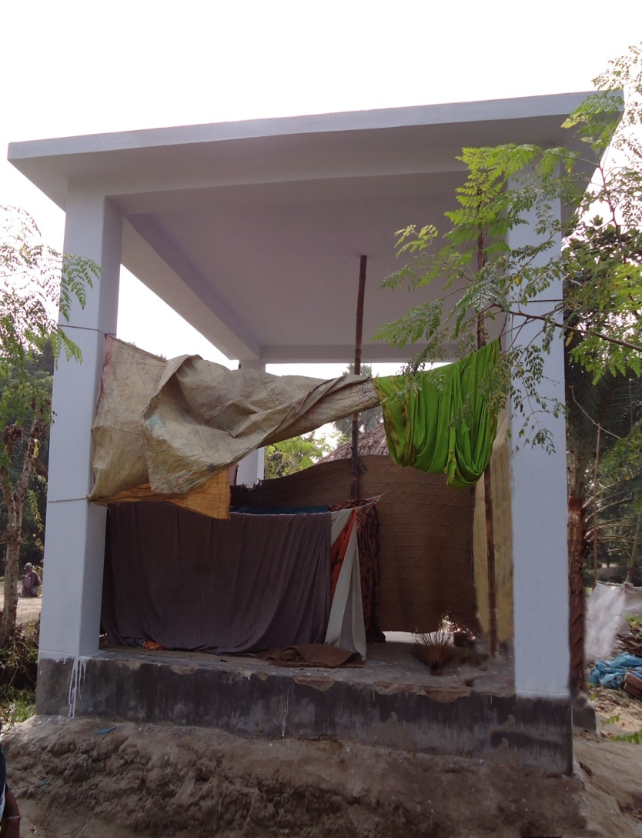
Findings: Construction of Cyclone Resistant Houses at char Area in Aila Affected District of Khulna
Political Commitment – Miss-match in Preach and Practices
Faulty design – High opportunity cost for marginalized people
Faulty procurement process- political consideration and non-transparency in rewarding contract
Lack of proper M&E caused to low quality of construction works
No better than cow-shed – affected households
Features: Size of shelter is 15'-12,
Basement and floor, 4 RCC pillar and concrete roof.

Slide 29
Constructing Site of Cross Dam in the Char Mynka-Char Islam-Char Montaz
Fisheries community will lose their livelihood due to dam in the channel
Two very active channels and other ten small channels may be closed

Slide 30
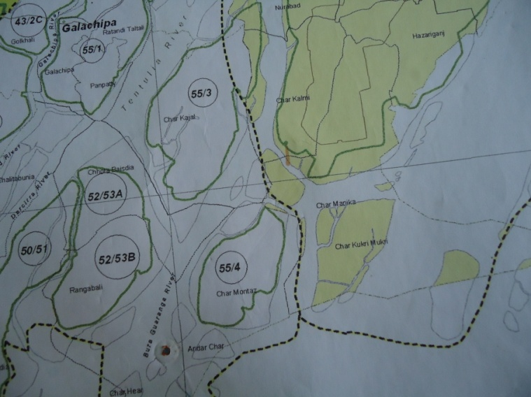
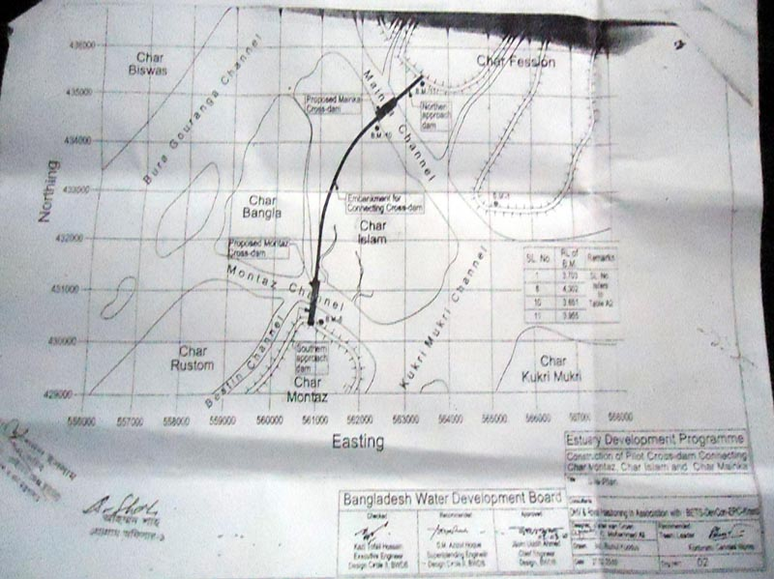
“Land Reclamation by Constructing Char Mynka-Char Islam-Char Montaz Cross Dam” by Bd Water Development Board
Approval of project under political consideration
No EIA, geographical and social impact
Fraudlent project design led to cutting around 39,000 tress – no consultation took place before approval of project
Project site with reserve forest
Forest site was absent in the approved project map

Slide 31
Findings: Plantation in the BWDB’s Embankment in the coastal belt and its adjacent Char Areas
Pre-assessment was not conducted- though fund available but some plantation are remain unplanted in proposed part of embankment because
Some lands of WDB are in leased by fish businessmen
Some lands are illegally occupied
Some proposed forestation area lie outside the Forest Department area – under district administration
Insufficient budget and resources for visiting field, especially in remote area

Slide 32
Thank
You

