Slide 1
Building Capacity on Climate Change Adaptation in Coastal Areas of Pakistan 2012

Slide 2
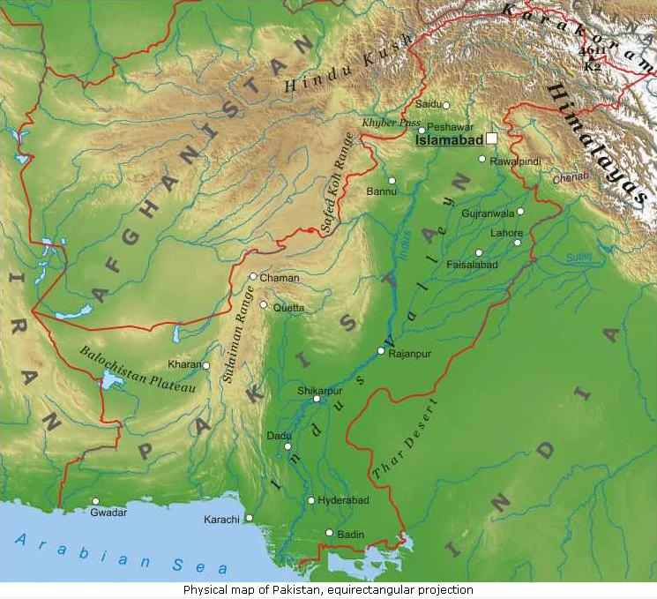
The country has a long latitudinal extent stretching from the Arabian Sea in the south to the Himalayan mountains in north
It is located in sub-tropics and partially in temperate region
Most Parts of Pakistan are Arid to Semi Arid with significant spatial and temporal variability in climatic parameters
59% Annual Rainfall is due to summer monsoons;
Greater Himalayan region above 35º N receives winter precipitation mostly in the form of snow and ice.

Slide 3
Climate Change What it means to Pakistan?
Notes:
3

Slide 4
Pakistan’s Shifting global view
The Most Dangerous Nation - 2007
The World’s Bravest Nation - 2010

Slide 5
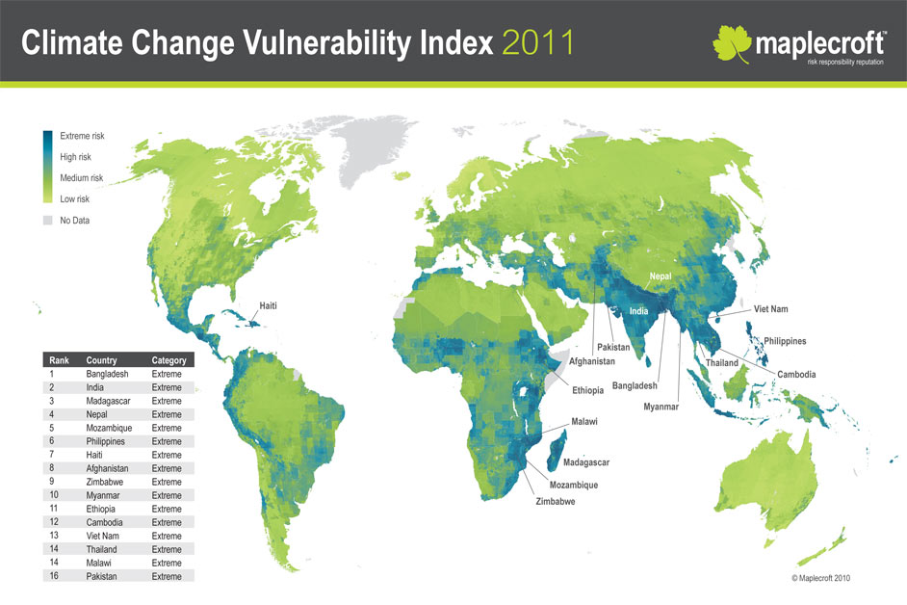
Pakistan – where we are ?

Slide 6
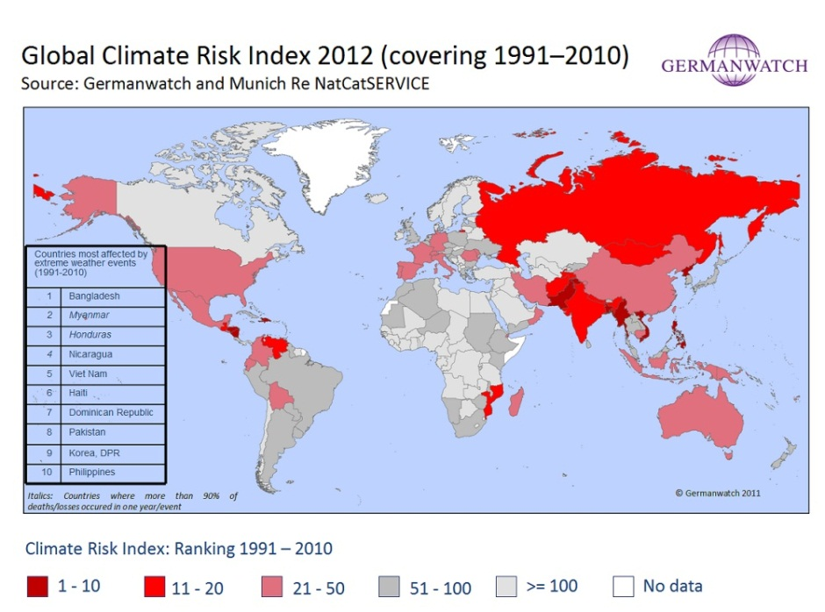
Pakistan – where we are ?

Slide 7
Global Climate Risk Index for 2010
Abs
o
lute
Losses
Deaths per
lo
s
ses (in
per unit
Human
CRI
Death
100,000
million
G
DP
in
Dev
e
lopment
Country
score
toll
inhab
1
i
tants
US$
PPP)
%
I
n
dex
1 (68)
Pakistan
3
.
50
1
,
891
1.
10
25,316
5.
42
1
4
5
2 (53)
Guatemala
6.
33
229
1.
59
1,969
2.
80
1
31
3 (100)
Colombia
8.
00
320
0.
70
7,
54
4
1.
73
87
4 (75)
Russia
11.
00
56,
165
39.
30
5,537
0.
25
6
6
5 (65)
Honduras
14.
67
139
1.
73
2
20
0.
65
1
21
6 (88)
Oman
17.
00
24
0.
81
1,314
1.
73
89
7 (14)
Poland
17.
83
151
0.
40
4,745
0.
66
39
8 (93)
Portugal
19.
67
47
0.
44
1,749
0.
71
41
9 (23)
China
23.
50
2
,
889
0.
22
33,395
0.
33
101
10 (38)
Tajikistan
24.
17
27
0.
35
262
1.
77
1
27
1
UNDP, 2011: Human Development
Report,
http:
//hdr.undp.org/en/statistics/hdi/

Slide 8
Natural Disasters
Maximum natural disasters (90% in the Table) are climate related.
The damage costs of these natural disasters is going up with the top three disasters occurring in the past three years
The frequency of these natural disasters is going up with 60% occurring in the past 10 years.
 | Disaster | Date | Damage (000 US$)
1 | Flood | 2010 | 9500000
2 | Earthquake | 2005 | 5200000
3 | Storm | 2007 | 1620000
4 | Flood | 1992 | 1000000
5 | Flood | 1973 | 661500
6 | Flood | 1976 | 505000
7 | Flood | 2007 | 327118
8 | Drought | 1999 | 247000
9 | Flood | 2001 | 246000
10 | Flood | 2008 | 103000

Slide 9
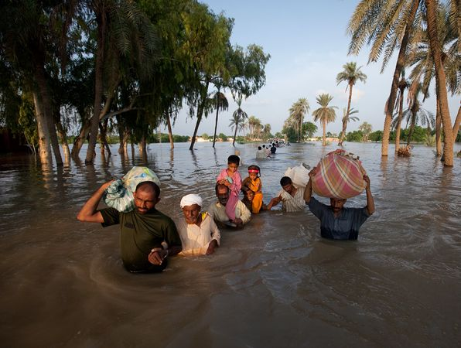
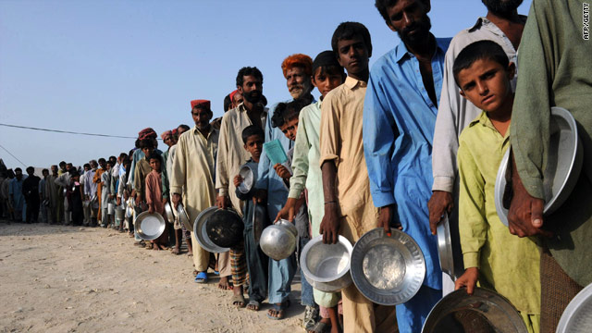
Which led to…..
Massive displacements and climate refugees……

Slide 10
The price tag !
Method | Time period | Cost of adaptation per annum
Actual (2010) | One year (2010) | 9.7++
As a percent of GDP | 2010-2050 | 10.71
Per Capita Basis | 2010-2050 | 7.12 to 14.0
Disaster Modeling (Floods only * 3) | 2010-2050 | 6.09 to 11.3
Adaptation to climate change is going to be a high value figure in the future
(U$ 6-14 bn per year range)

Slide 11
Strategy for Adaptation
Regional cooperation on CC –not luxury but an imperative.
Regional R&D cooperation as well as transfer of data and learning on issues such as :
Glacial melting
Coastal cyclonic activity
Floods early warning systems
Objective - manage the risks + share the benefits

Slide 12
Local Adaptation Plan of Action (LAPA)
Piloted in Nepal through NAPA
Vision
Enable communities to understand the changing uncertain future climatic conditions and engage effectively in the process of developing adaptation priorities
Implement climate resilient plans, that are flexible enough to respond to changing climate and vulnerability conditions

Slide 13
Local Adaptation Plan of Action (LAPA)
Decentralized and bottom up planning
Multi actor involvement
Local vulnerability and adaptation focussed
Local level ownership
Low risk and high impact
Mainstream development

Slide 14
LAPA In Pakistan
Customized by LEAD Pakistan for a 5 year Project being Implemented in Southern Punjab and Sindh
Innovations
Participatory socio-scientific approach with elaborated tools (19 tools in total)
Enhanced Stakeholder Participation
Integrated Performance assessment and monitoring
Effective Public Policy Engagement

Slide 15
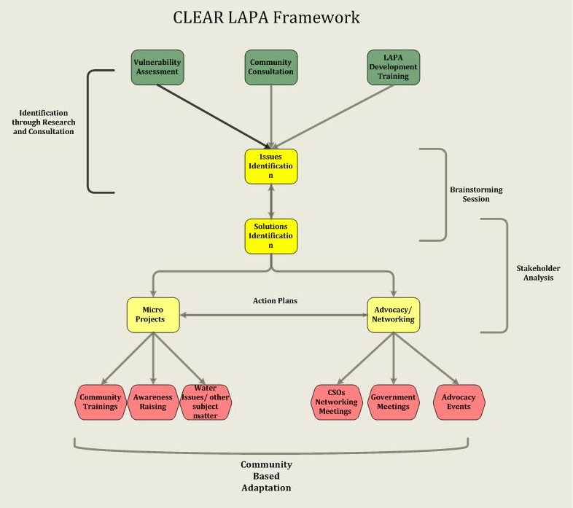

Slide 16
Way Forward
By 2015, 10 District level LAPAs will be developed in partnership with 45 Capacity built Partners Organizations working under CLEAR Project
By 2015, 2 LAPAs will be developed in Coastal Areas of Pakistan in collaboration with WWF-P under CCAP
Mainstreaming LAPA in Disaster Preparedness

