Slide 1
Surviving Climate Change through Migration: Untold story of climate refugees of Bangladesh
RIZWANA SUBHANI
Ph.D. Student, CCSD
School of Environment Resource and Development
Asian Institute of Technology (AIT)
Thailand

Slide 2
RESEARCH PROBLEM
Climate Change in Global perspective:
Climate change is creating environmental, social and economic threat around the world.
A large number of countries, particularly developing countries are facing serious challenges to deal with these problems
In 1995 the total environmentally displaced around the world was about 25 million
In 2010 the number was 50 million people (UNFCCC 2007) and
it is estimated that by 2050, in between 200 million to 1 billion will be forced to move primarily because of climate change

Slide 3
CC in Bangladesh and its Coastal areas:
Bangladesh is generally recognized as one of the most climate vulnerable country. It is likely to be among the countries that are the worst affected by climate change due to the geographic location of Bangladesh
the Coastal areas in Bangladesh are on the ‘front line’ of climate change, directly affected by natural disaster .
The major disasters are the occurrences of flood, cyclone and storm surge, flash flood, drought, tornado, riverbank erosion, and sea level rise

Slide 4
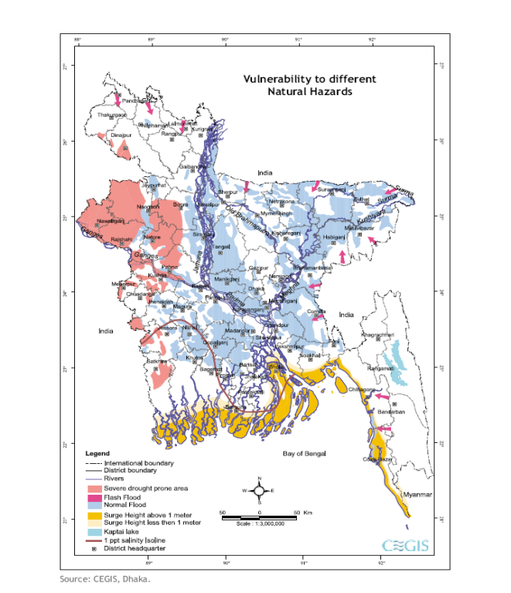

Slide 5
Continuation
These extreme natural events are adversely affecting the whole environment, including human and their shelters, resources for their livelihoods.
According to the fourth assessment report of the IPCC (2007) the sea level will rise about 9 cm by 2010 and 33 cm by 2050.
It is also projected that if the sea level is increased by one meter, around 22889 sq. km. of coastal land (65% land of southwest coastal region) of Bangladesh will go under water (Ali, 1996).
If it happens in near future, up to 30 million Bangladeshis will become climate refugees.

Slide 6
Continuation
two severe cyclones SIDR (2007) and AILA (2009) occurred in southwest coast of Bangladesh which is similar events usually referred to in the CC literature.– as consequences of GHG emission. impact of SIDR was rapid, AILA had slow but long term consequences.
AILA hit coastal districts during the springtide and so although the intensity of the cyclone was much lower; it inundated thousands of acres of land.
About half a million people were forced to leave their homes post AILA.
Literature shows, Forced migration in the case of climatic hazards began in 1988 and the highest level of migrations occurred in 2007 and 2009 immediately just after Cyclones SIDR and AILA in Khulna region (Ahsan 2011).
This study is an attempt to understand the coping and adapting behavior of families who are forced to migration due to extreme climate events – in particular it wants to know the pains and gains of migration as an effective adaptation strategy.

Slide 7
AILA Affected Areas

Slide 8
What are the pains and gains due to migration?
  Issues related to family relations
    Divorce
    Run-off and remarriage
    Multiple marriages (in two places)
  Issues related to grooming of children
    Educational attainments
    Behavioral changes
    Involvement with drugs/illegal business
    Marriage
  Issues related to family values
    Supporting the elders
    Religious values
    Social values/social norms
    Respecting family members

Slide 9
Gains and pains…
Managing the problems of migrant households
  Education of the children
  Income support
  Getting into the income earning
    By children
    By women
    By elderly
  New sets of problems in the jobs

Slide 10
Pattern of migration also varies
Patterns
  One member migration to a new location
  Unitary family migrating to a new location
  Joint family migrating to a new location
Type of location
  Nearby urban location
    With prior information
    With prior contacts
    Without prior information and contacts
  Distance city/rural location
    With prior information
    With prior contacts
    Without prior information and contacts

Slide 11
Objectives and Research Questions
Specific objectives are:
To analyze the impact of climate extreme events on migrating household in coastal areas of Bangladesh in terms of
  Changes in the livelihood
  Changes in the social strata
  Changes in the family life
  Changes in the education of the children
  Changes in the overall level of achievement of the household in the society
The research questions to be answered:
Does migration provide a viable social option for climate change ?
Does migration provide a viable economic option for climate change?
  If it does, for whom it works well
  if does not how to adjust the migrating program to make it effective.
.

Slide 12
Continuation
2. To explain how migration strategy could be made effective to deal with climate change.
The research questions to be answered:
How migration can be modified to make an effective adaptation option of climate change?
Hypothesis:
The cost of adaptation is much higher for cc migrant than Normal migrant
The social or psychological cost is always under representative in many studies.

Slide 13
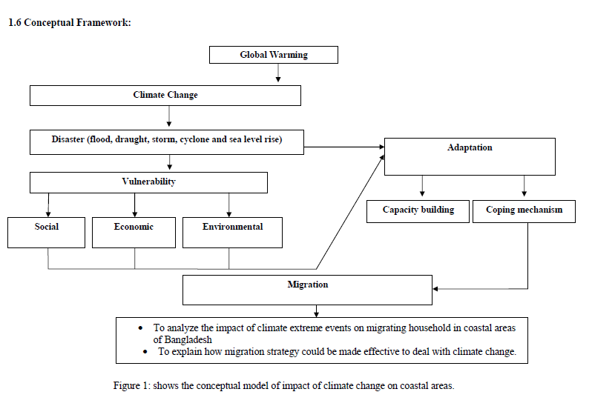

Slide 14
Literature Review
Climate Change :
Climate change: Refers to any long-term change in the statistical distribution of weather patterns, whether in terms of changes in average conditions (more/less rainfall, higher/lower temperatures), or in the distribution of events around the average (extreme weather events such as floods or droughts).
UNFCCC (IPCC reports 2001, 2007) has adopted two approaches for addressing the climate change issues.
Mitigation (reduce emissions) reducing the greenhouse gases (GHG) and or enhancing the sinks (such as ocean or forest) which absorb the greenhouse gases from the atmosphere known as mitigation
Adaptation (accepting the change and reacting to it) Adaptation is the process of coping with the potential impacts of climate change (anticipatory vs reactive)

Slide 15
Linking CC and Migration:
Theoretically, “Migration” understands the movement of people from one place to another. Migration can be divided into two main factors, "push" and "pull" factors. People to move for peace and safety, a chance of a better job, better education, social security. On the other hand people also forced to migrate because of various kinds of socio-economic, environmental reasons such as over population, inadequate income, unavailability of cropland, lack of employment opportunities and poverty
People also move due to environmental degradations. IPCC (2001) and other literature (Mcleman and Smit 2006; Meze-Hausken 2000) shows that Environmental degradation and climate change a factor of migration or displacement. UNFCCC (2007) report changing pattern of climate can turn into forced migration or displacement; when the deterioration becomes so extreme that forced people to leave an area.
Studies show Mcleman and Smit (2006), Brown (2008), ADB (2009) population migration as a possible adaptive response to risks associated with climate change. Increased migration in itself may contribute to further degradation and vulnerability. (IPCC 2001). Migration could be forced, permanent or temporary. In general the poorest of the poor migrate because of their limited resources and inability to deal with the situation.

Slide 16
Research Method
Study Area:
the study area of this research would be Khulna, located in southwest of Bangladesh. It is the third largest city of 4394.46 km with 2.5 million of people.
Khulna Zilla is the most disaster prone zilla due to its geographical location; it is 2.5 meters above the main sea level. The study focuses on Koyra and Dacope upazila of Khulna district and Shymnagar of Satkhira district.
The Cyclone AILA hits Koyra, Dacope and shymnagar upazila under the Satkhira and Khulna Districts of southwest coastal belt of Bangladesh. It killed about 325 people with enormous infrastructure damages. About 2.3 million people were affected by AILA and about 1,120 people went missing. About half a million people were forced to leave their homes.

Slide 17
Study method
Possible choices
  Sample survey of households
    Does not always help for exploration in social relations and socio-anthropological studies
  FGDs
    Useful to generate information but cannot provide information on intricate social and family level information
    Case studies
      Very useful for the purpose of this study
      Need to be stratified based on the pattern of migration and on the type of location.
      Plan to do 2 cases for each group means a total of 18 cases.

Slide 18
Thank you

