Slide 1
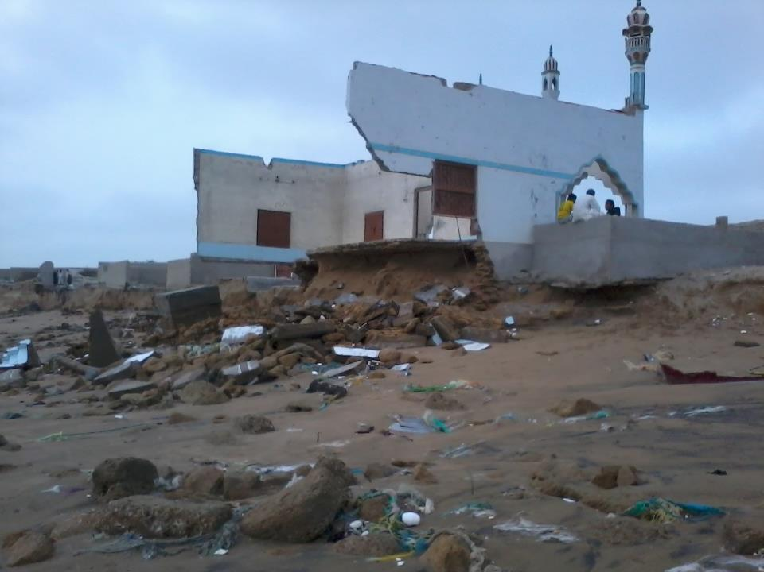


Climate Change Adaptation at Jiwani Tehsil, Balochistan
Building Capacity on Climate Change Adaptation in the coastal areas of Pakistan(CCAP)
Date: 14 December, 2012
Abdul Rahim
WWF Pakistan, Gwadar office.
Jiwani beach eroded by Sea erosion

Slide 2
Presentation Outline:
Finding of CVA results of CCAP project
Climate Change issues in coastal areas
Formation of Climate Change adaptation committee at Jiwani
Climate Change impacts at Balochistan coast specifically Jiwani Tehsil
Case Studies of best adaptation practices of climate change by WWF Pakistan at Makran Coast, Balochista

Slide 3
Community at Jiwani Tehisl, Gwadar.
Shortening of Fishing Season
  “Before it used to be 6-8 months fishing season and now its only 5-6 months long”
Shortage of Freshwater
  “ At Jiwani well over 90% of those sampled pay below PKR 50 for water. However, recently fresh water supplies have been halted due to non availability of freshwater in Ankara Kaur Dam”
Agriculture
  “ Due to low rainfall through out the only few households are engaged in agriculture”

Slide 4
Community at Jiwani Tehsil, Gwader.
Low rainfall
  “ In terms of climate conditions Jiwani is known not to have a regular pattern of rainfall, from well beyond ten years ago”
Migration pattern
  “ Migration patterns are revealed to be highest at village Shaabad bazar (all houses reporting temporary migration due to flooding at Dasht) Migration of any type is reported by 10% of all 576 household sampled in Jiwani in the present study”
  Health issue
  “Malaria and Diarrhoea is prevalent in most villages”

Slide 5
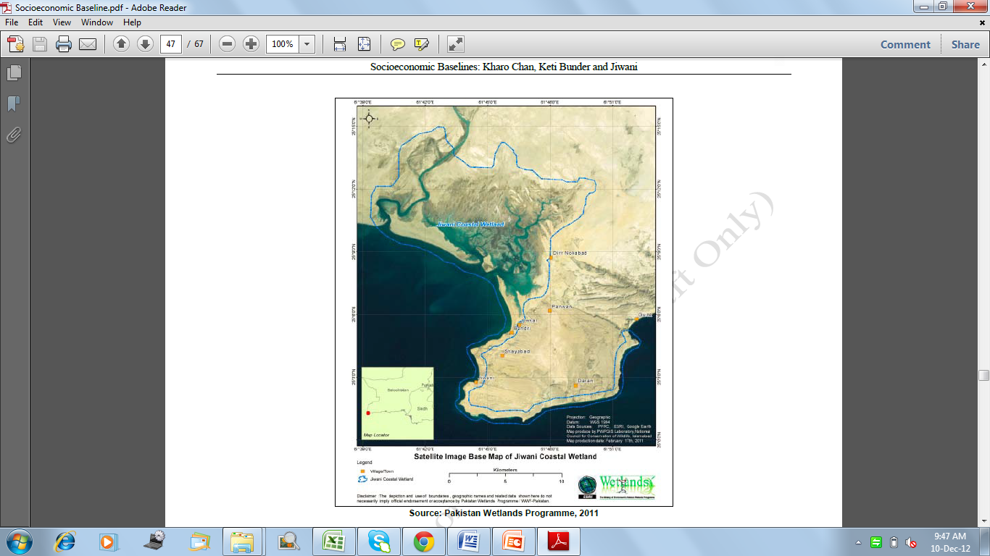

Slide 6
Community at Jiwani Tehsil, Gwader.
Forest cutting
  “ Wood collection is everywhere across the board for those sample in our study” Gas cylinder ownership is reported 33 % of sampled households at Jiwani”
Income losses due environmental challenges
Most of losses are in forest, fish catch and grazing lands during the last two years

Slide 8
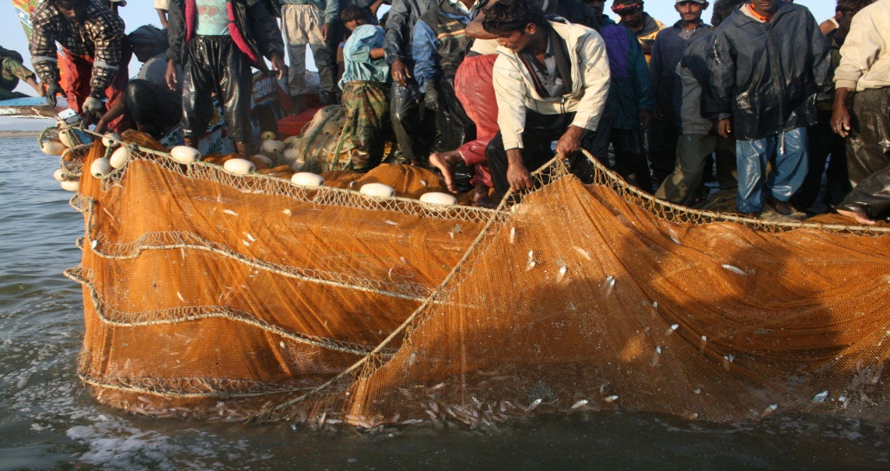
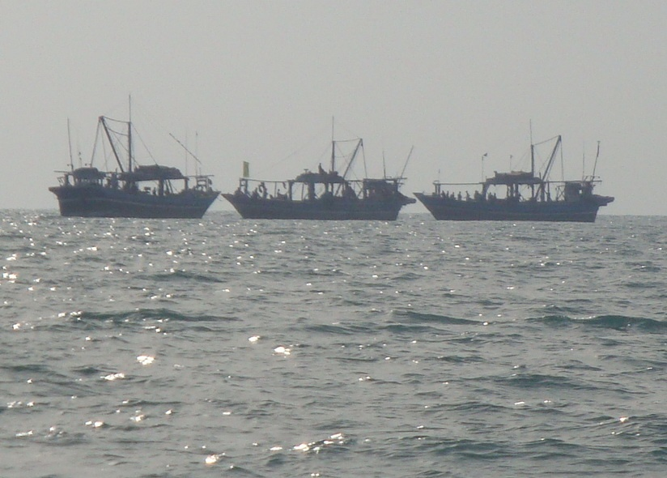
Top Priorities for Jiwani
Controlling Oil pollution
Illegal fishing by locals and trawlers
Developing a plan for solid waste disposal and land erosion.

Slide 9
Major Challenges for Jiwani
Law enforcement
Bribery & Corruption
Middleman capture margins before the product reaches the market.
Lack of control over illegal activities.
High demand and subsequent pressures on poorly managed natural resource stock.

Slide 10
Women livelihood, sewing is their main skill set and their principle source of earning.
The most popular skills are hat making and embroidery.

Slide 11
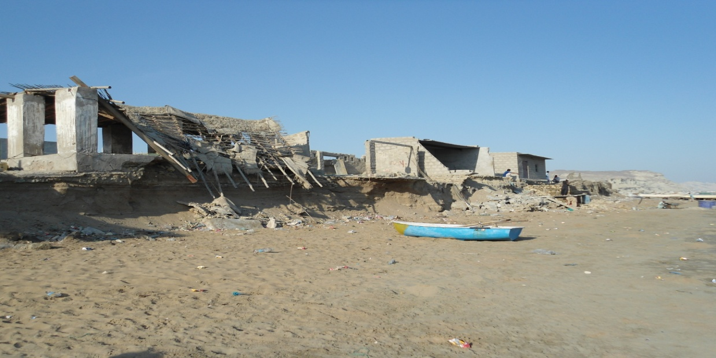
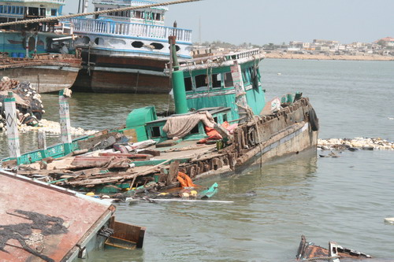
Climate Change Issues
Coastal erosion at alarming stage 10 – 15 feet/year.
Low rainfall
Frequent cyclone and floods
Drought
Sand dune shifting
Invasive species in coastal areas.

Slide 12
Impacts of Climate Change
Scarcity of Freshwater ( One water tanker cost is PKR= 15000- 20000/=) and all district water supply with tankers.
Damage of coastal town due to Sea erosion like Jiwani, Gunz, Surbandar and Gwadar city.
Mass migration within district and inter-province.
Water born diseases common and Malaria
Algal bloom and red tide is common in recent years.

Slide 13
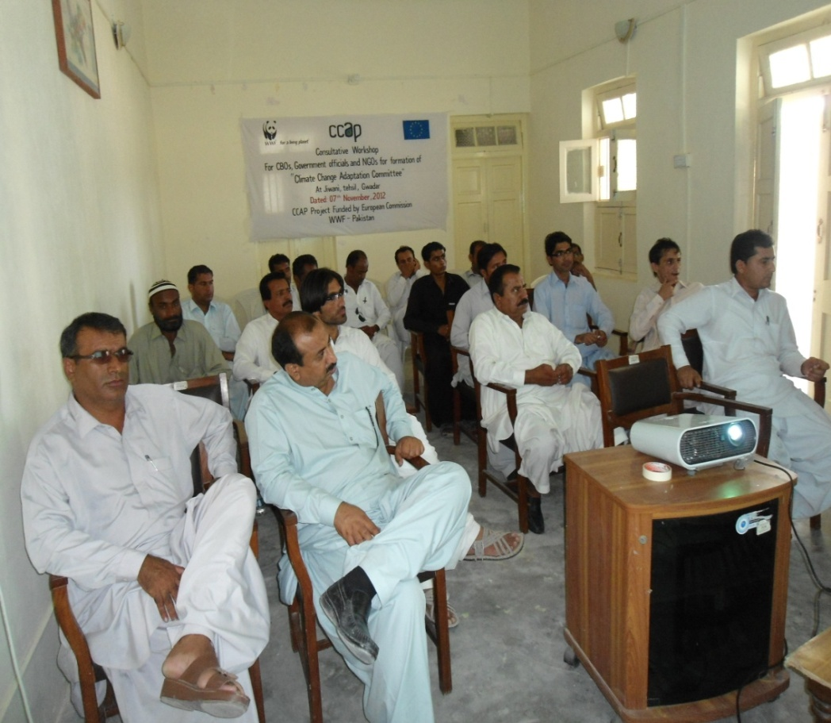
Formation of Climate Change Adaptation Committee at Jiwani
Climate change adaptation committee formed by CCAP project at Jiwani.
Members are selected from CBO, NGO, local representatives, and Government employees.
08 members are selected and first meeting organized.

Slide 14
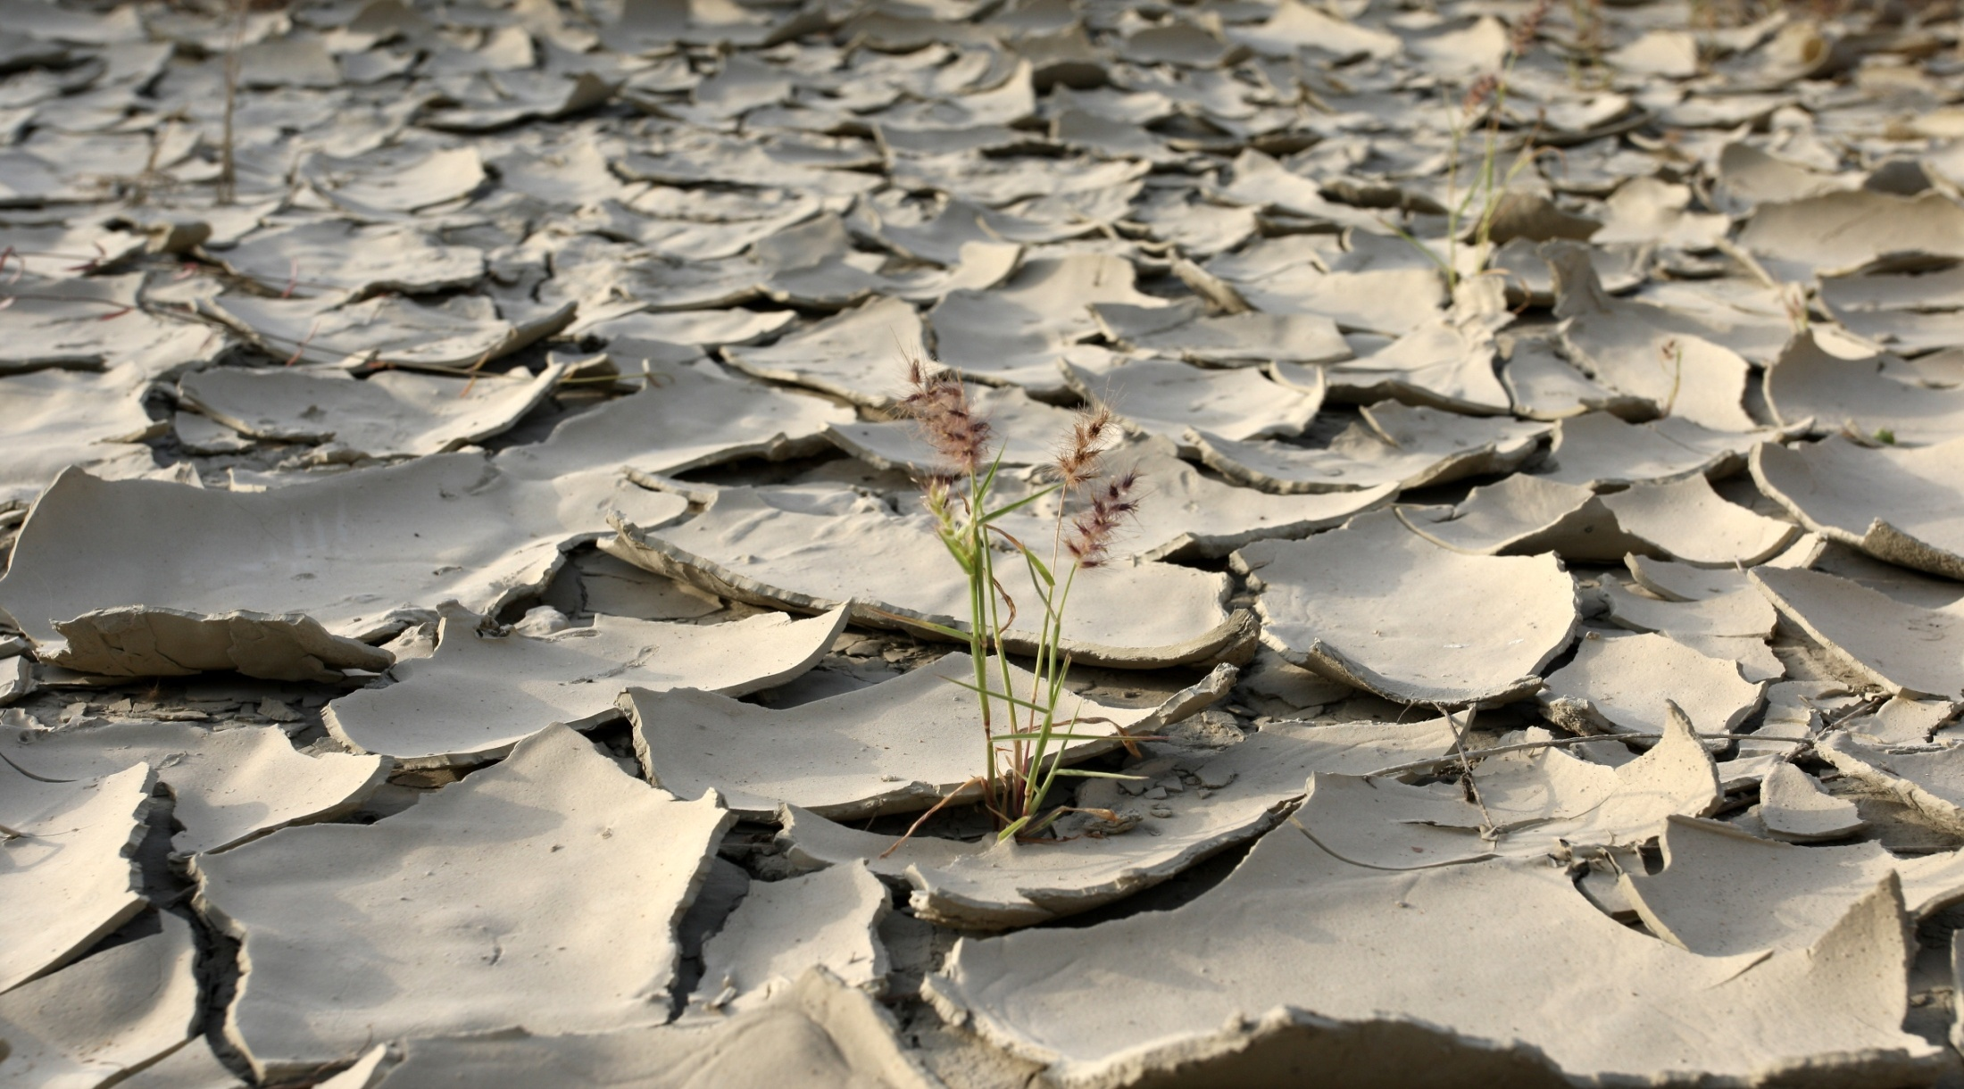
Climate Change Adaptation Models in
Makran Coast by WWF Pakistan

Slide 15
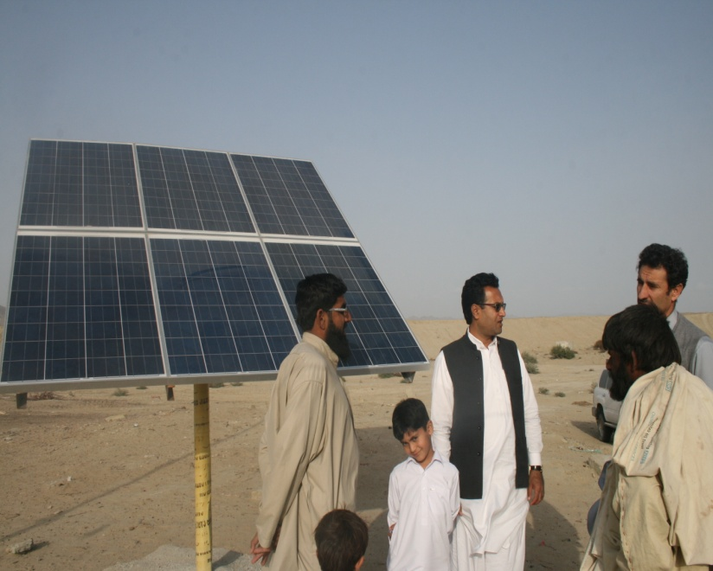
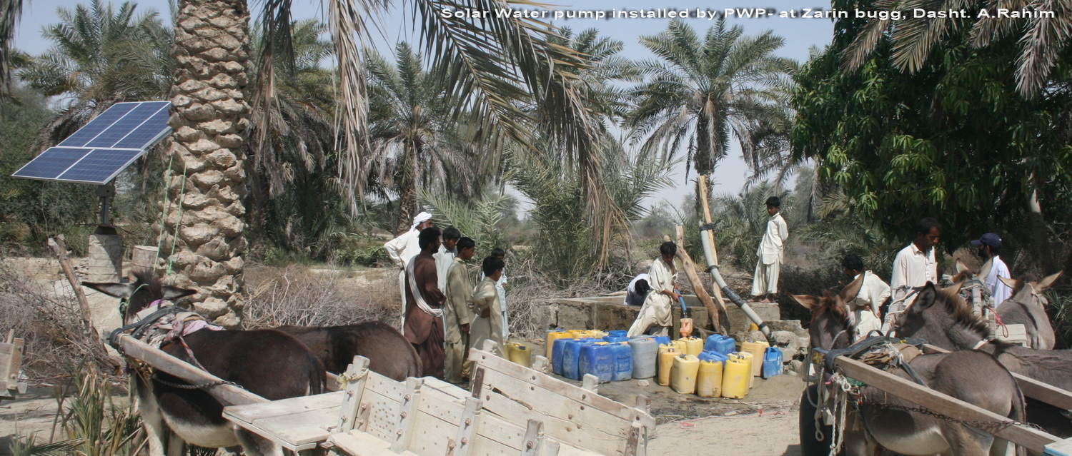
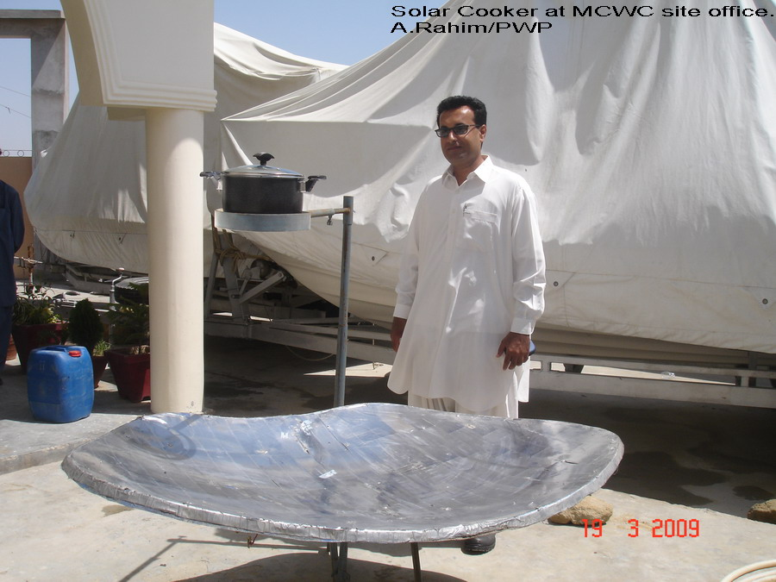
Adaptation at Balochistan Coast
Renewable energy models.
  Hybrid (wind and Solar)
  Solar geysers and lantern
  Solar Water pumps
  Solar Cookers

Slide 16
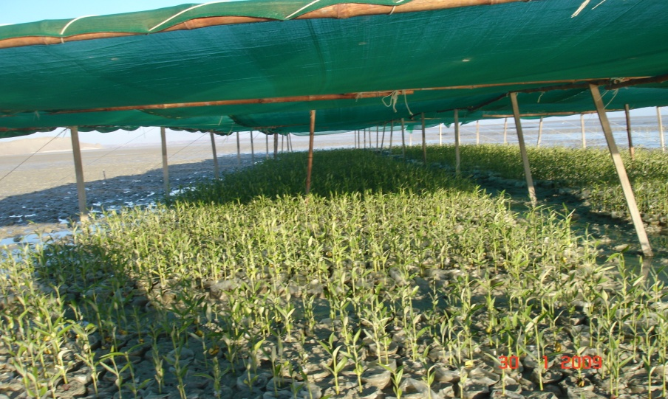
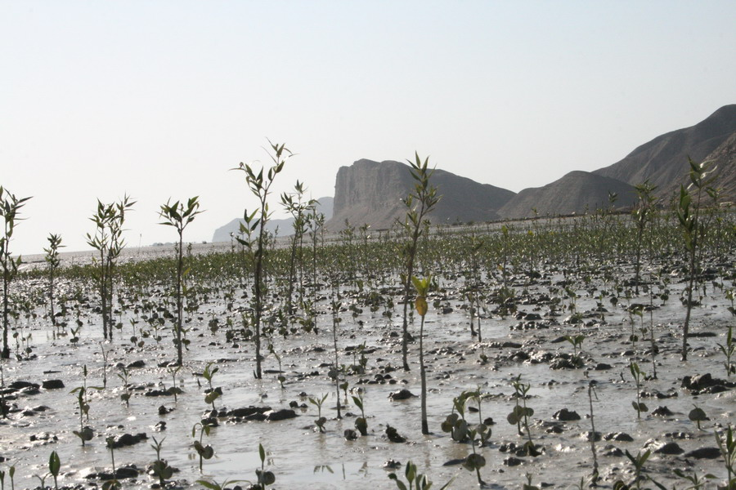
Mangrove Plantation to Support Fishery

Slide 17
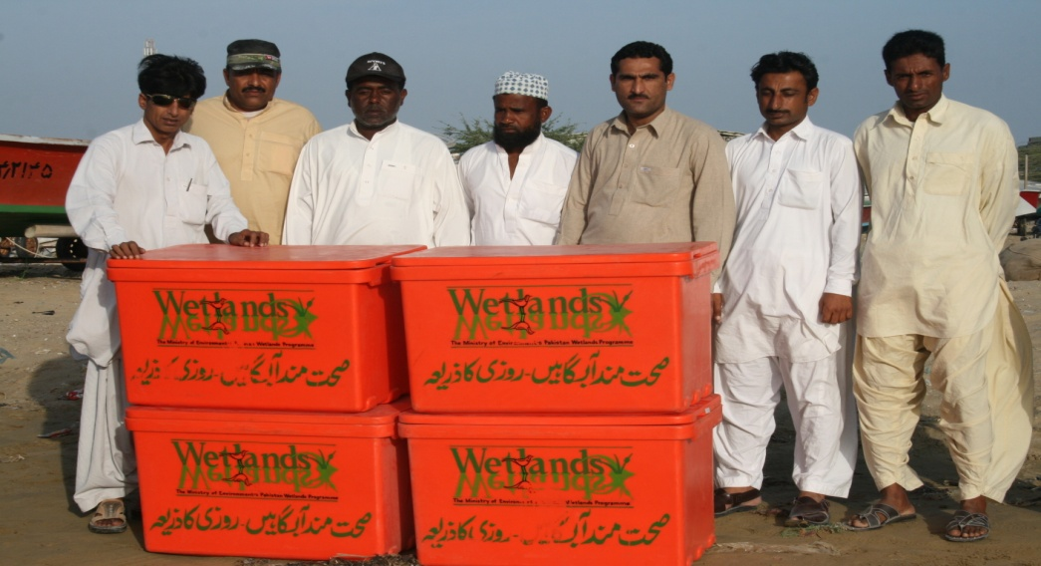
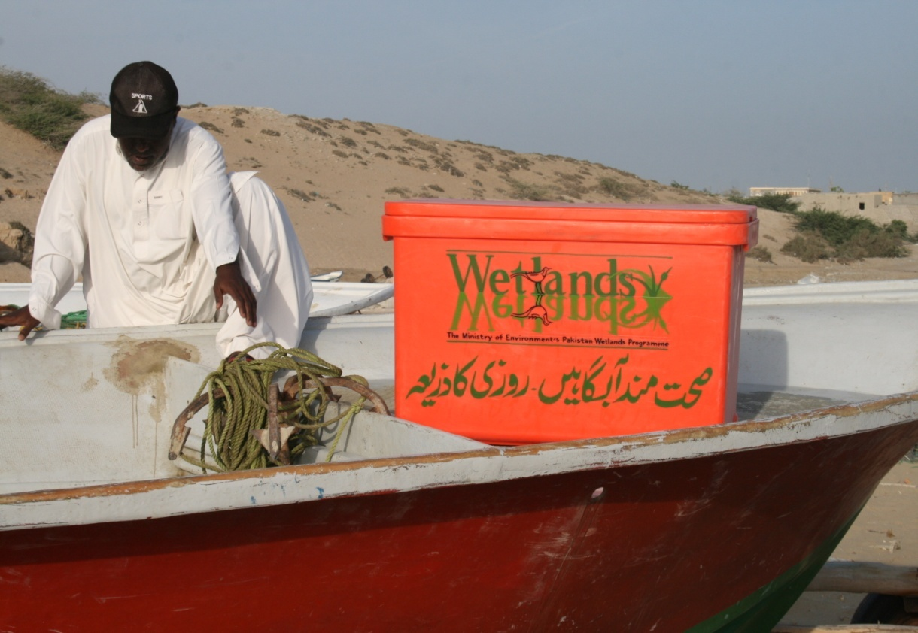
Fish quality assurance/preservation
Introduced Insulated Fish boxes to fishermen for keeping fish fresh condition.

Slide 18
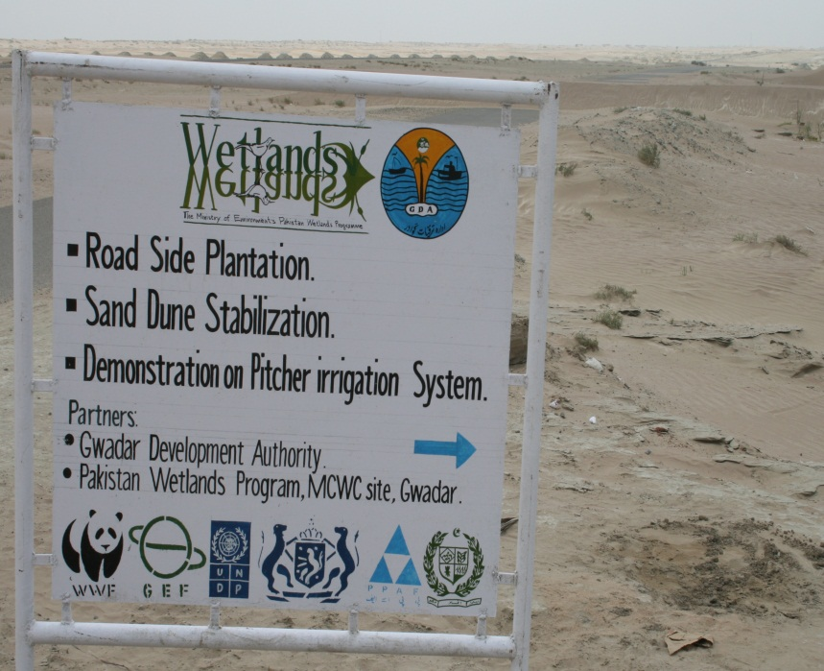
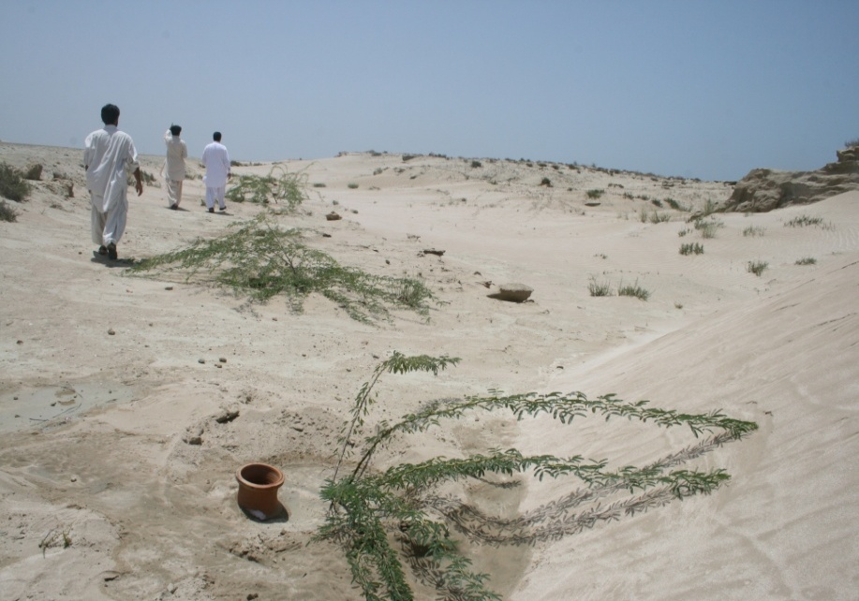
Sand Dune Stabilization With GDA
Pitcher irrigation demo on sand dune stabilization with GDA (two and half kilometer)

Slide 19
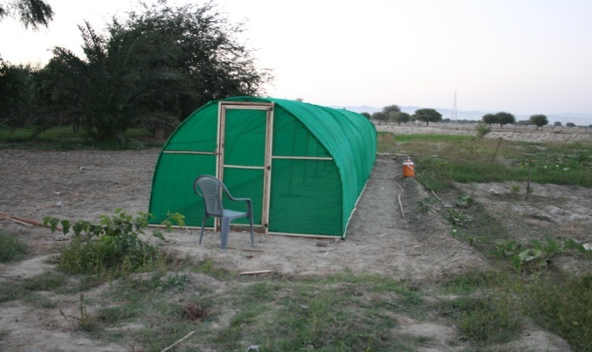
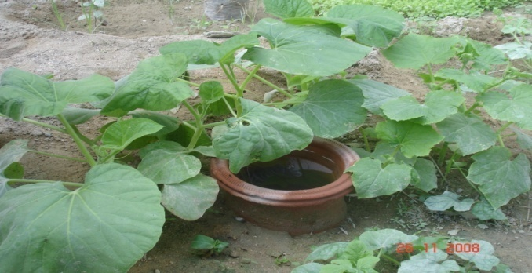
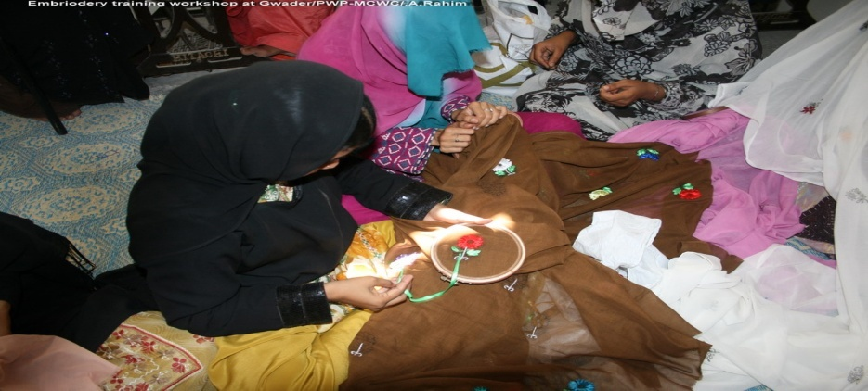
NRM Capacity Building
Off-season tunnel vegetable farming
Training program for alternate livelihood earnings
  Sea Shell Craft makings,
  embroidery trainings.
  Pitcher irrigation and kitchen gardening

Slide 20
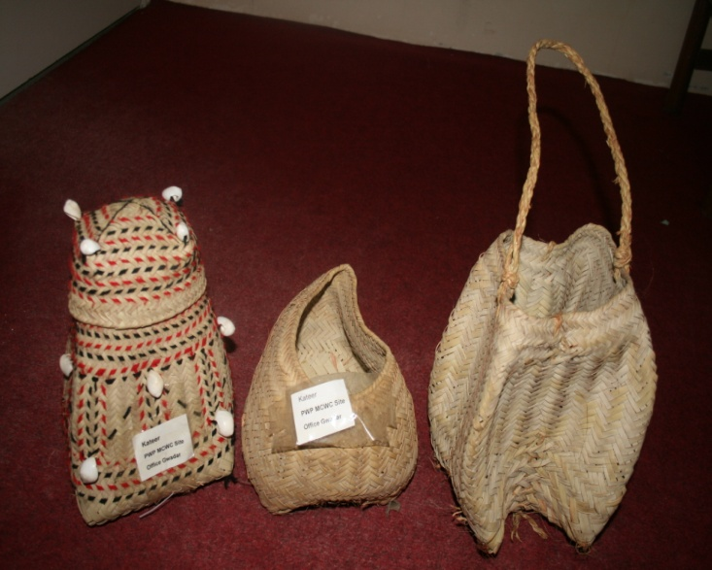
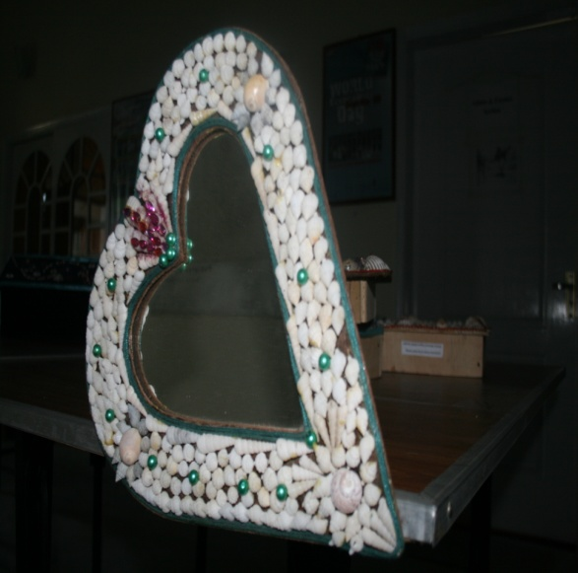
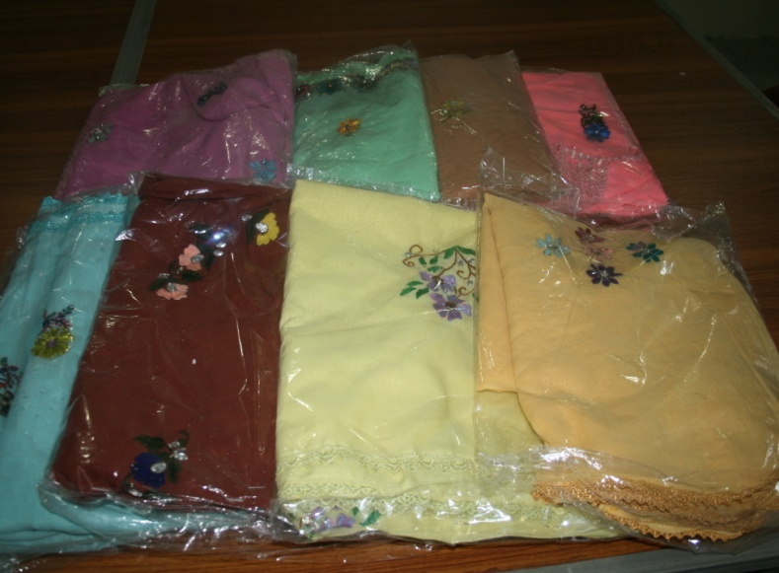
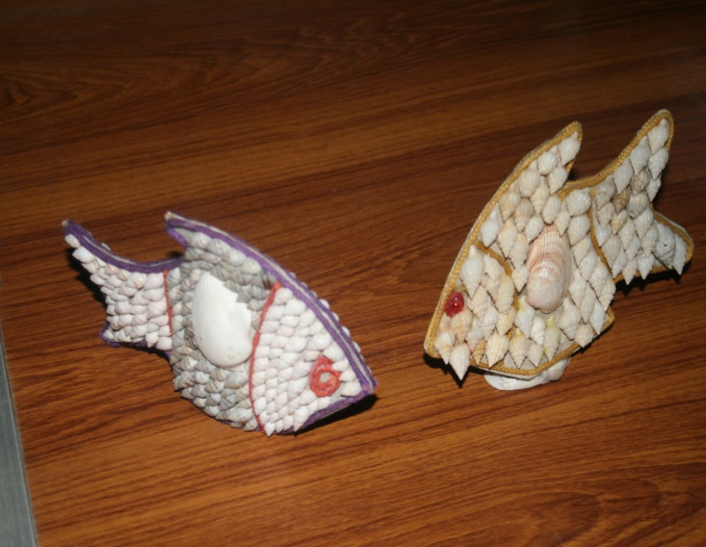
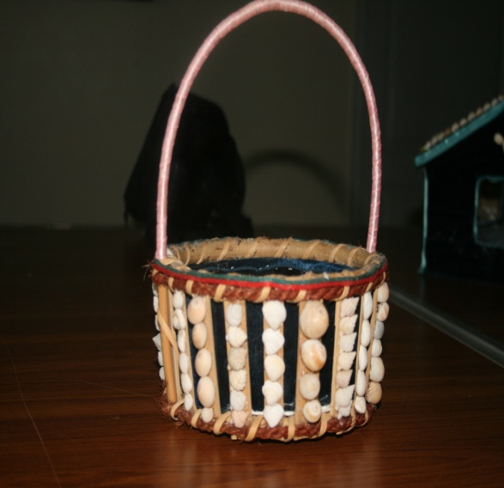
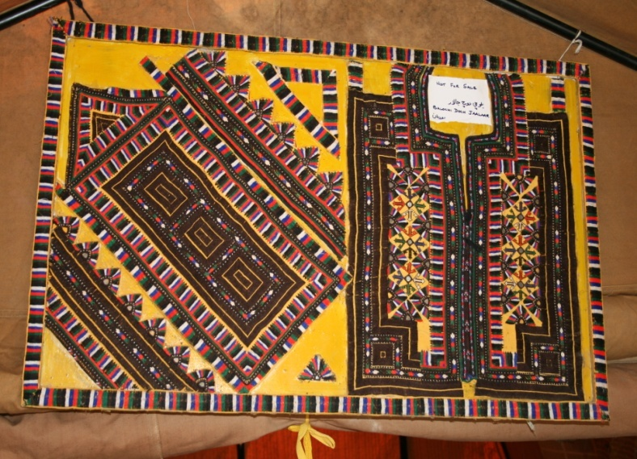

Slide 21
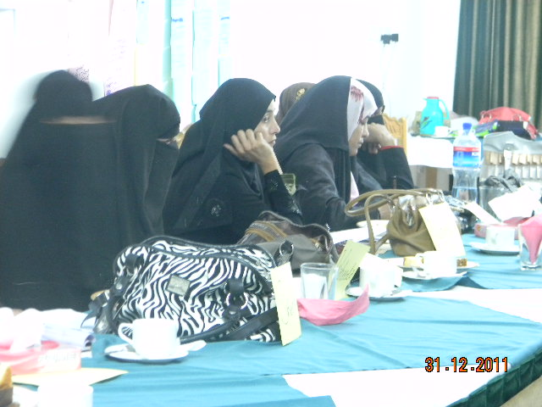
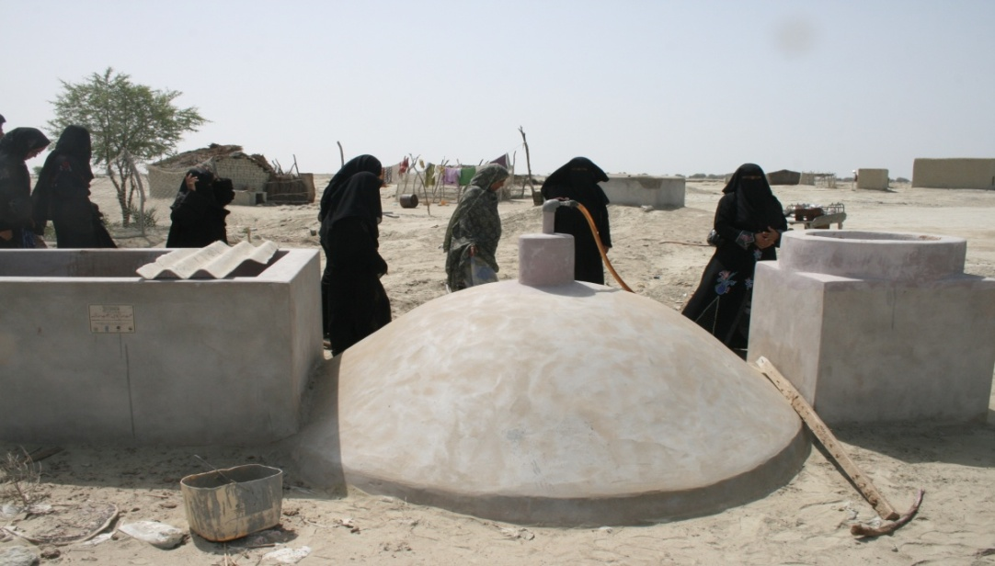
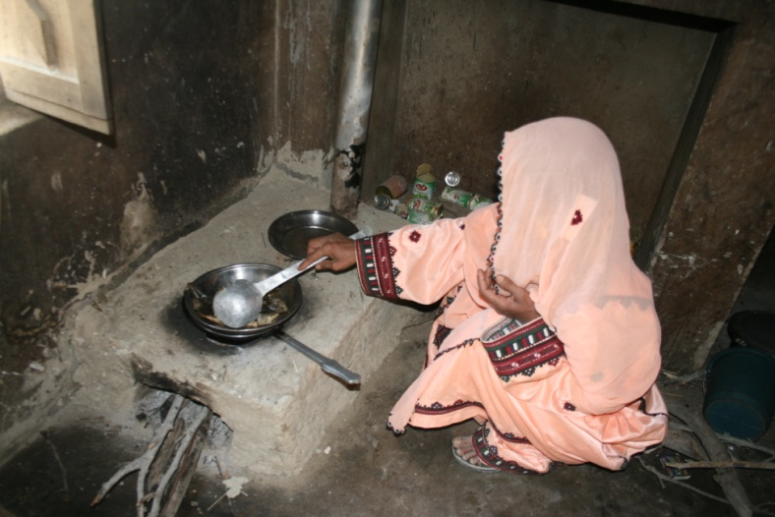
Biogas plant
Exposure visit for community members women
Mud fuel efficient stoves for Women

Slide 22
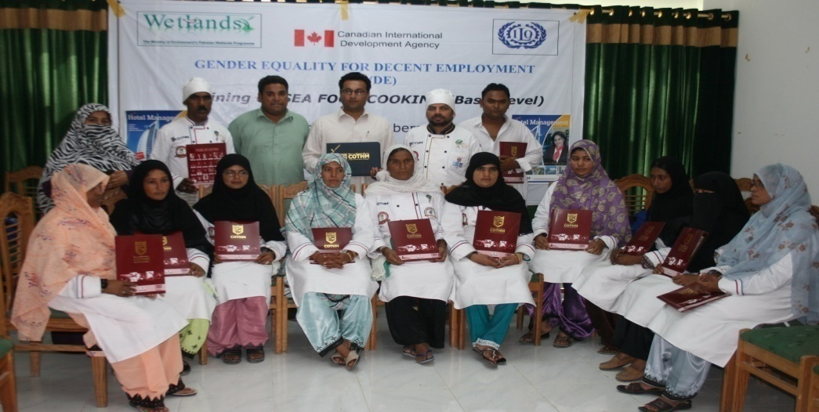
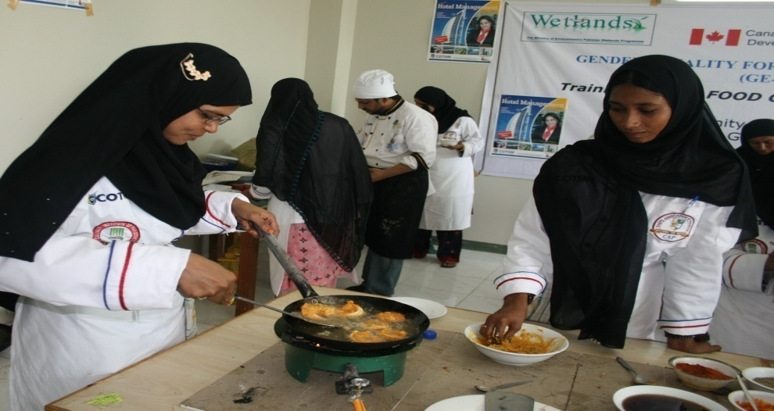
Alternate Livelihood Program
Advance Seafood cooking program for Women and Men.
Established seafood kitchen and marketing assistance to local women.

Slide 23
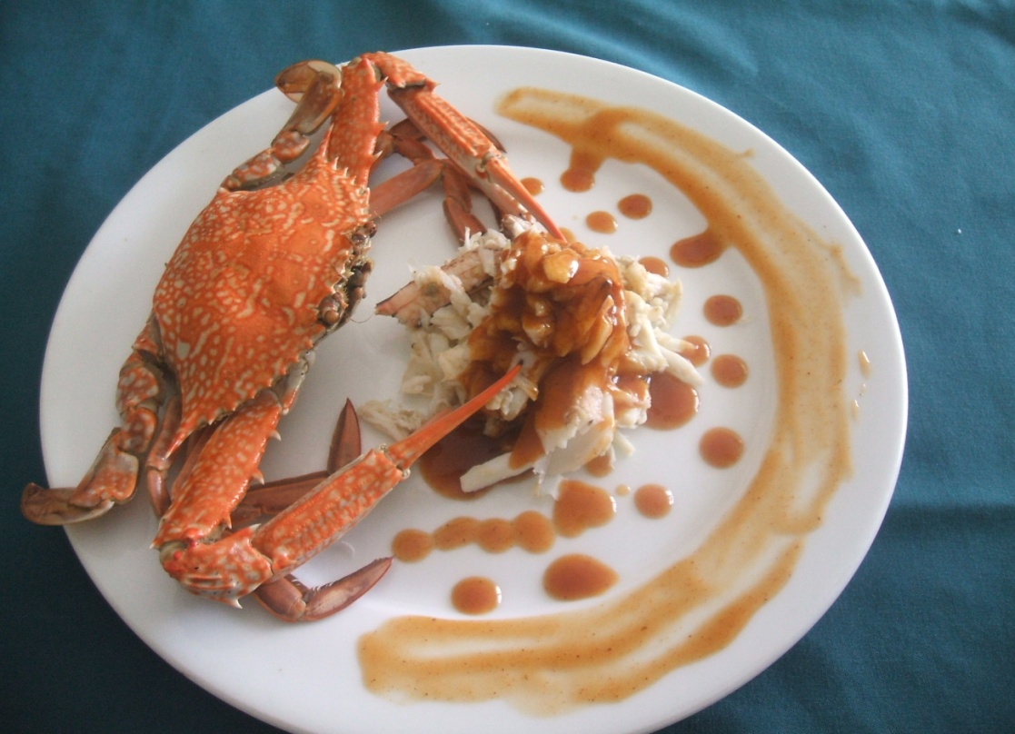
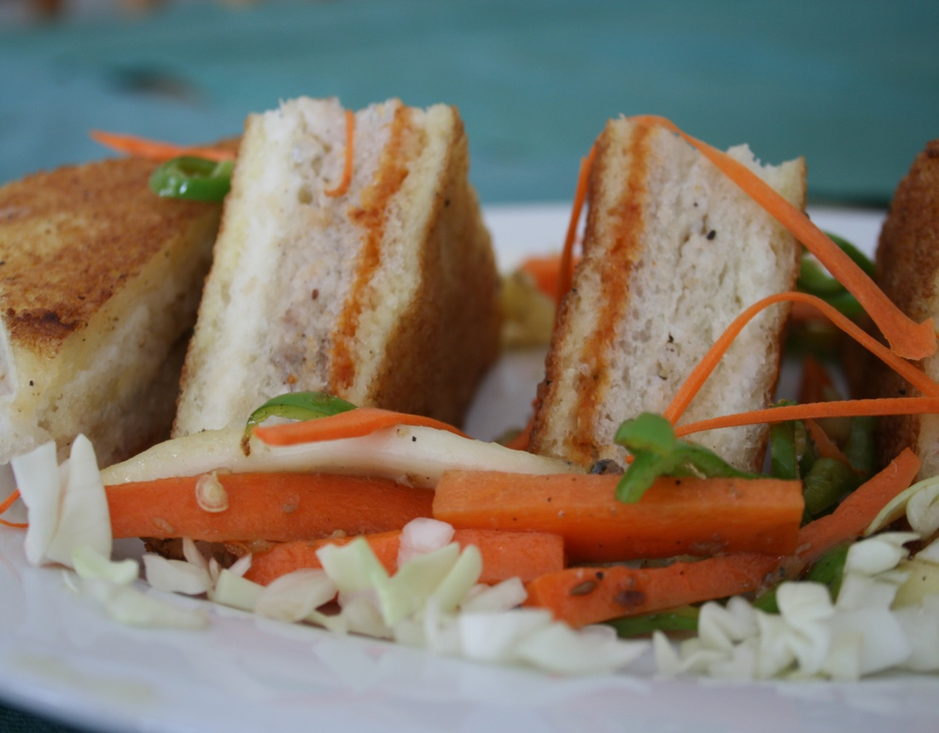
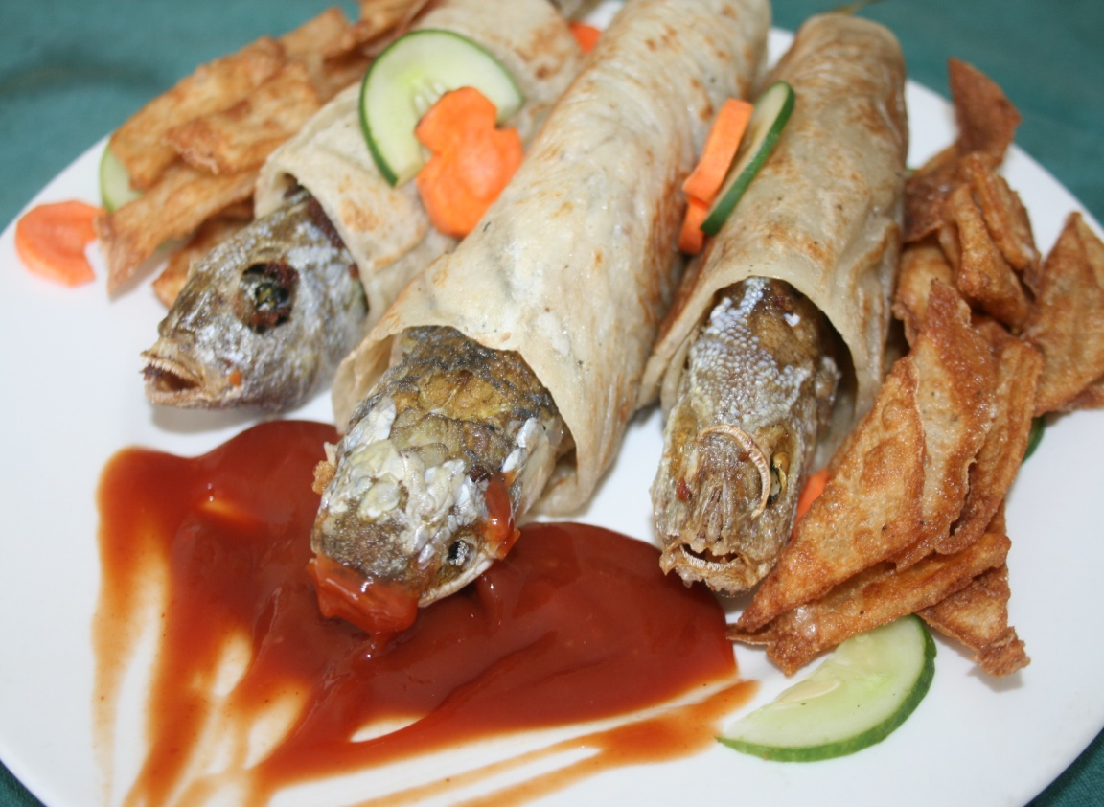
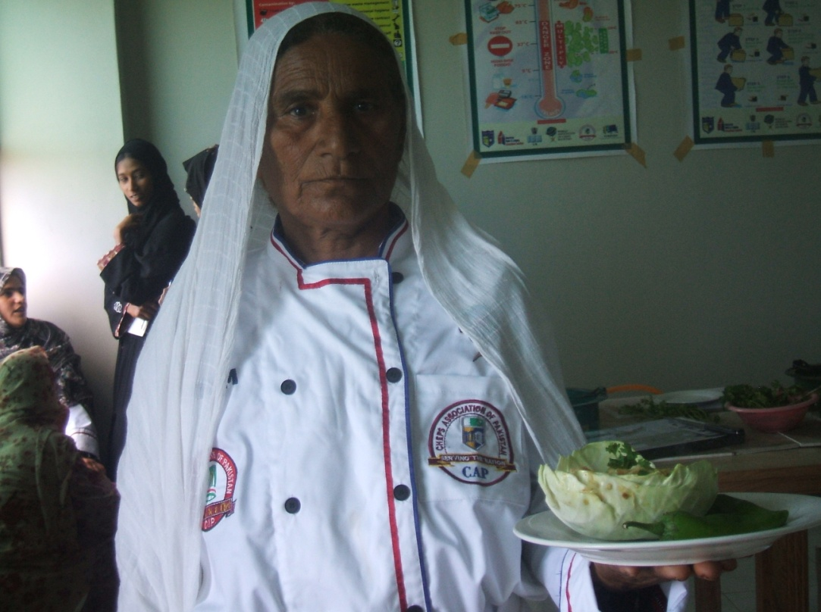

Slide 24
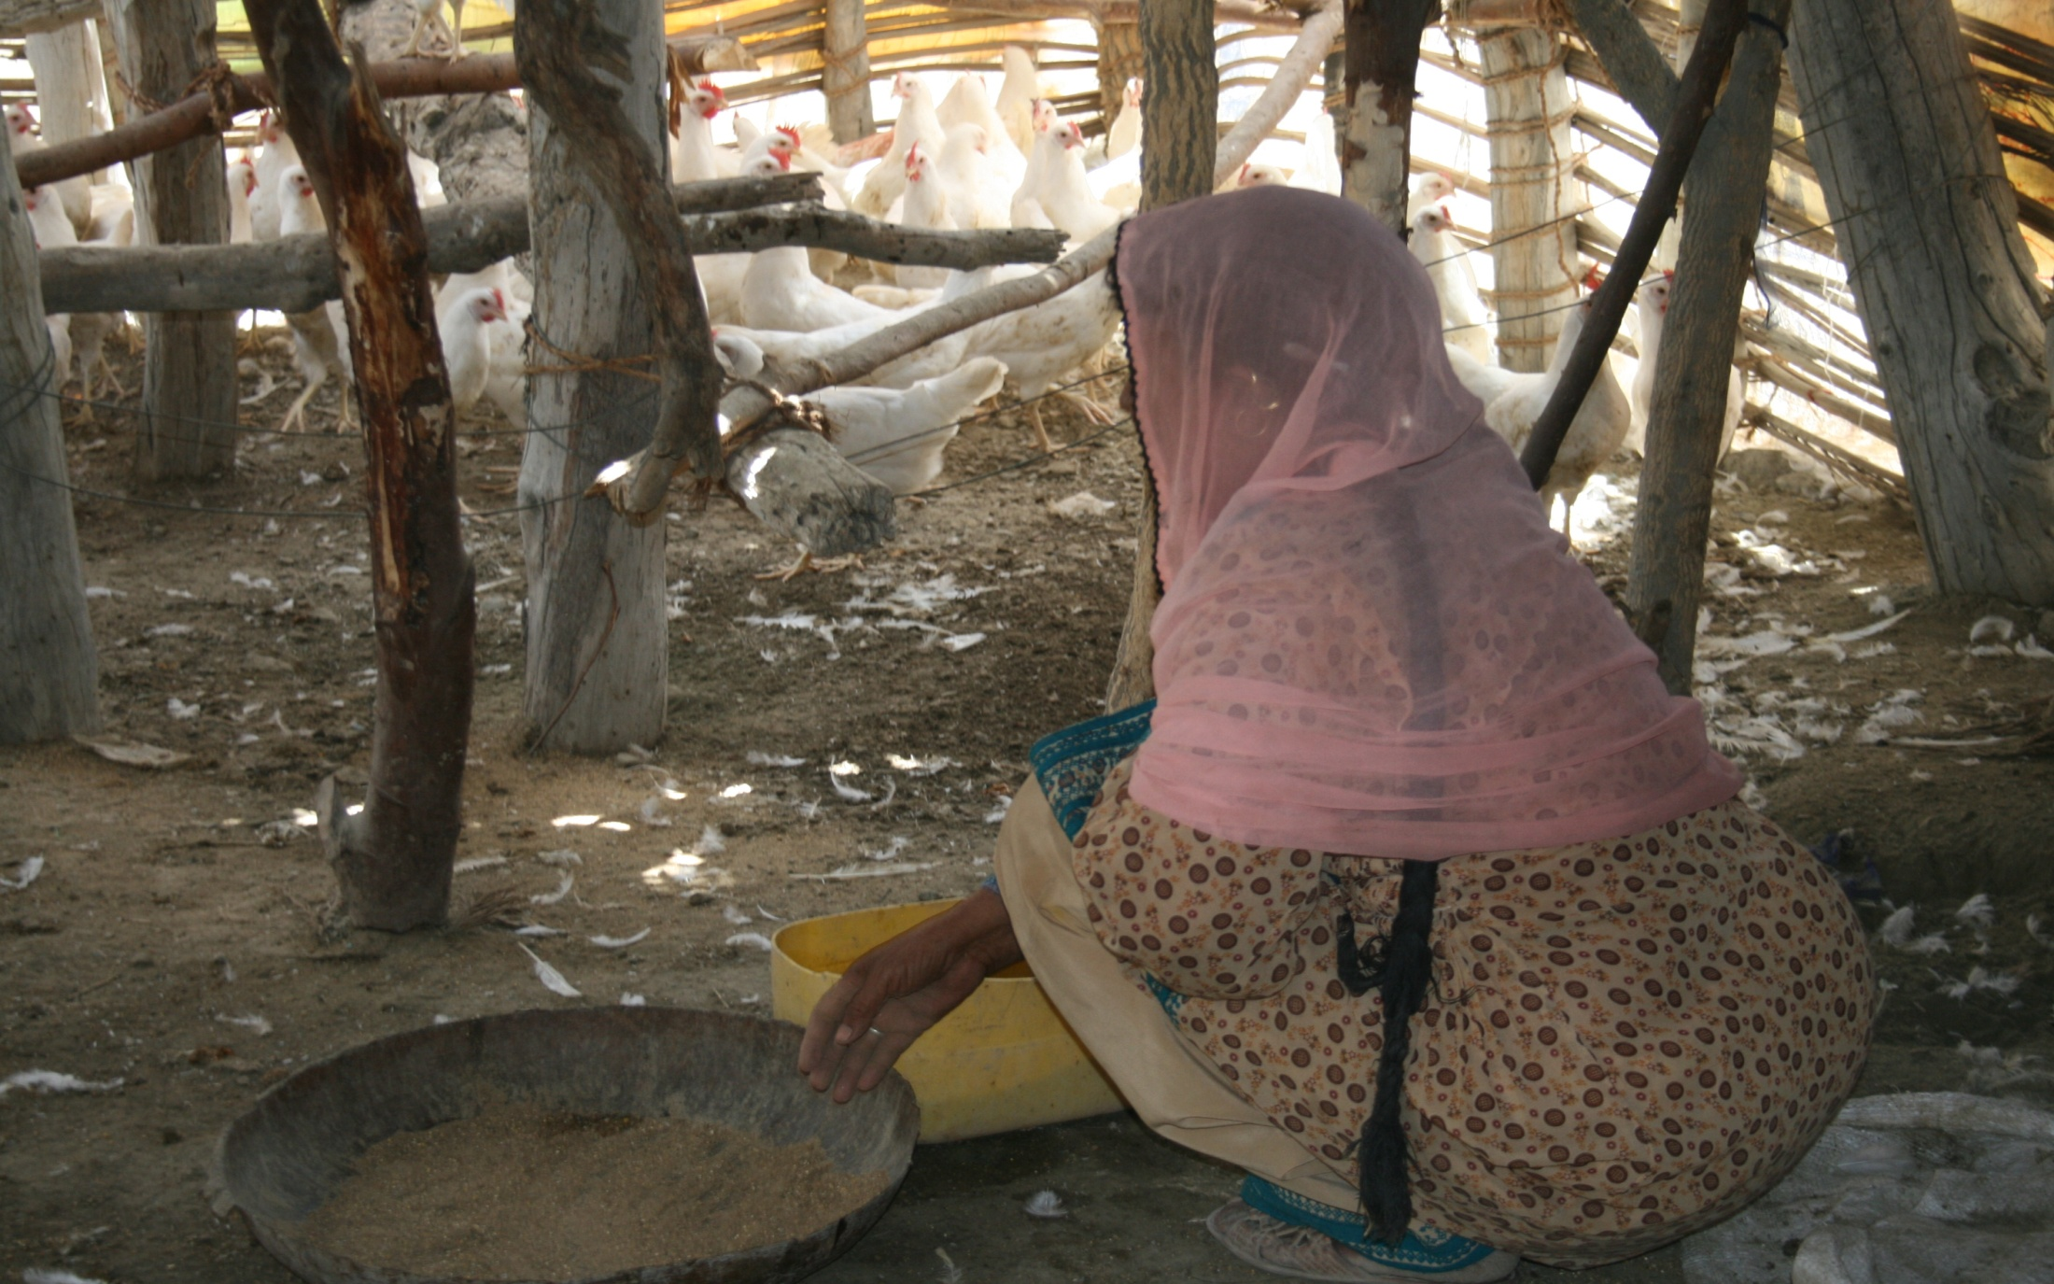
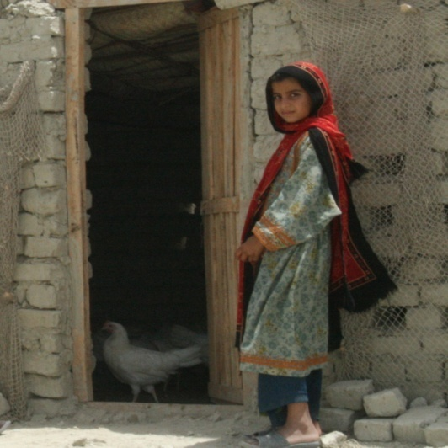
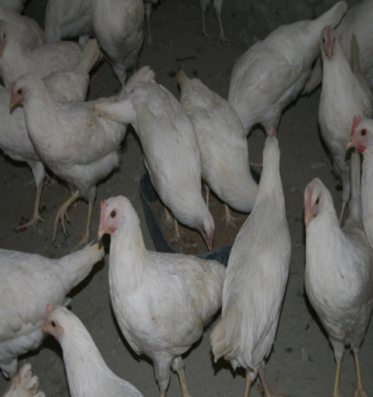
Poultry farming for women

Slide 25
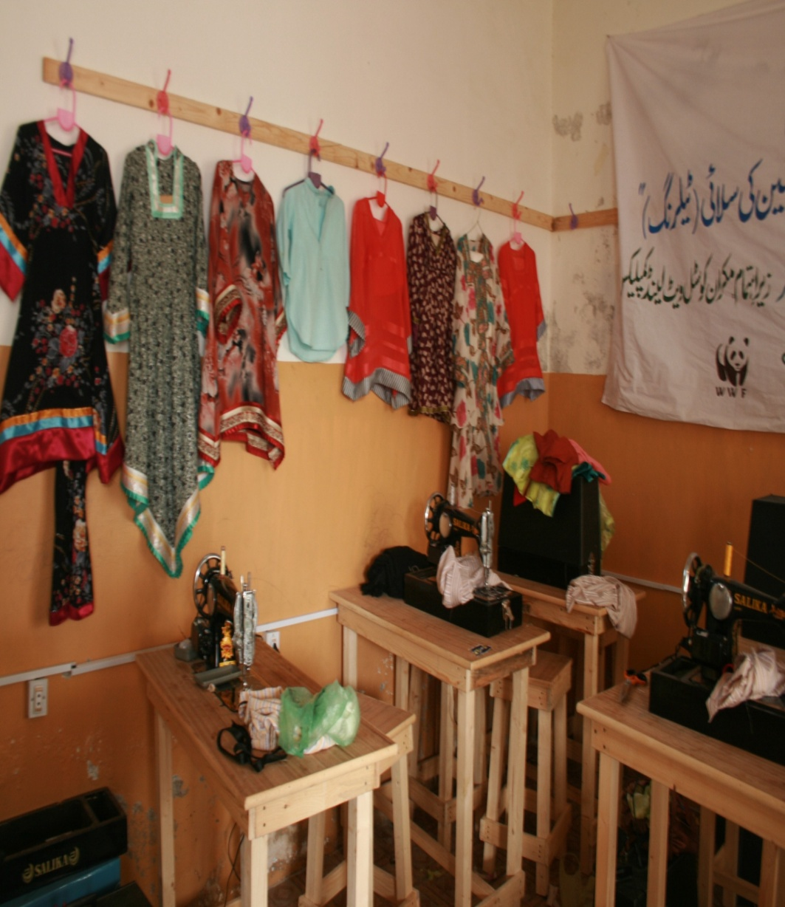
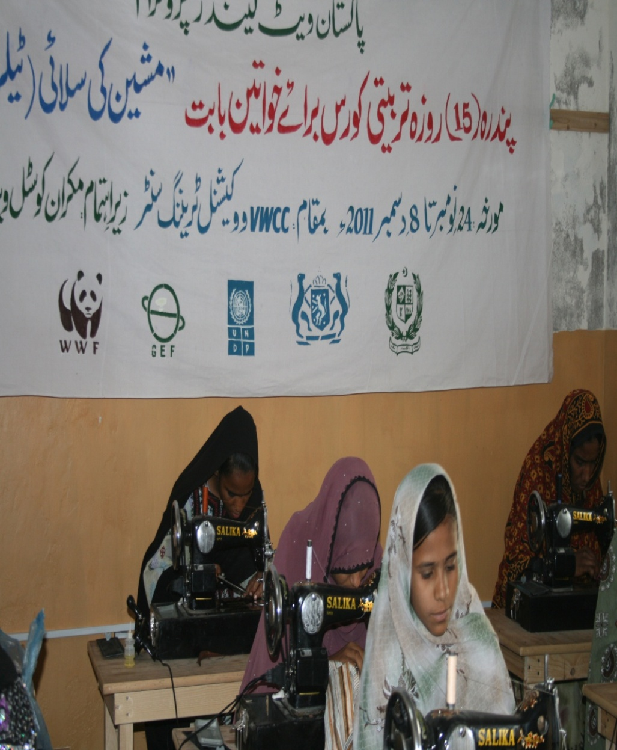
Vocational Centres for Women at Gwadar

Slide 26
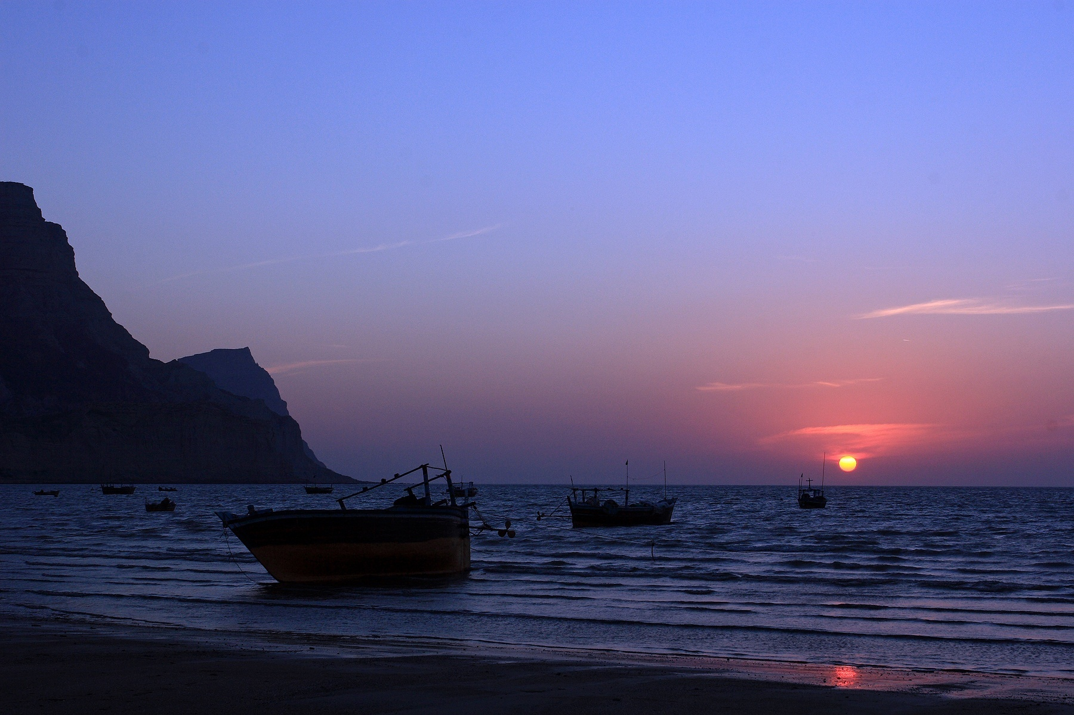
Thanks and Good bye ☺

