Slide 1
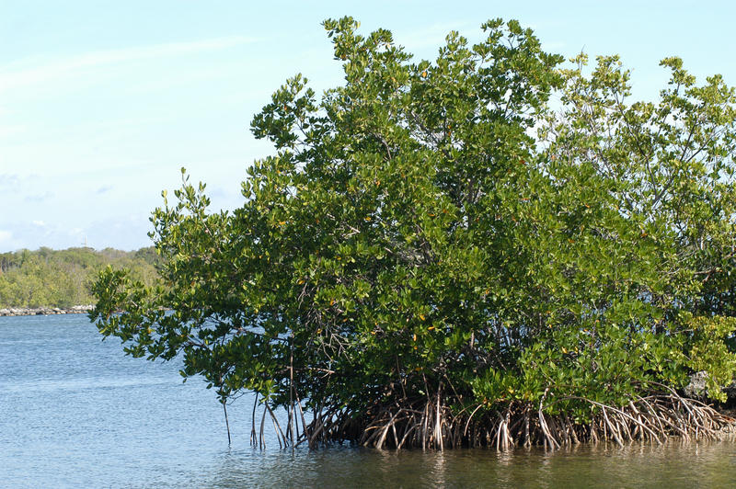
Climate Change
& Adaptation Mechanism
in
Sindh Coastal Belt
Shamsul-Haq Memon
Sindh Coastal Development Authority

Slide 2
Climate Change
Climate Change
is
An economic challenge
A social challenge
A development challenge
A National security challenge

Slide 3
Climate Change – Global Perspective
The World Meteorological Organization’s Report.
“The first 10 months of 2012 were the ninth warmest since records began in the mid 19th century”.

Slide 4
Current Climate-Related Risks
Changing patterns of seasons; Longer summers and shorter winters
More intense precipitation events
Increased risk of prolonged droughts
Increased and unpredictable frequency of tropical cyclones, storms, etc
Increased summer Monsoon precipitation
Flash flooding (Example: 2010 Floods in Pakistan)
Sea level rise
Erosion of islands of primary importance to the local fishing communities (Example: Buddo and Bundal; The twin islands off the Karachi coast)
Massive displacement and climate refugees

Slide 5
Modulating influences
Health effects
Health Effects
Temperature
Temperature-related
-
related
illness and death
illness and death
Extreme weather-
Extreme weather
-
related (floods, storms, etc.) health effects
related health effects
Human
exposures
Air pollution
Air pollution-related
-
related
health effects
Microbial changes:
Contamination paths
health effects
Regional weather
Contamination
Regional weather
Water and food-borne
Climate
pathways
Water and food
-
borne
Climate
changes
changes
diseases
Change
diseases
Change
Transmission
•
Transmission dynamics
•
Heat waves
Heat waves
Vector
-
Vector
-
borne and
•
dynamics
borne and
•
Extreme weather
Extreme weather
rodent
-
rodent
-
borne diseases
borne diseases
•
•
Temperature
Temperature
•
•
Precipitation
Sea-level rise
Changes in agro-ecosystems, hydrology
Effects of food and water shortages
Socioeconomic and demographic disruption
Mental, nutritional,
infectious-disease and other effects

Slide 6
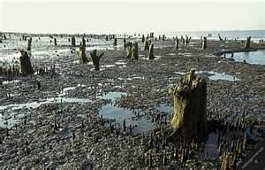
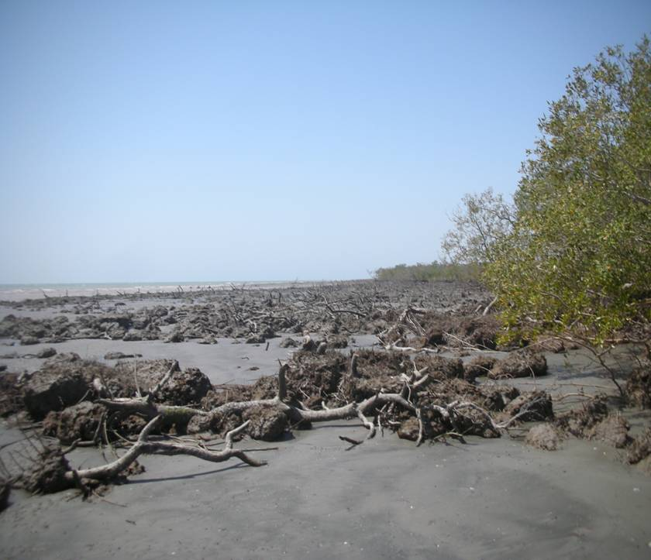
Climate Change – Pakistan’s Perspective
Increased variability of Monsoon
Rapid recession of Glaciers
Increased risks of floods and droughts
Food Insecurity due to reduced agriculture productivity
Deforestation
Irreversible loss of Biodiversity
Upstream intrusion of saline water in the Indus delta; and risk to mangroves, coral reef systems and breeding grounds of fish

Slide 7
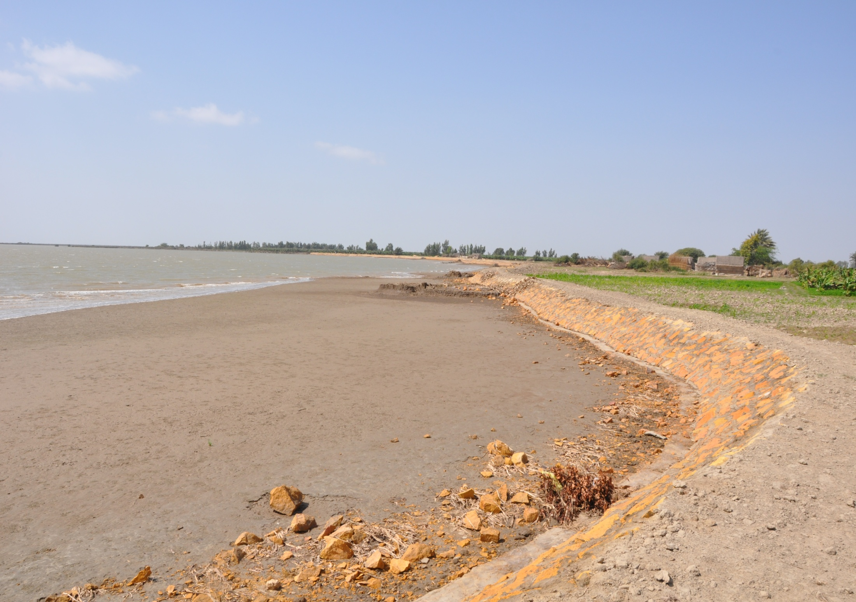
Sindh Coast; A front line of Climate Change
Pakistan is listed in the top-ten countries which are severally affected and are at stake due to climate change
The German Watch Global Climate Risk Index put Pakistan at one of the most vulnerable – No.1 in 2010 and No.3 in 2011.
The German Watch Global Climate Risk Index – Thailand, Pakistan and El Salvador on top of countries suffered most from extreme weather events during 2011.

Slide 8
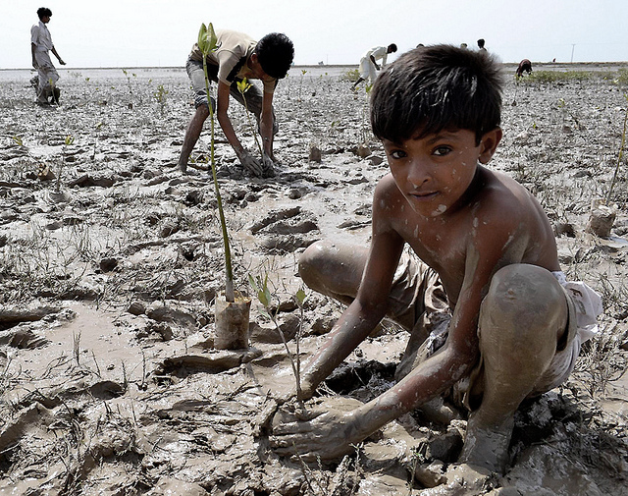
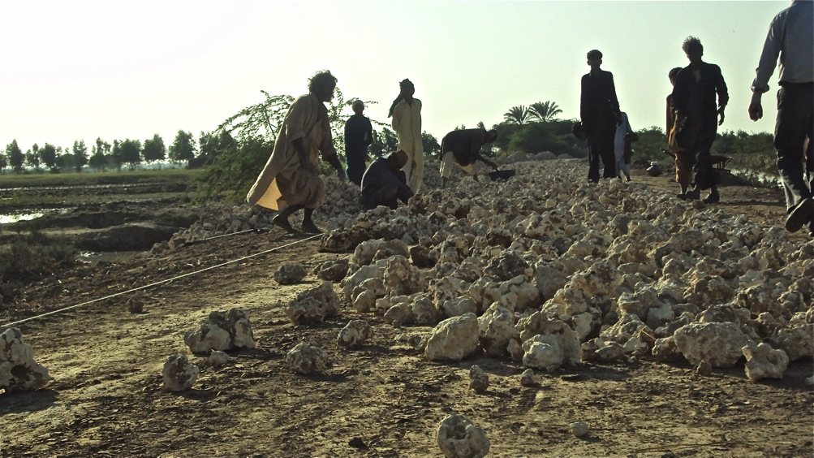
Solution?
Mitigation: involves actions that
are intended to reduce the
magnitude of our contribution to
climate change
Adaptation: consists of actions undertaken to reduce the adverse consequences of climate change, as well as to harness any beneficial opportunities
Coastal communities can be most effective for building low cost adaptations.

Slide 9
Adaptation Measures
Coastal vegetation cannot stop Tsunami but can reduce impact
Decrease deforestation/increase afforestation
Alternate energy resources
Agronomic management
Water harvesting and efficiency
Sustainable fishing
Resistant physical infrastructure

Slide 10
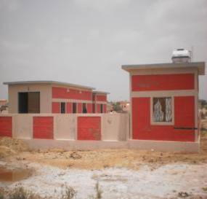
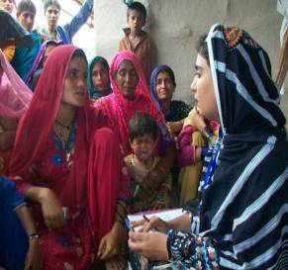
Adaptation Measures Through SCCDP
Developing linkages of the coastal communities with civil society organizations and govt. institutions for
Development of infrastructure
Provision of trainings
Disaster Risk Reduction
Provision of basic civic services
Provision of health services
Communities can be guided to develop alternative livelihood

Slide 11
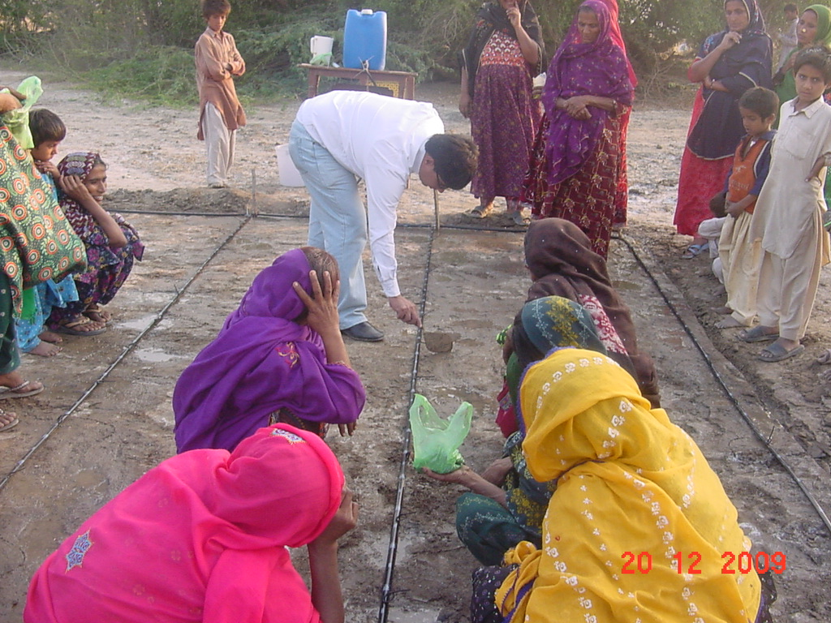
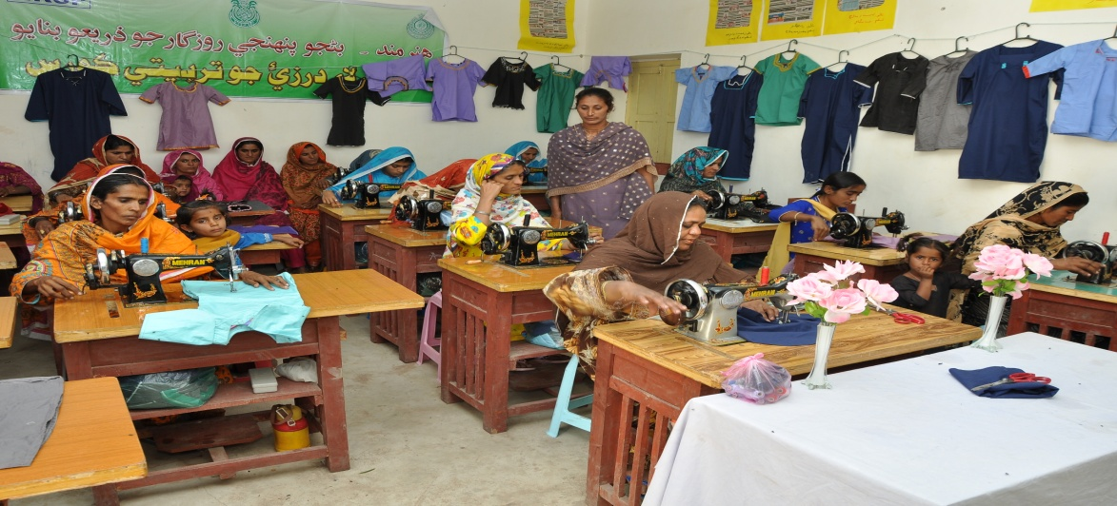
Adaptation Measures Through SCCDP (Continued…)
Fostering Community Institutions at grassroots level
Diversifying household income generation options by:
Imparting Skills Training
Providing Natural Resource
Management Trainings
Agriculture
Livestock
Fisheries
Forests

Slide 12
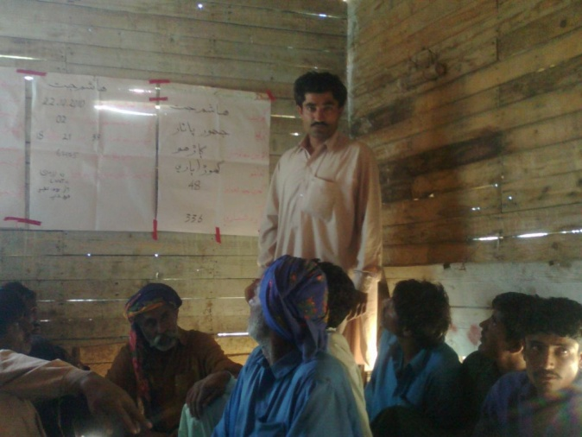
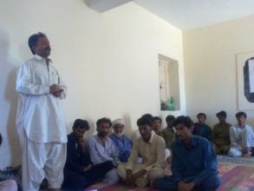
Adaptation Measures Through SCCDP (Continued…)
Awareness raising
cultural programmes for awareness creation of local people about climate change adaptation
Extension strategies
orientation meetings, farmer/fisher field schools,
Mobilization of local community
Farmer Groups
Local facilitation Team (LFTs)

Slide 13
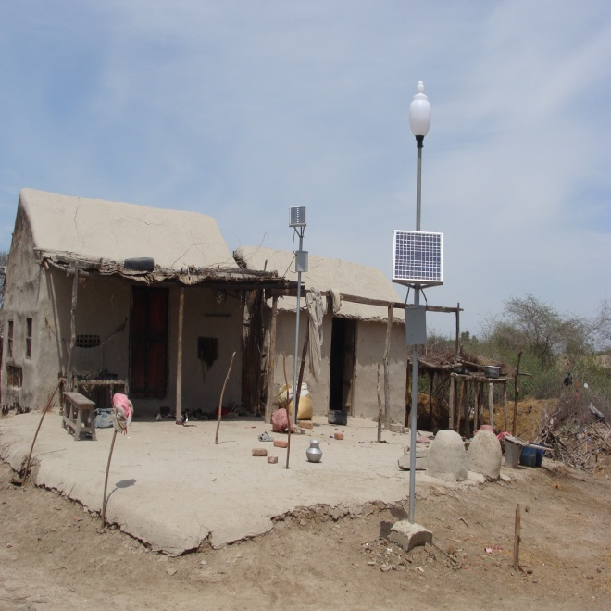
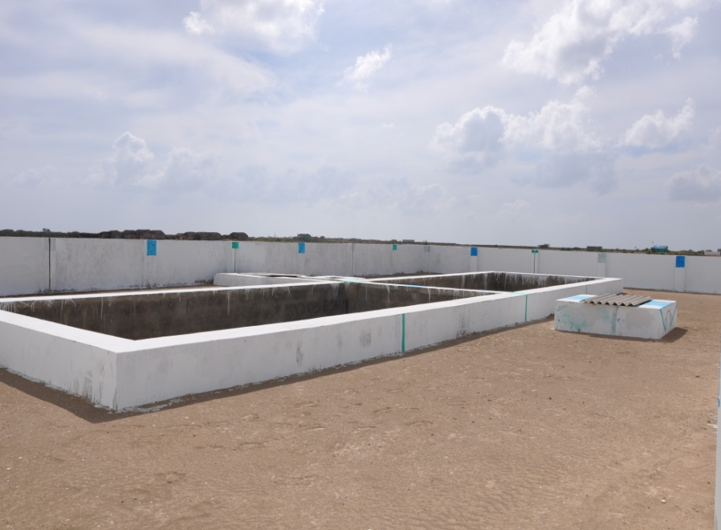
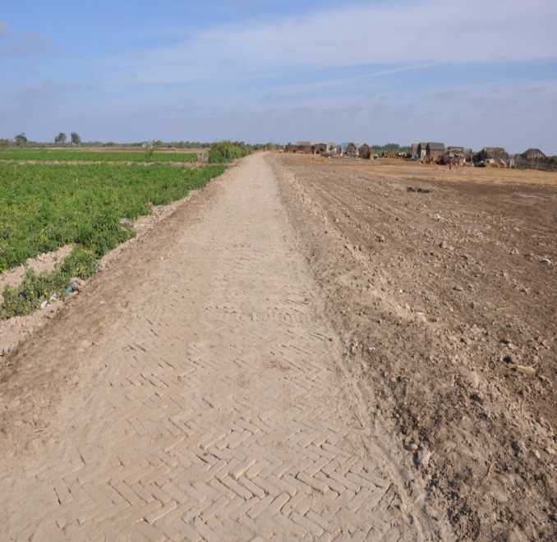
Adaptation Measures Through SCCDP (Continued…)
Empowering local communities by engaging them in planning and development mechanisms
Providing access to communities in developing small scale village infrastructure
Developing the Medium Scale village Infrastructure

Slide 14
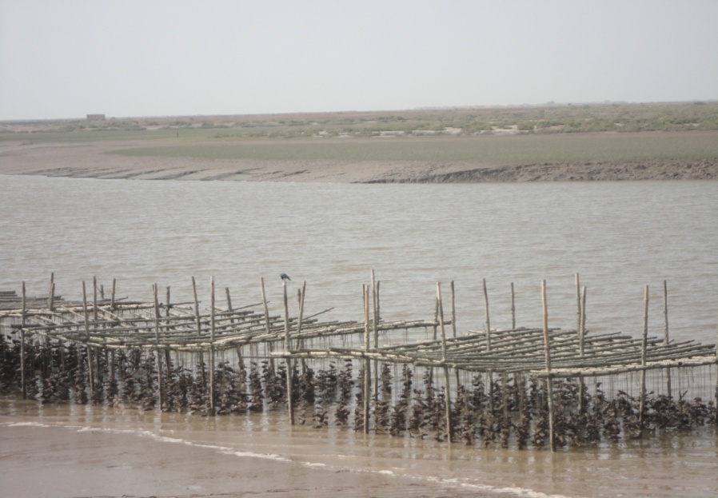
Adaptation Measures Through SCCDP (Continued…)
Planting Mangroves by involving the local communities.
Developing pilots regarding rafts and crab ponds.
Developing ‘Model Villages’ to demonstrate how community mobilization activities go hand in hand with the principles of Sustainable Development
Application of GIS for physical and temporal monitoring

Slide 15
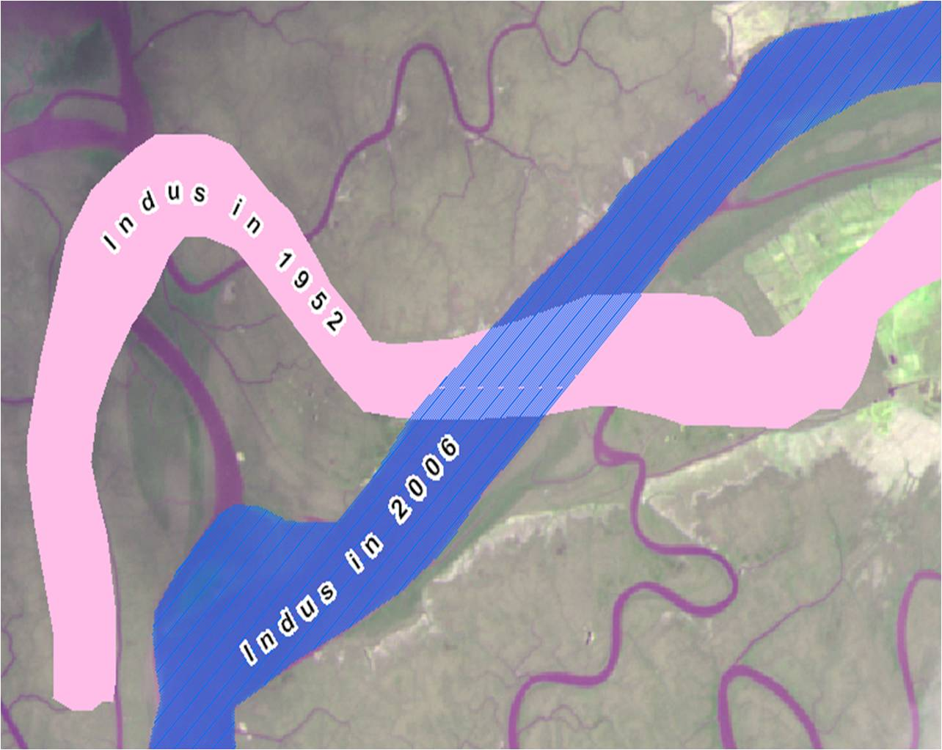
Use Remote Sensing and GIS for Monitoring
Shift in Indus River Path

Slide 16
Change/Shift in agricultural activities
Agriculture land in 1952
Agriculture land in 2006
Keti Bundar, District Thatta

Slide 17
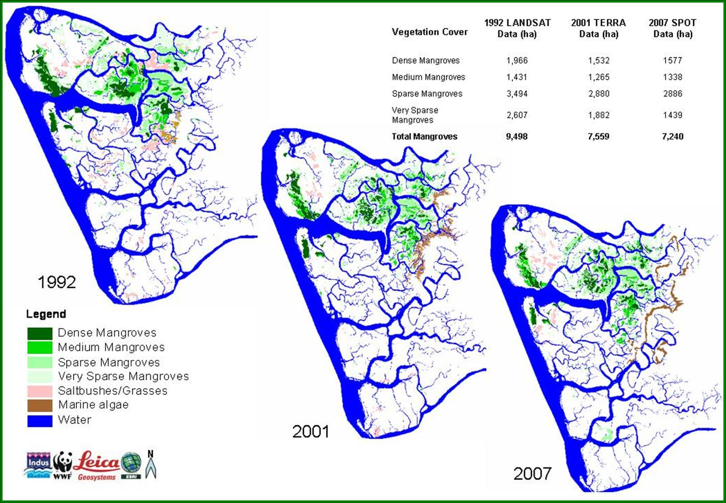
Temporal Change Mapping of Mangrove Forest

Slide 18
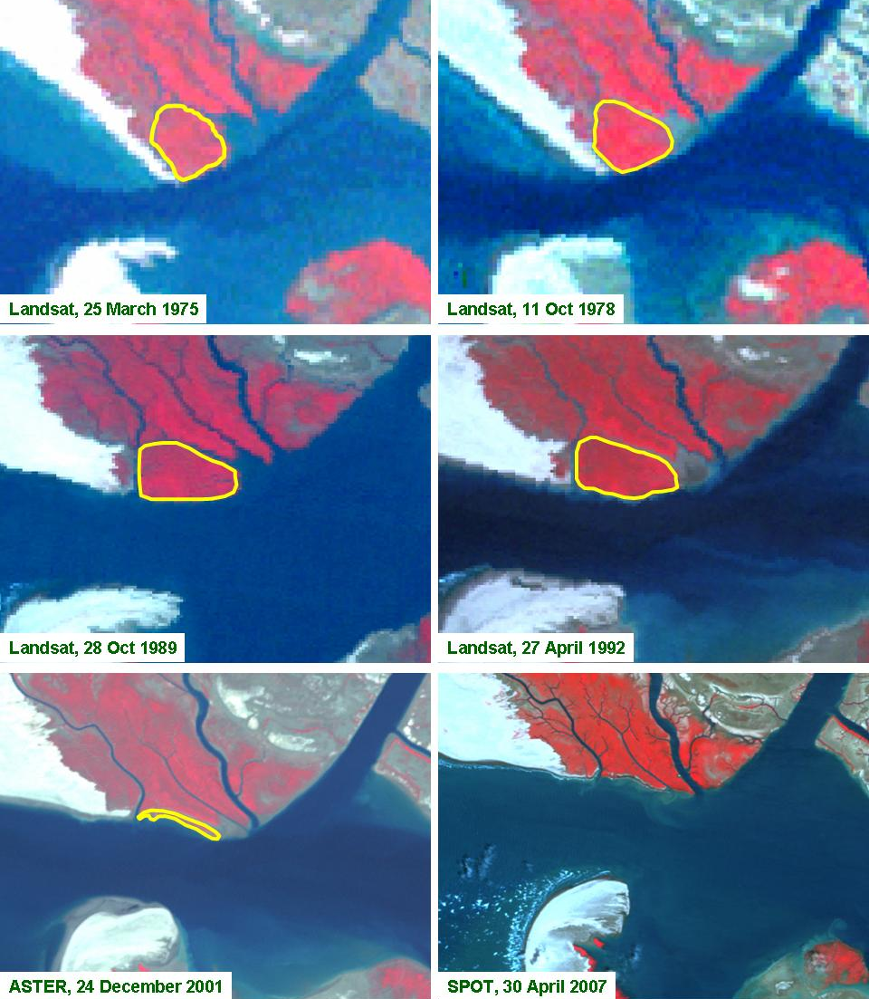
Temporal Change Mapping of Mangrove Forest

Slide 19
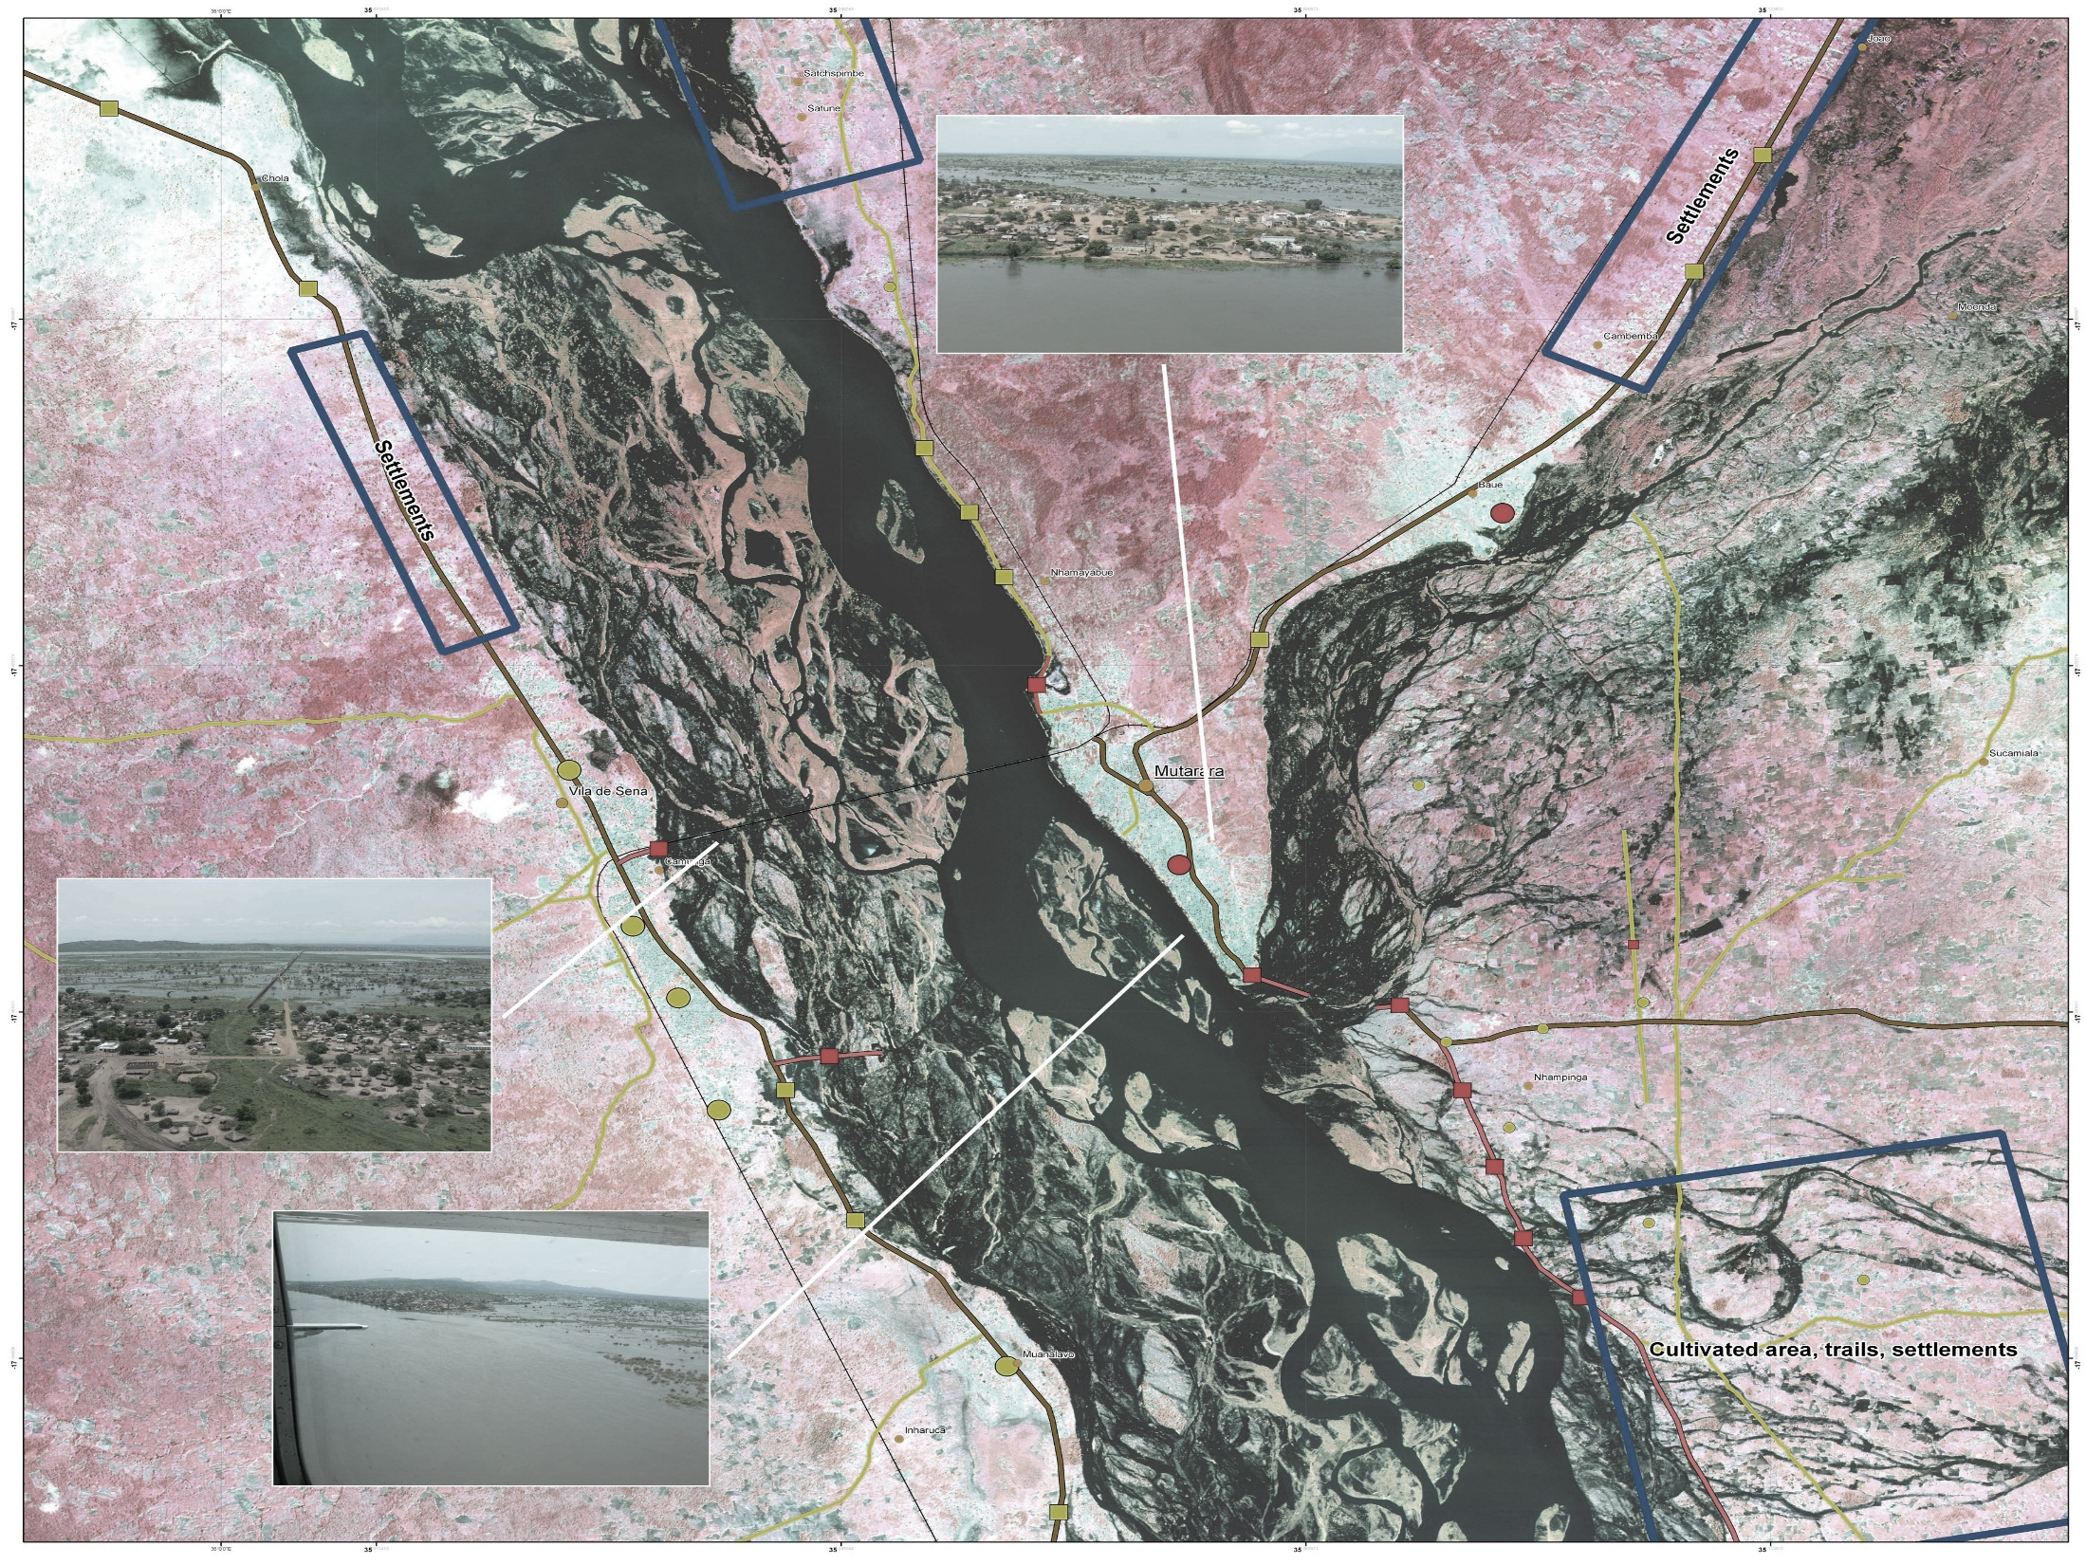
Development of Flood Monitoring Application in SCDA
GIS Based Prediction Models
Development of Monitoring System
Hazard Mapping
Databases
Achieving of Spatial Data

Slide 20
- Any questions? - Comments? - Discussion?
Thank You

