Slide 1


Slide 2
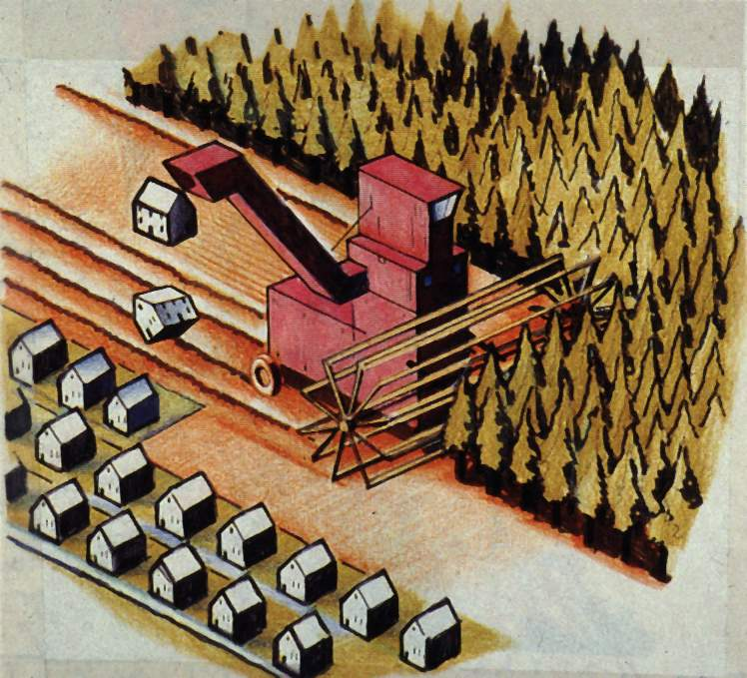
Baseline studies
Water Environment

Slide 3
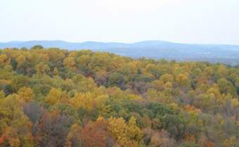
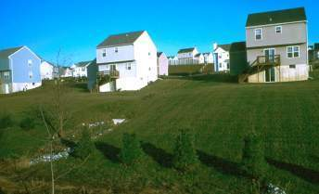
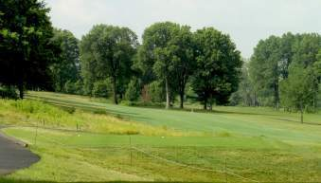
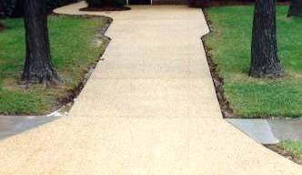
Common Bulk Density Measurements or
How compacted is this soil?
Undisturbed Lands:
Forests & Woodlands
1.03g/cc
Residential
Neighborhoods
1.69 to 1.97g/cc
Golf Courses, Parks, Athletic Fields
1.69 to 1.97g/cc
CONCRETE
2.2g/cc
David B. Friedman, District Director -- Ocean County Soil Conservation District
Bulk Density is defined as the weight of a unit volume of soil including its pore space (g/cc or grams/cubic centimeter). Water and air are important components of soil and we must frame our soil concepts so that factors affecting water and air dynamics are included. Thus, we are primarily interested in bulk density and pore space as they affect water and aeration status, and root penetration and development.
Notes:
NRCS has suggested linking ideal bulk densities to soil texture.
Permeability has an inverse relationship to bulk density.

Slide 4

Effects of Soil Disturbance
Adapted from Impact of Soil Disturbance During Construction on Bulk Density and Infiltration in Ocean County, New Jersey (2001) - www.ocscd.org/soil.pdf

Slide 5
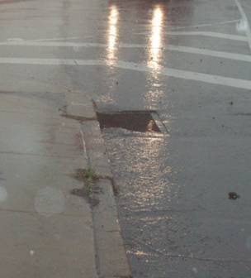
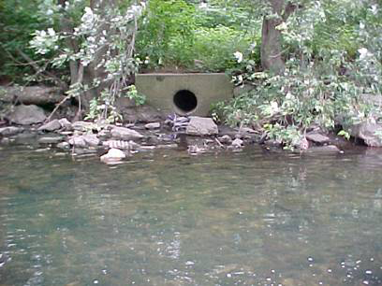
Old Approach to Manage Stormwater
Collect it and pipe it away quickly!

Slide 6
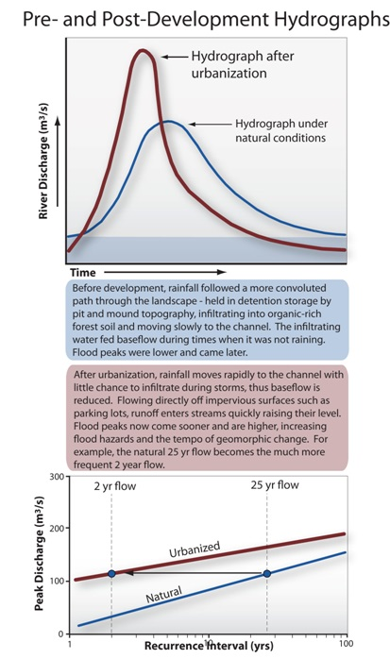
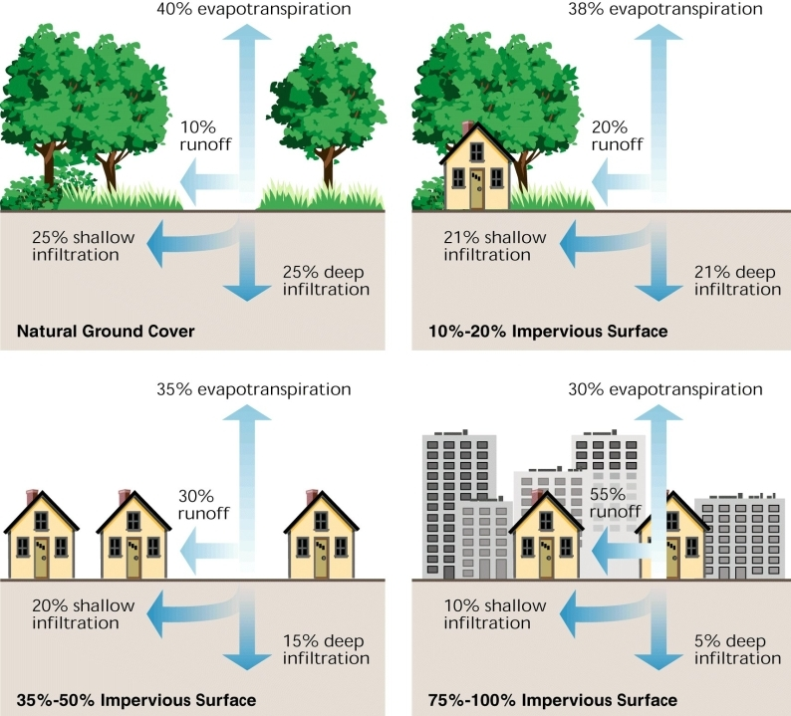
Watershed Urbanization

Slide 7
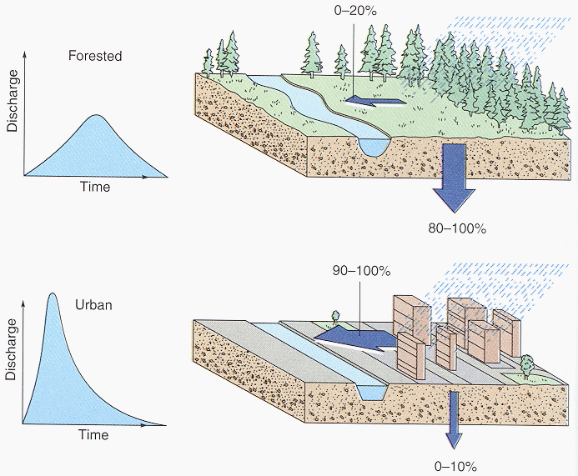
Floods and Urbanization
Surface runoff vs. Infiltration
Natural land cover vs. Urban area

Slide 8
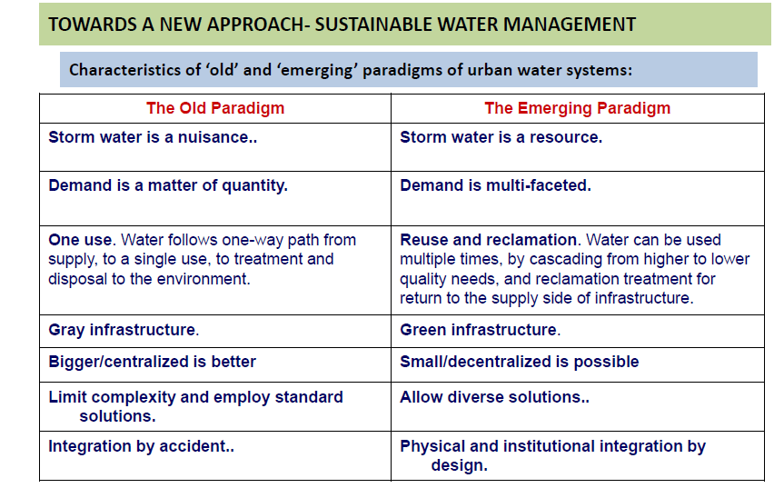

Slide 9
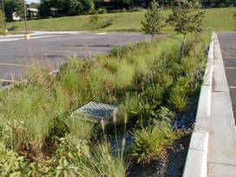
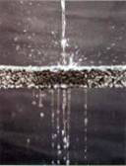
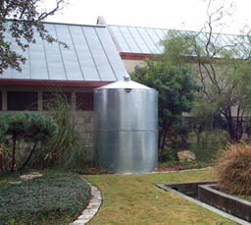
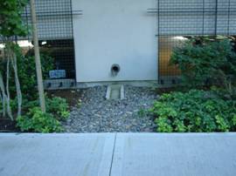
New approach for stormwater management
Temporarily hold it on site to allow it to:
Infiltrate
Evaporate
Be Reused

Slide 10
Structural BMPs
Runoff Volume/Infiltration-Oriented
Vegetative and Soil-Based
Porous Pavement
Infiltration Basin
Infiltration Bed
Infiltration Trench
Rain Garden/Bioretention
Dry Well / Seepage Pit
Constructed Filter
Vegetated Swale
Vegetated Filter Strip
Berm

Slide 11
SITE ASSESSMENT
PRELIMINARY ASSESSMENT
Published reports (e.g. geological reports, groundwater reports, soil surveys, rainfall data).
Topographical, geological, soil, and flood plain maps.
Previous and Visual site investigations.
FIELD INVESTIGATIONS
Test Pits
Borehole Construction
Monitoring Wells
Geological Information
Soil Information
Surface Water Information
Ground Water Information
Ecological Information

Slide 12
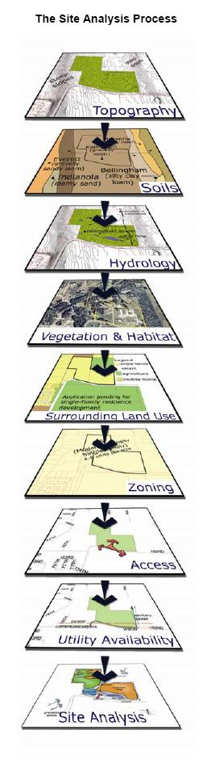
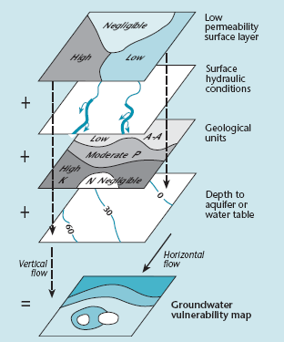

Slide 13
Suggested ways
Start at the top of the watershed, i.e. on the hills
Slow down the movement of water
Protection of the slopes for erosion and stability
Suitably sized channels on the hill side
Do not block any steep channel
Have storage volumes after de-silting
Have check dams in areas where slopes are < 5 deg.
Build series of percolating stone check dams across streams
Decrease the urban run off by Roof top Rainwater Harvesting structures
Implement sediment control for urban run off entering channel
Increase infiltration and soakage by various means

Slide 14
Binnie’s Percentages for Computation of Runoff
Annual Rainfall (mm) | Runoff (%) | Annual Rainfall (mm) | Runoff (%)
500 | 15 | 900 | 43
600 | 21 | 1000 | 38
700 | 25 | 1100 | 40
800 | 29 | > 1500 | 55
Strange Table Showing Daily Runoff Percentage
Daily Rainfall, mm | Runoff Percentage and Yield when the State of Ground is
 | Dry |  | Damp |  | Wet
 | % | Yield | % | Yield | % | Yield
5 | -- | --- | 4 | 0.20 | 7 | 0.35
10 | 1 | 0.10 | 5 | 0.25 | 10 | 1.00
20 | 2 | 0.40 | 9 | 1.80 | 15 | 300
25 | 3 | 0.75 | 11 | 2.75 | 18 | 4.50
30 | 4 | 1.20 | 13 | 3.90 | 20 | 6.00
40 | 7 | 2.80 | 18 | 7.20 | 28 | 11.20
50 | 10 | 5.00 | 22 | 11.00 | 34 | 17.00
60 | 14 | 8.46 | 28 | 16.80 | 41 | 24.60
70 | 18 | 12.61 | 33 | 25.10 | 48 | 33.60
75 | 20 | 15.00 | 37 | 27.75 | 52 | 41.25
80 | 22 | 17.60 | 39 | 31.20 | 55 | 44.00
90 | 25 | 22.50 | 44 | 39.60 | 62 | 55.80
100 | 30 | 30.00 | 50 | 50.00 | 70 | 70.00

Slide 15
Ingles and De Souza's formulae
For Ghat (Hilly) area, R = 0.85xP - 30.5
Where ‘R’ and ‘P’ are runoff and precipitation respectively, both expressed in cm.
Rational Method
The relationship for peak runoff Qp is then expressed as
Qp = C I A
Where, C = coefficient of runoff
A = area of the catchment (drainage basin)
I = intensity of rainfall.
Runoff Coefficient Factor (C):
The runoff coefficient factor (C) encompasses all other factors that affect the surface runoff, except the area (A) and the intensity of rainfall (I). It is defined as:
C = Qp/AI
Under ideal conditions, C represents the ratio of runoff volume to rainfall volume. Ideal conditions are rare. Consequently, the values of C are significantly lower than the values obtained through the above ratio.

Slide 16
Intensity of Rainfall
The formula for the intensity of rainfall is expresses as.
I = K T_{r}ª / (T_{c} + b)^{n}
Where I is the intensity of rainfall, Tr, the recurrence interval, Tc, Time of concentration, and a, b, n are constants.
The values of parameters K, a, b, n for different zones of India have been developed by the ICAR scientists,
Values of Parameters for Intensity – Duration - Return Period Relationships for Different Zones of India
Zone | K | A | b | n
North | 5.92 | 0.162 | 0.50 | 1.013
Central | 7.47 | 0.170 | 0.75 | 0.960
Western | 3.98 | 0.165 | 0.15 | 0.733
South | 6.31 | 0.153 | 0.50 | 0.950

Slide 17
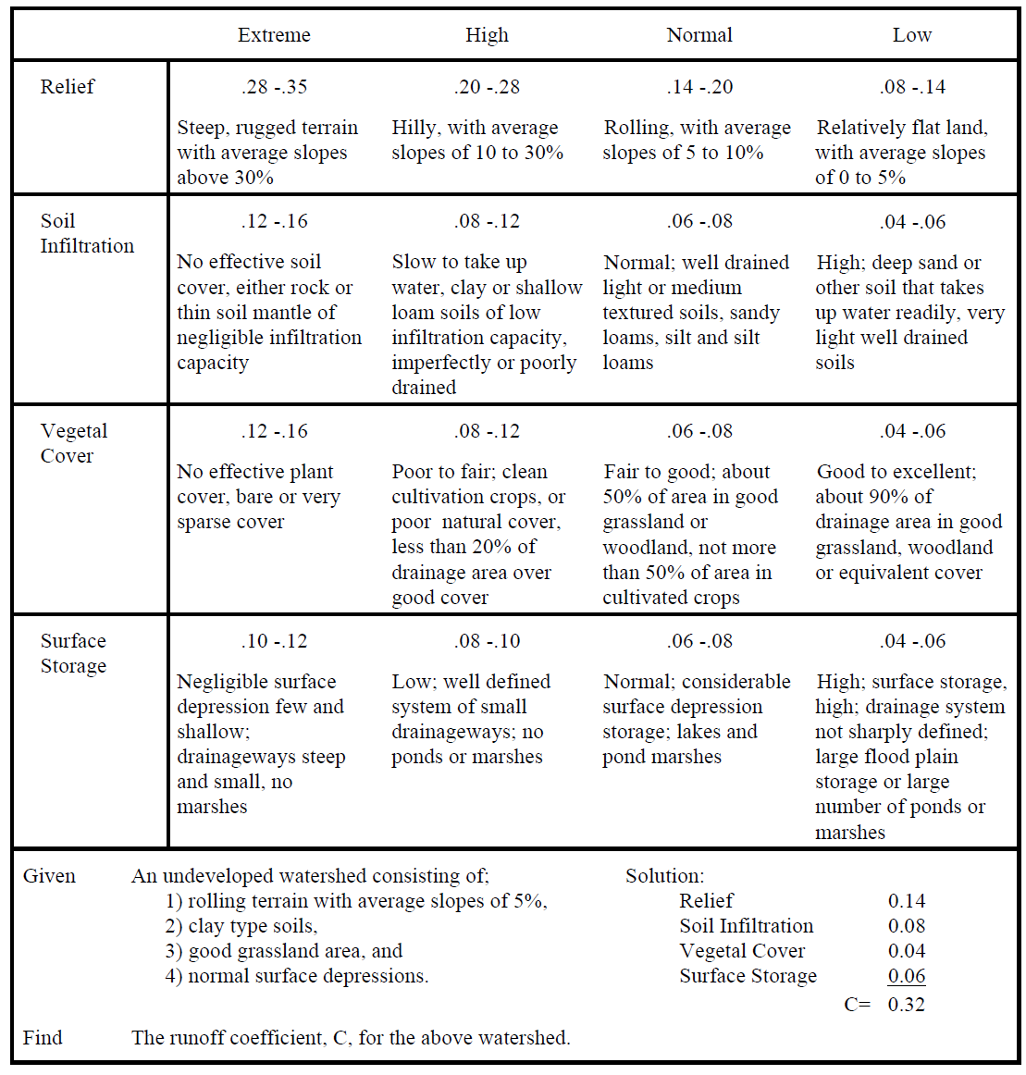
Runoff Coefficients for Undeveloped Areas Watershed Types

Slide 18
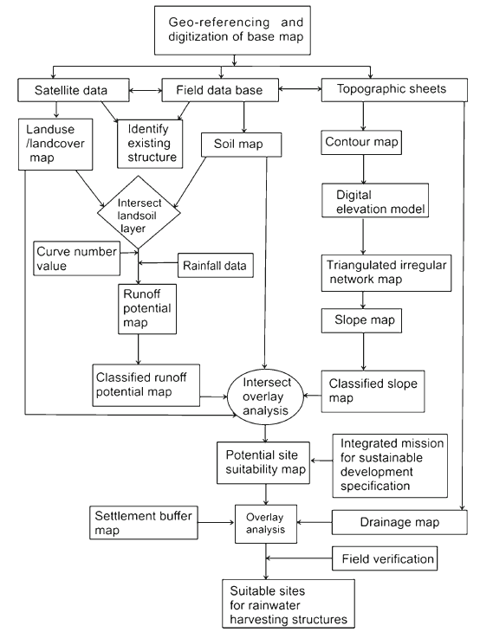
Identifying Potential Rainwater Harvesting Sites

Slide 19
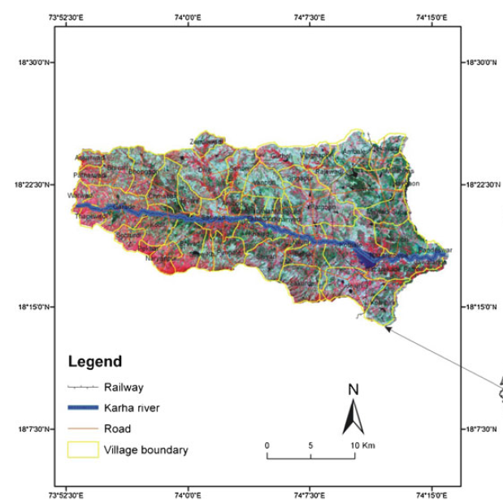
Location Map

Slide 20
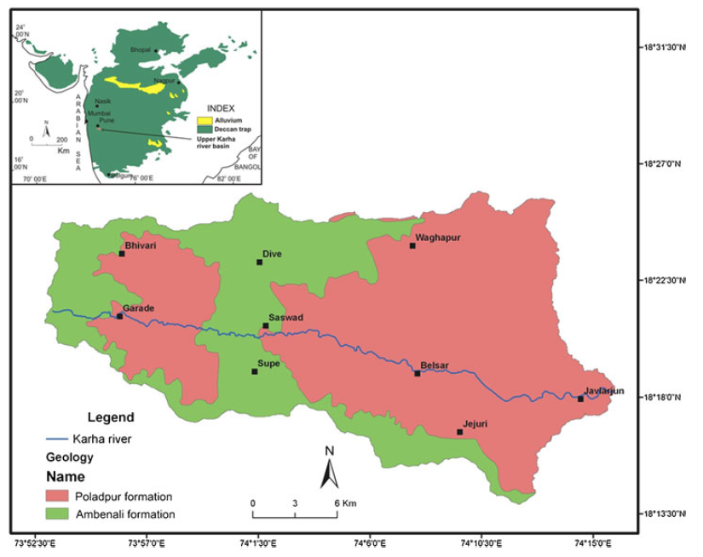
Geological map

Slide 21
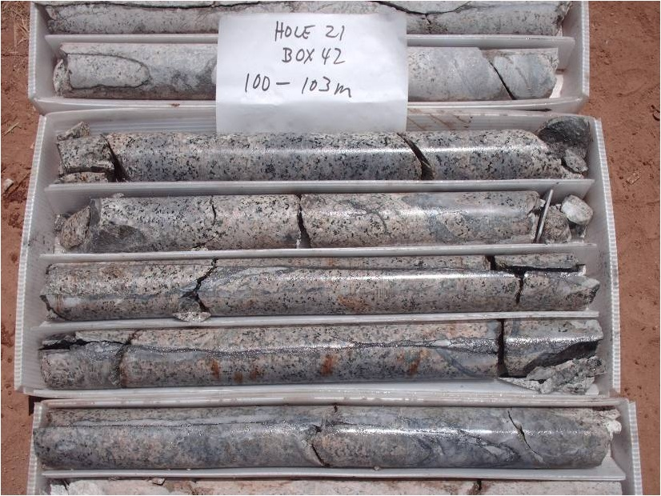
Bore logs for sub surface Geology

Slide 22
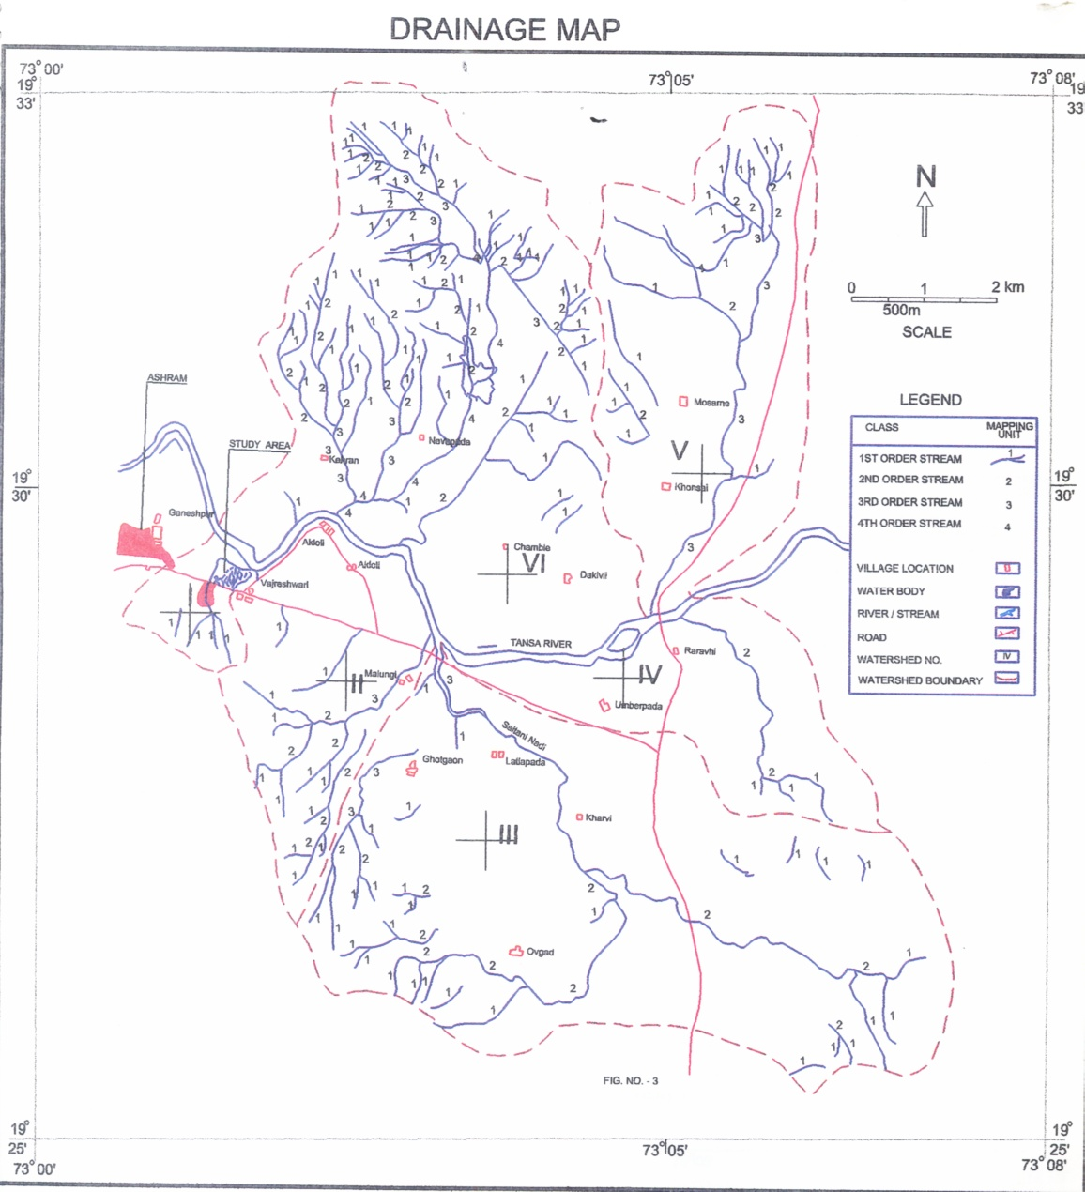

Slide 23
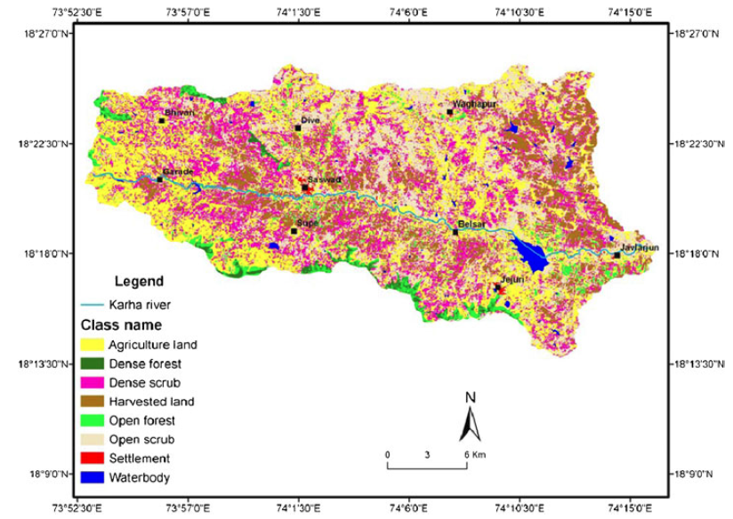
Landuse Landcover Map

Slide 24
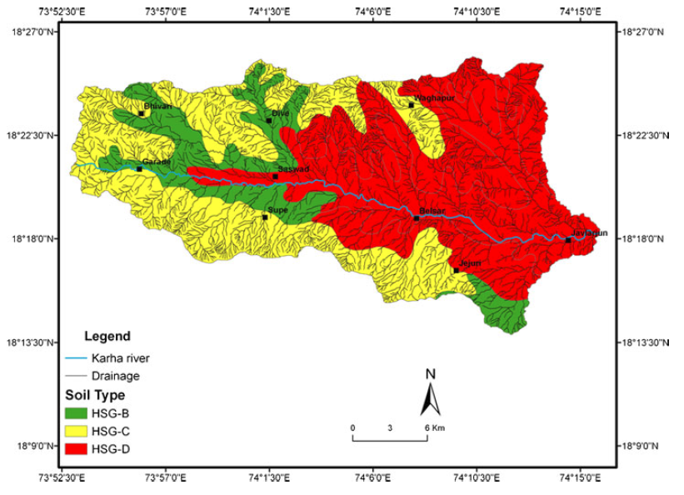
Soil Map

Slide 25
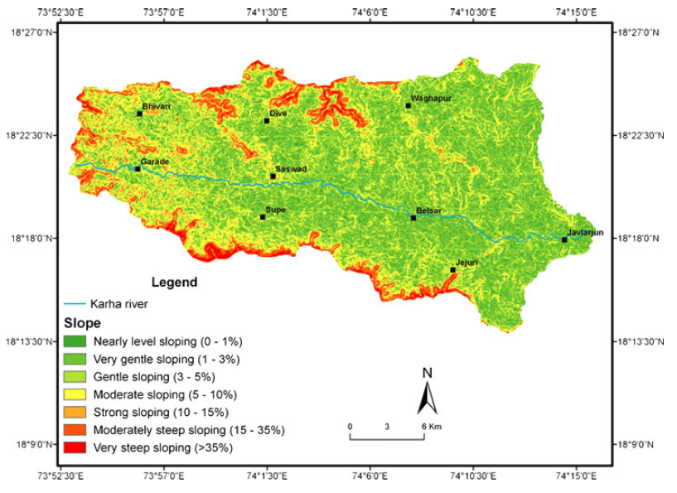
Slope Map

Slide 26
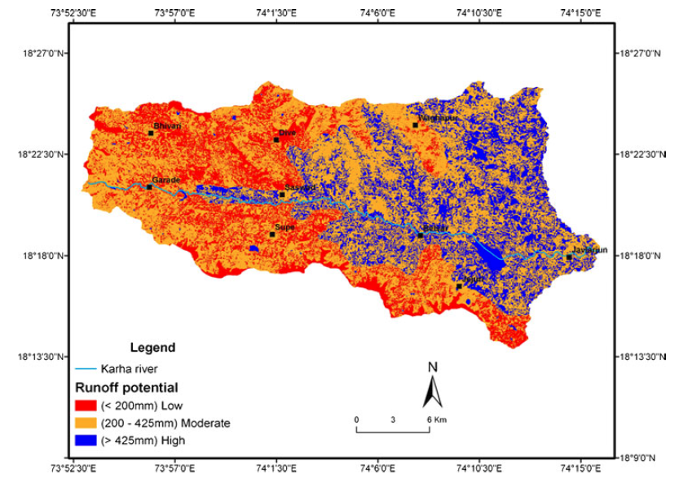
Runoff Potential Map

Slide 27
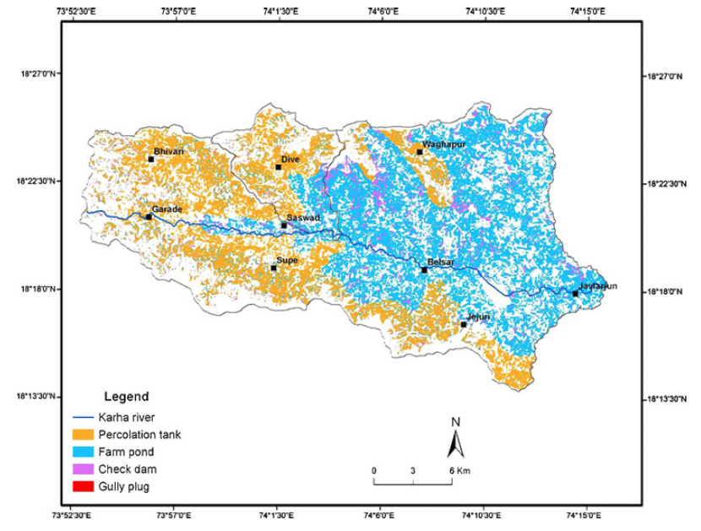
Potential Rainwater Harvesting Map

Slide 28
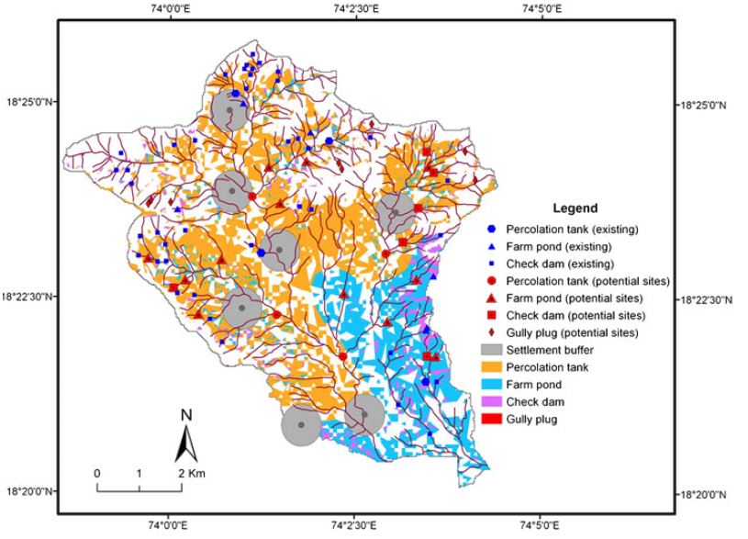
Potential Watershed Area Map

Slide 29
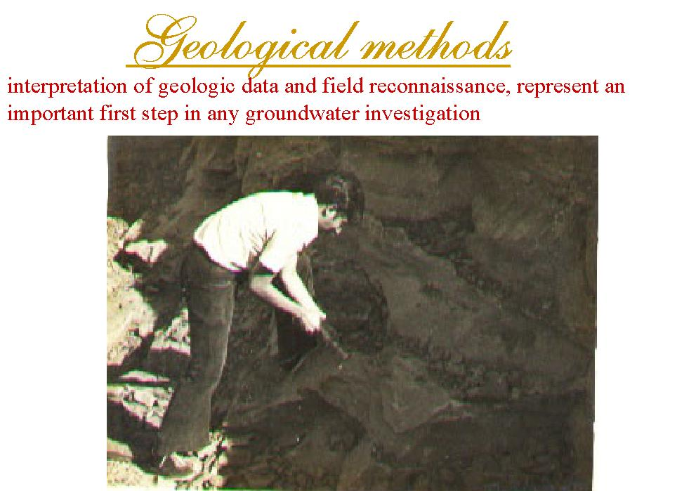

Slide 30


Slide 31
In situ Tests to assess Recharge, etc
RECHARGE TEST
The design is based on average annual rainfall and its intensity and the intake capacity of the water by the first aquifer.
In order to determine intake capacity of water by the aquifer, recharge test was carried out on an existing bore well/open well. In this test, water at varying rate was injected. For example- The water at rate of 500 liters/min did not spill over and the water column developed was recorded. The rate of dissemination of water column to the original static water level was periodically measured till original static water level was reached.

Slide 32
RECHARGE TEST DATA
Static water level = 6.20
Vol. of water injected = 500 liters (in 3 min.)
Initial water column observed = 5.21 m
Diameter of Well = 6 inches
Depth of well = 30 m
Total water dissemination period = 7 min.
Time in min. (t) | Water level in meters (h) | Head in meters
4 | 6.12 | 0.08
5 | 6.14 | 0.06
6 | 6.16 | 0.04
7 | 6.17 | 0.03
8 | 6.18 | 0.02
9 | 6.20 | 0.00
Therefore, rate of water intake works out to be 0.055 m³/min. i.e. 3.3 m³/hour.
Hence,
Recharge capacity = 3.3 m³/hour ≈ 79.20 m³/day

Slide 33
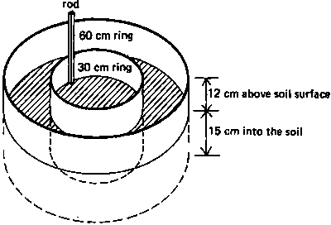
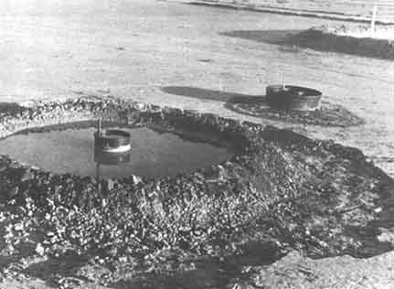
Infiltration Test
Hammer the 30 cm diameter ring at least 15 cm into the soil. Use the timber to protect the ring from damage during hammering. Keep the side of the ring vertical and drive the measuring rod into the soil so that approximately 12 cm is left above the ground.
Hammer the 60 cm ring into the soil or construct an earth bund around the 30 cm ring to the same height as the ring and place the hessian inside the infiltrometer to protect the soil surface when pouring in the water

Slide 34
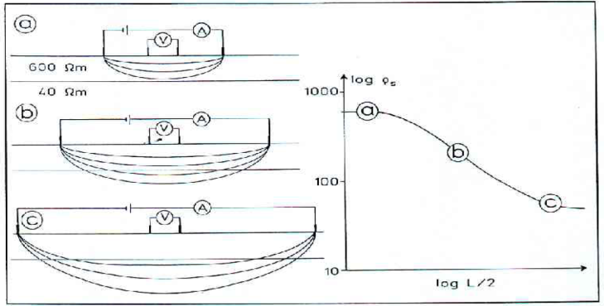
RESISTIVITY PROFILES
Based on the resistivity variations both depth wise and laterally, it is possible to estimate the depth and the lateral distribution of groundwater. The low resistivity
values less than 40 ohm-m are distributed for a= 10 and 25m, indicate the presence of weathered zones (first aquifer) which are favorable for groundwater accumulation.
Thus it is concluded that processing and interpretation of electrical resistivity data yield apparent resistivities for different electrode separations which, in turn, correspond to lateral resistivity distribution at different depths. This data represented
low and high resistivity zones. These are also correlated with local geological setting for a semi quantitative interpretation of potential groundwater zones. However this is also useful for suggesting sites and depths for artificial recharge.

Slide 35
Other Tests
Well Pumping Tests
Pump tests can be used to provide an estimate of the overall hydraulic conductivity of a geologic formation, and since it is in essence a full scale test, directly accounts for the layering and directionality of the hydraulic characteristics of the formation.
Packer Permeability Tests
Packer permeability tests can be used to measure the hydraulic conductivity of a specific soil or rock unit.
Slug Tests
These tests are easy to perform and can be performed in a borehole in which a screened pipe is installed. Two types of slug tests are commonly used, falling head and rising head.
Piezocone Tests
Piezocone data can be useful to estimate the hydraulic conductivity of silts and clays from interpretation of the coefficient of horizontal consolidation, ch, obtained from the piezocone measurments.

Slide 36
WSUD principles / strategies
Sustainable water supply options
water conservation / demand management
alternative water sources, e.g. rainwater / stormwater harvesting
aquifer storage
Wastewater minimisation
quality improvement
use of treated wastewater / recycled water
Stormwater management
SUDs (Sustainable Urban Drainage)
enhancement of amenity and biodiversity

Slide 37
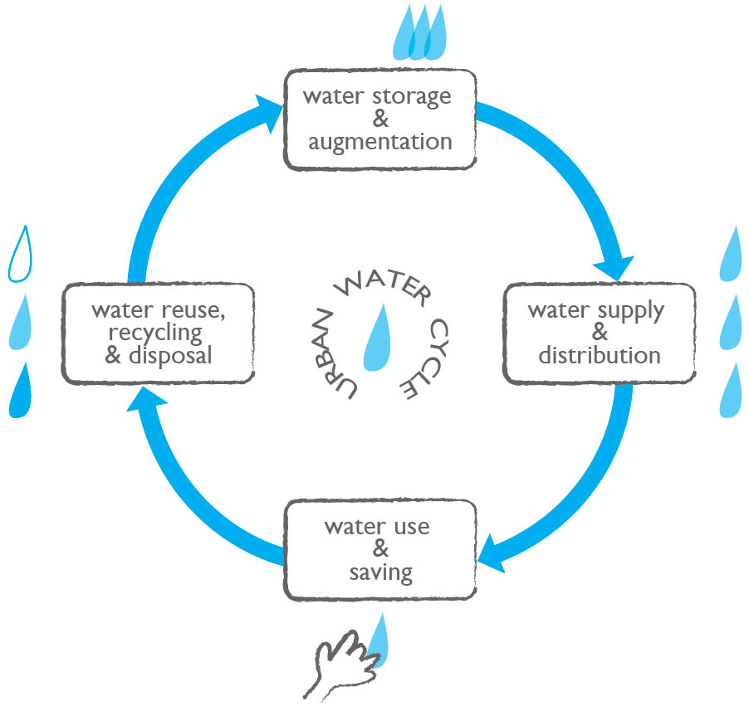
Urban Water Cycle

Slide 38
Suitability of Artificial Recharge Structure
Lithology | Topography | Type of Structure
Alluvial or hard rock | Plain area or gently undulating area | Spreading pond, subsurface to 40 m depth undulating area dike, minor irrigation tank, check dam, percolation tank, or unlined canal system
Hard rock down to 40 m depth | Valley slopes | Contour bunding or trenching
Hard rock | Plateau Regions | Recharge ponds
Alluvial or Hard rock with confined aquifer to 40 m depth | Plain area or gently | Injection well or connection well
Alluvial or Hard rock with confined aquifer to 40 m depth | Floodplain deposits | Injection well or connection well
Hard rock | Foot hill zones | Farm ponds or recharge trenches
Hard rock or alluvium | Forested areas | Subsurface dikes

Slide 39
1. Site selection criteria for Percolation Tank
• A tank can be located either across small streams by creating low elevation.
• Terrain with highly fractured and weathered rock for speedy recharge.
• Submergence area should be uncultivated as far as possible.
• Rainfall pattern based on long-term evaluation is to be studied so that the percolation tank gets filled up fully during monsoon (preferably more than once).
• Soils in the catchment area should preferably be of light sandy type to avoid silting up of the tank bed.
• The location of the tank should preferably be downstream of runoff zone or in the upper part of the transition zone, with a land slope gradient of 3 to 5%.
2. Site selection criteria for Nala Bunds
• Nala bunds can be constructed across bigger streams of second order in areas having gentle slopes.
• The rainfall in the catchments should be less than 1000 mm/annum.
• The soil downstream of the bund should not be prone to water logging.
• The Nala bunds should be preferably located in area where contour or graded bunding of lands have been carried out.
• The rock strata exposed in the ponded area should be adequately permeable to cause ground water recharge through ponded water.

Slide 40
3. Site Selection criteria for Farm ponds
• In relatively flatter terrain with good soil cover, a farm pond has an earth section with usually 3:1 side slopes on waterside and 2:1 side slopes on the downstream face.
• The drainage area above the pond should be large enough to fill the pond in 2 or 3 spells of good rainfall.
• The pond should be located where it could serve a major purpose: e.g. for irrigation, it should be above the irrigated fields and for sediment control it should intercept the flow from the most erodible parts of the catchment.
• Junction of two drainage channels or large natural depressions should be preferred.
• The land surface should not have excessive seepage losses unless it is meant to serve as a percolation tank for ground water recharge.
4. Site Selection criteria for Bore wells
• Where present land use is crop land or fallow land
• Where slope is 0–10%,
• Where major lineament intersects
5. Site Selection criteria for Dug-cum-bore wells
• Where land use is crop land or fallow or waste land
• Where slope category 0–5%,
• Where minor lineaments and major lineaments intersect
6. Site Selection criteria for Dug well
• Where land use is crop land or fallow or waste land
• Where slope category 0–3%,
• Where minor lineaments intersect

Slide 41
Managed Aquifer Recharge
To meet the ever-increasing demand for water
To augment the ground water storage and water levels
To reduce ground water pollution
To improve the quality of ground water
To reduce the soil erosion
In saline or coastal areas, rainwater when recharged to groundwater, it reduces salinity and also helps in maintaining balance between the fresh-saline water interfaces

Slide 42
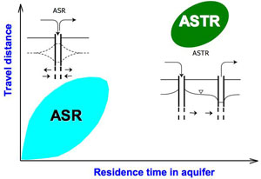
Aquifer storage & Recovery..ASR
Aquifer Storage Transfer & Recovery..ASTR

Slide 43
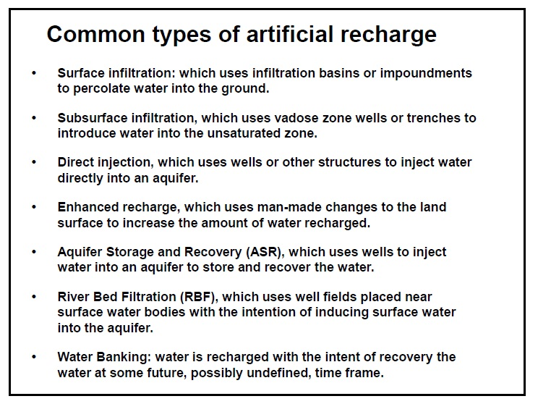

Slide 44
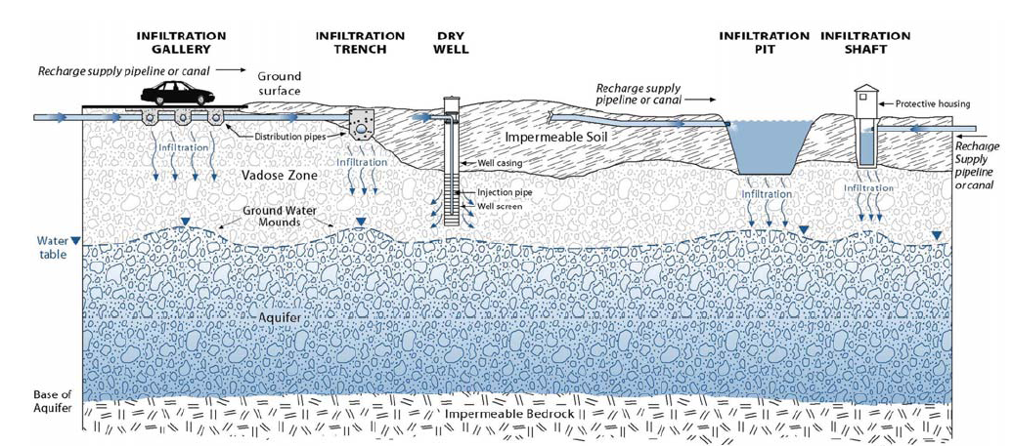
SUBSURFACE INFILTRATION TECHNOLOGIES
Source: Ralf Topper, et. al., Colorado Geological Survey Department of Natural Resources, Artificial Recharge of Ground Water In Colorado - A Statewide Assessment, 2004.

Slide 45
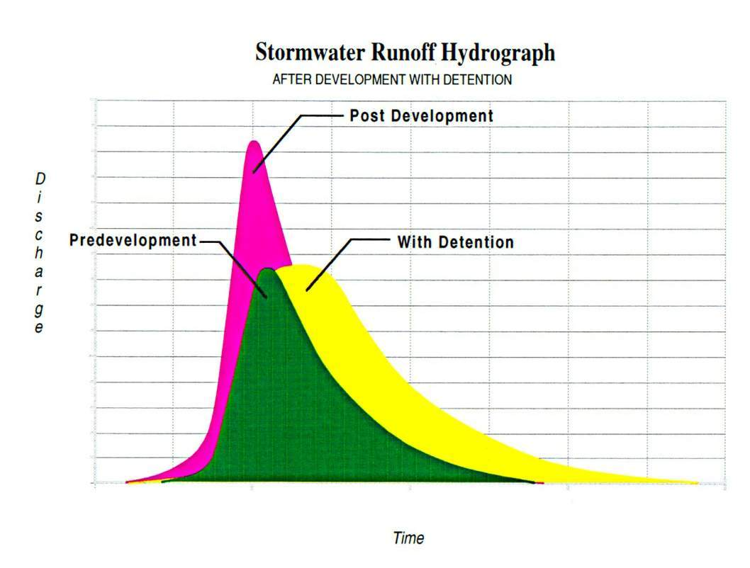

Slide 46
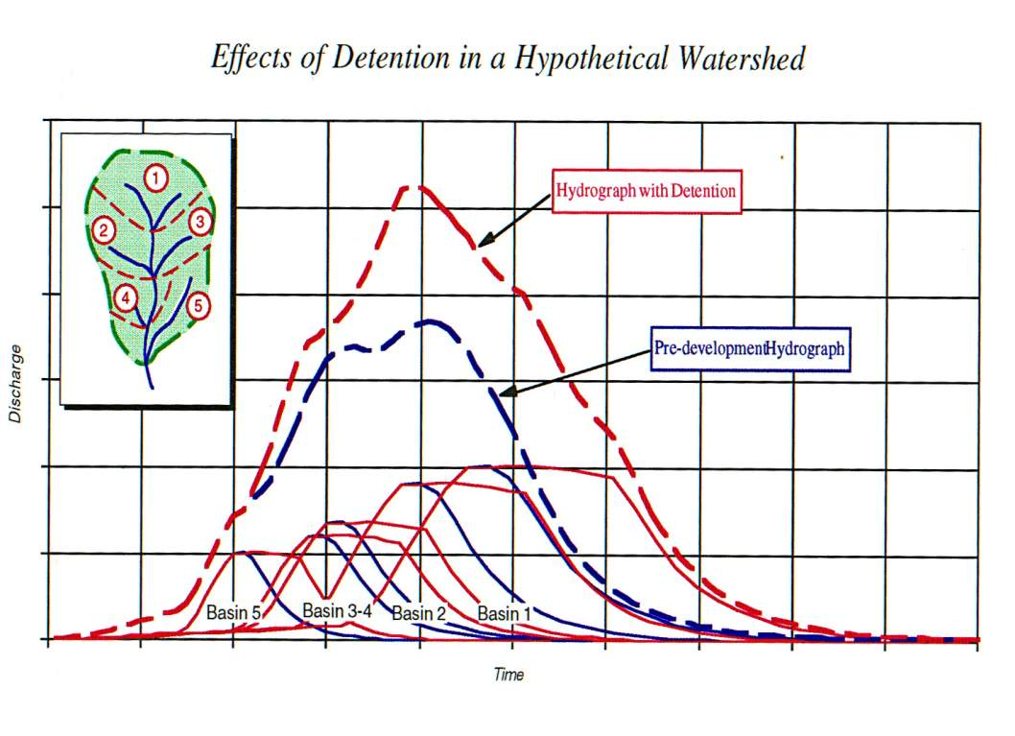

Slide 47
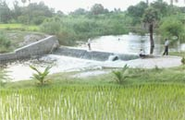
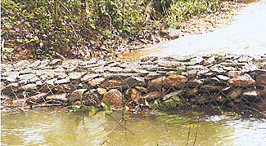
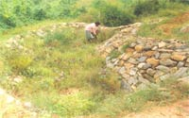
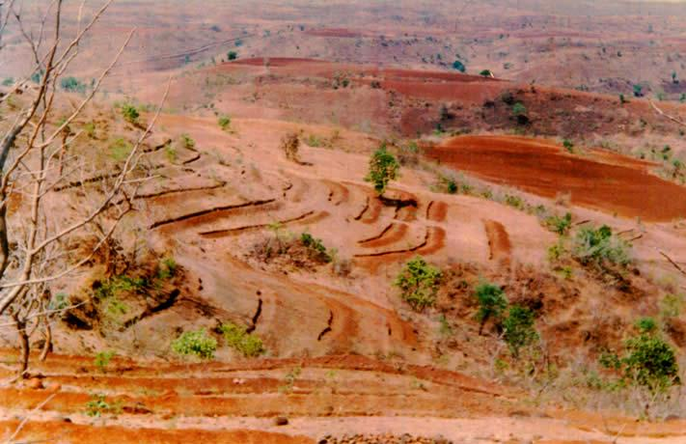
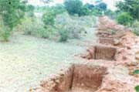
Check Dams
Bandharas
Gabions across stream bed
Bunding/Gully plugging
Contour Terracing
Contour trenches

Slide 48
Water Sensitive Urban Design
Water Sensitive Urban Design (WSUD) is a relatively new approach to water management in urban areas. The objective of WSUD is to maintain or replicate the pre-development water cycle through the use of design techniques to create a functionally equivalent hydrological landscape.

Slide 49
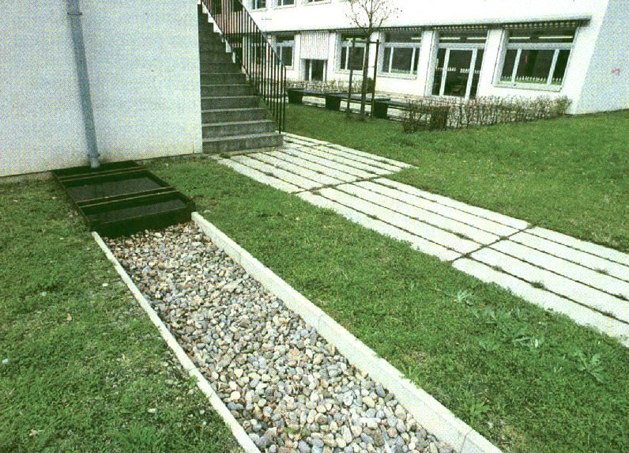
Infiltration

Slide 50
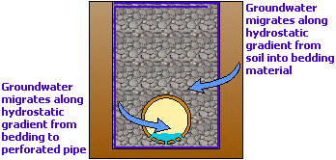
French Drains

Slide 51
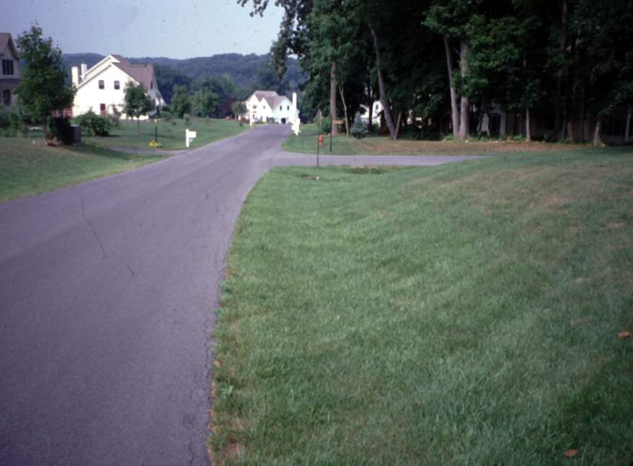
Vegetated Swales (simple & inexpensive)

Slide 52
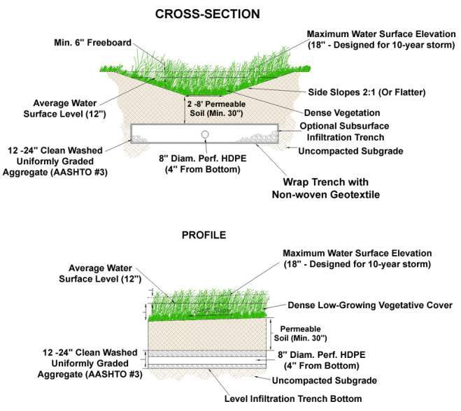
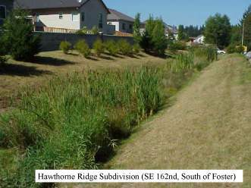
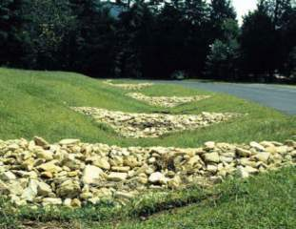

Vegetated Swale (Enhanced)

Slide 53


Vegetated Filter Strip

Slide 54


Vegetated Infiltration Beds
Distributing Water in Sub-Surface Bed

Slide 55



Infiltration Berms

Slide 56

INFILTRATION BASIN

Slide 57

Infiltration Basins

Slide 58

INFILTRATION TRENCHES

Slide 59



Infiltration Trenches

Slide 60

Trough infiltration
ev. overflow
Frost protection
Max. water level
Upper layer with low permeability
Bank protection
Humus,
h = 30 cm
Filter layer, sand,
h = 50 cm
Maximum groundwater level
min. 1 m
lower layer with high permeability

Slide 61

Infiltration pipe

Slide 62

Infiltration shaft

Slide 63

Trough-trench system

Slide 64




Constructed Wetlands

Slide 65


Wet Pond / Retention Basin

Slide 66





Water Quality Inserts/Filters

Slide 67




Riparian Buffer Restoration and Reforestation

Slide 68






Landscape Restoration
Seeding
1st year
Lawn to Sustainable Meadows
2nd year
3rd year
Images courtesy of Rolf Sauer and Partners

Slide 69

Landscape Restoration (cont.)

Slide 70



Rain Gardens / Bioretention
Rainwater can support the landscape and soils, reducing pipes and basins.

Slide 71



Tree planter schematic

Slide 72

Bioretention Areas (Rain Gardens)
Stormwater directed to these shallow topographic depressions in the landscape is filtered, stored, and infiltrated into the ground using specialized vegetation and soils.

Slide 73



Open Swales/Surface Channels
A swale is a long, shallow depression used to direct water along the surface of the ground. Stormwater is slowed, cleaned, and absorbed into the ground and/or evaporated.

Slide 74


Dry Well / Seepage Pit

Slide 75



Soil Amendment / Restoration

Slide 76

Porous Paving w/ Infiltration

Slide 77

PERMEABLE/POROUS PAVEMENTS

Slide 78





POROUS PAVEMENTS
A type of pavement that allows rain to pass through it. Can be specialized asphalt or concrete, dry-laid interlocking pavers, or other materials.
Pavements

Slide 79

Pervious Area

Slide 80
PARKING LOT PERIMETER

Slide 81


Slide 82

Permeable Patios, Terraces, Courtyards

Slide 83

Pre-treatment

Slide 84

Oil/Particle Separators

Slide 85

FILTERS IN PARKING LOTS

Slide 86


Slide 87

Better Site Design Stormwater Controls
Rain Garden
Treatment Train Approach
Raingarden Cell
Flow Path
Grass Filter Strip
Grass Swale
Raingarden Cell
Storm Drain System

Slide 88

Bio-drainage
Shallow groundwater tables and associated salinity problems have become dominant features in some areas in coastal areas.
The solution to this often focus on engineering approaches such as deep open ditches, vertical drainage (groundwater pumping) or horizontal subsurface drainage.
Bio drainage, i.e. the use of vegetation to manage water fluxes in the landscape, is one such technique that has recently attracted interest in drainage and environmental management groups.

Slide 89

Trees for controlling dryland salinity and waterlogging
Water movement to (recharge) and from (discharge) the water-table in a catchment

Slide 90

Trees intercept groundwater flowing down a slope. Water used by the trees will reduce recharge of water tables further down the slope.

Slide 91

Plant trees on the perimeter of bare, salt-scalded soils in discharge areas to
control water-table levels

Slide 92
Rainwater Harvesting..Urban
The activity of collecting rainwater directly or recharging into the ground to improve ground water storage is called as Rain Water Harvesting.
The decision whether to store or recharge water depends on the rainfall of a particular region. In areas where the total rainfall occurs only during 3 or 4 months of monsoon, Rainwater collected during monsoon has to be stored for the year, which means that huge volumes of storage containers would be required. So, it is always feasible in these areas to use rainwater to recharge groundwater aquifers rather than for storage.
Rainwater is to be harvested to conserve and augment the storage of ground water, to reduce water table depletion, to improve the quality of ground water, and to arrest seawater intrusion in coastal areas.

Slide 93
Rain Water Harvesting Ways
    Capturing run-off from rooftops;
    Capturing run-off from local catchments;
    Capturing seasonal flood water from local streams; and
    Conserving water through watershed management.

Slide 94

Non-land-based Systems
Non-land-based micro-catchment systems collect and store rainwater from the roofs of houses or large buildings, greenhouses, courtyards, and similar impermeable surfaces, including roads.

Slide 95
Calculating the amount of water the catchment area will produce
Qdes = 2.8 x C x i x A
Qdes : the design peak runoff rate, or the maximum flow of stormwater the system will be designed for (in litres per second)
C : the runoff coefficient
i : the rainfall intensity at the time of concentration read from the chosen
IDF curve; if no IDF curves are available, a value of 100 mm/h can be taken (in mm/h)
A : the surface area of the catchment area (in ha (10,000 m*2)
Efficiency of Rainfall capture E
E = W / (P x A x F),
W = annual water supply volume obtained from RWH system (in litres per year),
P = annual precipitation (in mm)
A = area of roof (in m2)
F = ‘Run-off fraction’ = Water volume reaching the down pipe volume falling on roof
(e.g. .85)
Mean Daily Run off R
R = P x A x F / 365
P = annual precipitation (in mm)
A = area of roof (in m2)
F = ‘Run-off fraction’ = Water volume reaching the down pipe volume falling on roof (e.g. .85)

Slide 96

Run off coefficient of developed areas

Slide 97
DATA FOR DESIGNING A RAINWATER HARVESTING SYSTEM
Sr. No. | Subject | Information as | Values | Remarks
1 | Location, Lay out, Block plan | Maps, drawings | Hard copy | Topography
2 | Area of the plot | In square meters
3 | Area of Roof/Terrace | In square meters
4 | Rainwater down take pipes | No. of pipes and diameter |  | Material type
5 | Size of Partitions in u.g. tank | Cubic meter |  | Domestic/ Flushing
6 | Paved, road area in the plot | Square meters
7 | Unpaved or garden or RG area | Square meters |  | Show on map
8 | Storm water drains, size, etc | Drawing | Hard copy | Cross section
9 | Soil analysis report | Geo technical report | Logs | Bore logs
10 | Presence of Bore well/open well | Depth, yield & quality | Logs | Mark on map
11 | Presence of water body nearby | Pond, river, creek, sea, nala | Hard copy | Mark on map
12 | Septic tank, etc | Distance from wells | Hard copy | Mark on map
13 | Flood data | Max. flood level |  | M & Year

Slide 98


Slide 99
Schedule for Rooftop Rainwater Harvesting:
Component | Description | Purpose | Size | Quantity
Coarse Mesh | At the mouth of Rainwater down takes on terrace of SS grills | To trap large sediments entering the conduit pipes | 160 mm diameter | nos
Down take pipes | As per the specification by plumbing agency | To bring rainwater down | 160 mm | nos.
Collection chamber | To collect rain water and join it with channel pipe | To avoid breaking of joints of down take and channel pipes | 0.5 m x 0.5m x 0.5 m with air tight cover | nos.
Channel pipe | ISI brand rigid pipes of PVC material of 4/6 kg/cm² strength | To direct rainwater flow to Rainwater Harvesting Unit | 200 mm diameter | As per site
First Flush (FF) valves | Ball valves of PVC material | For first seven day reject water in by pass arrangement | 160 mm | 1 set /unit
Valve Box chamber | 225 mm brick masonry chamber plastered from inside in M-25 and cover | Chamber to house the FF valves | 1 m x 1 m x 1 m depth Or as per the valve size | nos.
Filtration chamber/ Filter Unit | RCC tank near the storage tank | Filtration | 1.5 m x1.5 m x2.0 m depth with graded filter media | no.
Holding tank | RCC tank | To hold 15 min. peak rainfall | Total vol. of all tanks 125 m³ | 6 no.
Recharge Bore well | Bore well drilled for groundwater extraction | Recharging the aquifer zones from overflow of storage tank or down takes | 150 mm diameter bore well with water source | 6 no.
Recharge Bore well pit | RCC rings of 1 m diameter around B/W | Recharge volume | 10 m³ | 6 nos.

Slide 100
Schedule for Surface Run off Harvesting:
Surface run off from paved areas
Component | Description | Purpose | Size | Quantity
Recharge pits/ trenches | Increased water infiltration area | To drain off and minimize run off | m x m x m depth made in 225 mm brick work | gravels, pebbles and coarse sand filter
Deep bored soak away | Increased water infiltration area | To drain off and minimize run off | 100 mm dia. drilled till 25 m | nos.
Infiltration Basin | Swale | Stabilize run off | As per site | nos.
SWD | Check dams | Slow down of run off | As per SWD dimensions | c.c. @ 100 m
Infiltration trenches | Increased water infiltration area | Increasing imperviousness | m x m depth | ....do...
Tree box planters | Increased water infiltration area | Increasing imperviousness | As per size of tree boxes | All available tree boxes

Slide 101


Slide 102


Slide 103

Terrace Top Harvesting
Amount of water collectable in rainy season =
Roof area x a.a.r. x frictional coefficient of surface

Slide 104


Slide 105




Roof catchments

Slide 106


First Flush valve

Slide 107



On line filters/Filtration tank

Slide 108

Holding Tank

Slide 109

Recharge Bore well

Slide 110


Slide 111




Trench …Surface water

Slide 112


Recharge pits

Slide 113


Slide 114



Install check dams to reduce velocity and enhance infiltration.

Slide 115

Soak ways
Soak ways are one type of "Infiltration Device", a simple way of dispersing surface and storm water in situations where connection to the SW system is impractical or unwarranted. The basic principle is that of a 'reverse well' i.e. a 'hole-in-the-ground' that loses water rather than collecting water.

Slide 116


Slide 117




Slide 118


Slide 119





Urban RWH layout
Channeling down takes
Soak away
First Flush valve
Pop up valve
Gate Trench
FF, Filter, Recharge B/W

Slide 120

The area after completion of RWH work

Slide 121
Cost
Rainwater harvesting methods are site specific and hence it is difficult to give a generalized cost.
But first of all, the major components of a rainwater harvesting system - rain and catchments area - are available free of cost.
A good proportion of the expenses would be for the pipe connections. By judiciously fixing up the slopes of roofs and location of rainwater outlets, this could be brought down considerably.
However the cost varies widely depending on the availability of existing structures like wells and tanks which can be modified and used for water harvesting.

Slide 122
Cost of Recharge Structures
The cost of each recharge structure varies from place to place. The approximate cost of the following structures is as under:
S.No. Recharge Structure Approximate cost INR
1. Recharge pit 2,500 – 5,000
2. Recharge Trench 5,000 – 10,000
3. Recharge through hand pump 1,500 – 2,500
4. Recharge through dug well 5,000 – 8,000
5. Recharge well 50,000 – 80,000
6. Recharge shaft 60,000 – 85,000
7. Lateral Shaft with Bore well
Shaft per m. 2,000 – 3,000
8. Bore well 25,000 – 35,000
Unit cost of construction activities.
Item | Unit | Rate (Rs.)
Excavation in soils | cu. m. | 90.00
Excavation in rock | cu. m. | 150.00
Brickwork with cement mortar (1:6) | cu. m. | 1400.00
Plain cement concrete (1:3:6) | cu. m. | 1500.00
Reinforced cement concrete (1:2:4) cu. m. 4700.00Including steel bars, shuttering etc. | cu. m. | 4700.00
PVC piping for rainwater pipes - 110 mm diameter - 200 mm diameter | Metre metre | 165.00 275.00
Making borehole in metre 165.00Soft soil (with 150 mm diameter PVC casing) | metre | 180.00

Slide 123
Installation Cost For Rainwater Harvesting System
System cost include supply and installation and varied accordingly depending to the type of materials used.
 | Unit | Amount (Rs./m)
Gutter (uPVC) |  | 150.00
Conveyance System |  | 200.00
Plumbing works |  | 400.00
Water tank (top) | 1 No | 10,000
Water tank (ground) |  | 10,000
Water pump (electrical) |  | 7500
Unit Cost of Water by Rainwater Harvesting
Unit Cost of water by rainwater harvesting system can be calculated using simple formula below:-
Allowing about 10% of the capital cost to cover interest and depreciation each year.
Cost per 1,000 liters = Cost of the system X 0.10
-----------------------------------------------
Yield in liters per day X 0.365

Slide 124
Cost of system
Cost of the system X 0.10
Cost per 1,000 liters = --------------------------------------------
Yield in liters per day X 0.365
7,70,000 x 0.10
= -----------------------
30,000 x 0.365
77500
= ----------------
10950
= Rs. 7.07 in the first year,
Allowing about 10% of the capital cost to cover interest and depreciation each year.

Slide 125
Pay Back Period
MCGB Tarrif
@ Rs. 25 per KL
System Cost
:
Rs. 7,75,000/-
Water Saving/
month
:
Rs.28800/ per month
Payback Period
:
Rs. 7,75,000 / (Rs.28800X 12)
:
28 months

Slide 126
Final thought
It is my opinion that we can't just assign recharge coefficients as a function of the geological formations.
These coefficients depend on several factors, from which I will refer only two: the land cover and the annual precipitation.
Land cover conditions the amount of water available for plant growth and evapotranspiration.
Precipitation is the input of water for the groundwater medium. If precipitation is almost the same as the potential evapotranspiration and the water available on the soil for roots uptake is not fullfilled, then there will be no recharge and recharge coeffiecient is near zero.
On the other hand, if precipitation is much higher than potential evapotranspiration then recharge will be expected and the groundwater recharge coefficient could be very high.

