Slide 1
3 R’s of water
Recharge, Reuse & Recycling

Slide 2
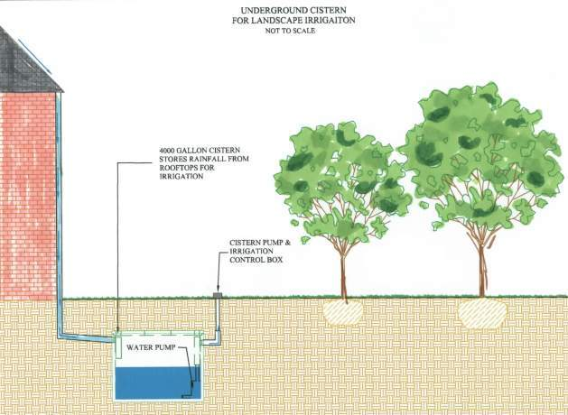

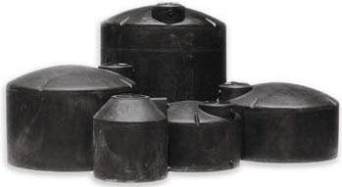
Capture / Reuse
Volume Control
Reduced potable water consumption
Cost savings

Slide 3
Groundwater Recharge – Techniques
Source: US EPA. Guidelines for water reuse

Slide 4
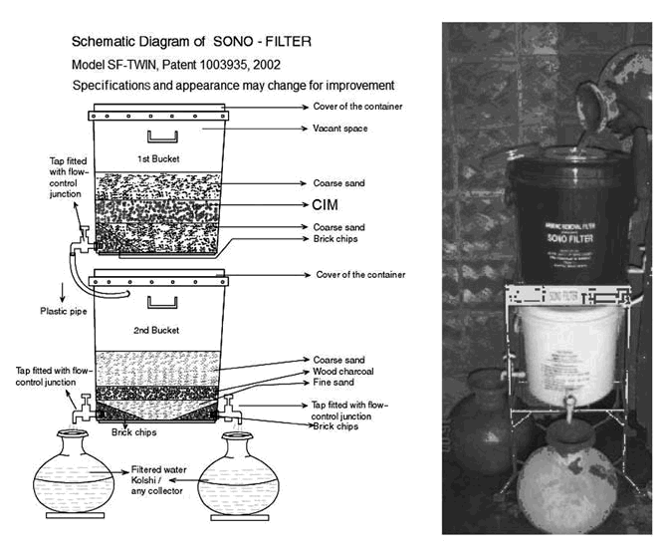
Arsenic contamination
composite-iron matrix (CIM)
Activated alumina is an adsorbent that effectively removes arsenic. Activated alumina columns connected to shallow tube wells in India and Bangladesh have removed both As(III) and As(V) from groundwater for decades.

Slide 5
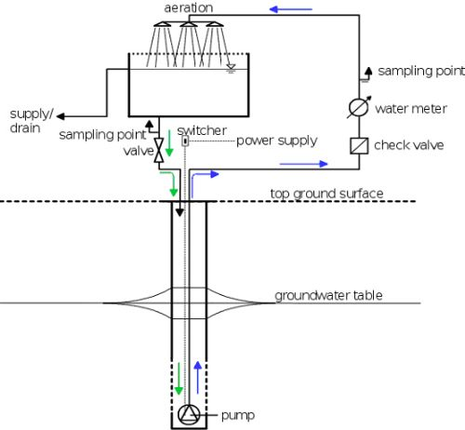
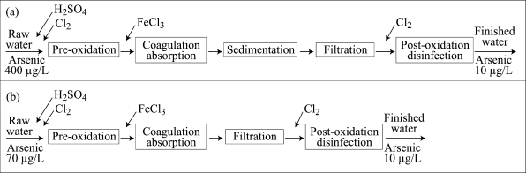
Subterranean Arsenic Removal (SAR) Technology
General schematic Chillean arsenic-removal treatment process: (a) Surface water and (b) Groundwater

Slide 6
Typical Composition of Wastewater
 |  | Raw Wastewater
 |  | _{99.9%} |  |  | _{0.1%}
 | Water |  |  |  | Solids
 |  | _{70%} |  |  |  |  |  |  | _{30%}
 |  | Organic |  |  |  |  |  | Inorganic
_{65%} |  | _{25%} |  | _{10%}
Proteins |  | Carbohydrates |  | Fats |  | Grit |  | Salts |  | Metals

Slide 7
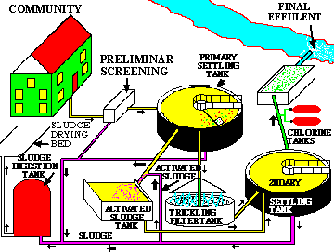
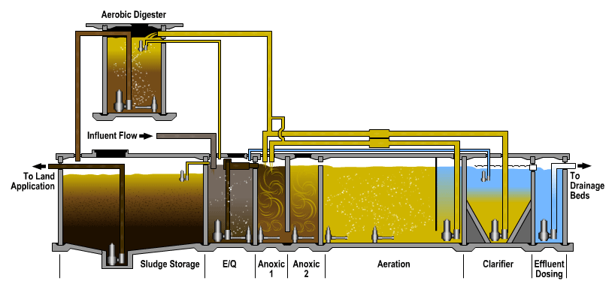
Wastewater
Typical municipal wastewater
treatment plant design
Typical industrial
wastewater
treatment plant
design

Slide 8
Levels of Wastewater Treatment
Treatment Level | Description
Preliminary | Removal of wastewater constituents such as rags, sticks, floatables, grit, and grease that may cause maintenance or operational problems with the treatment operations, processes, and ancillary systems
Primary | Removal or portion of the suspended solids and organic matter from wastewater
Secondary | Removal of biodegradable organic matter (in solution or suspension) and suspended solids. Disinfection is also typically included in the definition of conventional secondary treatment
Tertiary | Removal or residual suspended solids (after secondary treatment), usually by granular medium filtration or microscreens. Disinfection is also typically a part of tertiary treatment. Nutrient removal is often included in this definition
Advanced | Removal of dissolved and suspended materials remaining after normal biological treatment when required for various water reuse applications

Slide 9
Advantages and disadvantages of chlorine for wastewater disinfection
 | Advantages | Disadvantages
CHLORINE | Well established technology Effective disinfectant Chlorine residual can be monitored and maintained Combined chlorine residual can also be provided by addition of ammonia Germicidal chlorine residual can be maintained in long transmission lines Availability of chemical system for auxiliary uses such as odour control, dosing RAS lines, and disinfection plant water systems Oxidises sulphides Relatively inexpensive (cost increasing with implementation of Uniform Fire Code regulations) Available as calcium and sodium hypochlorite considered safer then chlorine gas | Hazardous chemical that can be a threat to plant workers and the public; strict safety measures must be employed Relatively long contact time required as compared to other disinfectants Combined chlorine is less required as compared to other disinfectants Residual toxicity of threat effluent must be reduced through dechlorination Formation of trihalomethaned and other dbpsª Release of volatile organic compounds from chlorine contact basins Oxidises iron, magnesium, and other inorganic compounds (consumption of disinfectant) Oxidisation of a variety of organic compounds (consumes disinfectant) TDS level of treated effluent increased Chloride content of the wastewater can be reduced if alkalinity is insufficient Acid generation; ph of wastewater can be reduced if alkalinity is insufficient Increased safety regulations, especially in light of the Uniform Fire Code Chemical scrubbing facilities may be required to meet

Slide 10
Chlorine dioxide for wastewater disinfection
 | Advantages | Disadvantages
CHLORINE DIOXIDE | Effective disinfectant More effective than chlorine in inactivating most viruses, spores, cysts, and oocysts Biocidal properties not influenced by ph Under proper generation conditions, halogen-substituted dbps are not formed Oxidises sulphides Provides residuals | Unstable must be produced onsite Oxidises iron, magnesium, and other inorganic compounds (consumes disinfectant) Oxidises a variety of organic compounds Formation of dbps (i.e. Chlorite and chlorate) Potential for the formation of halogen-substituted dbps Decomposes in sunlight Can lead to the formation of odours Increased TDS level of treated effluent Operating costs can be high (e.g., must test for chlorite and chlorate)

Slide 11
Ozone for wastewater disinfection
 | Advantages | Disadvantages
OZONE | Effective disinfectant More effective than chlorine in inactivating most viruses, spores, cysts, and oocysts Biocidal properties not influenced by ph Shorter contact time than chlorine Oxidises sulphides Requires less space Contributes dissolved oxygen | No immediate measure of whether disinfection was successful No residual effect Less effective in inactivating some viruses, spores, cysts at low dosages used for coliform organisms Formation of dbps Oxidises iron, magnesium, and other inorganic compounds (consumes disinfectant) Oxidises a variety of organic compounds (consumes disinfectant) Off-gas requires treatment Safety concerns Highly corrosive and toxic Energy-intensive Relatively expensive High operational and maintenance-sensitive Lack of chemical system that can be used for auxiliary uses such as dosing RAS lines May be limited to plant where generation of high-purity oxygen already exists

Slide 12
UV for wastewater disinfection
Source: Metcalf & Eddy, 2003
 | Advantages | Disadvantages
UV RADIATION | Effective disinfectant No residual toxicity More effective than chlorine in inactivating most viruses, spores, cysts No formation of dbps at dosage used for disinfection Does not increase TDS level of treated effluent Effective in the destruction of resistant organic constituents such as NDMA Improved safety compared to the use of chemical disinfectants Requires less space than chlorine At higher dosages, UV radiation can be used to reduce concentration of trace organic constituents (e.g. NDMA) | No immediate measure whether disinfection was successful No residual effect Less effective in inactivating some viruses, spores, cysts at low dosages used for coliform organisms Energy intensive Hydraulic design of UV system is critical Relatively expensive (reduction in prices as new technologies enter the market) Large number of UV lamps required where low-pressure low-intensity systems are used Low-pressure low-intensity lamps require acid washing to remove scale Lack of chemical system that can be used for auxiliary uses such as odour control, dosing RAS lines, and disinfection of plant water systems

Slide 13
General Characteristics of Membrane Processes
Process | Membrane driving force | Typical separation mechanism | Operating structure (pore size) | Typical operating range, μm | Permeate description | Typical constituents removed
Microfiltration (MF) | Hydrostatic pressure difference or vacuum in open vessels | Sieve | Macropores (>50nm) | 0.08 – 2 | Water & dissolved solutes | TSS, turbidity, protozoan oocysts & cysts, some bacteria & viruses
Ultrafiltration (UF) | Hydrostatic pressure difference | Sieve | Mesopores (2-50nm) | 0.005 – 0.2 | Water & small molecules | Macromolecules, colloids, most bacteria, some viruses, proteins
Nanofiltration (NF) | Hydrostatic pressure difference | Sieve & solution/ diffusion & exclusion | Micropores (<2nm) | 0.001 – 0.01 | Water & very small molecules, ionic solutes | Small molecules, some harness, viruses
Reverse osmosis (RO) | Hydrostatic pressure difference | Solution/ diffusion & exclusion | Dense (<2nm) | 0.0001 – 0.001 | Water & very small molecules, ionic solutes | Very small molecules, colour, hardness, sulphates, nitrate, sodium, other ions
Dialysis | Concentration difference | Diffusion | Mesopores (2-50nm) | - | Water & small molecules | Macromolecules, colloids, most bacteria, some viruses, proteins
Electrodialysis | Electromotive force | Ion exchange with selective membranes | Micropores (<2nm) | - | Water & ionic solutes | Ionised salt ions

Slide 14
Urban Wastewater Reuse
What can urban reclaimed water be used for?
  Irrigation - public parks, schools, road medians, any landscaped areas, golf courses
  Commercial - vehicle washing facilities, laundry facilities, window washing, mixing pesticides and herbicides
  Construction - dust control, concrete production
  Toilet and urinal flushing
  Fire protection

Slide 15
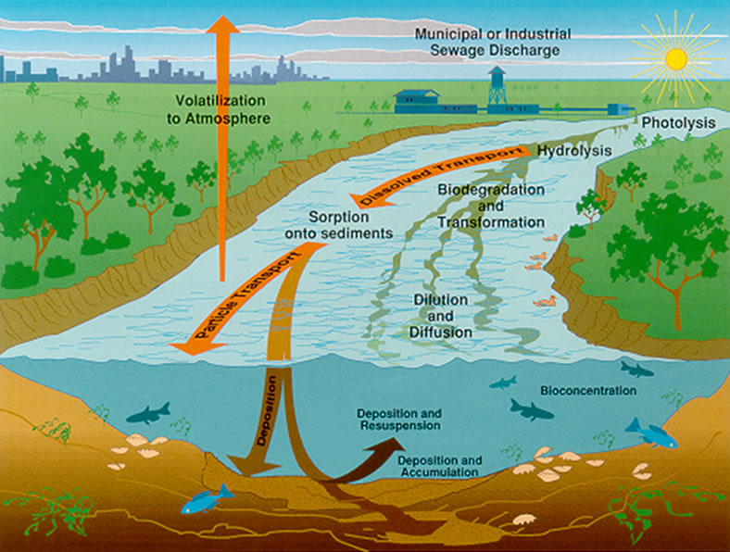

Slide 16
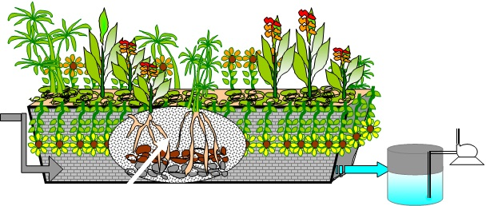
Reed Bed System
A reed bed is essentially a basin that is lined with an impermeable membrane, filled with gravel and planted with macrophytes such as reeds and rushes
Coarse media and bacteria Interacting with roots
Salient features
Fit it and forget it system
No foul odours.
No flies and mosquitoes
Picturesque garden like appearance
No need of electricity for aeration
No moving parts, hence very low maintenance and replacement cost
The treated water can be recycled for industrial use, for agriculture, aquaculture or ground water recharge.

Slide 17
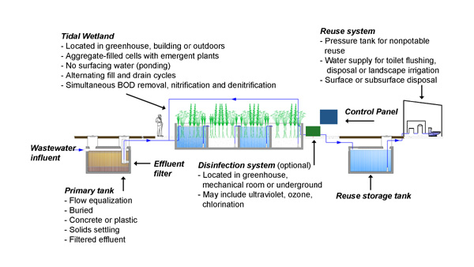

Slide 18
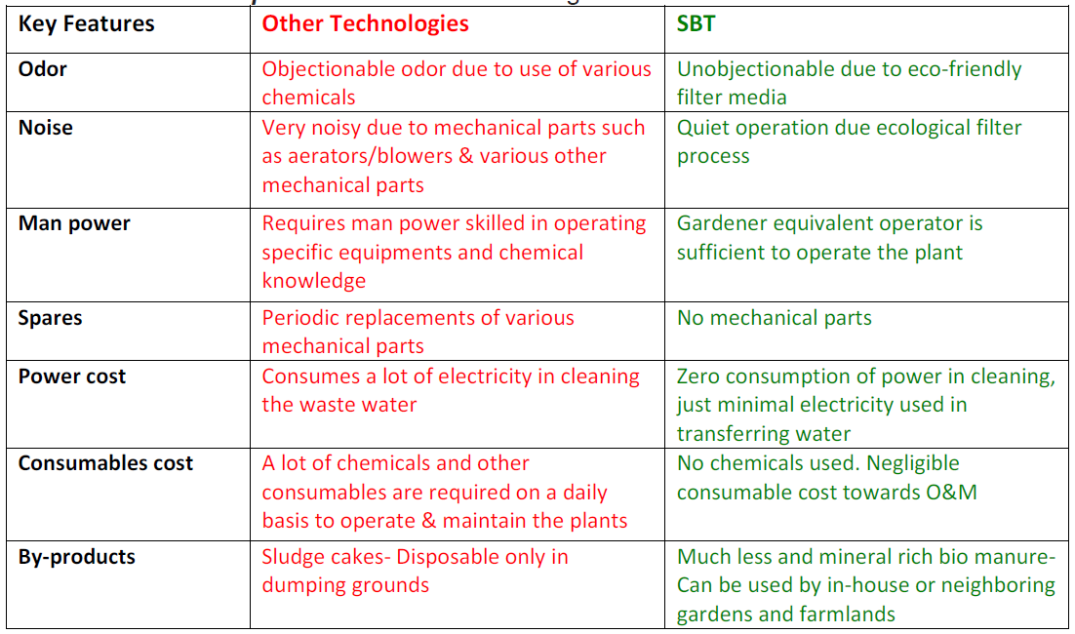
SOIL BIOTECHNOLOGY/ SBT SYSTEM
Apply SBT for
Sewage Treatment & Recycling Effluent Treatment & Recycling Grey Water Recycling
Water Treatment & Recycling

Slide 19
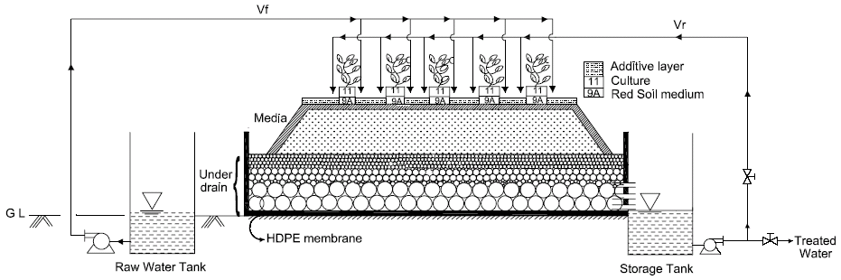
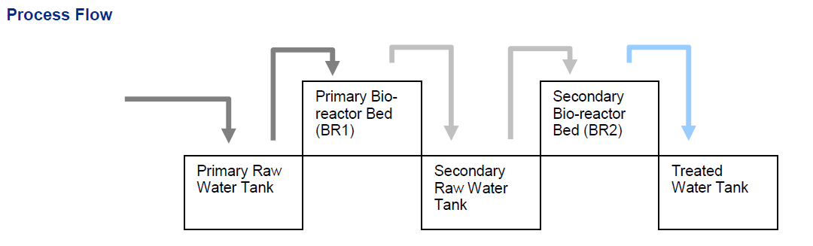

Slide 20
Media & Culture
Underdrain:- Stone rubble of various sizes ranging upto Gravel (200.0-2.0 mm), Very coarse sand (1.0-2.0 mm), Coarse sand (0.5-1.0 mm), Medium sand (0.25-0.5 mm), Fine sand (0.1-0.25 mm)
Media:- Formulated from soil as required and primary minerals of suitable particle size and composition
Culture:- Geophagus (Soil living) worm Pheretima elongata and bacterial culture from natural sources containing bacteria capable of processing cellulose, lignin, starch, protein, also nitrifying and denitrifying organisms. Anaerobic organisms for methanogenesis. For industrial wastes, development of appropriate culture required
Additives:- Formulated from natural materials of suitable particle size and composition to provide sites for respiration, CO₂ capture
Bioindicators:- Green plants particularly with tap rootsystem

Slide 21
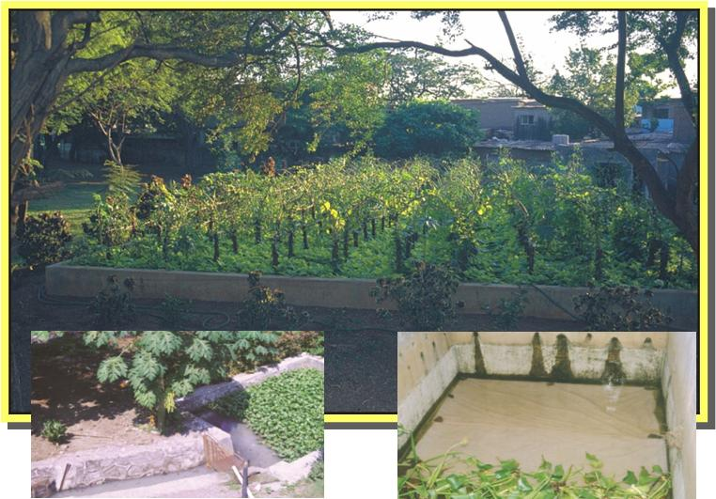
SBT PLANT

Slide 22
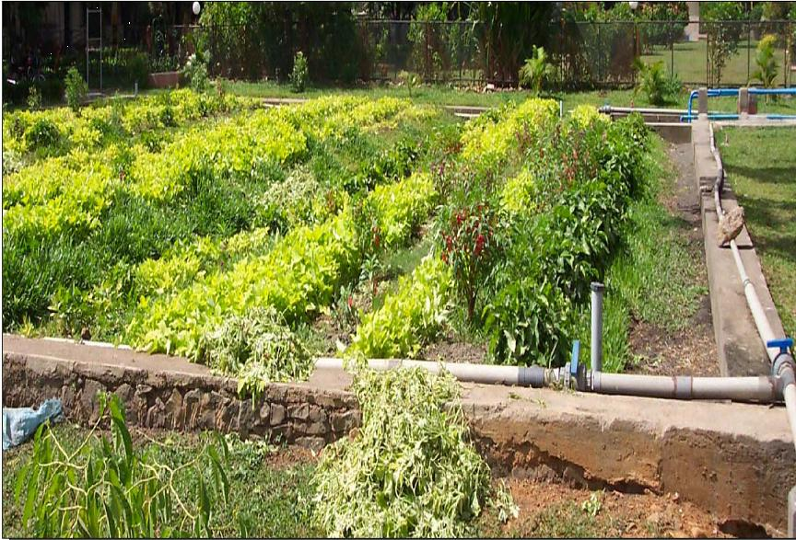

Slide 23
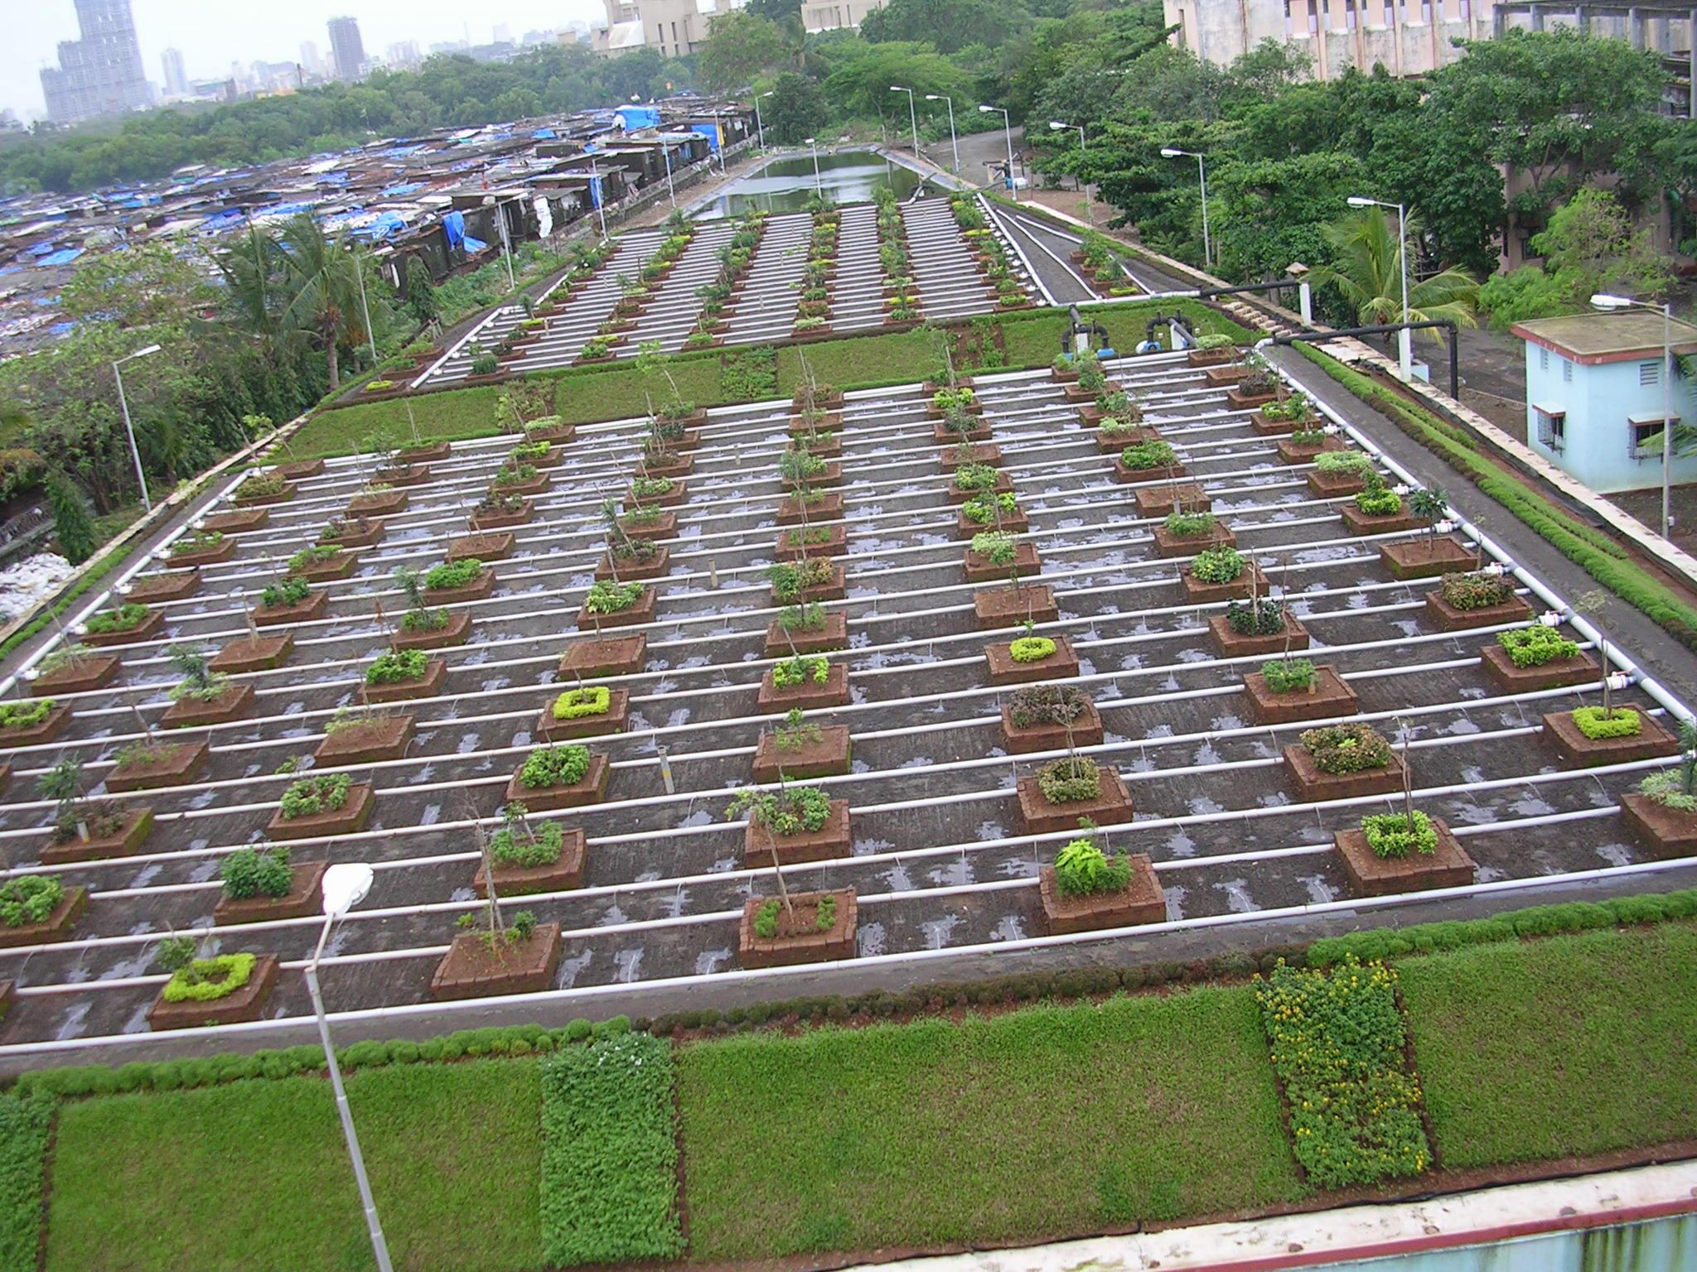
SBT PLANT
3MLD Sewage Purification in MCGB
Notes:
23

Slide 24
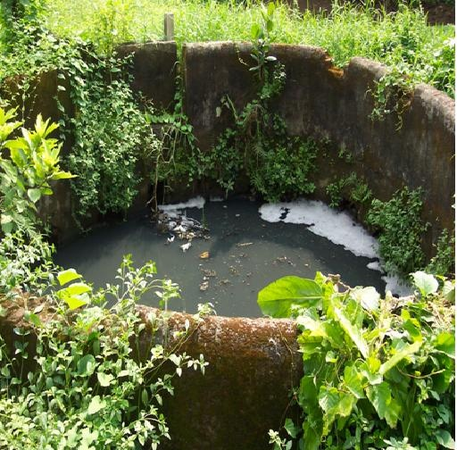
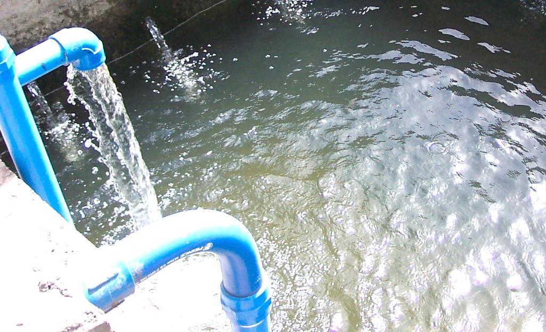
REUSABLE WATER FROM WASTEWATER
Wastewater Treated Wastewater
Notes:
24

Slide 25
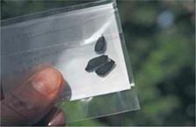
BIOSANITIZER- Ecotechnology
BIOSANITIZER granules convert polluted water into clean water, which also becomes a resource for eco-logical restoration of wells, bore wells, water storage tanks, ponds and lakes.
BIOSANITIZER is a natural catalyst; 100 mg of this product has the capacity of 1 acre of rich natural forest, in terms of its nitrate utilization, CO2 trapping and oxygen production ability.
Rainwater Harvesting and Flood Control: Soil has a built-in mechanism to restrict the entry of polluted water into groundwater. Soil, thus, can soak in just 10 mm/d of polluted water. After applying BIOSANITIZER in the surface water pool, one can find that water starts penetrating much faster, up to 1,000 mm/d.

Slide 26
Nitrates: Root Cause of Pollution
Nitrates can be utilized only by green plants, to produce resources, using CO₂.
Nature produces nitrates only as per the demand from the plants.
Increase in nitrates in rain, surface water, soil and also in the groundwater
Wasted nitrates sound unpleasant alarms.

Slide 27
Alarms of Pollution
Scaling, corrosion, biofouling, algal growth
Odor, pathogens and pests (mosquitoes)
Water logging, floods and droughts
Water borne diseases
Due to wasted nitrates
Need root cause correction

Slide 28

Learning from Nature
Low nitrate blue lagoon: coconut plants with roots in the seawater
Converts seawater into tasty coconut water.
BIOSANITIZER is based on many such lessons from Nature.

Slide 29
Current Challenges
Higher use of drinking quality water.
Untreated sewage becomes a problem.
Conventional sewage treatment methods not suitable for slums in developing countries.
Production of sludge and greenhouse gases
Treated sewage is not fit for recycling.
Use of toxic chemicals to control odor, pathogens and pests
Eco-Logical Approach
Plants provide us with all of our necessities.
Plants flourish on human/animal wastes.
Hence toilet should have plant ecology.
Odor, pathogens and pests come only when we neglect this wisdom.
BIOSANITIZER
Natural granular bio-catalyst developed by BERI, Pune.
Goes to the root cause of pollution.
Converts pollution into resources, using time-tested natural biochemical reactions.
Small investment, no recurring charges.
No need of any machinery, electricity, skilled manpower, repairs and maintenance.

Slide 30
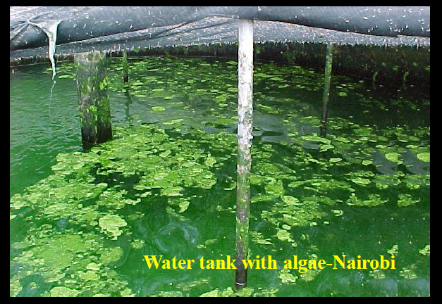
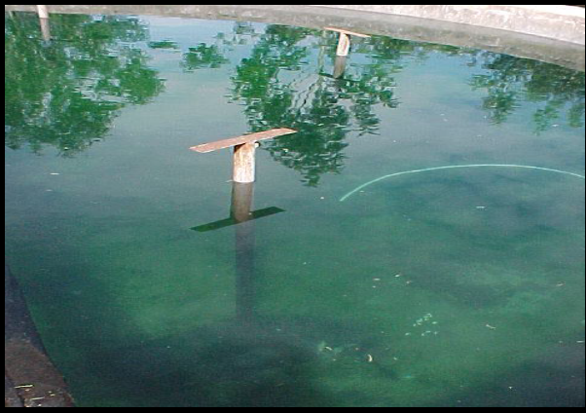

Slide 31

Be water wise!
Thank you!

