Slide 1
RAINWATER HARVESTING
A Solution for survival

Slide 2
Outline of the Presentations
Introduction to water
Movement of water
Water Conservation & Rainwater Harvesting Methods
Water recharge-recycle-reuse
Water Basics
Movement of water
RWH Methods
Water Recycling

Slide 3
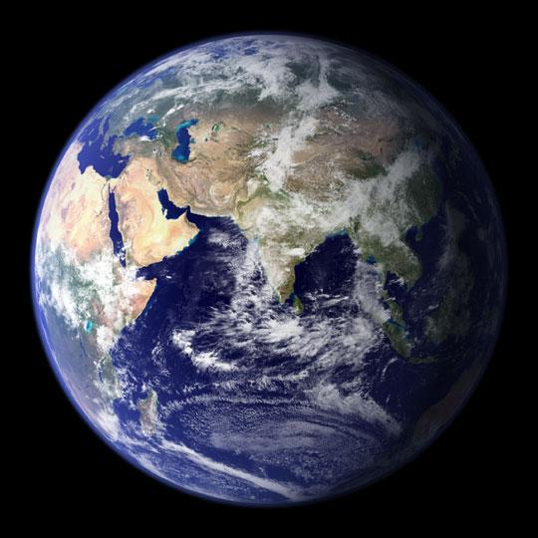
THE PLANET "AQUA"

Slide 4
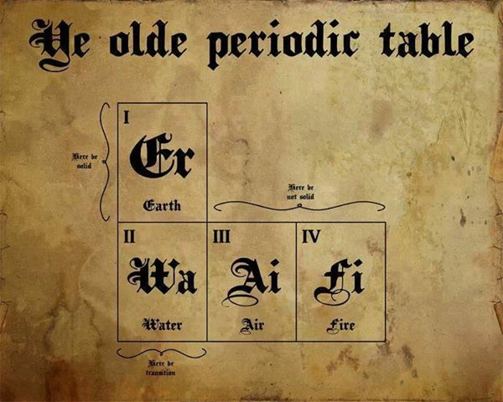
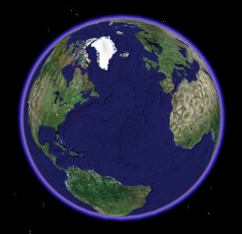
WATER AND LAND
The Earth is covered with WATER and LAND.
There is more water than land on the Earth!
We can find water is many different places. Most of the water is salty.

Slide 5
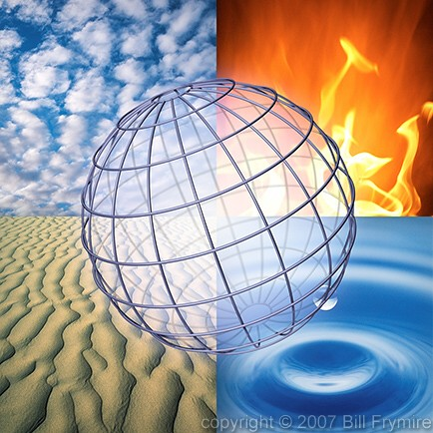
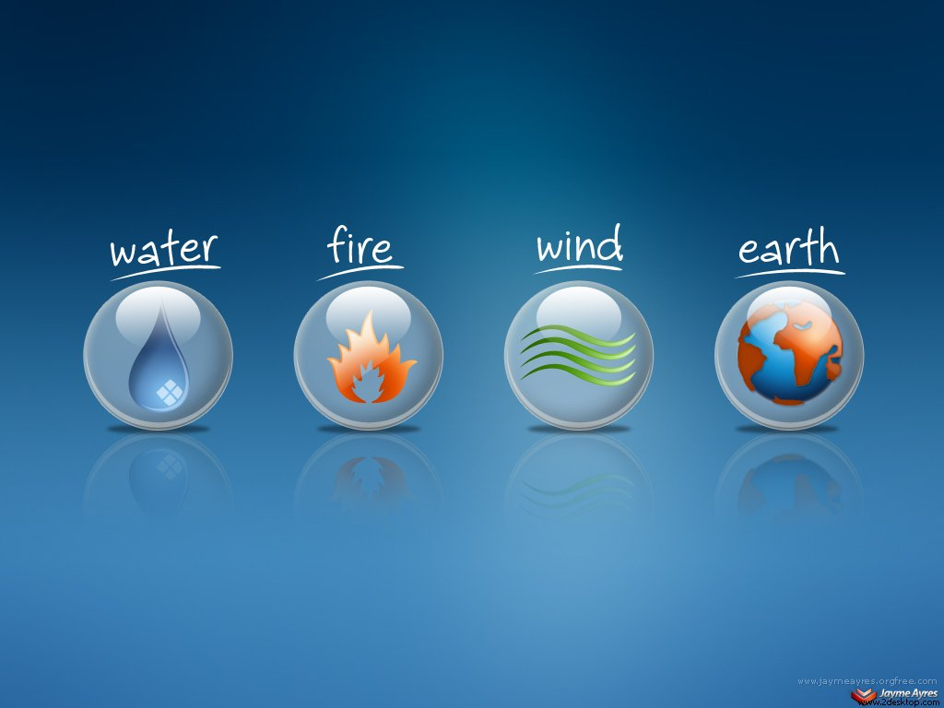
Major 4 Elements of Earth

Slide 6
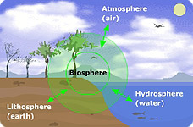
The Four Spheres
Lithosphere – earth’s crust (soil, rocks, and minerals)
Hydrosphere – earth’s water
Atmosphere – the gases in the air
Biosphere – all living things (plants, bacteria, animals)

Slide 7
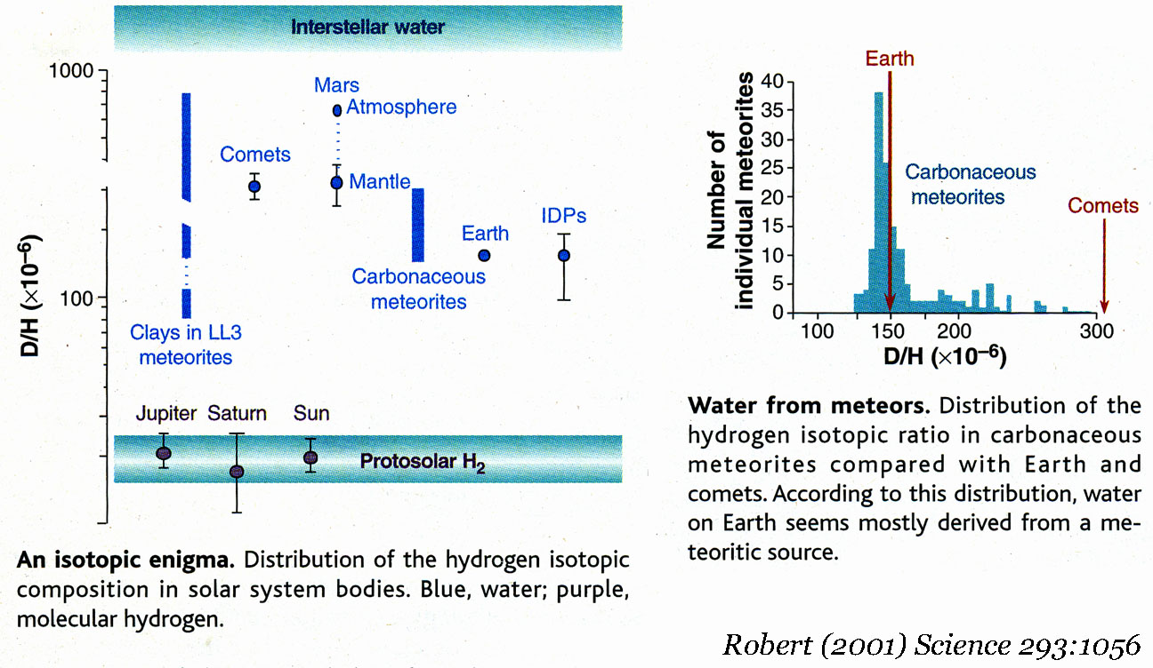
WHERE DID THE WATER COME FROM?
Water was transported from the outer solar system to Earth by objects that no longer exist.
A sizeable quantity of water would have been in the material which formed the Earth.

Slide 8
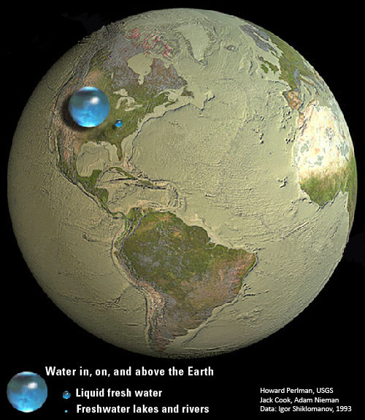
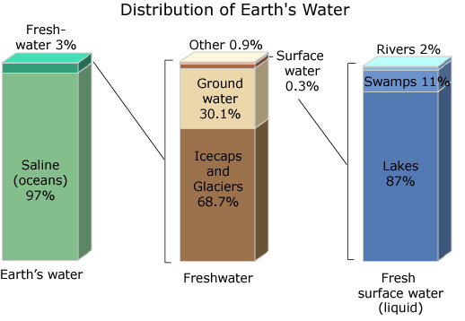

Slide 9
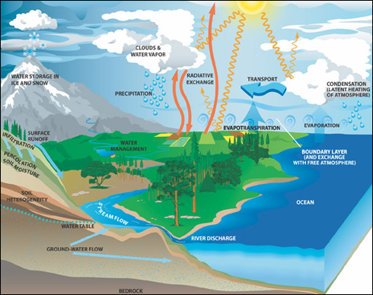
Hydrological Cycle

Slide 10
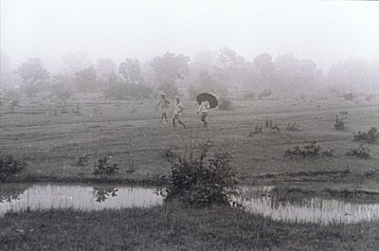
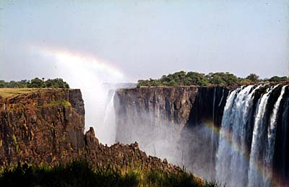
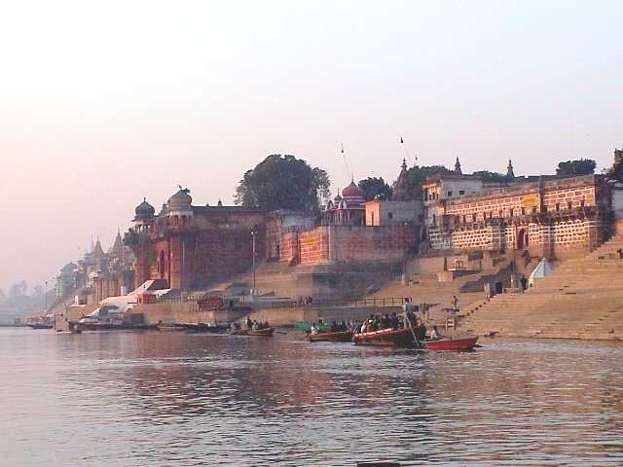
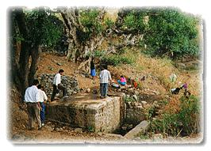
NATURE’S GIFT

Slide 11
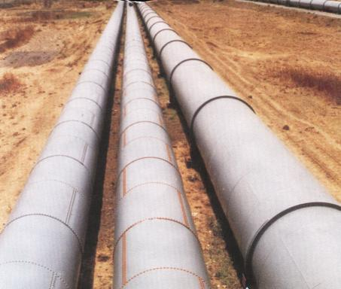
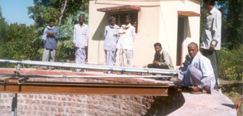
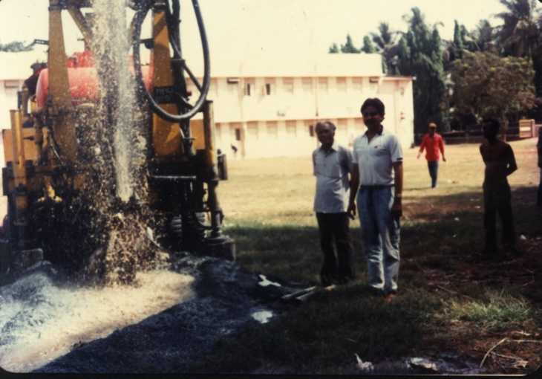
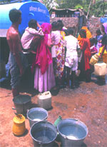
PRESENT DAY SOURCES OF WATER

Slide 12
One Estimate of Global Water Distribution (Numbers are rounded)
Water source | Water volume, in cubic miles | Water volume, in cubic kilometers | Percent of freshwater | Percent of total water
Oceans, Seas, & Bays | 321,000,000 | 1,338,000,000 | -- | 96.5
Ice caps, Glaciers, & Permanent Snow | 5,773,000 | 24,064,000 | 68.7 | 1.74
Groundwater | 5,614,000 | 23,400,000 | -- | 1.69
Fresh | 2,526,000 | 10,530,000 | 30.1 | 0.76
Saline | 3,088,000 | 12,870,000 | -- | 0.93
Soil Moisture | 3,959 | 16,500 | 0.05 | 0.001
Ground Ice & Permafrost | 71,970 | 300,000 | 0.86 | 0.022
Lakes | 42,320 | 176,400 | -- | 0.013
Fresh | 21,830 | 91,000 | 0.26 | 0.007
Saline | 20,490 | 85,400 | -- | 0.006
Atmosphere | 3,095 | 12,900 | 0.04 | 0.001
Swamp Water | 2,752 | 11,470 | 0.03 | 0.0008
Rivers | 509 | 2,120 | 0.006 | 0.0002
Biological Water | 269 | 1,120 | 0.003 | 0.0001
Source: Igor Shiklomanov's chapter "World fresh water resources" in Peter H. Gleick (editor), 1993, Water in Crisis: A Guide to the World's Fresh Water

Slide 13
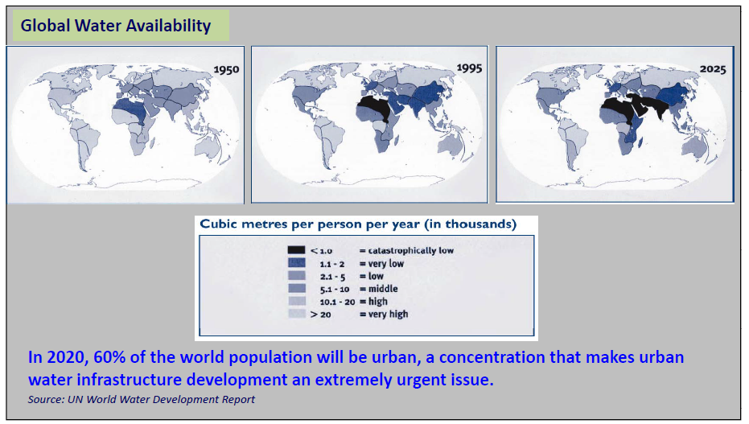

Slide 14
Amazing Water Facts
Fact | Feature | Size
Largest Ocean | Pacific Ocean | area = 166 million km2 (64 million mile2)
Largest Sea | South China Sea | area = 3 million km2 (1.1 million mile2)
Biggest Bay | Bay of Bengal | area = 2.2 million km2 (868,000 mile2)
Deepest point in ocean | Mariana Trench (Pacific Ocean) | 11 km (36,000 feet down)
Saltiest Sea | Dead Sea (Israel/Jordan) | 9 times saltier than ocean water
Hottest Seawater | Persian Gulf | 35o C (95o F)
Longest River | Nile River (Africa) | 6,670 km (4,145 miles)
River that carries most water | Amazon River (South America) | pours 4 million cubic feet every second into Atlantic
Muddiest River | Yellow River (China) | deposits rich silt over 141,645 sq km in its flood plain and delta. (2 billion tons of soil washed down each year)
Highest Waterfall | Angel Falls (Venezuela) | Total drop = 980 m (3212 feet)
Deepest and oldest lake | Lake Baikal (Siberia) | Deepest part = 1,940 m (6,365’) age = 25 million years old
Largest freshwater lake | Lake Superior (N. America) | area = 82,103 km2 (32,000 mile2)
Smallest Great Lake | Lake Ontario (N. America) | area = 19,546 km2 (7,550 mile2)
Shallowest Great Lake | Lake Erie (N. America) | 64 m (210 feet deep)
Largest salty sea | Caspian Sea | area = 371,841 km2 (143,630 mile2) length = 1207 km (750 miles)
Longest freshwater lake | Lake Tanganyika (Africa) | length = 676 km (420 miles)
Highest navigable lake | Lake Titicaca (S. America) | height = 3,811 m (12,307 feet)

Slide 15
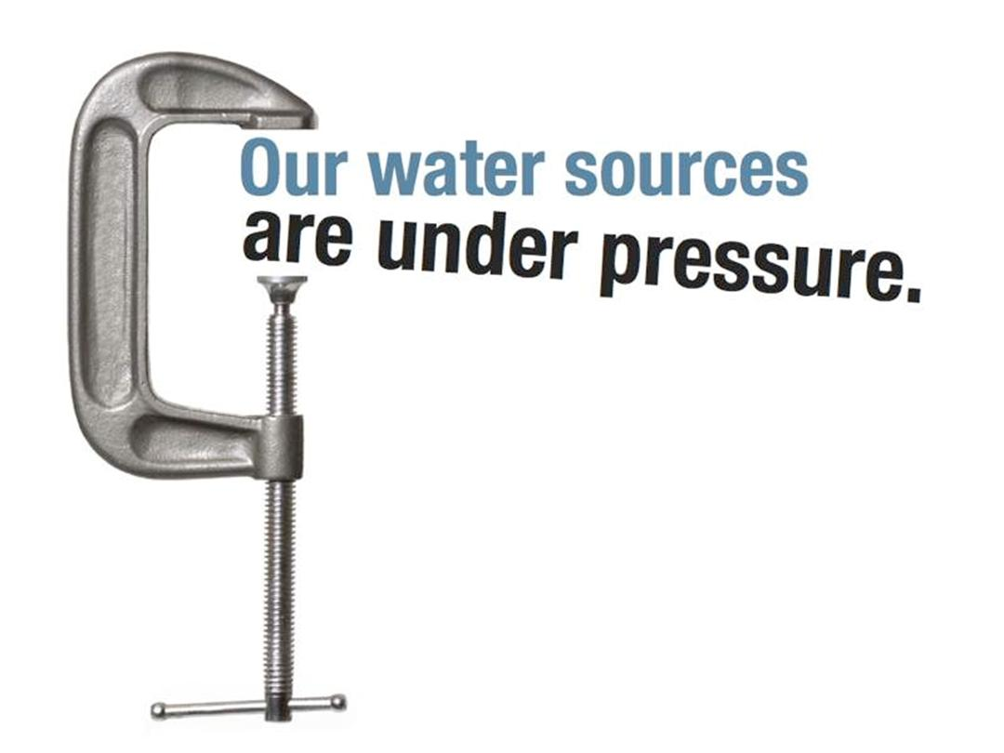

Slide 16
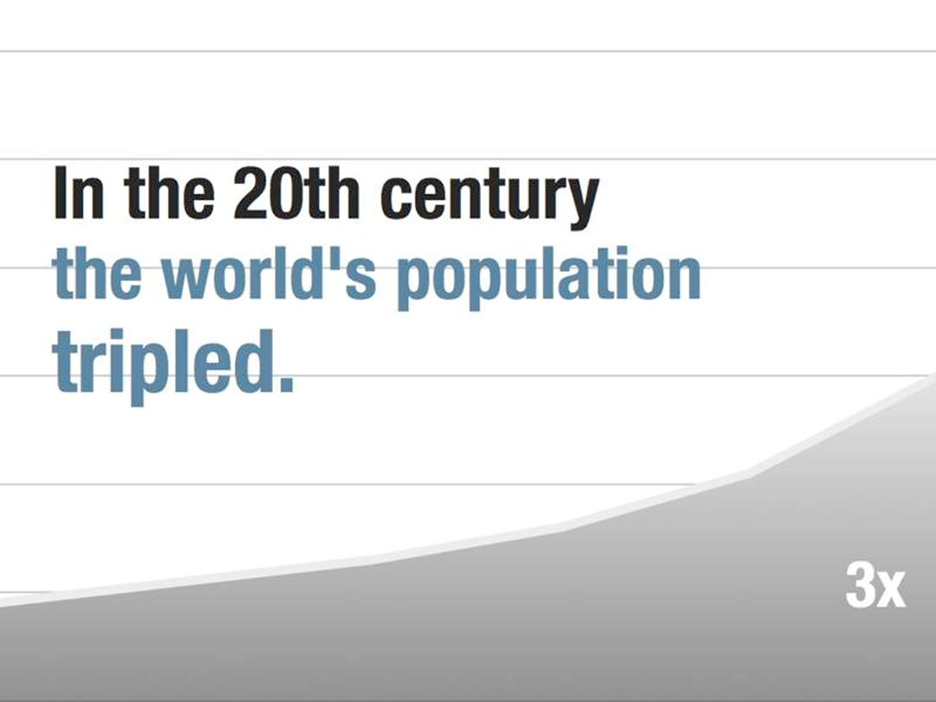

Slide 17
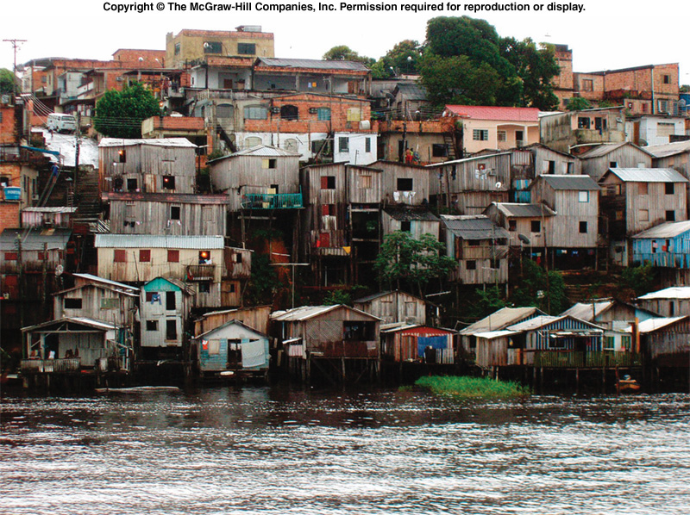
ImPaCT
(Ehrlich & Holdren)
Human Impact (Im) =
Population (P) x Consumption (C) x Technology (T)
Favelas above the Amazon River, Manaus, Brazil; Fig.14-20 in http://www.mhhe.com/cunningham3e

Slide 18
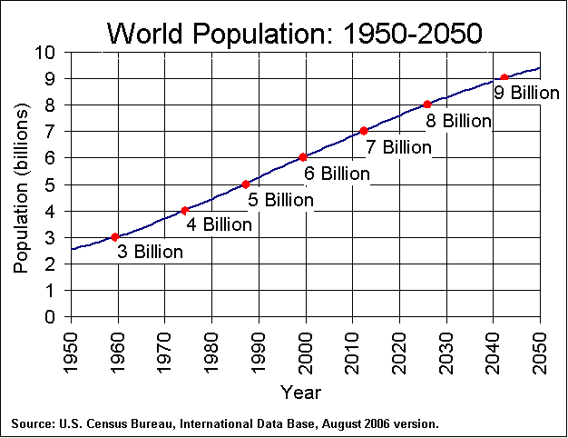
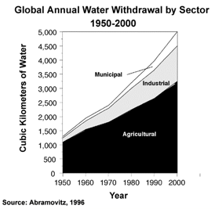
Trends in Population and Water Use

Slide 19
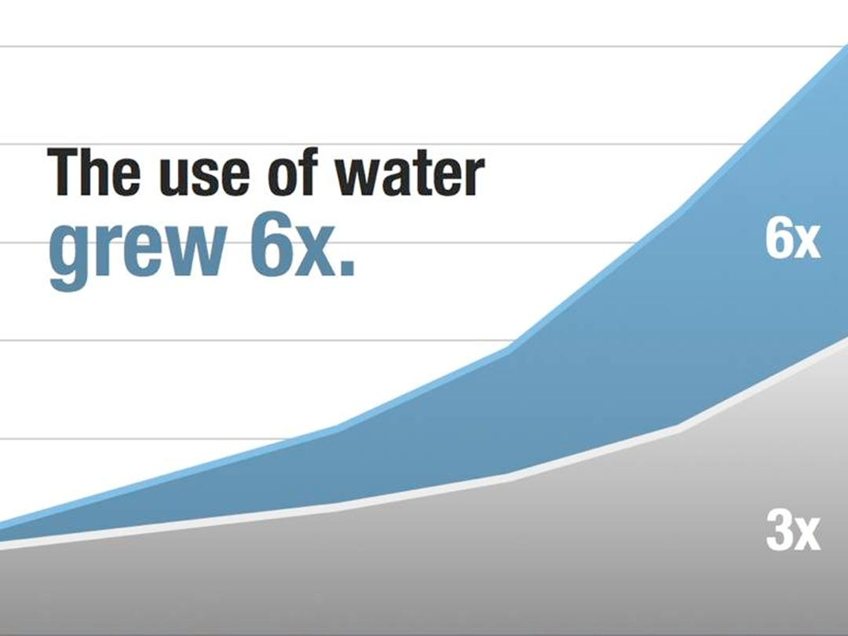

Slide 20
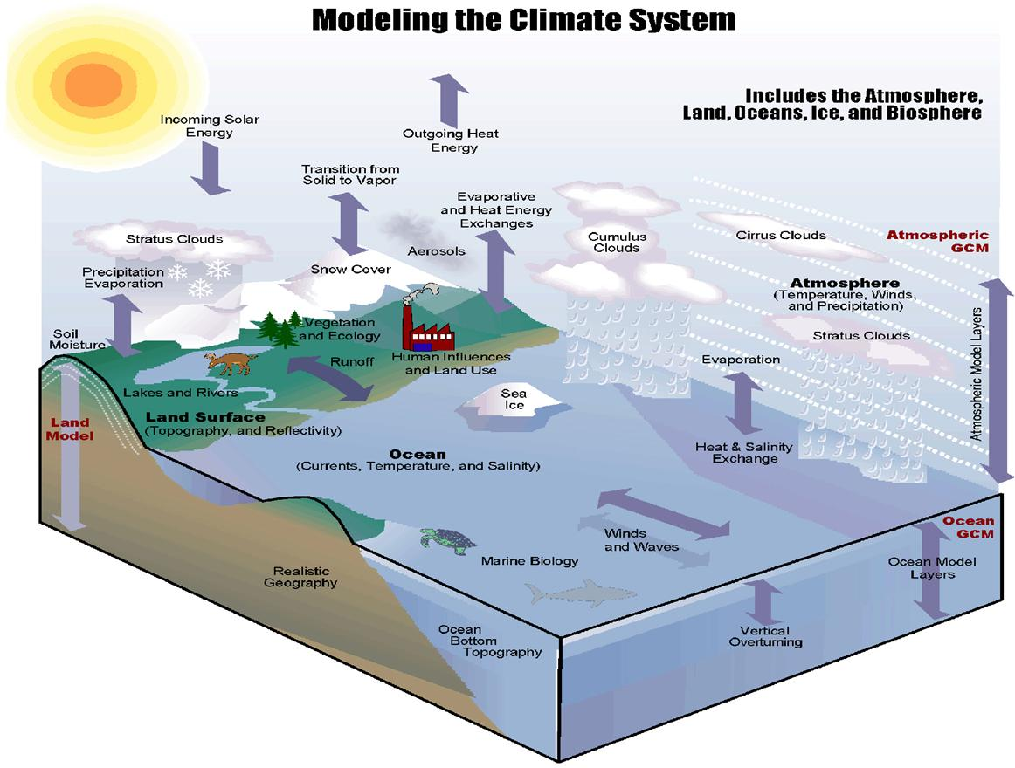

Slide 21
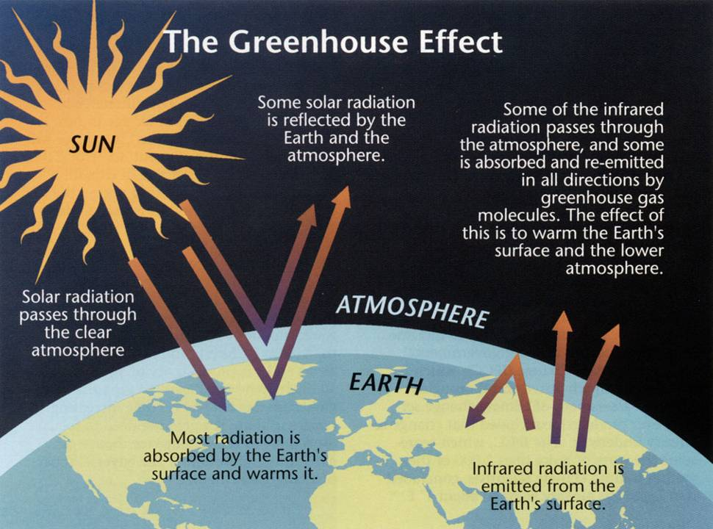

Slide 22
Climate Change and Water Resources:
Climate Change Will Lead To More Precipitation - But Also To More Evaporation
Precipitation Will Probably Increase In Some Areas And Decline In Others.
Changing Precipitation Patterns Will Affect How Much Water Can Be Captured.
The Drier The Climate, The More Sensitive Is The Local Hydrology.
High-latitude Regions May See More Runoff Due To Greater Precipitation.
The Effects On The Tropics Are Harder To Predict.
Reservoirs And Wells Would Be Affected.
New Patterns Of Runoff And Evaporation Will Also Affect Natural Ecosystems.
Rising Seas Could Invade Coastal Freshwater Supplies.
Reduced Water Supplies Would Place Additional Stress On People, Agriculture, And The Environment.
Conflicts Could Be Sparked By The Additional Pressures.
Improved Water Resource Management Can Help To Reduce Vulnerabilities.

Slide 23
What to look for specifically?
Precipitation amount
Precipitation frequency and intensity
Evaporation and transpiration
Changes in average annual runoff
Natural variability
Snowpack
Coastal zones
Water quality
Water storage
Water demand

Slide 24
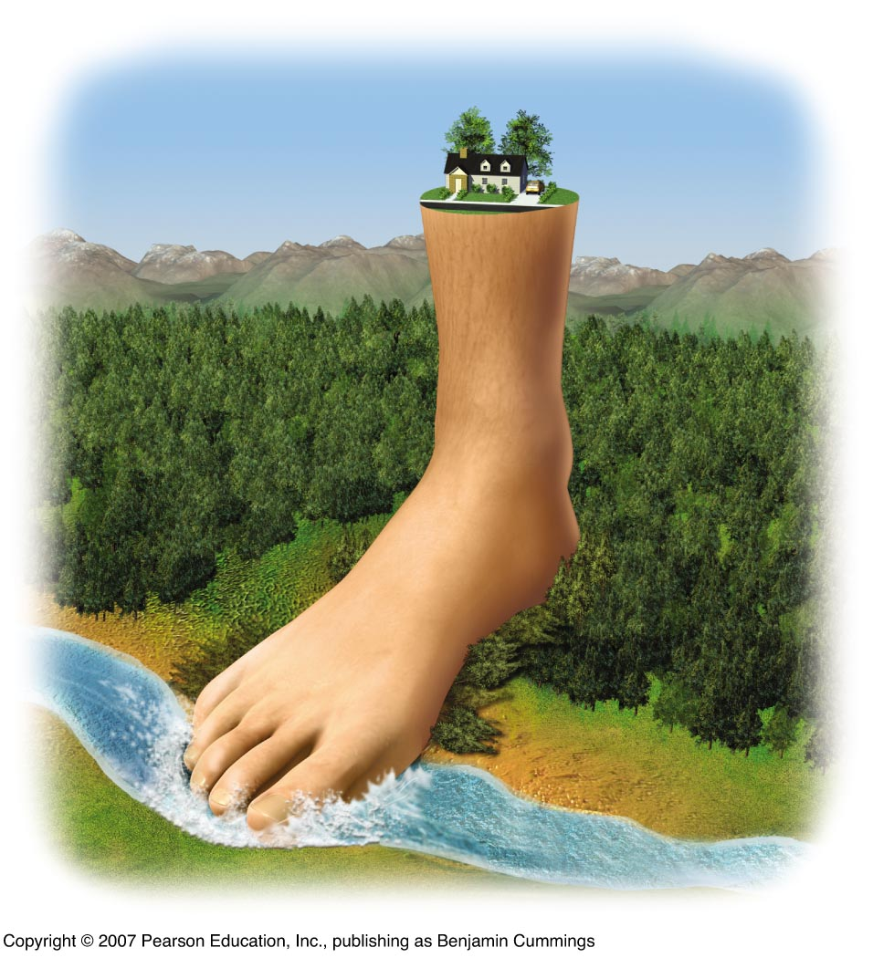
The “Ecological Footprint”
The ecological footprint is the area of land and water needed to produce the resources a person or population uses, plus the amount needed to dispose of their waste.

Slide 25
Water footprint of a consumer
► The total volume of water appropriated for the production of the goods and services consumed.
► equal to the sum of the water footprints of all goods and services consumed.
► dimensions of a water footprint
volume
where and when
type of water use: green, blue, grey
Water footprint of a product
► the volume of fresh water used to produce the product, summed over the various
steps of the production chain.
► when and where the water was used:
a water footprint includes a temporal and spatial dimension.

Slide 26
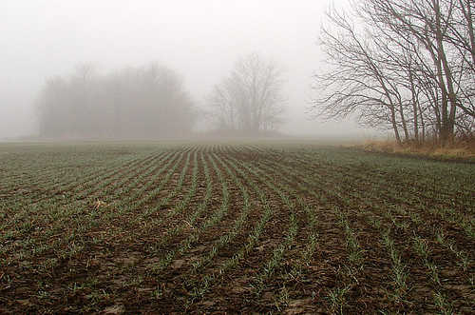
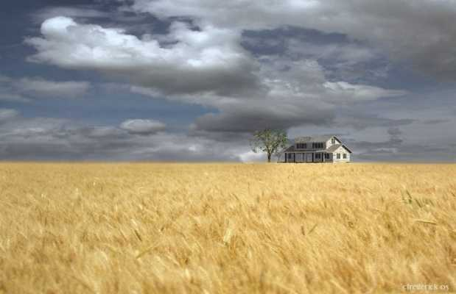
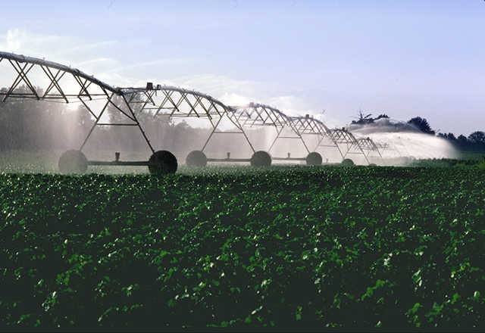
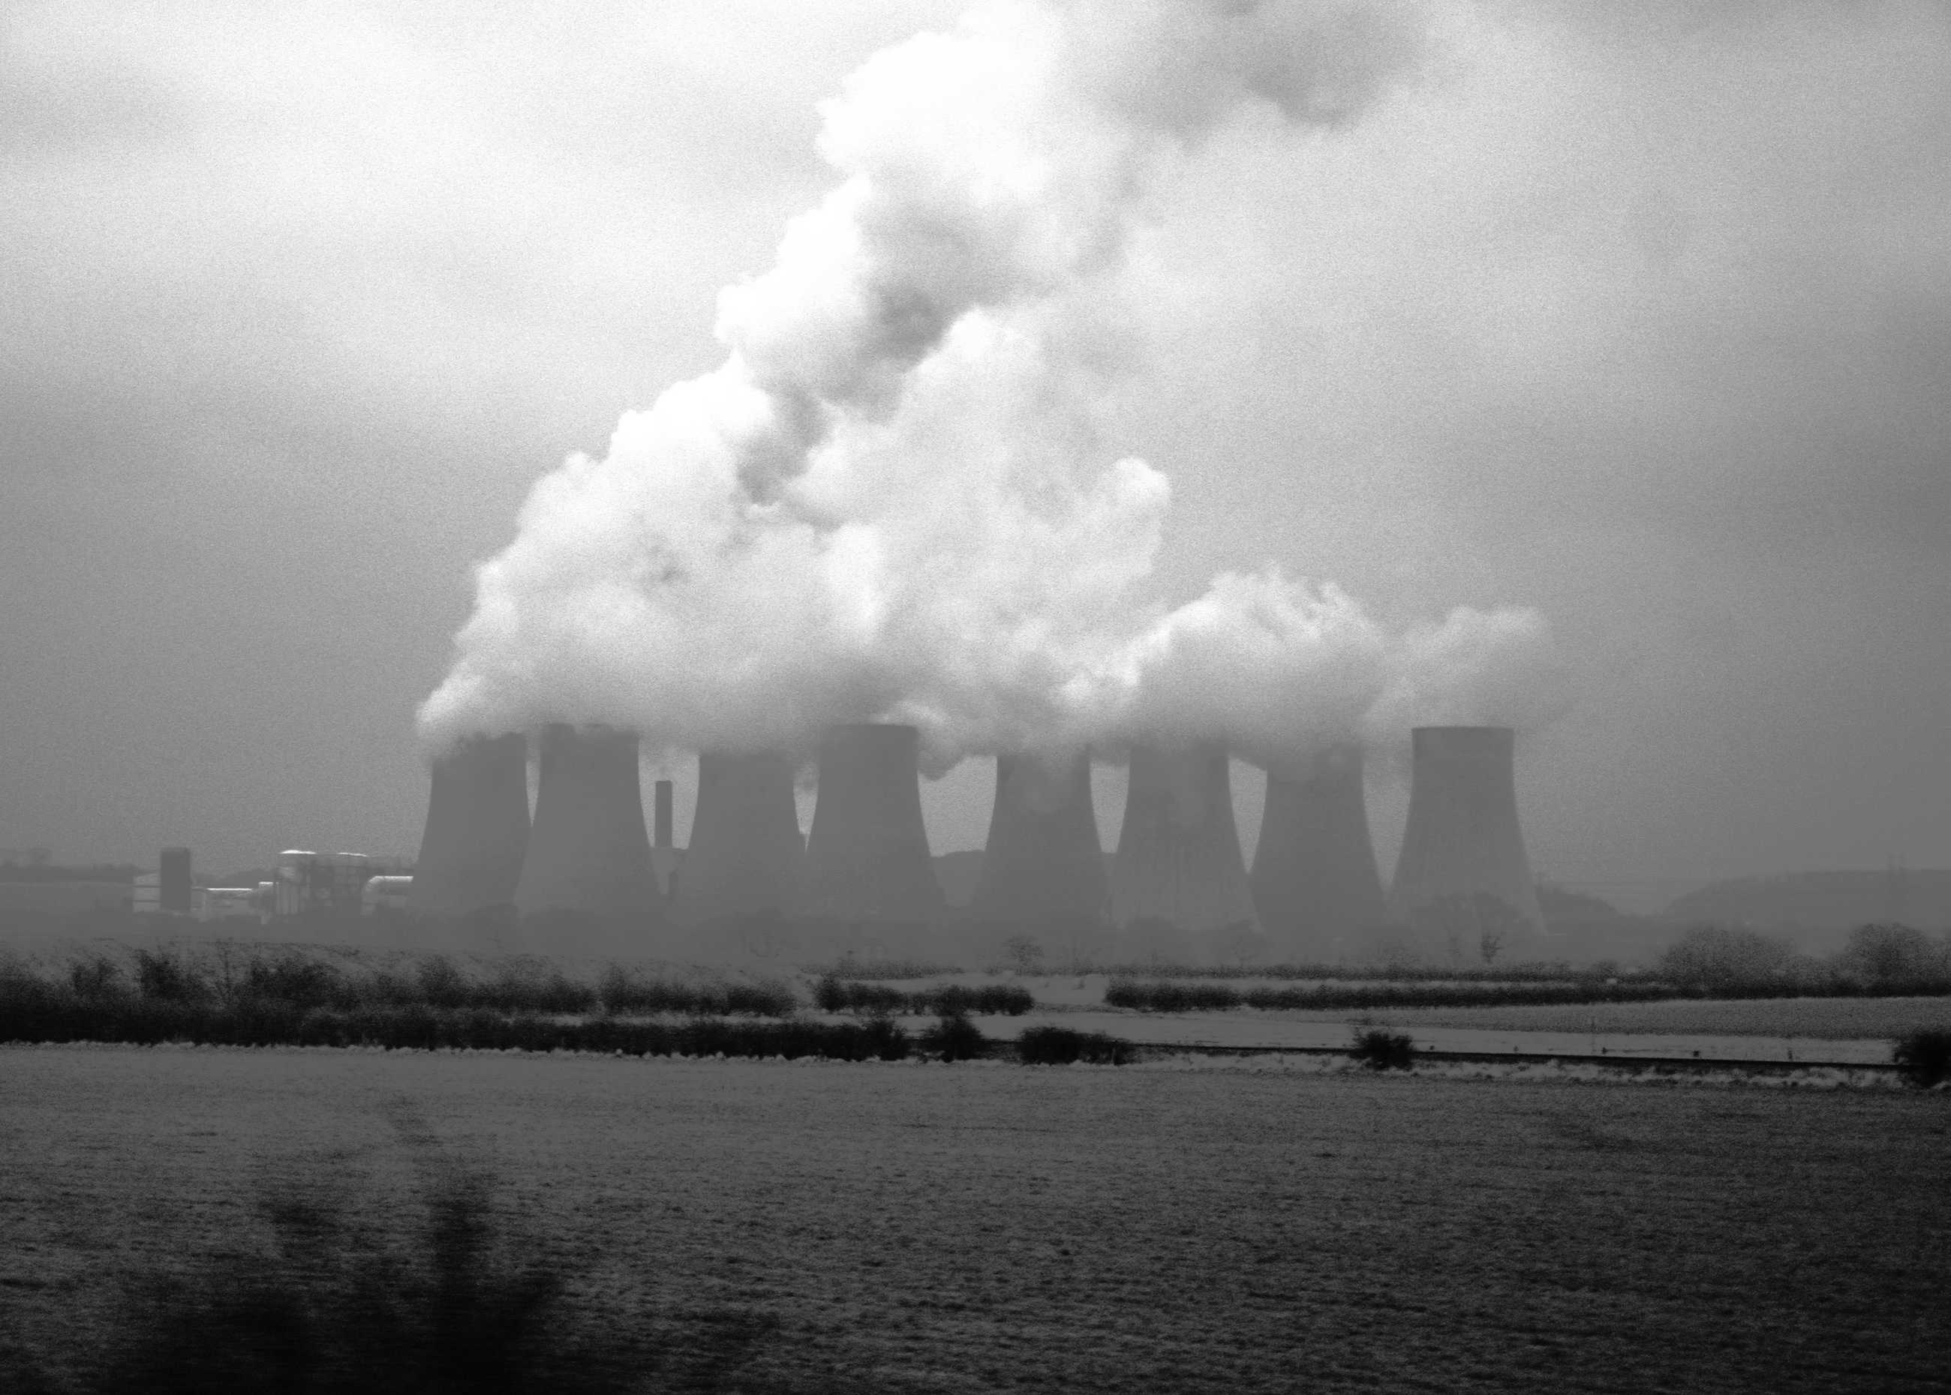
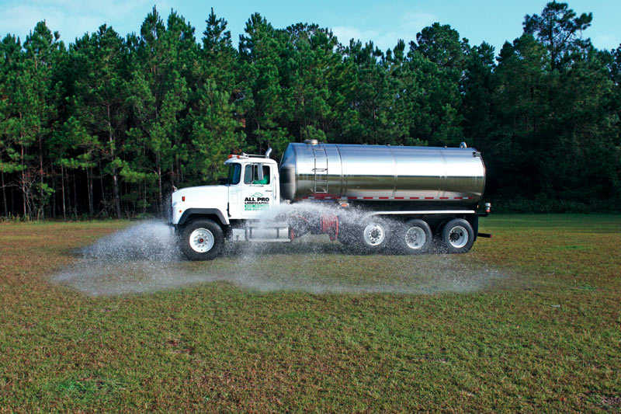
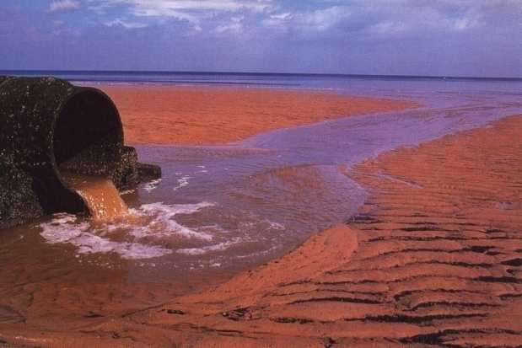
The water footprint of a product
Green water footprint
► volume of rainwater evaporated or incorporated into product.
Blue water footprint
► volume of surface or groundwater evaporated,
incorporated into product or returned to other catchment or the sea.
Grey water footprint
► volume of polluted water.

Slide 27
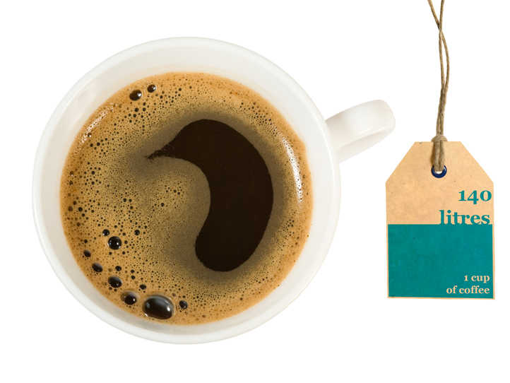
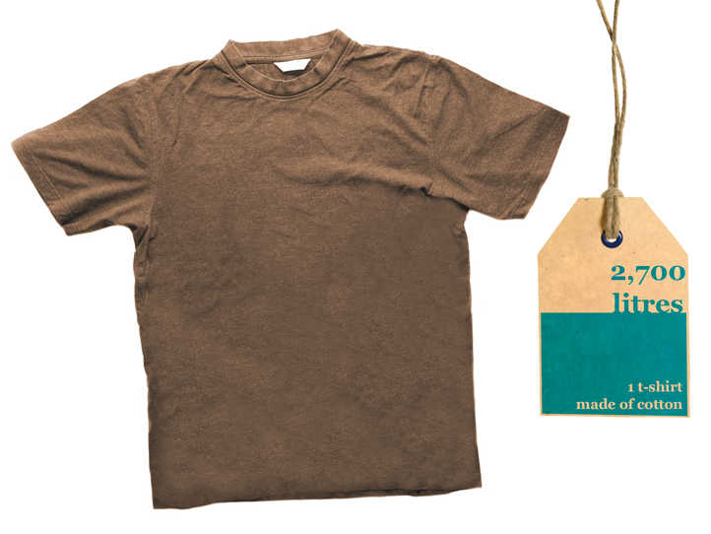
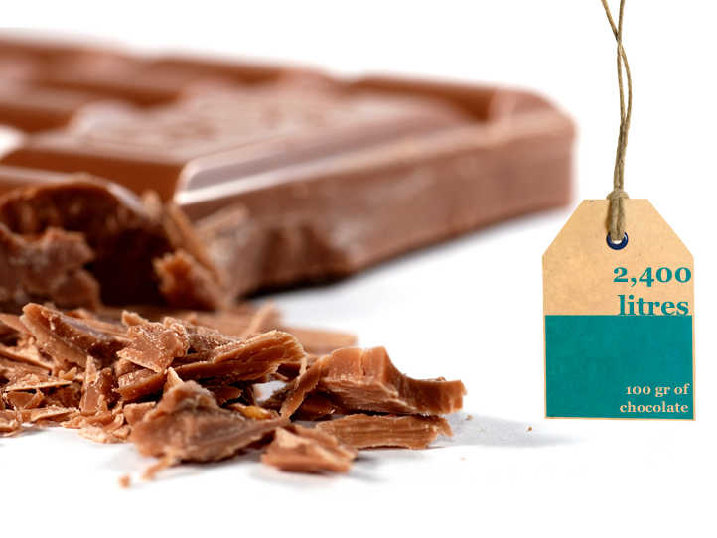
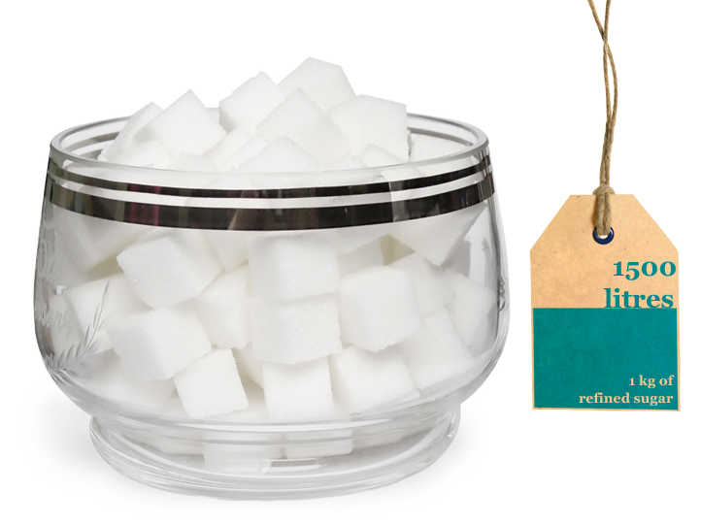
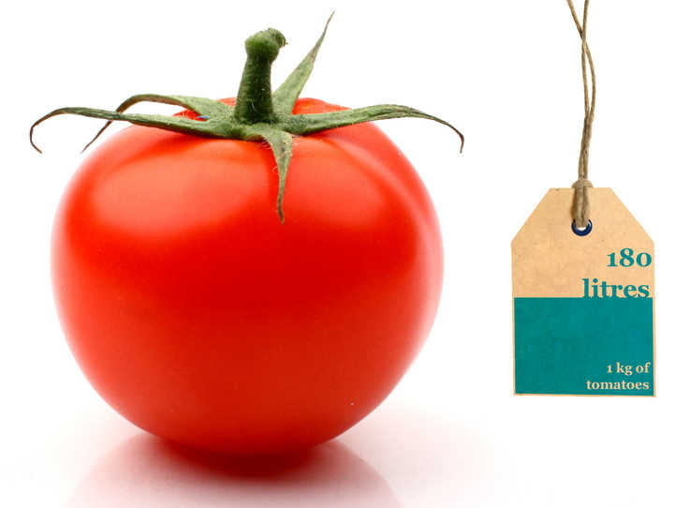
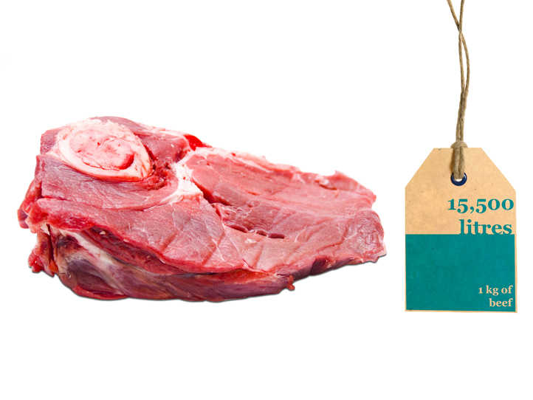

Slide 28
Water footprint per capita
Global average water footprint
[Hoekstra & Chapagain, 2008]

Slide 30
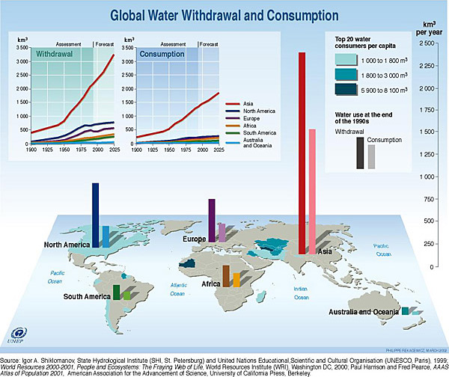
Global Water Withdrawal

Slide 31
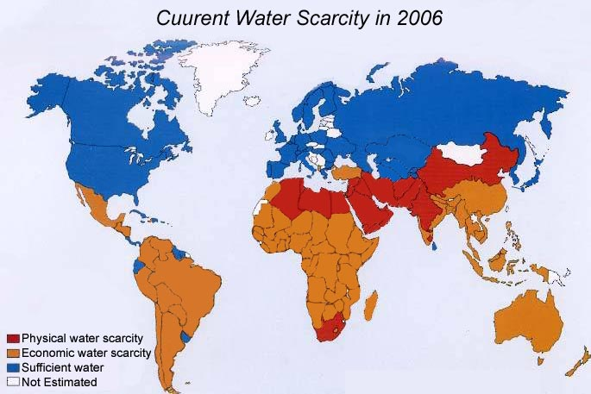
Water is Scarce in Some Regions
2.4 billion people live in highly water-stressed areas
Current Water Scarcity: 2006
Source: Adapted from http://www.waterlink.net/assets/images/waterscarity2025.jpg

Slide 32
REASONS FOR LESS WATER
SOURCE | PROBLEM | EFFECT | RESULT
Piped | Breakage/ rusting | Leakage | Less water for end user
Dams | Silting | Decrease in storage | Less quantum of water
Lakes | Silting Effluents | Quantity Quality | Less water Polluted
Rivers | Erosion Sewer & waste | Quantity Quality | Erratic Polluted
Wells | Lowering of water table | Dry | No water
Bore/Tube wells | Overdraft | Low yields | Less water

Slide 33
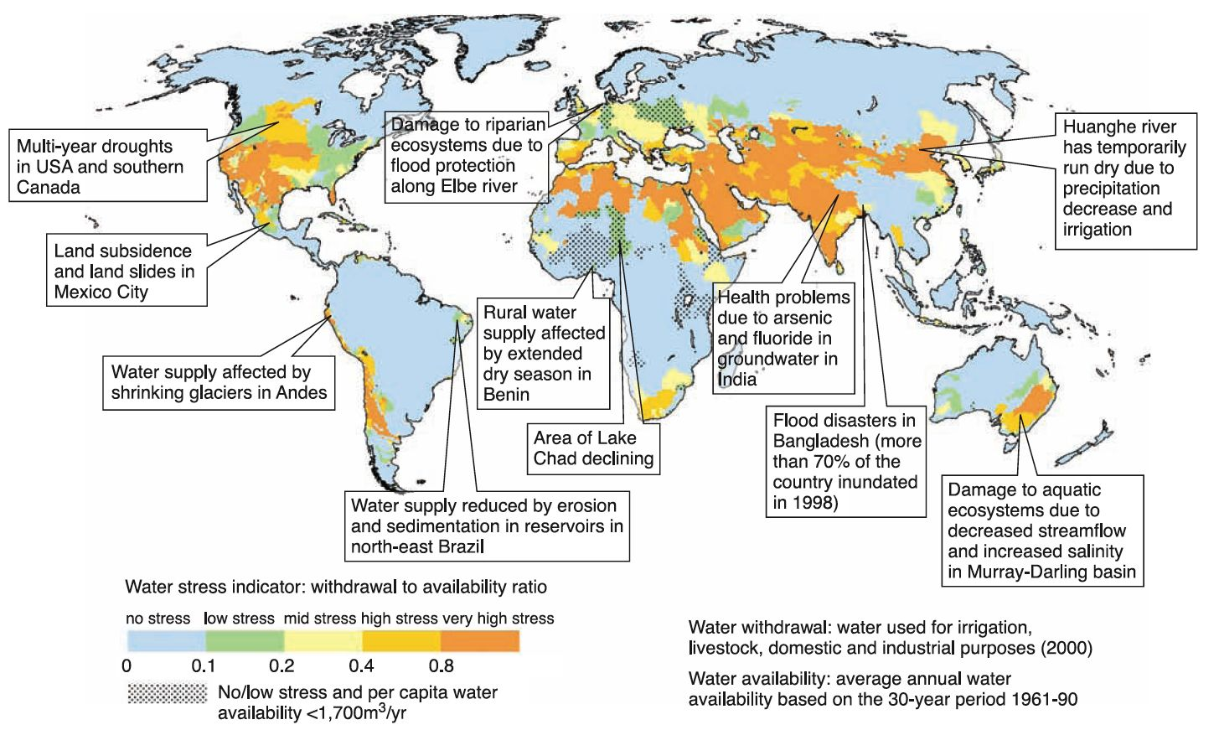
Current Water Stress

Slide 34
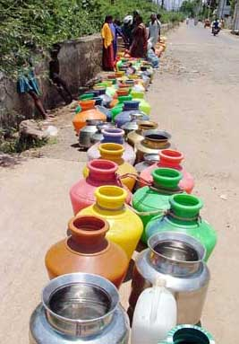
No Single Cause for the Water Crisis
Many factors
  Climate and geography
  Lack of water systems and infrastructure
  Inadequate sanitation
    2.6 billion people (40% of the world’s population) lack access to sanitation systems that separate sewage from drinking water
    Inadequate sanitation and no access to clean water have been highly correlated with disease

Slide 35
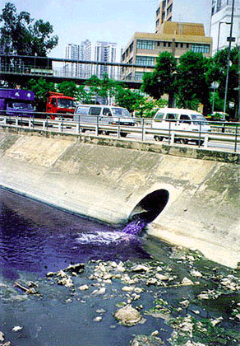
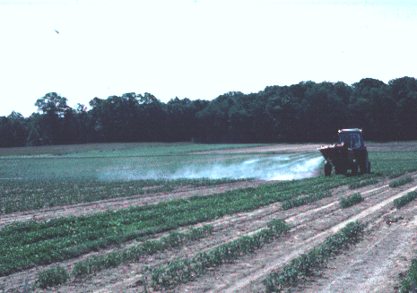
Pollution is a Big Problem Too
Types of pollution in fresh water:
  Sewage is the most common
  Pesticides and fertilizers
  Industrial waste dumping
  High levels of arsenic and
  fluoride
Sources: http://www.marenrecycling.com/polluted_water.JPG
http://mainegov-images.informe.org/agriculture/pesticides/drift/mstblow1.gif

Slide 36
REASONS FOR LESS WATER
SOURCE | PROBLEM | EFFECT | RESULT
Piped | Breakage/ rusting | Leakage | Less water for end user
Dams | Silting | Decrease in storage | Less quantum of water
Lakes | Silting Effluents | Quantity Quality | Less water Polluted
Rivers | Erosion Sewer & waste | Quantity Quality | Erratic Polluted
Wells | Lowering of water table | Dry | No water
Bore/Tube wells | Overdraft | Low yields | Less water

Slide 37
FUTURE WATER SCENARIO
Water availability will be to 1 person out of 3.
Water quality will become unsafe in majority of the places.
No food to 1/3 of the population.
Many water borne diseases like Fluorosis, Dementia, Diarrhea, Cancer etc. will be order of the day.
There will be fight for water between
  Man to man.
  City to city.
  State to state.
  Country to country
  Possible third world war?

Slide 38
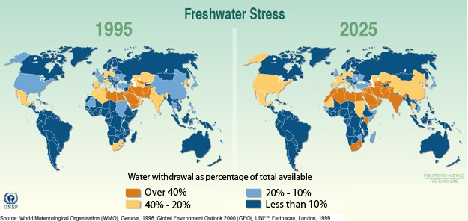
Water Scarcity is Projected to Worsen

Slide 39
Water conflicts and the future
What are the possible conflicts and solutions to increasing demands for water?
This section looks at 4 themes, and the table below summarises three scenarios for the future
Trends in water demand globally and locally
Water players
Responses to need to increasing water supply and the issues these strategies raise
The role of technology in water supply
Business as usual | The cost of water will increase Water consumption will increase resulting in declining stores Food transfers will mitigate shortage of water in areas where agriculture declines
Water Crisis | Demand will outstrip supply The proportion of the world’s population without access to clean water will increase Food insecurity and migration will increase Conflicts of water supplies (intra and inter state) become more likely
Sustainable Water | Agricultural and household water prices will double in the developed world and triple in the developing world Global water consumption will fall, although the gap between per capita use will close Green water flows will increase Improvements in water harvesting and farming techniques allow food yields to increase whilst water consumption declines
From: 2002 International Food Policy and Research Institute future models

Slide 40
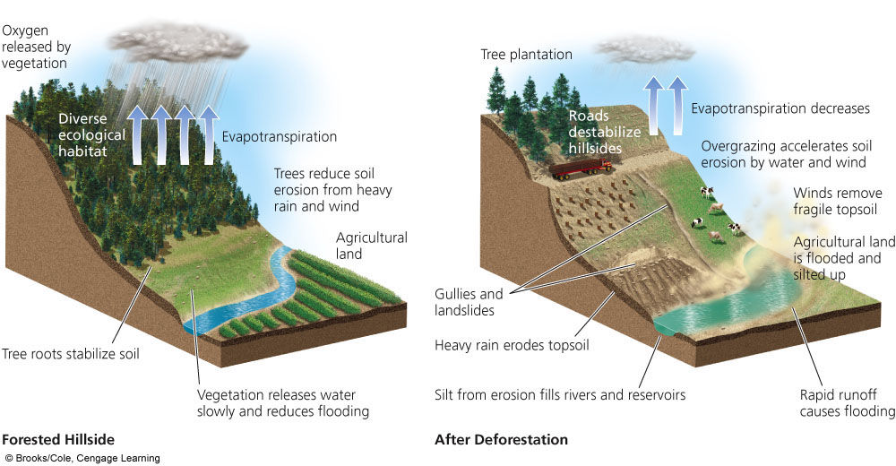
Natural Hill side Degradation

Slide 41
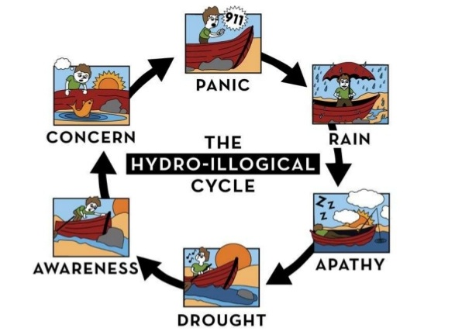

Slide 42
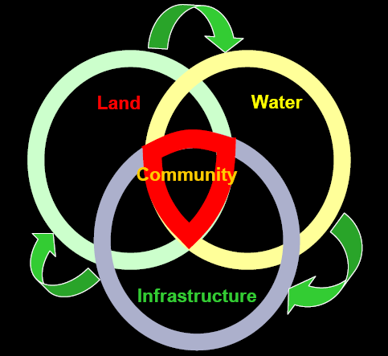
Linking Land & Water

Slide 43


Slide 44
WATER’S IMPORTANCE, AVAILABILITY, AND RENEWAL
We currently use more than half of the world’s reliable runoff of surface water and could be using 70-90% by 2025.
About 70% of the water we withdraw from rivers, lakes, and aquifers is not returned to these sources.
Irrigation is the biggest user of water (70%), followed by industries (20%) and cities and residences (10%).
We are using available freshwater unsustainably by wasting it, polluting it, and charging too little for this irreplaceable natural resource.

Slide 45

Provides water for year-round irrigation of cropland
Is Building More Big Dams the Answer?
Flooded land destroys forests or cropland and displaces people
Large losses of water through evaporation
Provides water for drinking
Downstream cropland and estuaries are deprived of nutrient-rich silt
Reservoir is useful for recreation and fishing
Risk of failure and devastating downstream flooding
Can produce cheap electricity (hydropower)
Downstream flooding is reduced
Migration and spawning of some fish are disrupted

Slide 46
GROUND WATER PROBLEMS & MANAGEMENT
Overdraft
Salt water encroachment
Surface collapse
Water quality
Ground water pollution
Water conservation

Slide 47






Slide 48
Stormwater Impacts of Conventional Development
Not just Increased Flooding!
Increased Runoff Volume
Decreased Evapotranspiration and Groundwater Recharge
Increased Frequency of Runoff Events
Faster Conveyance of Water
Erosion and Stream Channel Changes
Decreased Baseflow
Impacted Aquatic Life
Pollutants and Temperature Impacts

Slide 49


Annual & Altered Hydrologic Cycle

Slide 50


Slide 51

Drip irrigation
(efficiency 90–95%)
Gravity flow
(efficiency 60% and 80% with surge valves)
Center pivot
(efficiency 80%–95%)
Above- or below-ground pipes or tubes deliver water to individual plant roots.
Water usually pumped from underground and sprayed from mobile boom with sprinklers.
Water usually comes from an aqueduct system or a nearby river.

Slide 52


Slide 53


