Slide 1
Synthesis Report
28th February 2013
Climate Data Modeling and Analysis of the Indus Ecoregion
by
Dr. Ghulam Rasul
Chief Meteorologist
Pakistan Meteorological Department
rasul@pmd.gov.pk

Slide 2
Reasons for Climate Change
Natural
Anthropogenic
Ocean
Land
Volcano
Solar Activity
Natural Variability
Greenhouse Gases
Aerosols
Land use
Urbanization

Slide 3
Climate System
Atmosphere: Troposphere, Stratosphere, Mesosphere, Thermosphere and Ionosphere
Hydrosphere: The oceans, rivers & inland water masses
Cryosphere: The snow, ice & permafrost
Biosphere: Vegetation, animals and human beings
Lithosphere: Soil, the deeper layer below soil, sea bed

Slide 5
Global Warming Potential
Global warming potential (GWP) is a measure of how much a given mass of greenhouse gas contributes to global warming. It is a relative scale which compares that gas to the same mass of carbon dioxide.
The GWP depends on the following factors:
  the absorption of infrared radiation by a given species
  the spectral location of its absorbing wavelengths
  the atmospheric lifetime of the species
GWP values and lifetimes from 2007 IPCC AR4 | Lifetime (years) | GWP time horizon
 |  | 20 years | 100 years | 500 years
Methane | 12 | 72 | 25 | 7.6
Nitrous oxide | 114 | 310 | 298 | 153
HFC-23 (hydrofluorocarbon) | 270 | 12000 | 14800 | 12200
HFC-134a (hydrofluorocarbon) | 14 | 3830 | 1430 | 435
Sulfur hexafluoride | 3200 | 16300 | 22800 | 32600
Notes:
5

Slide 6
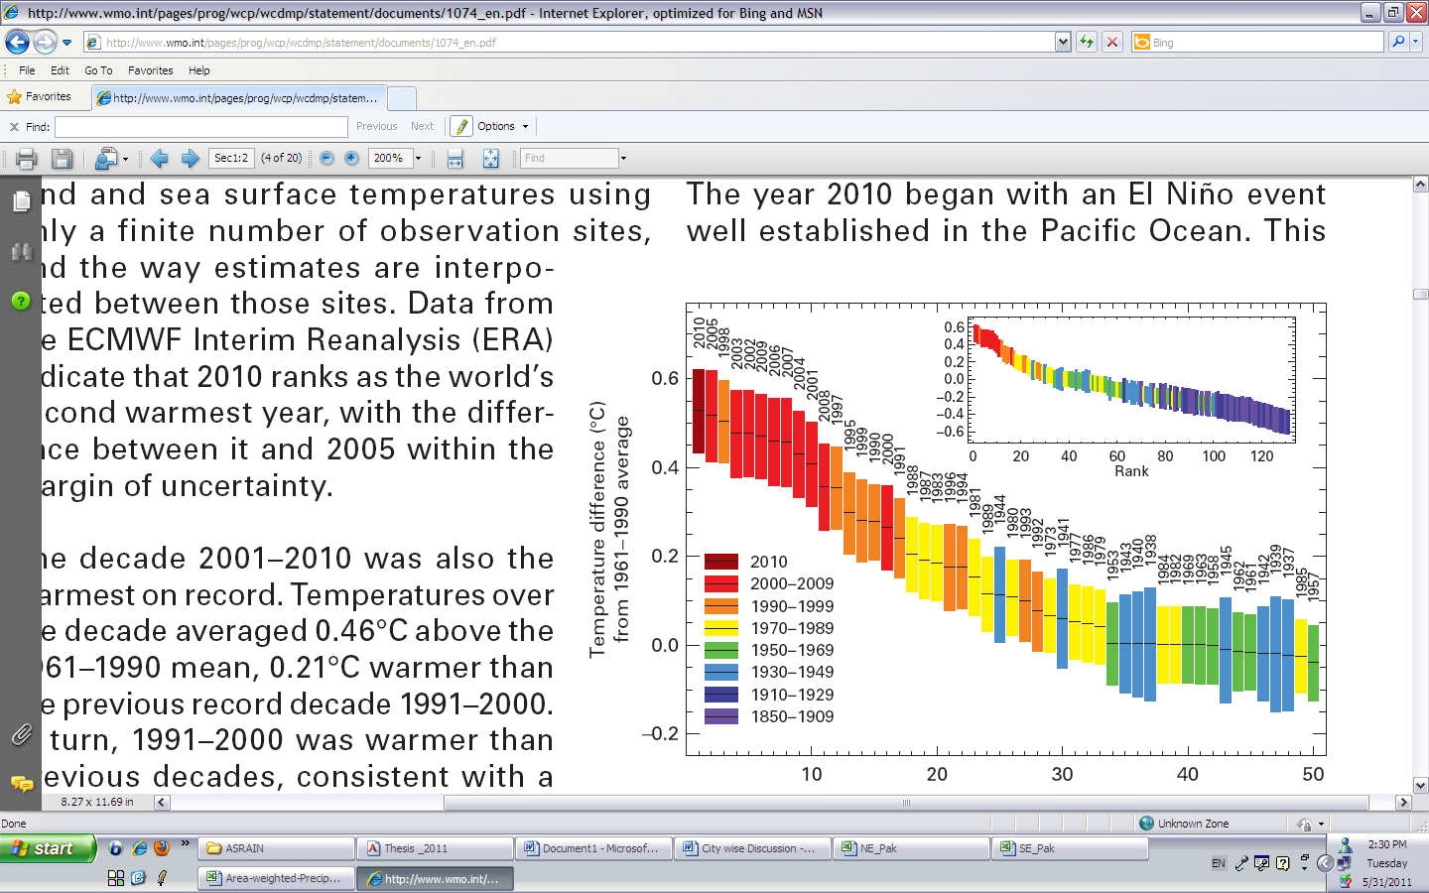
2010 The Ever Warmest Year
(WMO 2012)
2010 happened to be the warmest year in records dating back to 1880. The 2010 nominal value of 0.53°C ranks just ahead of those of 2005 (0.52°C) and 1998 (0.51°C),

Slide 7
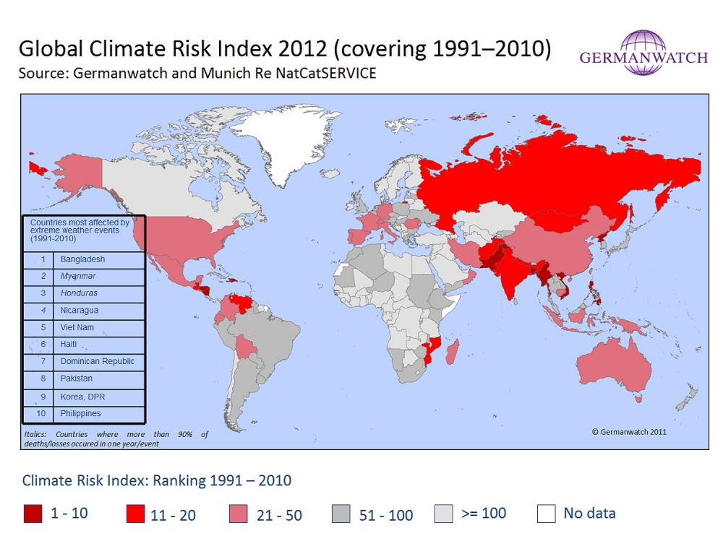
Notes:
The Climate Risk Index indicates a level of exposure and vulnerability to extreme events which countries should see as a warning signal to prepare for more frequent or more severe events in the future.

Slide 8
Response of Glaciers to Climate Change
IPCC 2007 AR4

Slide 9
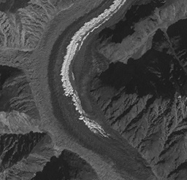
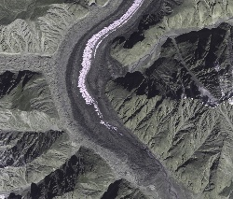
Siachen Glacier Past & Present
2000
2006
* Siachen Glacier has been retreated about 3.8 Km in last 17 years

Slide 10
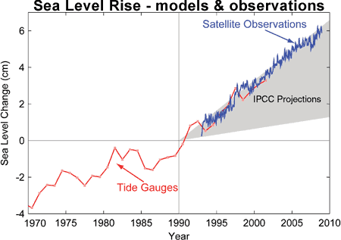
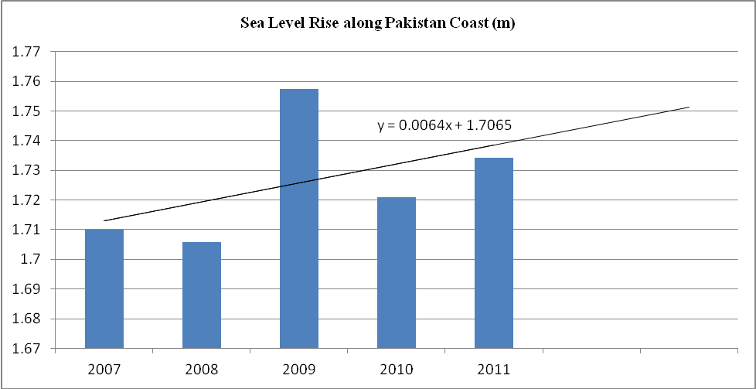
Sea Level Rise along Pakistan Coast
Sea level rise is resulting into saline water intrusion to the fertile cultivated lands of the Indus Delta.

Slide 11
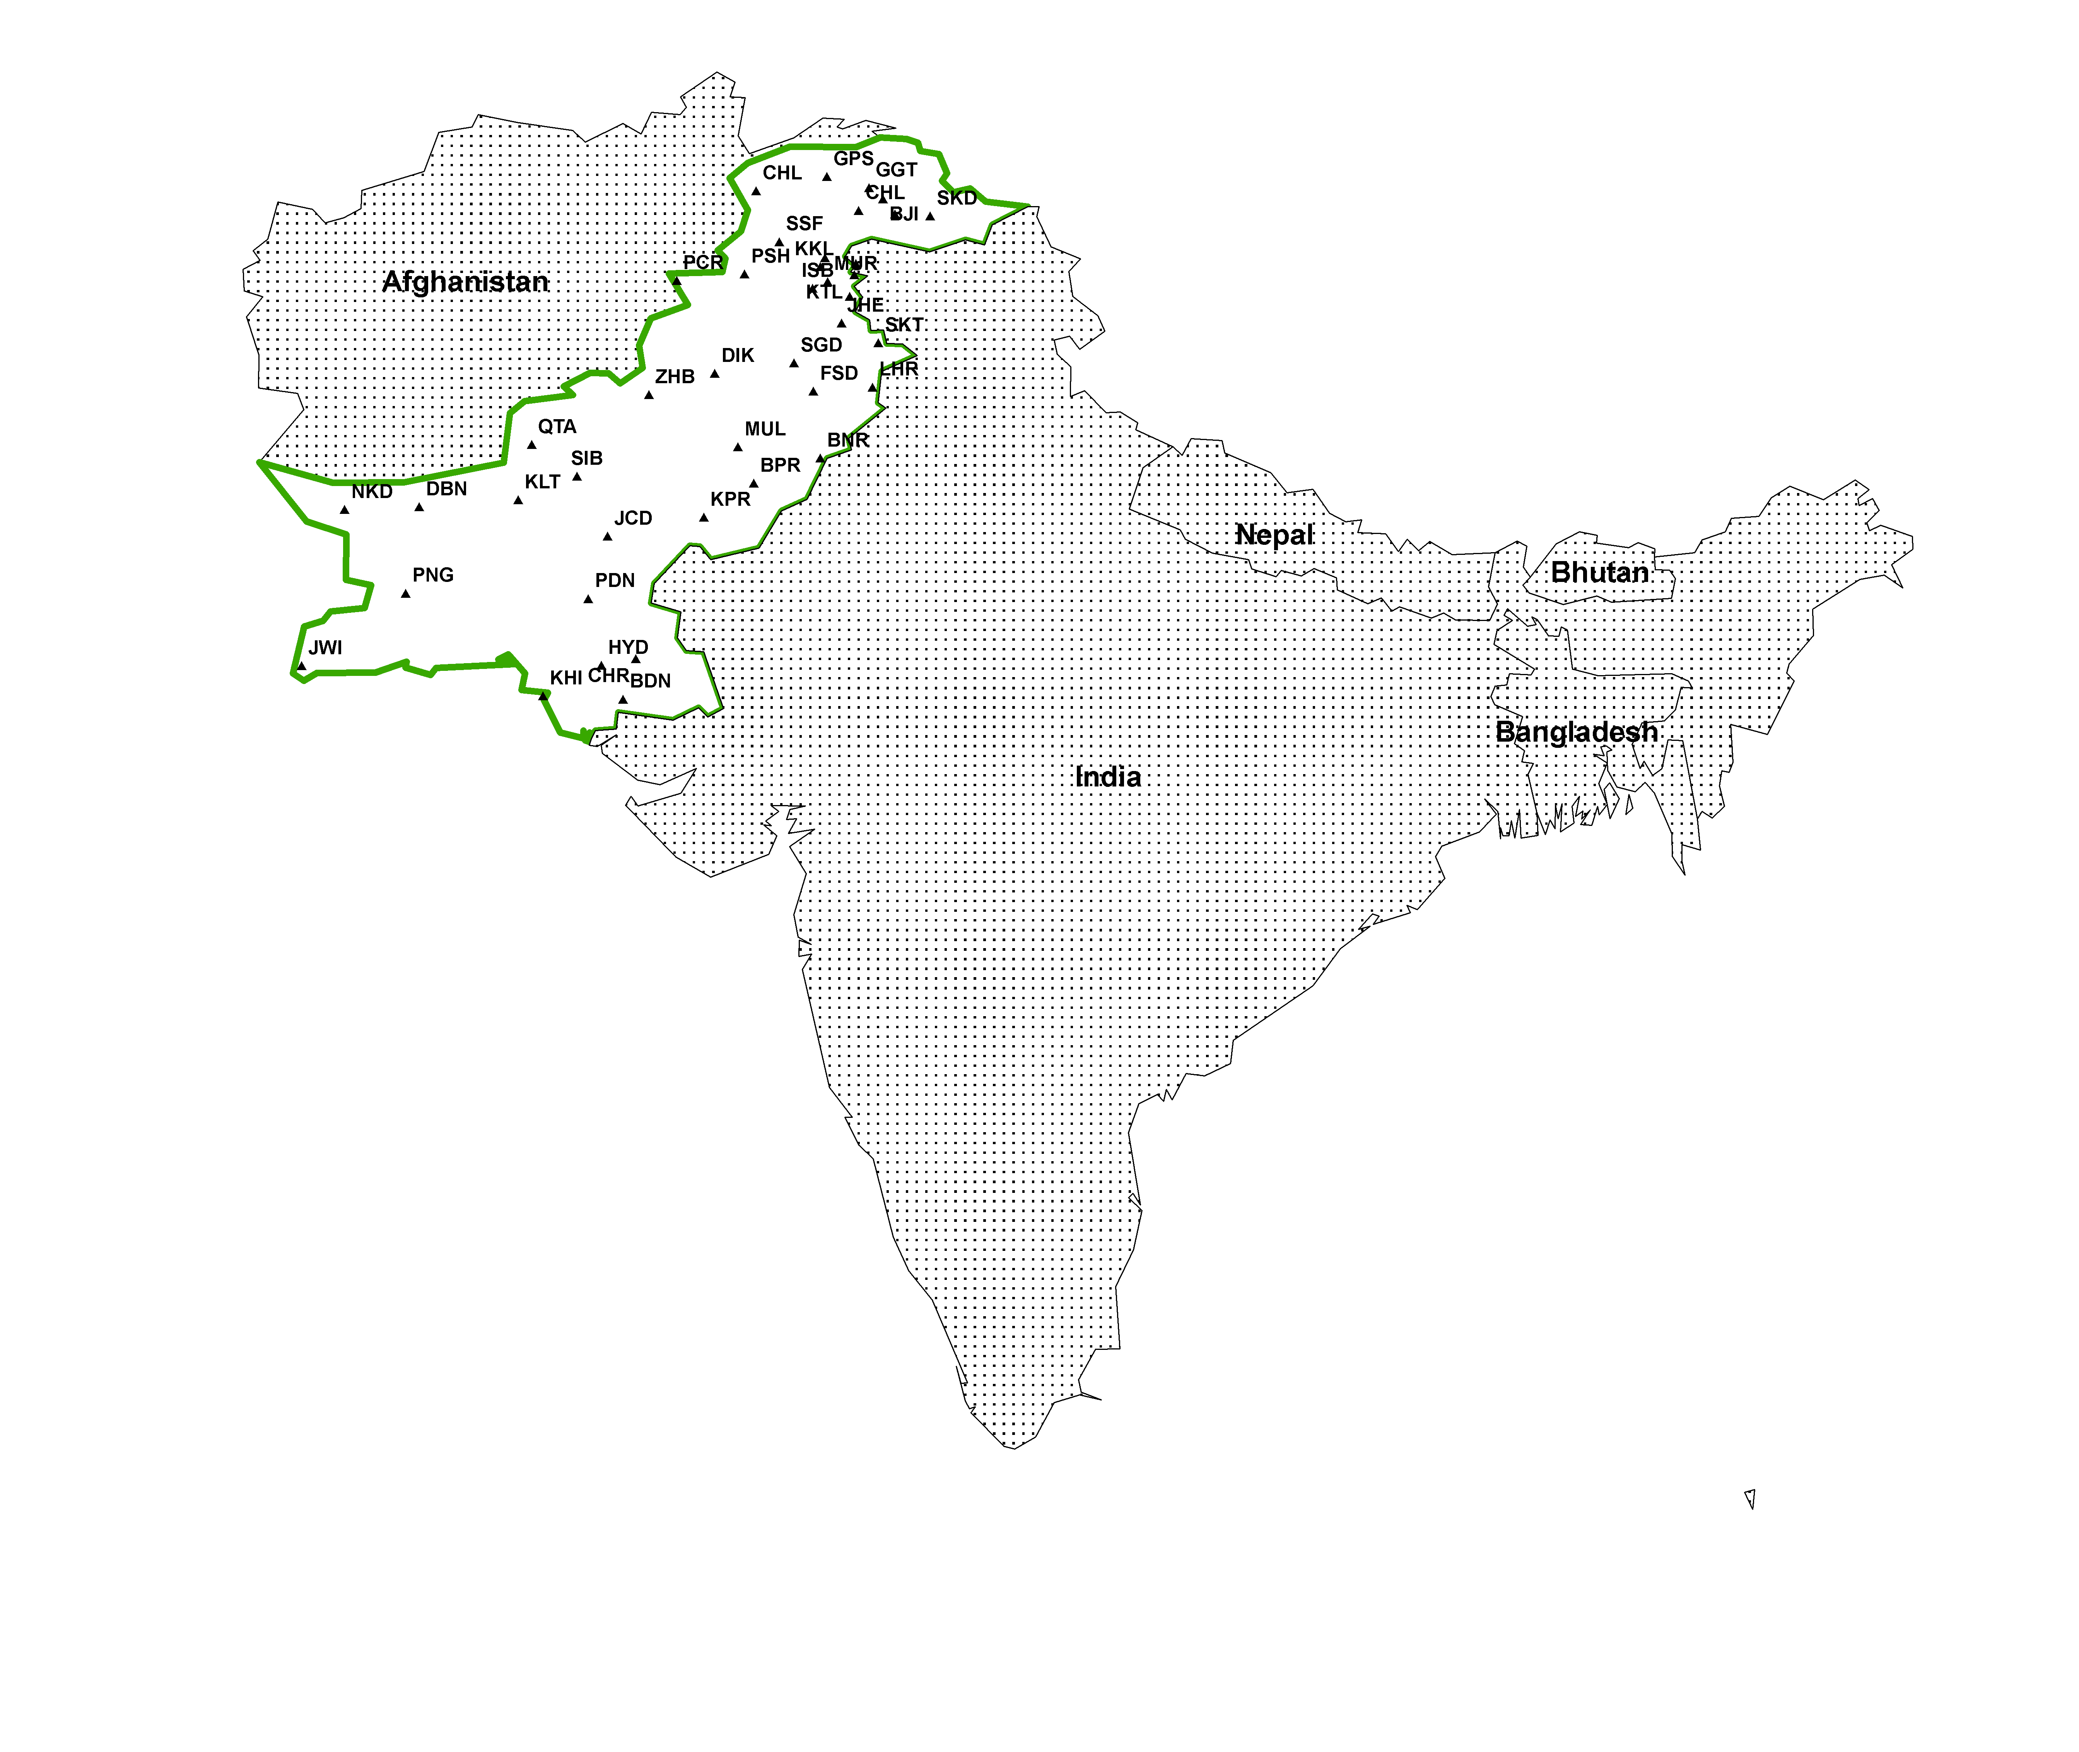
Areas of Heat Waves in South Asia
Changing Trends of Thermal Extremes in Pakistan
Severe HW
Moderate HW

Slide 12
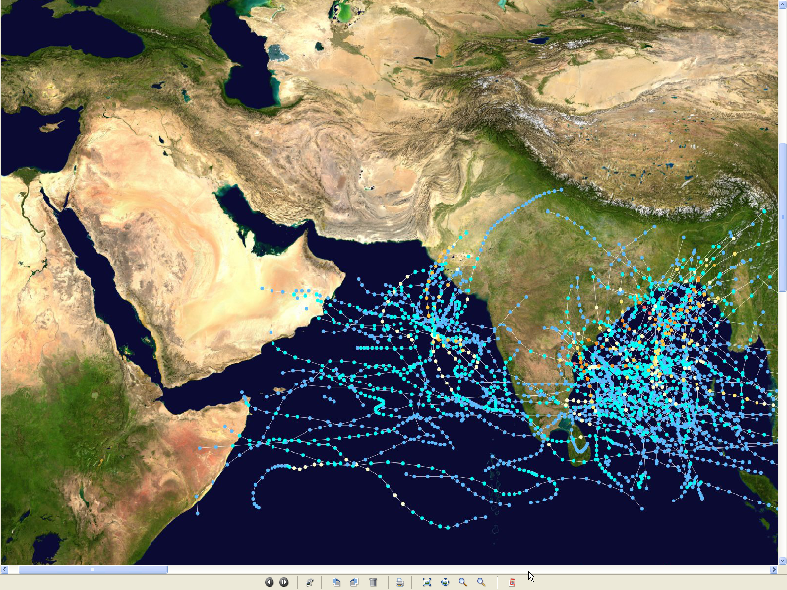
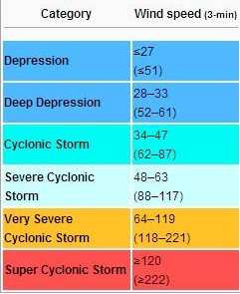
Tropical Cyclones
Tracks vs. Inensity
1985-2005
PMD
Tropical Cyclone Intensity Classification

Slide 13
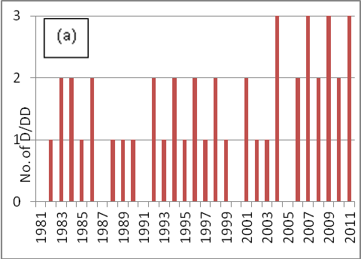
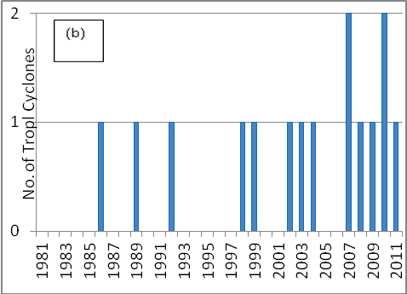
Frequency of Tropical Depressions and Cyclones
For Pakistan, Tropical Cyclones were the rare phenomena till the end of 20th century. Now they are the frequent visitor of Pakistan Coast. In 2007, two Tropical Cyclones Gonu (Category V) and Yemyin (Category III) cast vivid damage to lives and infrastructure in Sindh and Balochistan.

Slide 14
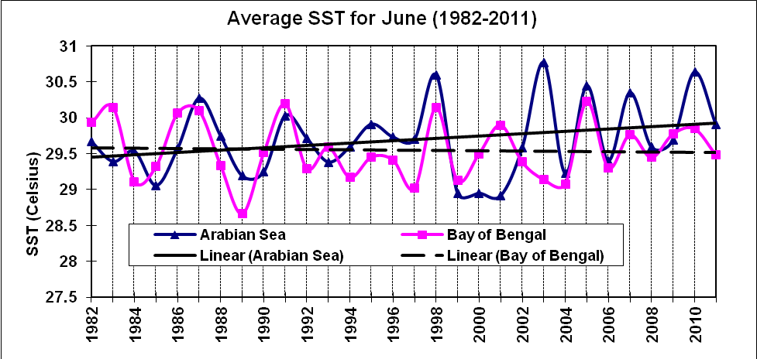
Sea Surface Temperature
Arabian Sea and Bay of Bengal
Due to Rise in SST of Arabian Sea Cyclogenesis activity has enhanced to produce Tropical Cyclones which may hit coastal area of Pakistan frequently

Slide 15
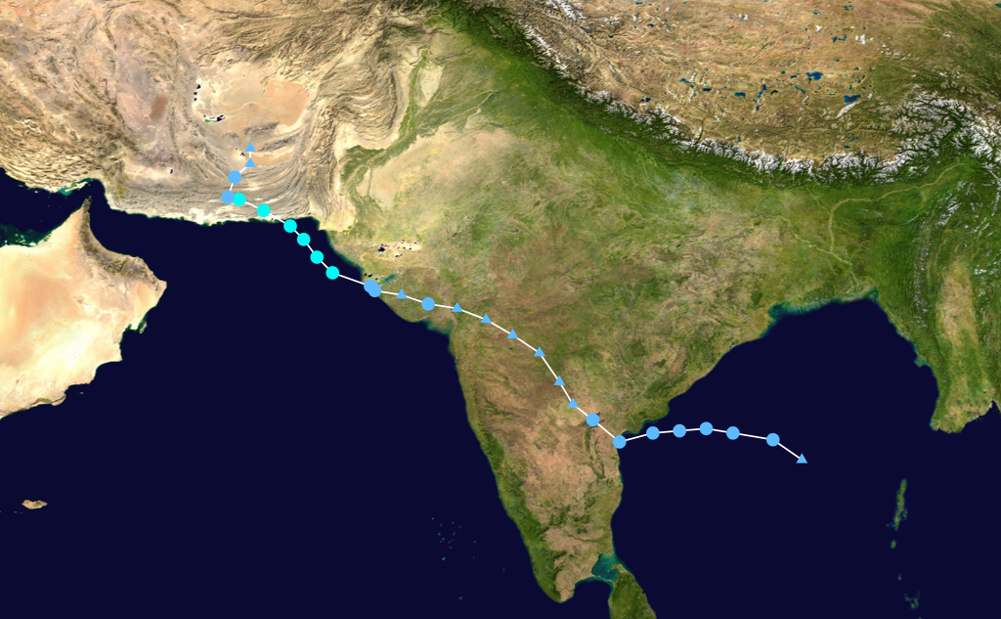
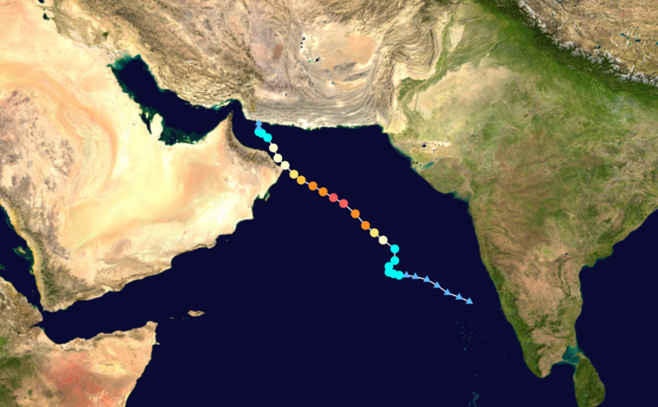
Landfall of Yemyin and Gonu Trop. Cyclones
June 2007
Yemyin
Gonu

Slide 16
Annual Mean Precipitation(mm)1901-2011

Slide 17
Annual Mean Temperature(ºC)1901-2011

Slide 18
Annual Mean Minimum Temperature(ºC)1901-2011

Slide 19
Frequency of Extreme Events is Increasing
Cloudburst Events 2001, 2003, 2007, 2008,2009, 2010, 2011, 2012
Prolonged Drought 1998-2002
Historic River Flooding 2010, 2011, 2012
Tropical Cyclones 1999,2007,2009,2010, 2011, 2012
Heat Waves in Spring 2006, 2007, 2010, 2011 (Reduced wheat yield)
Snowmelt flooding 2005, 2007 and 2010
Drought at sowing stage 2009, 2010, 2011

Slide 20
Flow data below Kotri Barrage

Slide 21
Wheat
Warmer February
13 days above normal (2-3⁰C) temperatures caused 28% reduction in wheat yield in Ludhehana (India). Goswami et al., 2005
In Sindh and southern Punjab, February (2006) was 2-4 ⁰ C warmer than normal and significant yield reductions were reported

Slide 22
Wheat
Warmer March 2010
Over most of the low elevation agricultural plains, the temperatures during last week of February and first decade of march remained 3-6 ⁰ C above normal.
Early maturity did not allow to gain the normal weight, size and starch contents in the grains.

Slide 23
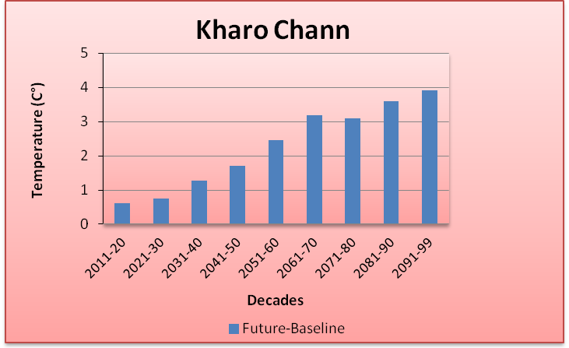
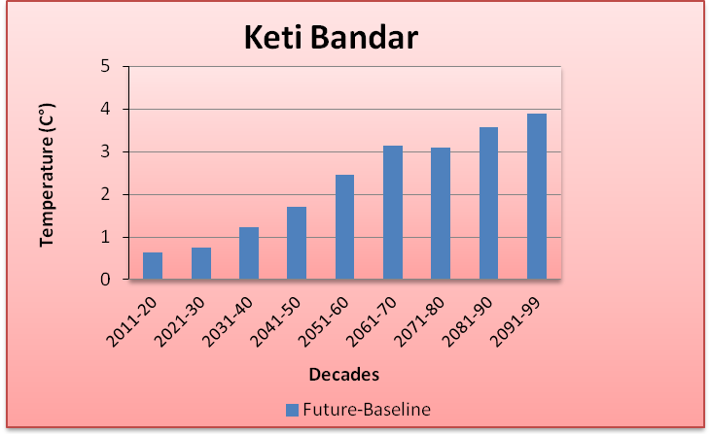
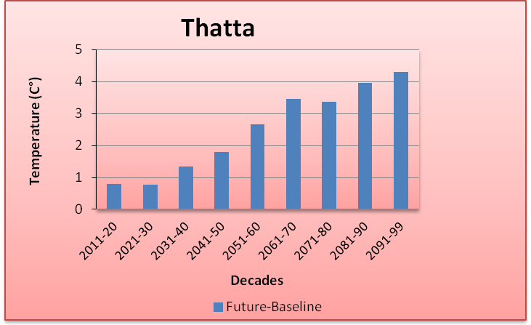
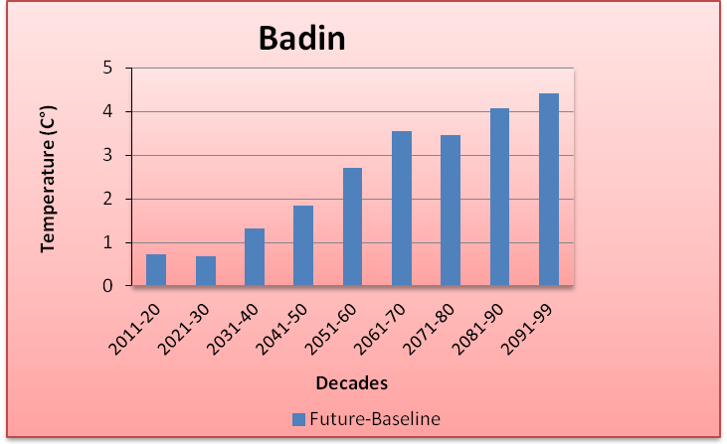
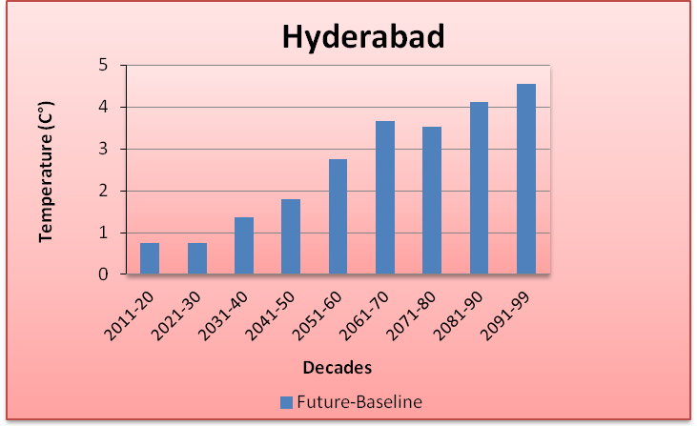
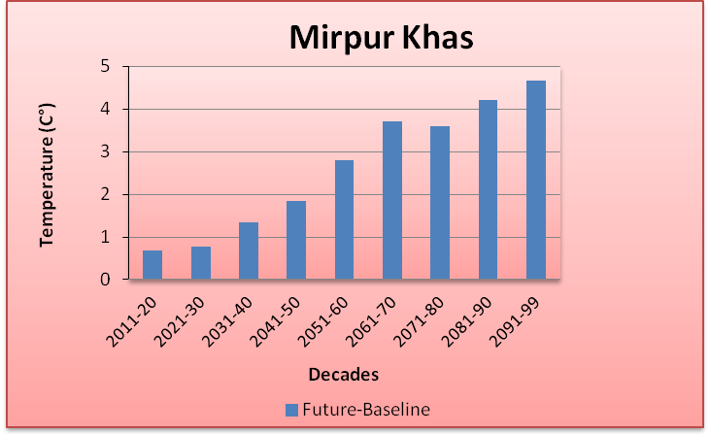
Future Projections of Temperature

Slide 24
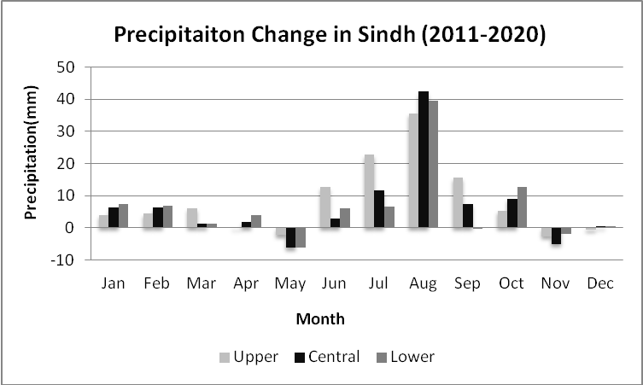
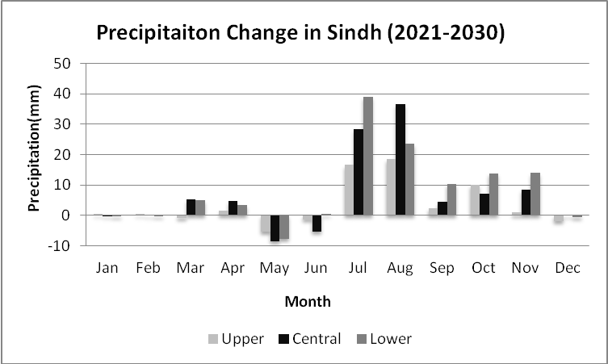
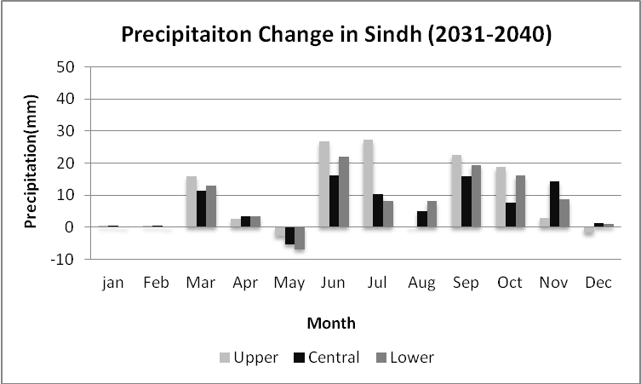
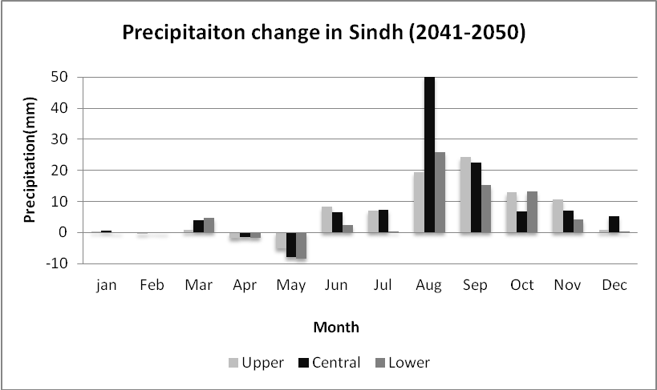
Rainfall Projections for Sindh

Slide 25
Major Challenges
Pakistan is one of the most vulnerable nation to the challenges of climate change such as:
Reduction in productivity of crops and livestock due to heat stress and other adverse impacts of change in climate
Increase in water requirements of due to higher evapotranspiration at elevated Temperatures, while less water will be available
Uncertain timely availability of irrigation water due to variable river flows

Slide 26
Major Challenges (Conti…)
Erratic and uncertain rainfall patterns may affect food production particularly in rain-fed areas
Increase in frequency and intensity of extreme climatic events such as floods, drought and cyclones
Abundance of insects, pests and pathogens in warmer and more humid environment, particularly after heavy rains and floods

Slide 27
Major Challenges (Conti…)
Intrusion of sea water into deltaic regions of country, affecting coastal agriculture, forestry and biodiversity
Lack of technical capacity of public institutions and limited resources
Low adaptive capacity to adverse climate change impacts

Slide 28
Recommendations
To mitigate the risks/threats due to climate change:
Effective implementation of approved climate change policy of Pakistan
Climate change monitoring and impact assessment activities should be organized on scientific basis by filling the observational gaps over low elevation plains and glaciers zones

Slide 29
Recommendations (Conti…)
Climate resilient infrastructure should be built along the coastal belt and wind power potential already identified along Sindh coast be harnessed to initiate economic activity - a step towards green economy
Increasing losses of crops and livestock due to frequent floods, drought and tropical cyclones have been pressing the farming community’s marginal economic condition harder and harder, therefore, Insurance industry should be urged to play its role

Slide 30
Recommendations (Conti…)
Low elevation and poor drainage have been causing water logging and salinity which required technically viable drainage infrastructure to reclaim the soils
Irrigation Efficient Methods such as use of sprinkler, drip and trickle irrigation systems be promoted

Slide 31
Recommendations (Conti…)
Local Industry concerned with solar energy solutions should be encouraged to play its role using this precious natural resource as an initiative to green economy

Slide 32
Summary
“A key emerging issue in the climate change debate that exemplifies this challenge is food”
“We need to grow much more food to feed the added population over coming decades”
From probably less land and with less available water than we have now
With much higher costs for energy, water and nutrients, in a much more hostile climate

Slide 33
Thank You

