Slide 1
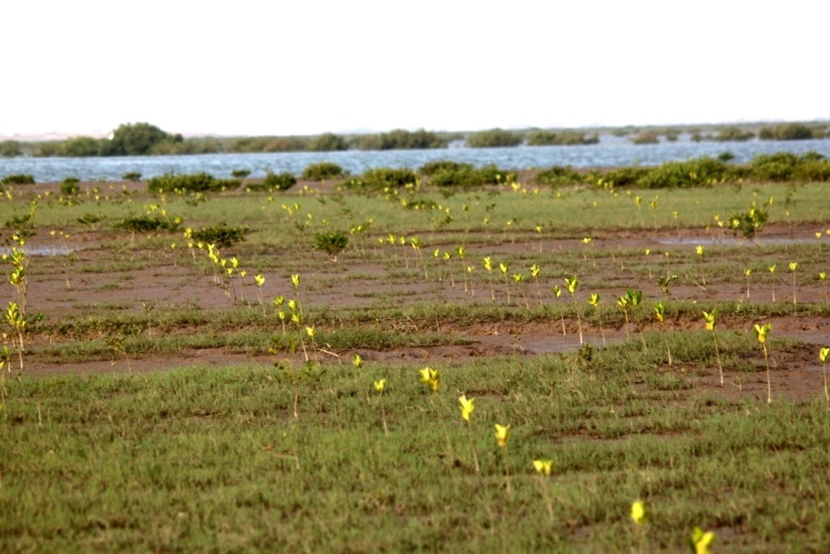
Management of Mangrove Forests by Sindh Forest Department
Riaz Ahmed Wagan Sindh Forest Department

Slide 2
Extent of Pakistan’s coast
The Pakistan’s coast is about 1050 km long extending from the Indian border on the east to the Iranian border in the west.
The Exclusive Economic Zone (EEZ) of Pakistan is about 240,000 sq. km with an additional continental shelf area of about
50,000 sq. km. As such, the total maritime zone of Pakistan is over 30% of the land area NIO 2011).

Slide 3
Coastal Resources of Sindh
In Sindh, mangroves of the Indus Delta are present in the districts of Thatta and Karachi; However deltaic area devoid of mangroves is also present in Badin district as well.
Early records show eight species of mangroves exist along the delta. Presently only four are found i.e. Avicennia marina, Rhizophora mucronata, Aegiceras corniculatum and Ceriops tagal

Slide 4
Ownership status of the Mangroves of Indus delta
Organization / Department | Area (Hectares) | Legal Status
Sindh Forest Department | 280,470 | Protected Forests (1958)
Sindh Board of Revenue | 260,000 | Protected Forests (Nov. 2010)
Port Qasim Authority | 64,400 | Protected Forests (1958)
Karachi Port Trust | 2,000 | Protected Forests (Nov. 2010)
Total | 606,870

Slide 5
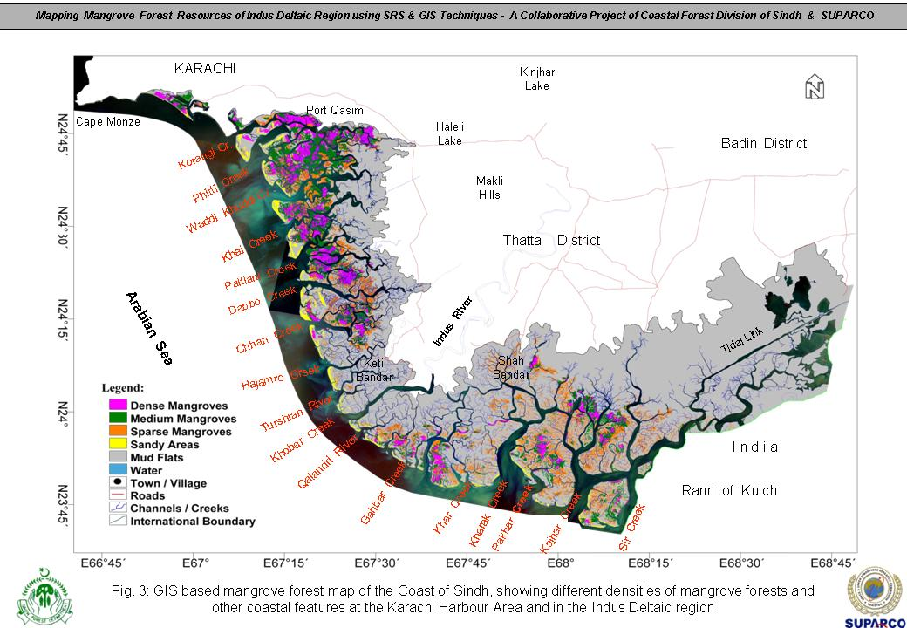
Coastal Resources of Pakistan
MANGROVES: The Indus delta mangrove ecosystem is spread over 600,000 hectares
SUPARCO in 2009 estimated, the total covered mangrove forest area along the Coast of Sindh as107,640 hectares, out of which the mangrove forests at Karachi harbour area are spread over 1,160 hectares and in Indus Deltaic region, over an area of 106,480 ha.
About 7500 hectares of Mangroves exist in Baluchistan coast

Slide 6
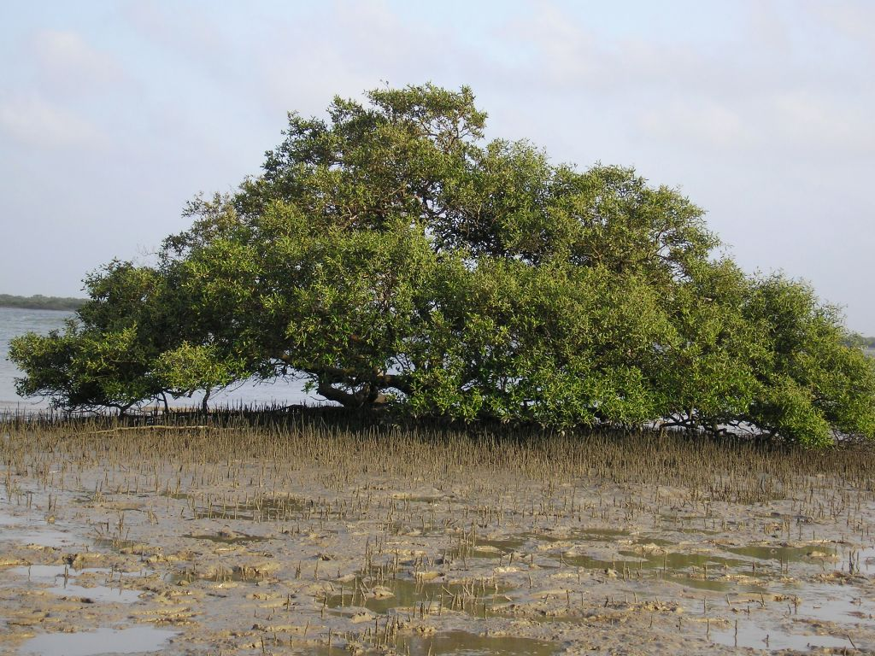
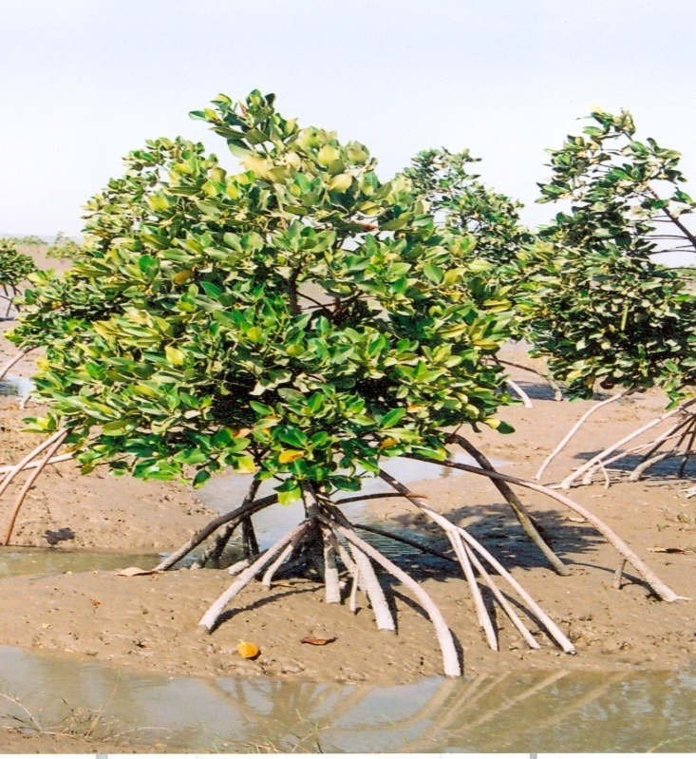
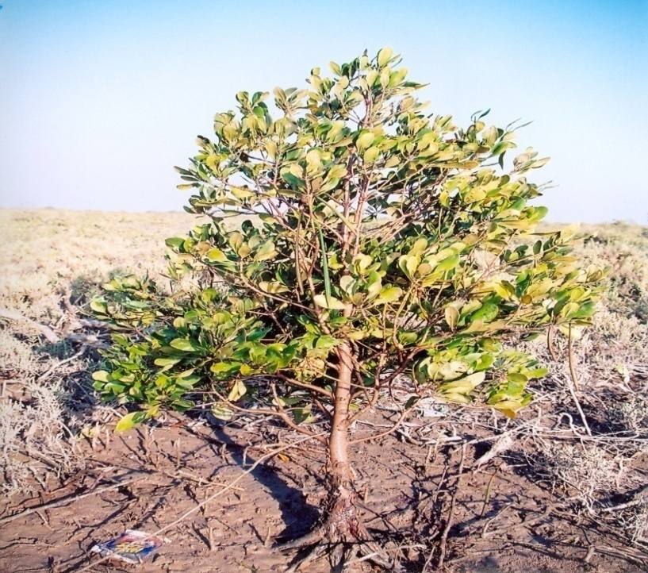
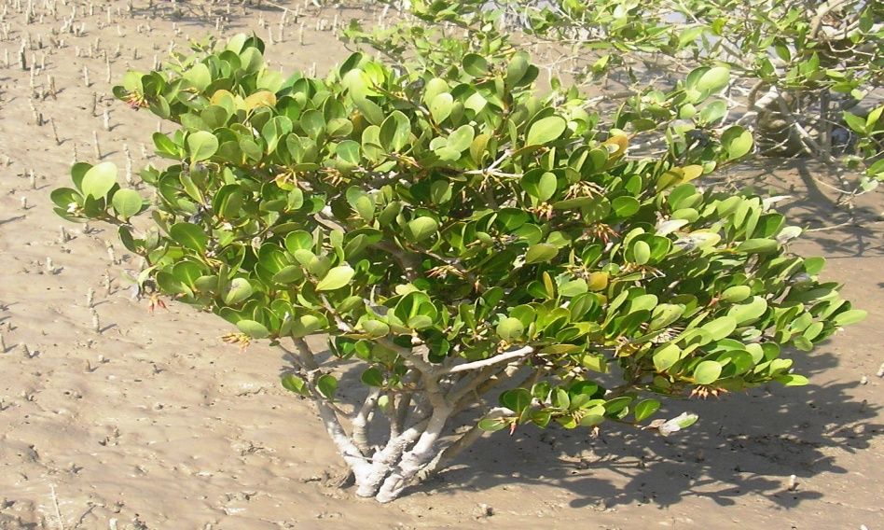
Mangrove Species of Indus Delta
Avicennia marina (Teemur)
Rhizophora mucronata (Kumri)
Ceriops tagal (Kiriri)
Aegiceras corniculatum (Chaunr)

Slide 7
Coastal Resources of Pakistan cont-
FISHERIES: The deltaic networks of creeks are a major breeding area for commercially important coastal fisheries that include shrimps, finfish, crabs etc with average export value of US $110 million a year.
The annual average catch of Shrimps from Sindh coast is 27,500 tons (35 times larger) whereas, from Balochistan is 800 tons
The annual Finfish harvest in Sindh is 231,000 tons as compared with 103,000 tons of Balochistan

Slide 8
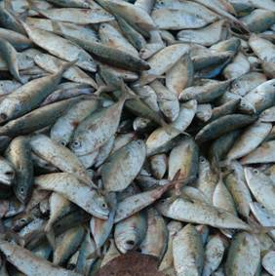
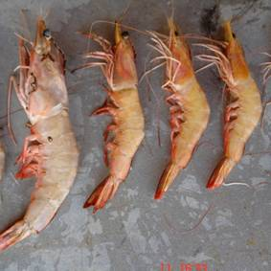
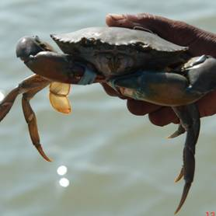
Economic importance of mangroves
Important supplier of nutrient and oxygen
Nurseries for many species of fish and shrimp
Stabilize shorelines and reduce coastal erosion
Protect coastal areas from storm damage
Act as carbon sinks
One ha of properly managed mangroves can yield annually
100 kg of Fish, 25 kg of Shrimp and 15kg of Crab meat
(IUCN 2005)
In Dollars terms
Direct Valuation = $ 37500/ha (Fishery and Forestry products)
Indirect Valuation = $ 1700/ha (Protective services)

Slide 9
Coastal livelihoods
The human population in and around mangrove forests on the coast of Pakistan is estimated to be about 1.2 million. Nearly 900,000 reside in the Indus Delta and 300,000 on the Baluchistan Coast. The number of households is estimated to be about 140,000 in the Indus Delta and 30,000 on the Baluchistan Coast Coastal Population of about 210,000 is directly dependant on coastal resources
About 90% of the households in the coastal
communities rely on fishing and other fisheries related activities(Siddiqi et.al 2007).

Slide 10
Coastal livelihoods contd-
A diagnostic survey of Indus delta shows that 25% of households depend on Mangrove wood for cooking & heating purpose. Each family uses 173 kg. of mangrove wood per month giving a total annual consumption of 18,000 tons.
It is estimated that a total of 6,000 camels and 3,200 cattle are using the ecosystems resources and consume about 19.5 m kg of grasses and 67 million kg of leaves annually.

Slide 11
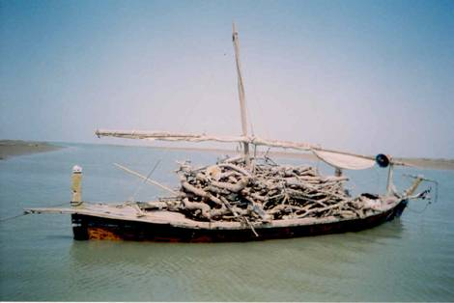
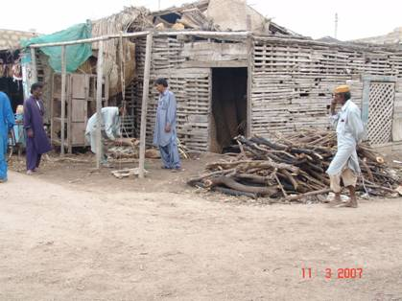
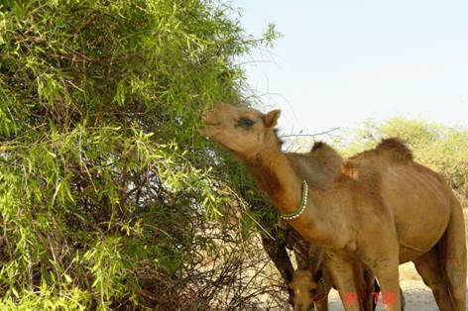
Coastal Livelihoods contd-

Slide 12
Conservation & Rehabilitation Initiatives By Sindh Forest Department spread over 25 Years
Activity | Achievement
Planting on Blank Mudflats | 31, 400 Ha.
Planting on High Lying Mudflats | 4, 000 Ha.
Planting to Assist Natural Regeneration Total | 15, 632 Ha. _________ 50, 032 Ha.
Planted Species | Avincennia marina; Rhizophora mucronata & Ceriops tagal

Slide 13
Current and Future Plans of SFD
Following development projects are underway:
Planting of Mangroves over 5000 hectares in Board of Revenue and Port Qasim areas
Planting of Mangroves over 8000 hectares in Keti Bandar and Shah Bandar areas with the assistance of Asian Development Bank
One new project on climate change and Sea intrusion effects is ongoing. Spanning over a seven year period, mangrove plantations over 50,000 Ha. would be developed/raised by Sindh Forest Department.
A Joint project with IUCN on mangroves is also under consideration in Keti Bundar and Kharo Chan areas.

Slide 14
Evident changes in mangrove coverage

Slide 15
Conservation initiatives 25 Years contd.
Pioneer Work: SFD is the pioneer in scientific management of Mangroves in Pakistan. The most important achievement is the re-introduction of an extinct tree species from Indus delta, Rhizophora mucronata. The spp. has successfully established to an extent that enough seed is available for planting operations from local source. Now trial planting of near extinction spp. Ceriops tagal is underway
Research: Socio-economic Survey; Species survival rates studies, etc.
Awareness Raising: Activities carried out with the collaboration IUCN Pakistan, WWF Pakistan & NRSP
Education: Through demonstration Plots and Nursery raising techniques, publicity and printing materials etc
Guinness World Record: The July 2009 record set for planting 541,176 Rhizophora plants

Slide 16
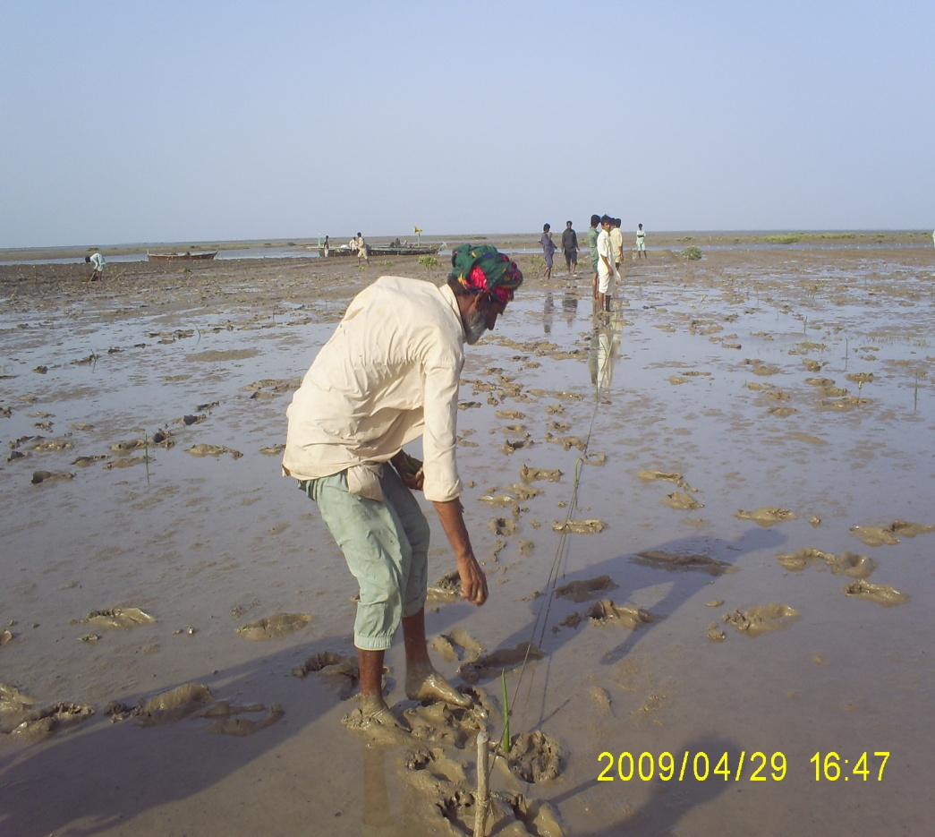
Community Participation
Mangrove Restoration activities

Slide 17
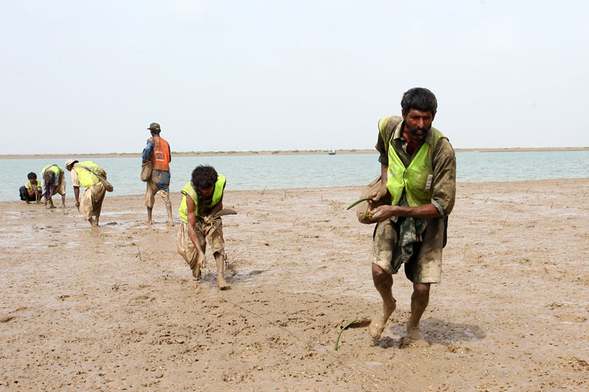
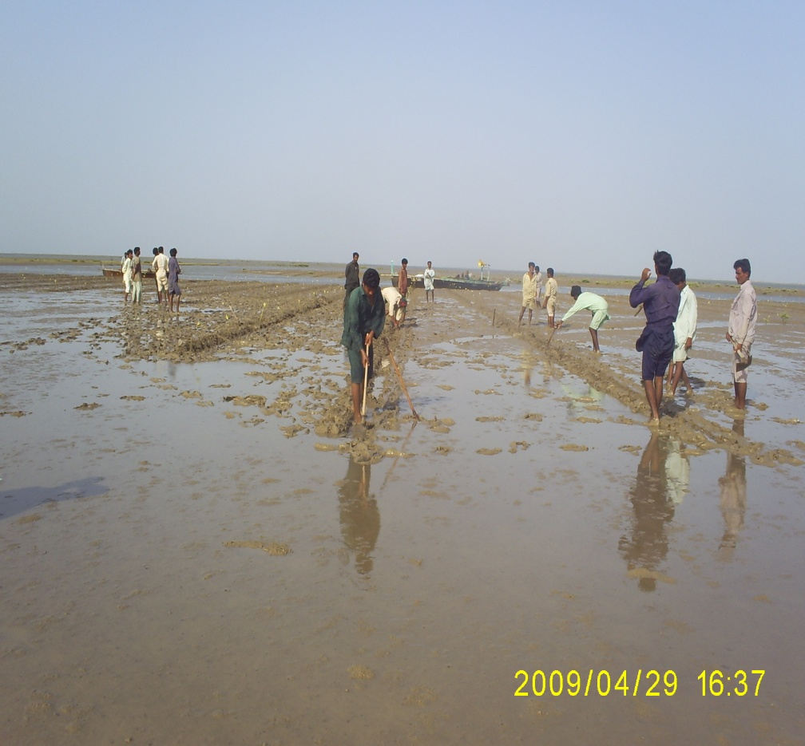
Community Participation in Mangrove Restoration activities

Slide 18
Mangrove Protection and Awareness Raising Activities

Slide 19
Mangrove Protection and Awareness raising activities contd-

Slide 20
Mangrove Protection and Awareness raising activities contd-

Slide 21
Community Protection Model
Sindh Forest Department is protecting newly planted mangrove forests through a family unit by paying a monthly sum of Rs. 6000/family for every 60 hectares of plantation. This arrangement helps in effective protection, conflict resolution and offers direct financing option to coastal communities. In future such plantations would be a source of carbon credit earnings for poor communities of the coastal belt

Slide 22
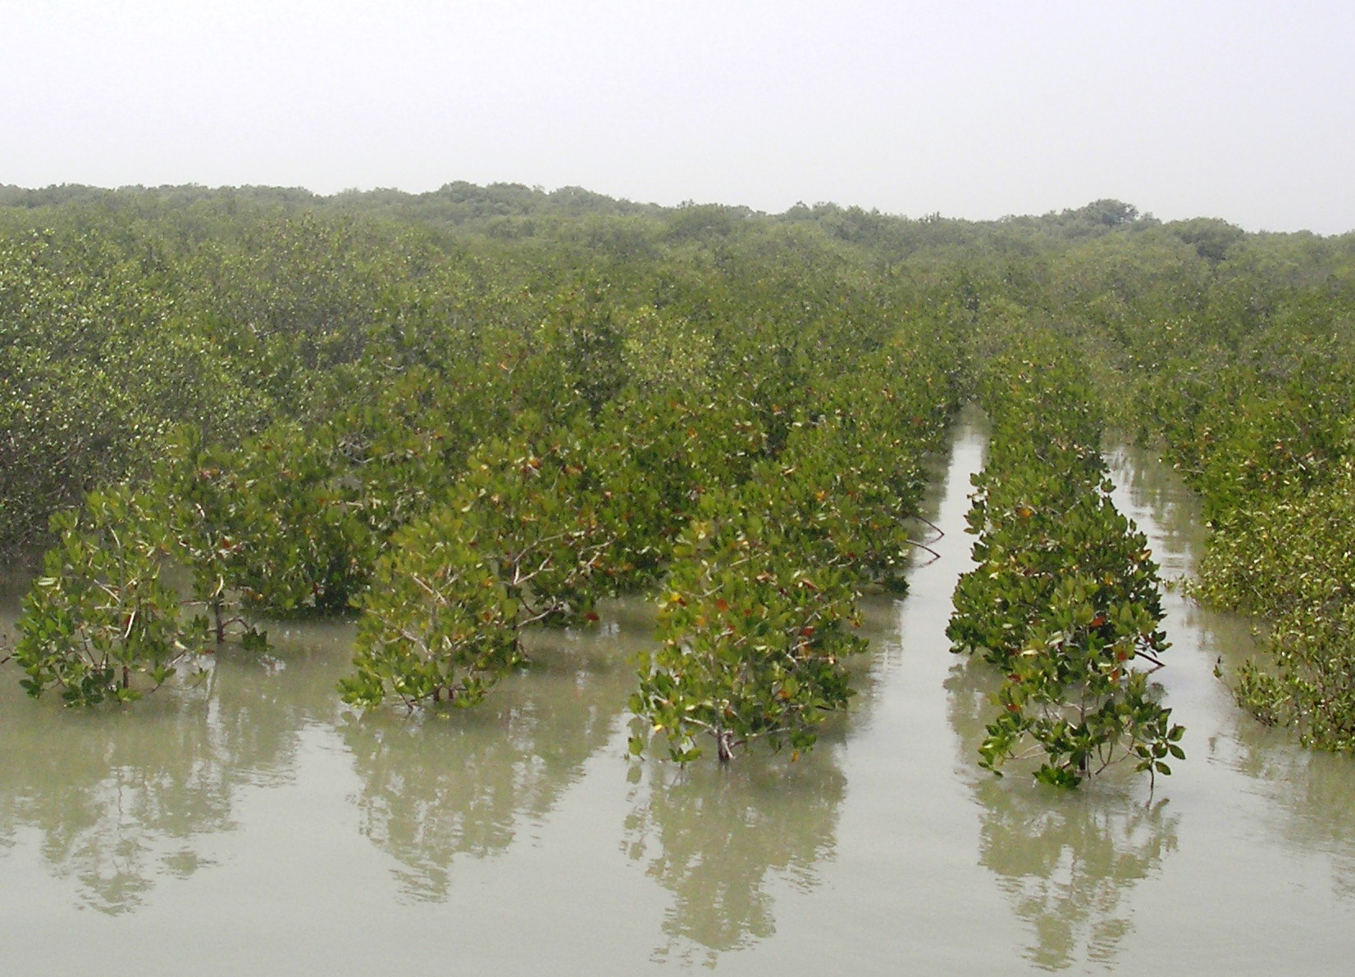
Plantations Raised by SFD in Keti Bundar area
Three- Year Old Avicennia Plantation
Five-Year Old Rhizophora Plantation

Slide 23
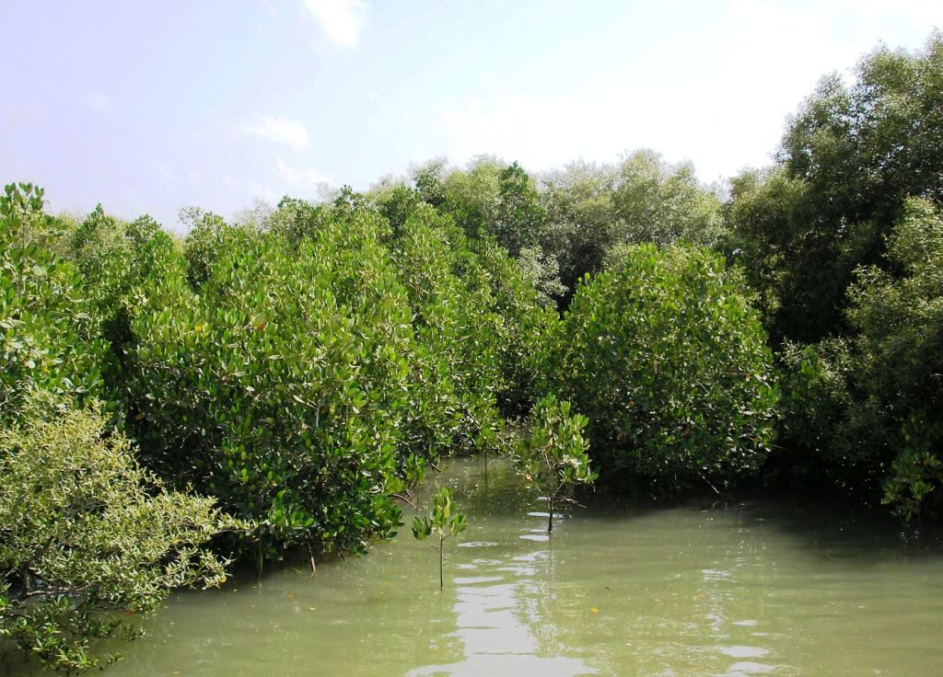
Mangrove Plantation at Keti Bandar

Slide 24
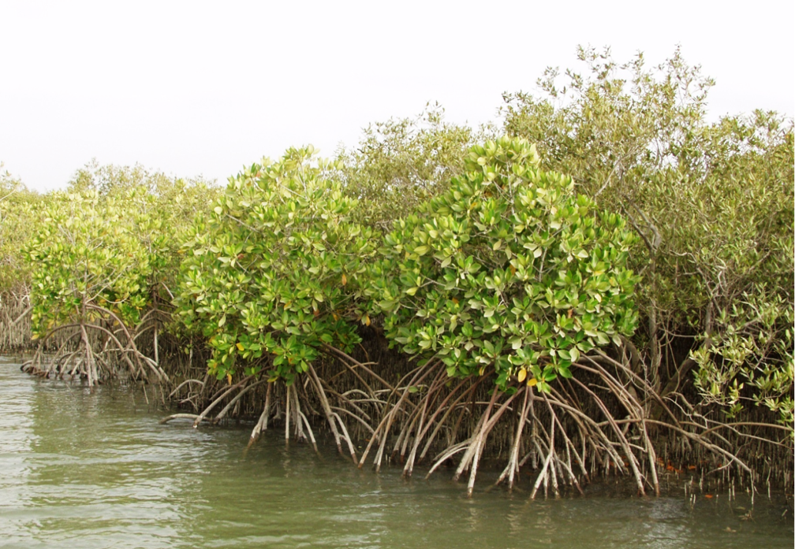
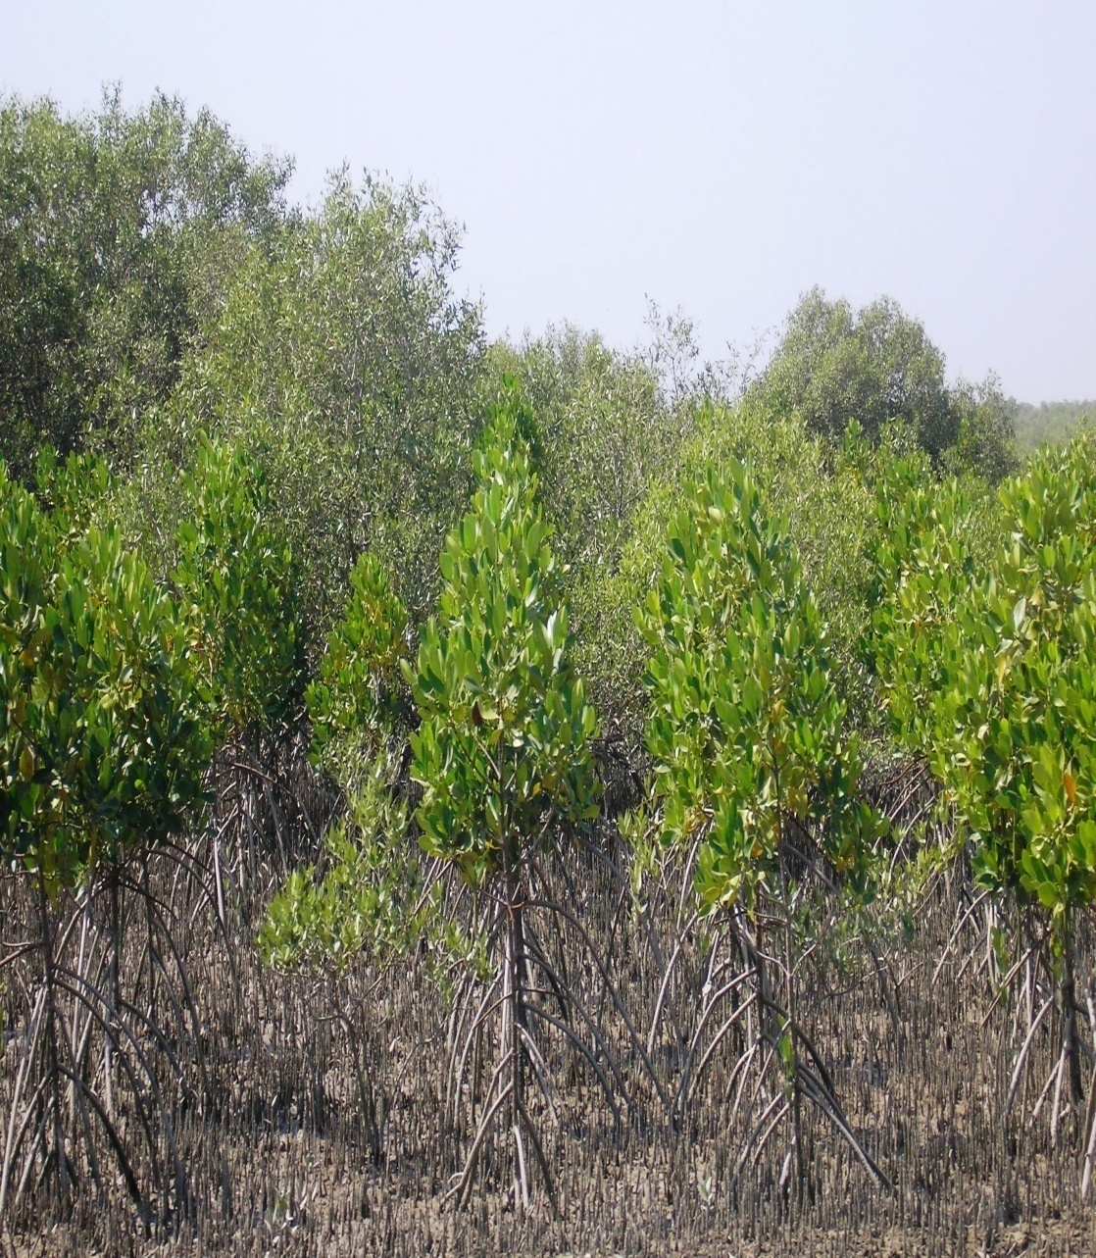
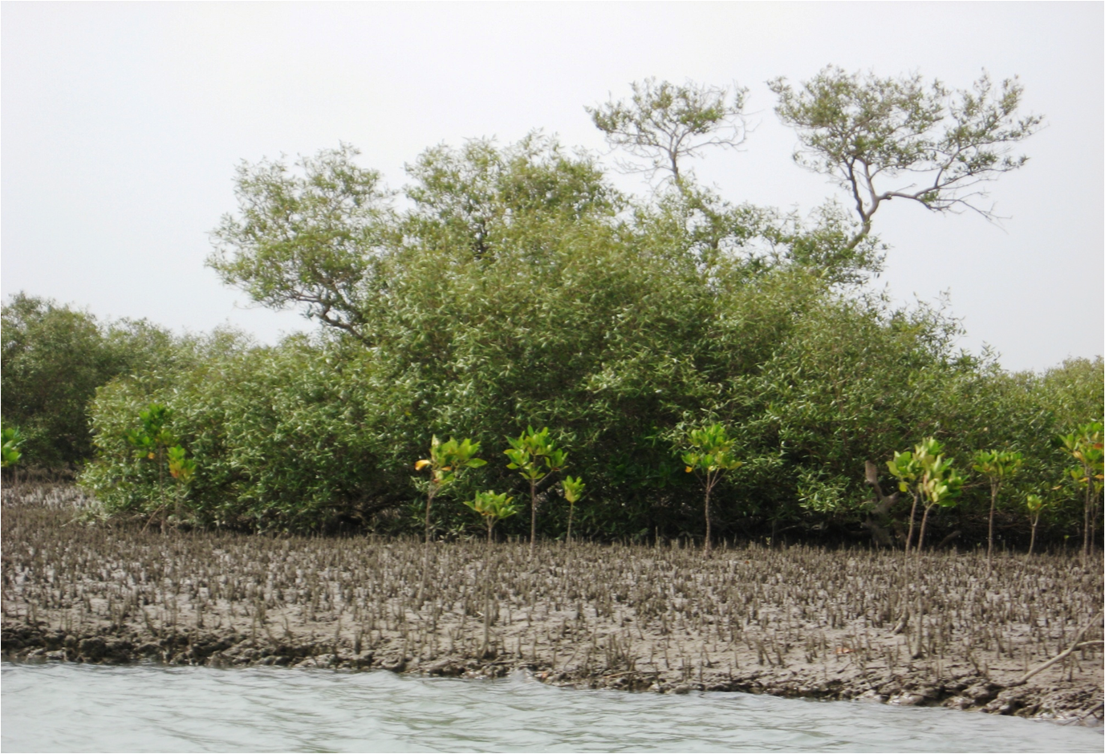
Established Mangrove Plantations

Slide 25
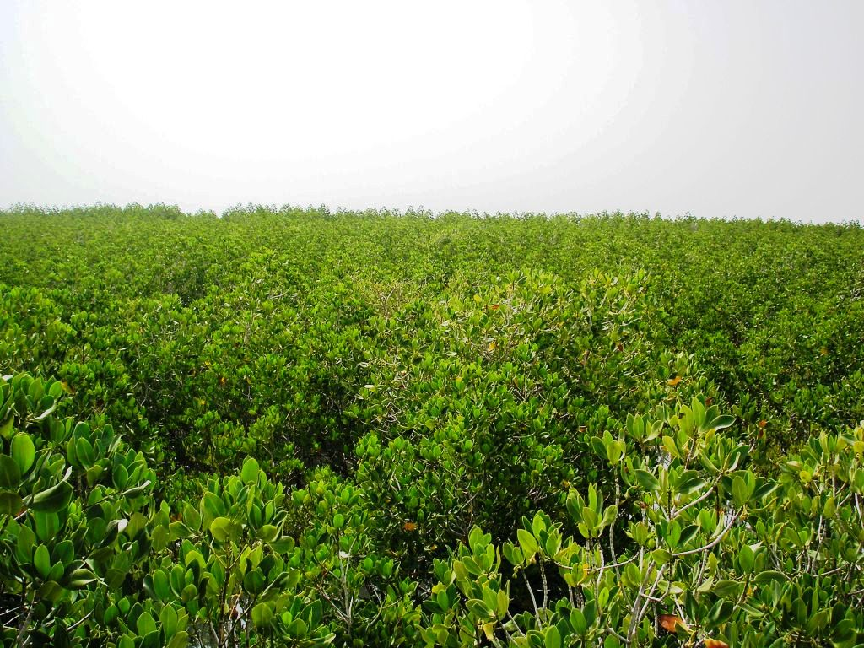
Mangrove Plantation at Shah Bandar

Slide 26
Threats to Mangroves
Shortage of required fresh water and silt depositions from River Indus have enhanced salinity levels in the delta
Sea intrusion and erosion in the delta caused by sea level rise
Encroachment for settlements around Karachi mangroves
Industrial and municipal pollution, dumping of waste, oil spills and leakages
Over exploitation of mangroves for fuel wood/fodder
Grazing and Browsing by Camels

Slide 27
Proposed Strategy
Threat | Recommendation | Responsibility
Insufficient water flow down-stream Kotri Barrage | Ensure sufficient water flow | Irrigation Dept: and all stakeholders
Industrial and Municipal Pollution | Ensure water treatment plants are operational and environmental regulations are followed | SEPA, provincial and local Government
Oil-spill and leakages | Strict monitoring and adoption of a disaster management strategy | SEPA, Maritime security agencies
Sea-level rise | Research into the affect of climate change and setting up on monitoring cell | SEPA, Ministry of Env (Global Change Impact Study Centre). Field level interventions by SFD through biological control mechanism. NGOs etc
Encroachment for settlements | Enforcement of laws | Sindh Police, Sindh Forest Dept, PQA, KPT.
Cutting for fuel-wood and fodder | Enforcement of laws, raising new plantations and provision of alternate sources of wood and energy | Sindh Forest Dept, NGO’s, provincial govt.
Awareness in local people, politicians and general public | Massive awareness campaign is required | NGOs, Media and Government Organizations

Slide 28
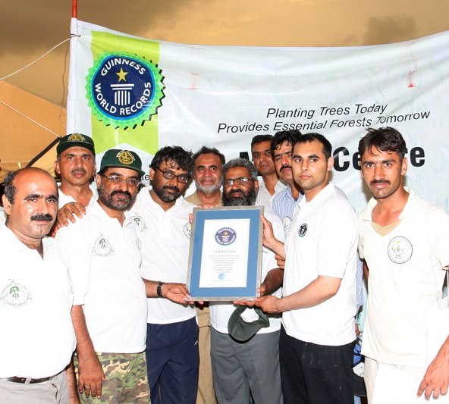
THANK YOU

