Slide 1
Building Capacity on Climate Change Adaptation in Coastal Areas of Pakistan
Capacity Building of Stakeholders and the Development of LAPAs
Notes:
Talk a bit about the partnership between LEAD and WWF and the role LEAD is playing in this project.

Slide 2
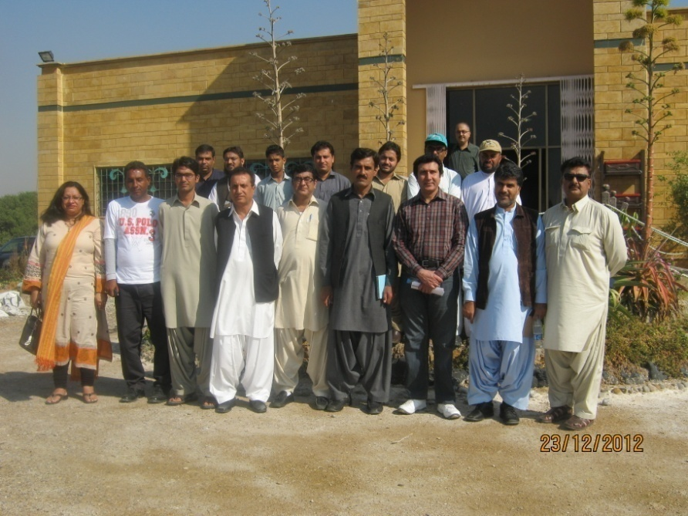
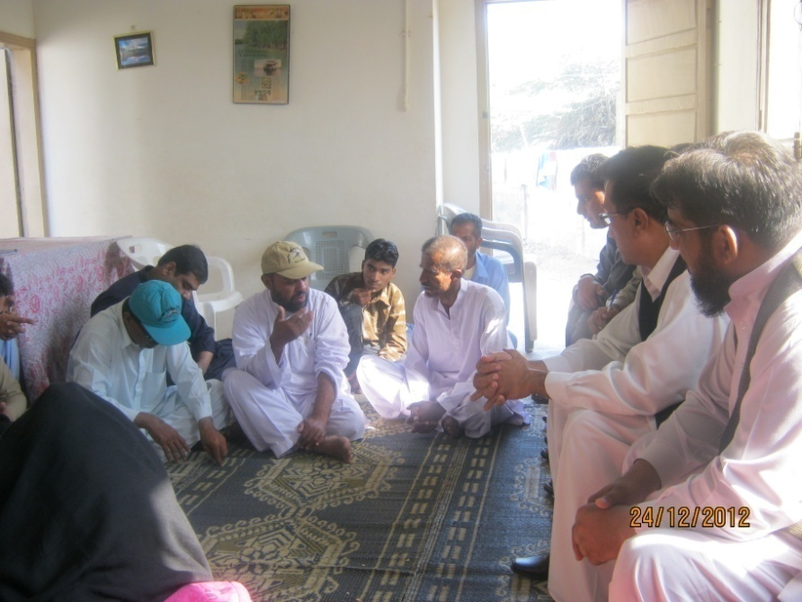
Local Adaptation Plans of Action
What is a LAPA?
Why do we need LAPAs?
LAPAs internationally
LEAD and LAPA
Notes:
1.Local Adaptation Plans of Action (LAPAs) take a decentralized, bottom up approach to local level adaptation planning, by involving multi stakeholders, including the vulnerable communities.
2. Failure of top down approaches, lack of community ownership, and varied topographical features
4. Overall shift toward Local adaptation. LAPA has been piloted in nepal. Other than that South American , African and South east asian countries are all shifting twoard this form of local level planning
5. LEAD has so far created 2 LAPAs, one in Punjab and one in sindh under its CLEAr project. 1 LAPA under BHC was created in Mgarh. 2 LAPAs will be created for the target area in CCAP with the collaboration of WWF

Slide 3
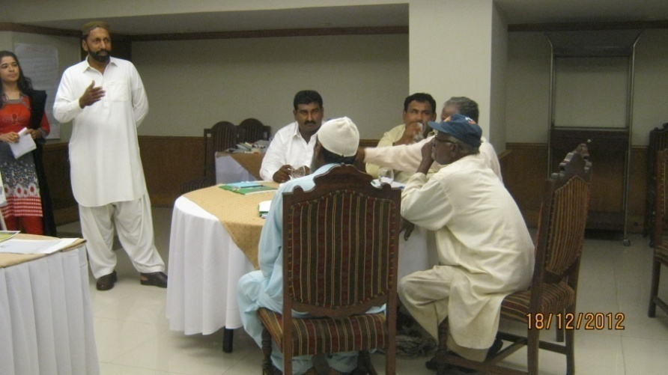
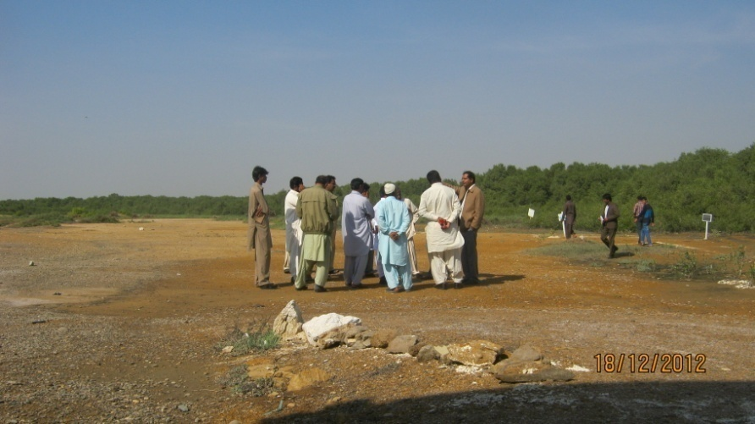
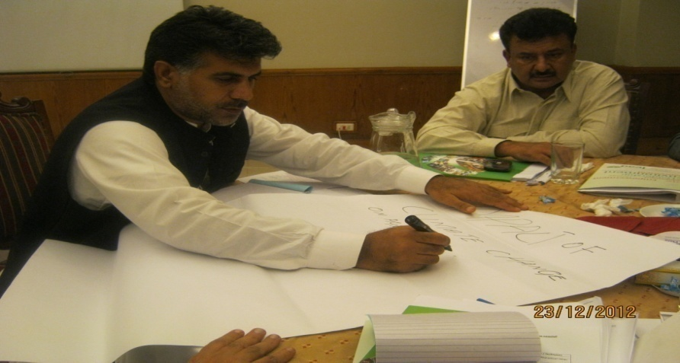
Approach
Inclusive
Multi tiered
Needs Based
Vulnerability Based
Notes:
Inclusive in that efforts will be made to include minority groups and women, as well as people representing all occupations and walks of life. Multi Tiered: 3 groups of stakeholders identified, i.e. Community, CSOs and Government, all of whom are recognized as being important to train. Trainings will be needs based- i.e. based on the requirement of the participants as well as based on assessments of their particular vulnerability based on the assessment carried out.

Slide 4
Vision
Individual
Aware
Empowered
Included
Notes:
Before any further discussion on the plan it is important for us to recognize the qualities we desire a fully trained individual, at the end of the project, to possess

Slide 5
Capacity Building Plan
Climate Change Orientation Training
LAPA Development Training
LAPA Review Workshop
Awareness Raising Sessions with Parliamentarians and Provincial Authorities
LAPA
Exposure visit to regional sites
Training on Implementation of Pilot Projects
Implementation of Pilot Projects
Notes:
Please read the diagram top down. Into the development of the 2 LAPAs for Keti Bunder and Kharo Chan there are two training components. Firstly, a training session on the Basics of Climate Change (done) for multi stakeholders. This will be followed by a LAPA development training during which all tiers of community will work together to develop LAPAs. This will be followed by a provincial level LAPA Review workshop in which the final LAPAs will be presented to government officials and CSOs and communtiy at a provincial level for review. Once the LAPAs are finalized, the pilot projects that are specified as a part of the LAPA will be implemented by the community under mentorship from WWF and LEAD. This will be preceded by a series of thematic trainings on the implementation of these pilot projects. Once the pilot projects are up and running, exposure visits by government officials, journalists and academia will be carried out to the project areas. Running paralell to this process will be awareness raising sessions with parlaimentatians and provincial authorities, to raise awareness not only of the project but also of the importance of adaptation for the coastal areas of Pakistan/

Slide 6
Climate Change Orientation Training
Duration: 3 days/3 Cycles
Participants: Community Representatives
Government Officials
Journalists
Areas Covered: Keti Bunder, Kharo Chan and Jiwani
Notes:
Description of training

Slide 7
Next Step: Action Planning Workshop
Target areas : Keti Bunder and Kharo Chan
5 day training
Issue identification, Solution Identification
Participation from district level Government, local CSOs, and community representatives

